Slide 1

Trust Board Report
Service Delivery Plan Report
Trust Board - Tuesday 9th January 2025
Alastair Campbell
Director of Performance, Planning & Informatics

Slide 2

Contents
Section 1 – Headlines
Section 2 - Effectiveness/timeliness
Key SDP Indicators
Unscheduled Care – 4 & 12 Hr targets, NIAS Handovers <30 mins & < 2 hrs, Delayed discharges and Hip Fractures
Cancer – 14, 31 and 62 day targets
Elective Care – New & Review OP attendances (Consultant & Nurse), admissions, daycases & endoscopy, Ortho admissions & daycases
Imaging – MRI, CT and NOUS
Section 3 – Quality/Safety
HCAIs – Cdif and MRSA
Serious Adverse Incidents
Datix - Complaints and Compliments
Section 4 – Experience
Patient Experience
APPENDIX
Service Delivery Plan Summary table (November 2024)
Waiting lists Summary

Slide 3

Section 1 – Headlines
Ongoing confidence issues in reporting in a number of areas as we try to understand how the new data differs from reporting pre-encompass. Validation is ongoing also to ensure all relevant data is captured within reports (eg OP Clinic data).
14, 31 and 62 day cancer data is reported, but subject to ongoing validation.
Outpatient activity, while below SDP targets, is reporting an increase.
Day Case and Scopes activity is reporting above SDP targets.
IPDC waiting list generally stable. OP and AHP waiting lists showing significant increase (as a result of encompass)

Slide 4
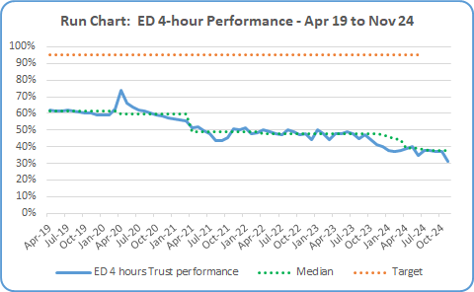

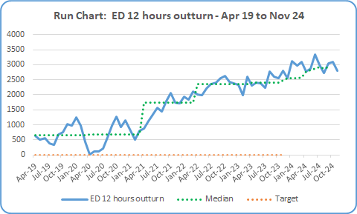
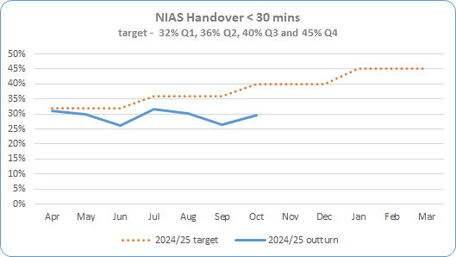
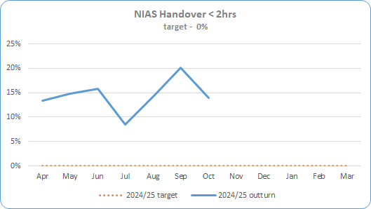
Section 2 – Key SDP Indicators
Service Area | Metric | Nov 24 Expected Activity | Nov 24 In-month Performance | Cumulative Activity YTD | Rag Status | Chart
Unscheduled Care * Targets included in SDP Summary Table | ED – 4 Hour Target % of patients waiting < 4 hours | 95% < 4 hrs | 5528 out of 17,677 patients attending were seen < 4 hours (31%) | Qtr 1 38% 17,831 <4 hrs out of 46,617 Qtr 2 38% 16,339 < 4 hrs out of 43,382 Avg Apr-Nov 45,472 <4hrs out of 123,461 37%
 | ED – 12 Hour Target * Reduce the number of patients waiting > 12 hours in ED in 22/23 by 10% | 2,515 | 2,806 patients waited > 12 hours during November +291 patients /+12% over expected target | Qtr 1 8,175 >12hrs. Target was 5531 – 2,644 over target/+33% Qtr 2 8,861 >12 hrs. Target was 6,469 – 2,392 over target/+23% Total >12 hrs Apr-Nov 23,676
 | NIAS % of Ambulance Handover Delay < 30 minutes | 40% (October data – Nov not available) | 27.4% - October data 12.6% below expected target (only %’s reported by SPPG ) | Qtr 1 29.1% Qtr 2 29.6%
 | NIAS % of Ambulance Handover Delay < 2 hours | 0% (October data – Nov not available) | 20.1% over expected target – October data (only %’s reported by SPPG ) | Qtr 1 14.6% Qtr 2 14.0%

Slide 5
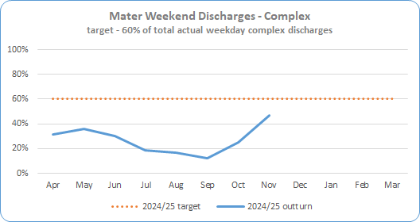
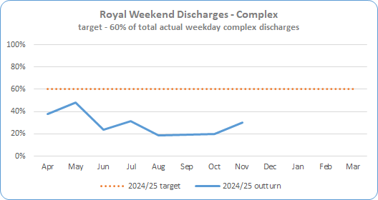
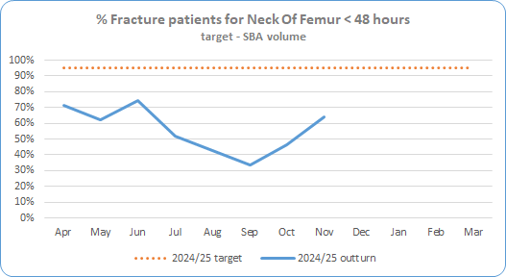
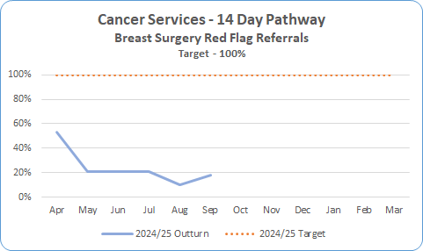
Section 2 – Key SDP Indicators
Service Area | Metric | Nov 24 Expected Activity | Nov 24 In-month Performance | Cumulative Activity YTD | Rag Status | Chart
Unscheduled Care * Targets included in SDP Summary Table | Complex Delayed Discharges – Mater * The number of complex discharges on any Saturday and Sunday should be at least 60% of the average daily number of complex discharges from Mon-Fri in that week. | 60% | 46.5% | Qtr 1 32.3% Qtr 2 15.9% Avg Apr-Nov 27%
 | Complex Delayed Discharges – RVH * The number of complex discharges on any Saturday and Sunday should be at least 60% of the average daily number of complex discharges from Mon-Fri in that week. | 60% | 30.0% | Qtr 1 36.7% Qtr 2 22.9% Avg Apr-Nov 28.7%
 | Hip Fractures – Number of Neck Of Femur (NOF) patients operated within 48 hrs | 95% | 64% 48 out of 75 seen <48hrs | Qtr 1 69% Qtr 2 43% Total Apr-Nov 322 out of 578 56%
Cancer | 14 day Performance * Core only 100% of patients to be seen <14 days | 100% | 15% - September data 26 seen < 14 days out of total 176 (Figures for September are latest figures validated) | Qtr 1 28% Qtr 2 16% Total Jul-Sep 114 out of 582

Slide 6
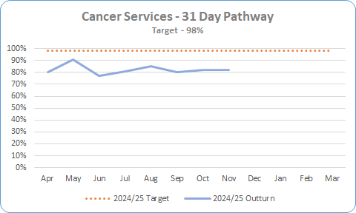

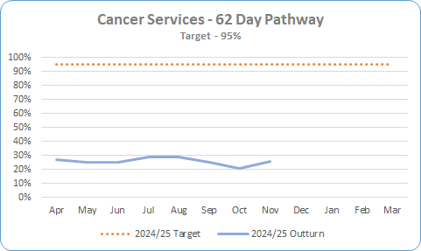
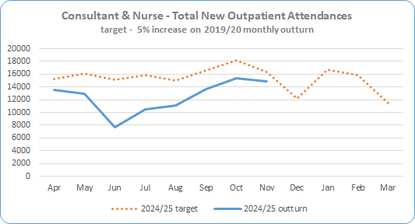
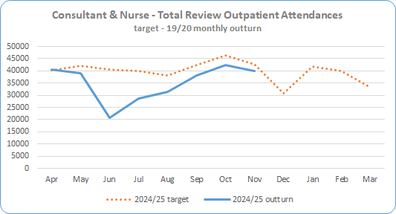
Section 2 – Key SDP Indicators
Service Area | Metric | Nov 24 Expected Activity | Nov 24 In-month Performance | Cumulative Activity YTD | Rag Status | Chart
Cancer * Targets included in SDP Summary Table | 31 day Performance * 98% of patients to be seen <31 days | 98% | 82% 194 out of 237 patients were seen <31 days October and November figures are provisional as pathways are still being closed down and validation ongoing. | 82% Apr – Nov = 2202 out or 2693
 | 62 day Performance * 95% of patients to be seen <62 days | 95% | 26% 26.5 out of 102 October and November figures are provisional as pathways are still being closed down and validation ongoing. | 25% Apr – Nov = 232.5 out of 910.5
Elective Care | Total New Outpatient Attendances * (Consultant & Nurse led) 105% of 2019/20 outturn | 16,363 | 14,854 New Outpatient attendances in November, 1,509 below expected activity (91% of expected) Encompass Data is subject to on-going validation – figures for Jun – Oct have been amended | Qtr 1 32,010 Qtr 2 25,367 Total Apr-Nov 99,561
 | Total Review Outpatient Attendances * - Nurse & Consultant 105% of 2019/20 outturn | 42,550 | 40,031 Review Outpatient attendances in Nov, 2,519 below expected activity (94%) Encompass Data is subject to on-going validation – figures for Jun – Oct have been amended | Qtr 1 98,398 Qtr 2 82,206 Total Apr-Nov 280,926

Slide 7
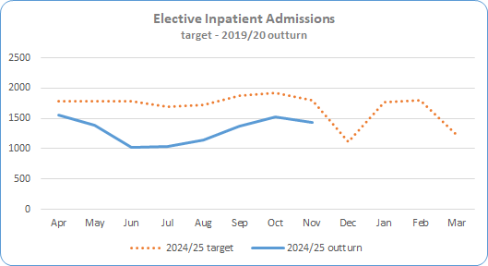

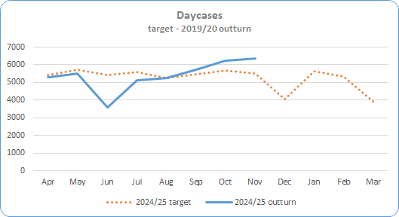

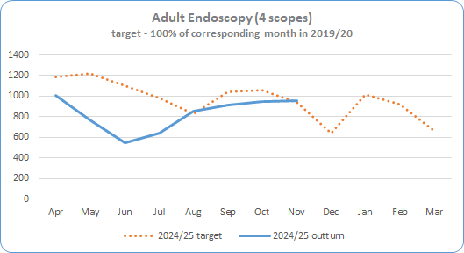
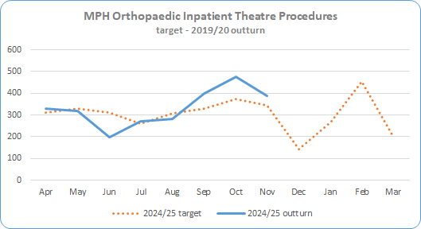
Section 2 – Key SDP Indicators
Service Area | Metric | Nov 24 Expected Activity | Nov 24 In-month Performance | Cumulative Activity YTD | Rag Status | Chart
Elective Care * Targets included in SDP Summary Table | Inpatient Admissions * 100% of 2019/20 outturn | 1,794 | 1,438 admissions 356 below expected activity (80.1%) | Qtr 1 3,961 Qtr 2 3,530 Total Apr-Nov 10,489
 | Day Case Procedures * 100% of 2019/20 outturn | 5,493 | 6,370 procedures 877 above expected activity (116%) | Qtr 1 14,386 Qtr 2 16,071 Total Apr-Nov 43,074
 | Endoscopy (4 scopes) * 100% of 2019/20 outturn | 943 | 959 16 above expected activity (102%) | Qtr 1 2,323 Qtr 2 2,417 Total Apr-Nov 6,646
 | MPH Inpatient Theatre Procedures * 100% of 2019/20 outturn | 345 | 388 procedures 43 over expected activity (112.5%) | Qtr 1 846 Qtr 2 950 Total Apr-Nov 2,661

Slide 8
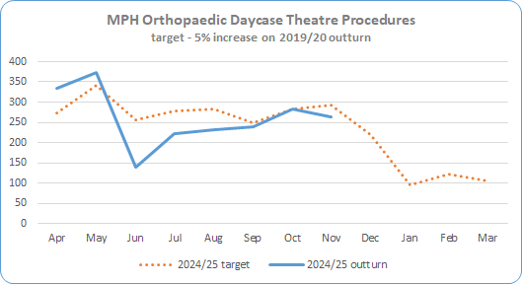
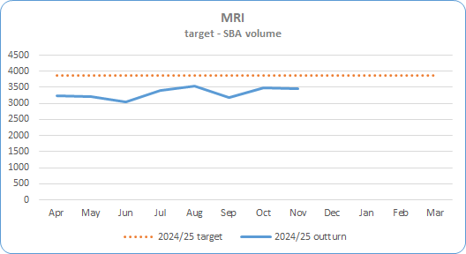
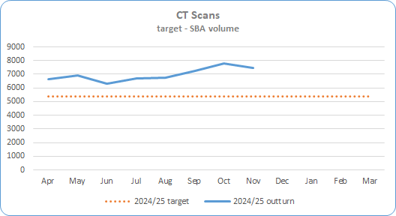
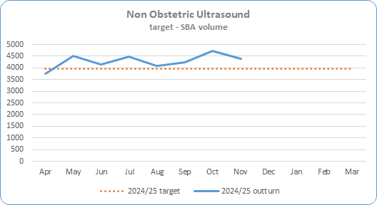
Section 2 – Key SDP Indicators
Service Area | Metric | Nov 24 Expected Activity | Nov 24 Actual Activity | In-month Performance | Cumulative Activity YTD | Rag Status | Chart
Elective Care * Targets included in SDP Summary Table | MPH Day Case Theatre Procedures * 105% of 2019/20 outturn | 292 | 264 procedures | 28 below expected activity (90.4%) | Qtr 1 843 Qtr 2 694 Total Apr-Nov 2,085
Imaging | MRI Scan * Deliver activity in line with agreed SBA volume | 3,864 per month | 3,446 | 418 below expected activity – 89.2% | Qtr 1 9,465 Qtr 2 10,116 Total Apr-Nov 26,510
 | CT Scan * Deliver activity in line with agreed SBA volume | 5,367 per month | 7,464 | 2,097 above expected activity – 139% | Qtr 1 19,880 Qtr 2 20,659 Total Apr-Nov 55,782
 | Non Obstetric Ultrasound * Deliver activity in line with agreed SBA volume | 3,977 per month | 4,378 | 401 above expected activity – 110% | Qtr 1 12,415 Qtr 2 12,813 Total Apr-Nov 34,346

Slide 9
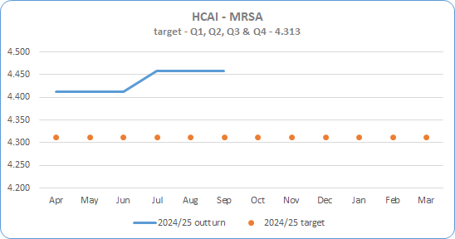
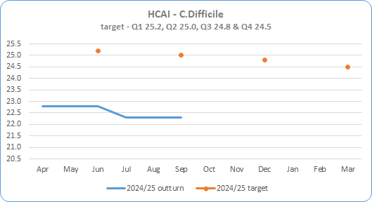
Section 3 – Quality and Safety
Service Area | Metric | Target | Qtr 2 Sept Actual Activity | Cumulative Activity YTD | Rag Status | Chart
HCAIs * Targets included in SDP Summary Table | Methicillin-resistant staphylococcus aureus (MRSA) * | 4.313 cases per 100,000 occupied beds (CDI) Quarterly target Q1 – 4.313 Q2 – 4.313 Q3 – 4.313 Q4 – 4.313 | Qtr 2 = 4.457 cases | Qtr 1- April to June = 4.412 cases
 | Clostridioides difficile (CDI) * | 25.0 cases per 100,000 occupied beds Quarterly target Q1 – 25.2 Q2 – 25.0 Q3 – 24.8 Q4 – 24.5 | Qtr 2 = 22.3 cases | Qtr 1 – April to June = 22.8 cases

Slide 10
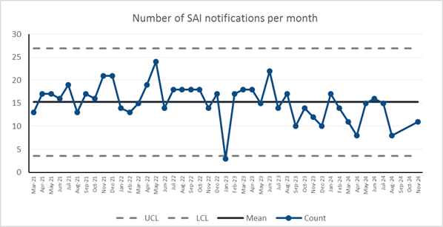
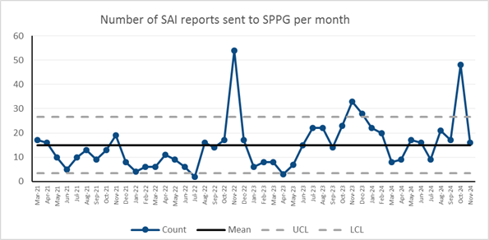
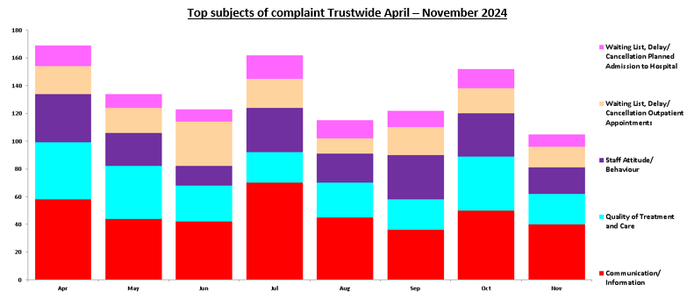
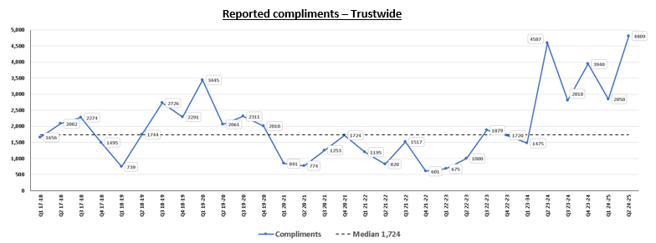
Section 3 – Quality and Safety
Service Area
Serious Adverse Incidents | SAI Notifications per month up to end of November 2024 Number of SAI reports to SPPG per month to end November 2024
Datix – Complaints and Compliments

Slide 11
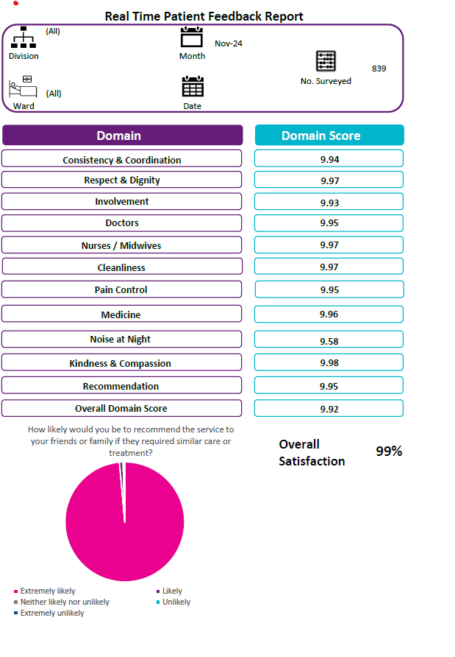
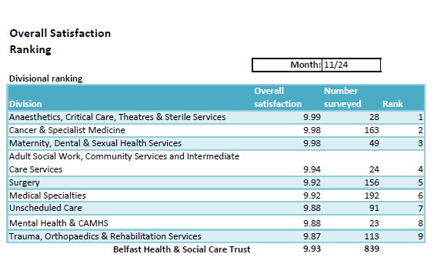
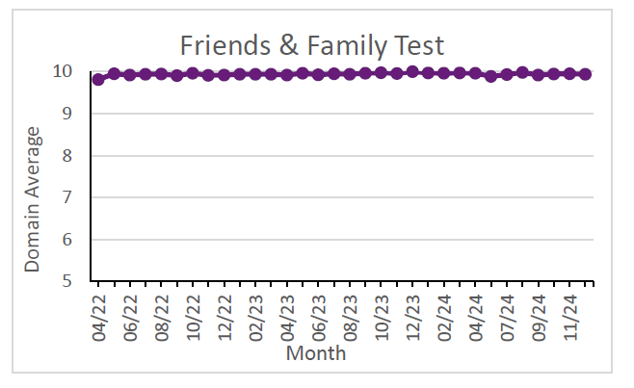
Section 4 – Patient Satisfaction - Real-Time Feedback: Patient Experience Charts - Month of November 2024 = 839 surveys
The collection of fortnightly Patient Experience feedback recommenced mid-July 2020 in 48 phase 1 acute areas, progressed to phase 2, and review is underway of current project spread and capacity to align with corporate priority areas ensuring wide advocacy for service users through gathering patient experience via an independent team on approximately 90 wards.
Monthly volume of surveys has increased to a relatively consistent performance level with approximately 700 surveys being completed across the majority of months across 2024-25 to the end of November 2024.
From April - November 2024 4,972 adult inpatient surveys have been completed. This includes new areas such as the SWAN Maternity Outpatient Clinic, Elective Overnight Stay Centre, and Neurology and reflects increased frequency of surveys being undertaken in some service areas.
RBHSC reporting is now embedded in Allen, Barbour, Clark Clinic & Paul wards and a total of 222 surveys completed so far this year, 2024-25. Project progress review of the RBHSC bespoke survey results and engagement with stakeholders is underway with further wards to be added to the RBHSC RTPE schedule.
High scores have been maintained in both Overall Satisfaction and the Friends & Family Test. In November 2024, of 839 patients, 99.6% were extremely likely to recommend the ward they were in to their friends or family.
Overall
Satisfaction
99%
How likely are you to recommend this ward to friends and family if they needed similar care or treatment?
7

Slide 12
Appendix

Slide 13
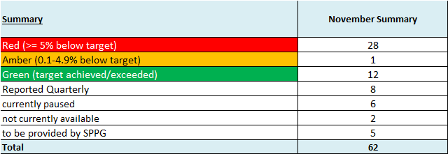
SDP Indicators Summary Table

Slide 14
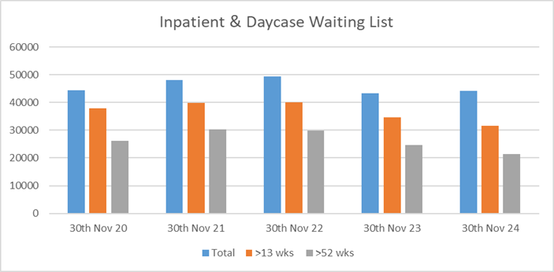
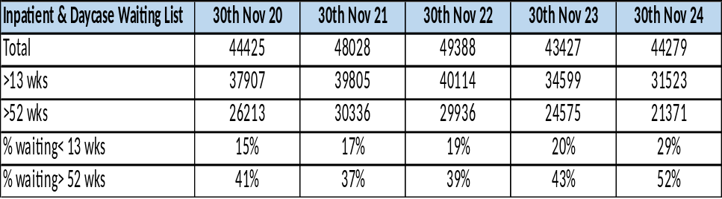
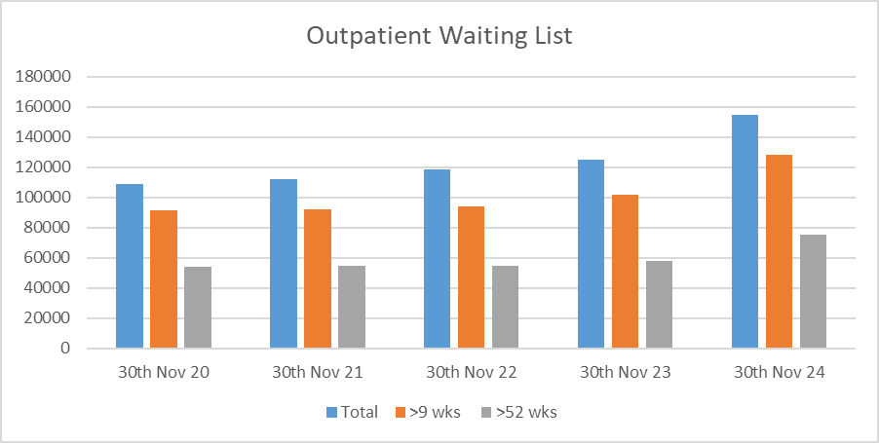
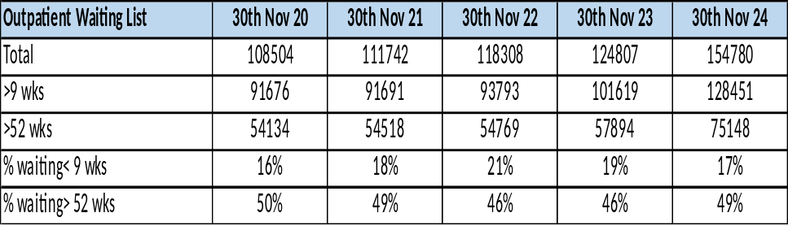
Waiting Lists
Service Area | Metric
Community Services | Children’s Social Care | Not Available due to Strike Action
Waiting Lists | Acute Hospital Inpatient & Daycases
 | Acute Hospital Outpatients

Slide 15
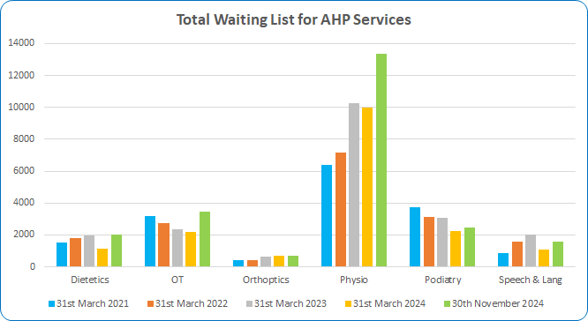
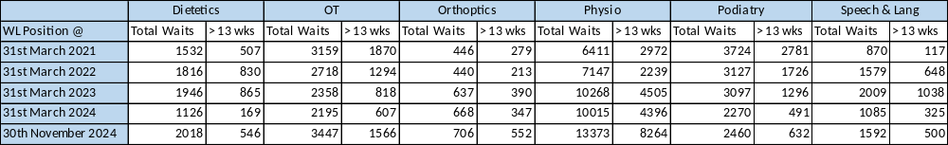
Waiting Lists
Service Area | Metric
Community Services Waiting Lists | AHP Services AHP waiting list numbers are subject to ongoing validation to remove duplicate referrals

