Slide 1

Service Delivery Plan Report
Trust Board - Thursday 6th March 2025
Alastair Campbell
Director of Performance, Planning & Informatics
Section 1 – Headlines
Section 2 - Effectiveness/timeliness
Key SDP Indicators
Unscheduled Care – 4 & 12 Hr targets, NIAS Handovers <30 mins & < 2 hrs, Delayed discharges and Hip Fractures
Cancer – 14, 31 and 62 day targets
Elective Care – New & Review OP attendances (Consultant & Nurse), admissions, daycases & endoscopy, Ortho admissions & daycases
Imaging – MRI, CT and NOUS
Cardiac Services - ECHO
Section 3 – Experience
Patient Satisfaction – Patient Experience Surveys, Friends and Family, Complaints and Compliments
APPENDIX
Service Delivery Plan Summary table (January 2025)
Waiting lists Summary

Slide 2

Section 1 – Headlines
Ongoing confidence issues in reporting in a number of areas as we try to understand how the new data differs from reporting pre-encompass. Validation is ongoing also to ensure all relevant data is captured within reports.
14, 31 and 62 day cancer data is reported, but subject to ongoing validation.
Outpatient activity while below SDP targets is continuing to report an increase.
Day Case activity is reporting above SDP target. IP and Endoscopy activity is improving and is above 95% of expected activity levels.
Diagnostics and ECHO services are delivering increases in activity. CT / Non Obstetric Ultrasound / Echo diagnostic activity is 95% and above of expected activity levels.
IPDC waiting lists are generally stable. OP and AHP waiting lists showing a significant increase. Waiting lists are subject to ongoing validation.
Patient experience report for January – 99% overall satisfaction

Slide 3
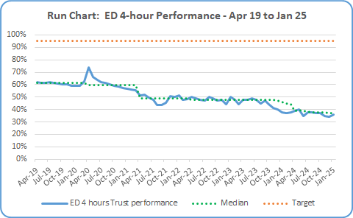

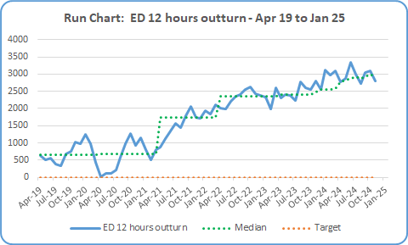
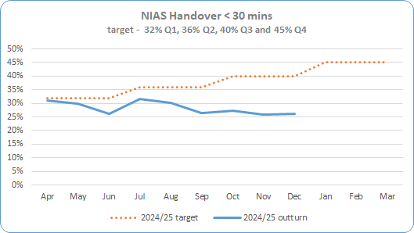
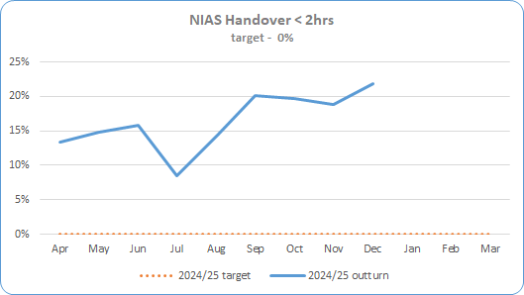
Section 2 – Key SDP Indicators
Service Area | Metric | Jan 25 Expected Activity | Jan 25 In-month Performance | Cumulative Activity YTD | Rag Status | Chart
Unscheduled Care * Targets included in SDP Summary Table | ED – 4 Hour Target % of patients waiting < 4 hours | 95% < 4 hrs | 5,190 out of 14,511 patients attending were seen < 4 hours (36%) during January 2025. | Qtr 1 38% - 17,831 <4 hrs out of 46,617 Qtr 2 38% - 16,339 < 4 hrs out of 43,382 Qtr 3 35% - 16,568 < 4 hrs out of 47,143
 | ED – 12 Hour Target * Reduce the number of patients waiting > 12 hours in ED in 22/23 by 10% | 2,057 | 2,691 patients waited > 12 hours during January 2025. +634 patients /+18% over expected target | Qtr 1 8,175 >12hrs. Target was 5531 – 2,644 over target/+33% Qtr 2 8,861 >12 hrs. Target was 6,469 – 2,392 over target/+23% Qtr 3 8,878 >12 hrs. Target was 6,610 – 2,268 over target/+34%
 | NIAS % of Ambulance Handover Delay < 30 minutes | 40% (December data – Jan not available) | 26.1% - December 24 data 13.9% below expected target (only %’s reported by SPPG ) | Qtr 1 29.1% Qtr 2 29.6% Qtr 3 26.5%
 | NIAS % of Ambulance Handover Delay < 2 hours | 0% (December data – Jan not available) | 21.9% - December 24 data 21.9% over expected target (only %’s reported by SPPG ) | Qtr 1 14.6% Qtr 2 14.0% Qtr 3 20.7%

Slide 4
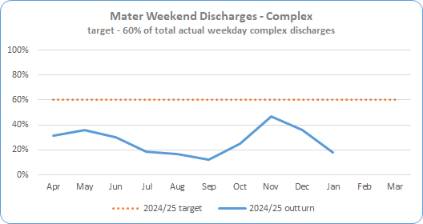
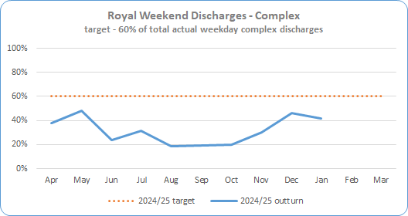
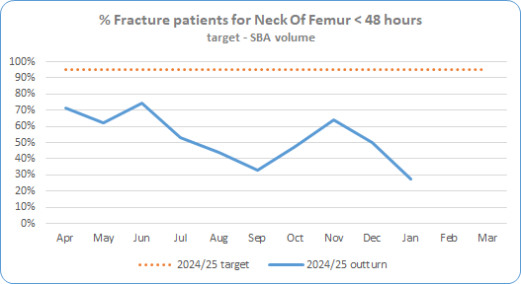
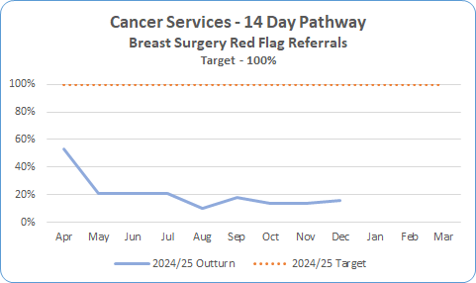
Section 2 – Key SDP Indicators
Service Area | Metric | Jan 25 Expected Activity | Jan 25 In-month Performance | Cumulative Activity YTD | Rag Status | Chart
Unscheduled Care * Targets included in SDP Summary Table | Complex Delayed Discharges – Mater * The number of complex discharges on any Saturday and Sunday should be at least 60% of the average daily number of complex discharges from Mon-Fri in that week. | 60% | 17.7% | Qtr 1 32.3% Qtr 2 15.9% Qtr 3 35.5%
 | Complex Delayed Discharges – RVH * The number of complex discharges on any Saturday and Sunday should be at least 60% of the average daily number of complex discharges from Mon-Fri in that week. | 60% | 41.8% | Qtr 1 36.7% Qtr 2 22.9% Qtr 3 32.3%
 | Hip Fractures – Number of Neck Of Femur (NOF) patients operated within 48 hrs | 95% | 28% 22 out of 58 seen <48hrs | Qtr 1 69% Qtr 2 43% Qtr 3 54% Total Apr – Jan 53% 350 out of 664
Cancer | 14 day Performance * Core only 100% of patients to be seen <14 days | 100% | 15.5% - December data 33 seen < 14 days out of total 213 (December 24 are latest figures validated) | Qtr 1 28% Qtr 2 16% Qtr 3 14% Total Oct - Dec 102 out of 722

Slide 5
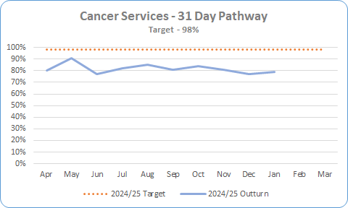

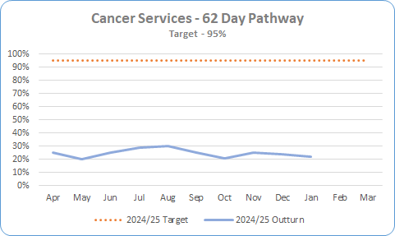
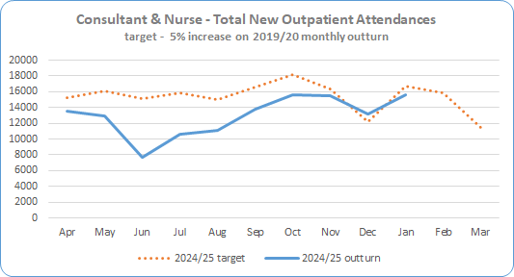
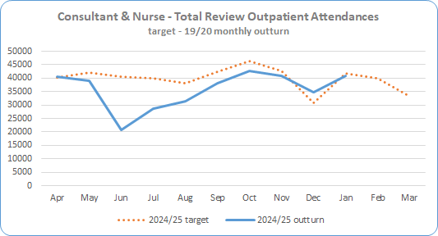
Section 2 – Key SDP Indicators
Service Area | Metric | Jan 25 Expected Activity | Jan 25 In-month Performance | Cumulative Activity YTD | Rag Status | Chart
Cancer * Targets included in SDP Summary Table | 31 day Performance * 98% of patients to be seen <31 days | 98% | 79% 157 out of 200 patients were seen <31 days Figures are provisional as pathways are still being closed down and validation ongoing. | Qtr 1 82% Qtr 2 83% Qtr 3 81% Apr – Jan 82% - 2,596 out of 3,178
 | 62 day Performance * 95% of patients to be seen <62 days | 95% | 22% 18 out of 83.5 patients were seen <62 days Figures are provisional as pathways are still being closed down and validation ongoing. | Qtr 1 24% Qtr 2 28% Qtr 3 25% Apr – Jan 26% - 301 out of 1172.5
Elective Care | Total New Outpatient Attendances * (Consultant & Nurse led) 105% of 2019/20 outturn | 16,664 | 15,614 New Outpatient attendances in January, 1,050 below expected activity (98.4% of expected) Encompass Data is subject to on-going validation | Qtr 1 34,078 Qtr 2 35,509 Qtr 3 44,267 Total Apr - Jan 129,468
 | Total Review Outpatient Attendances * - Nurse & Consultant 100% of 2019/20 outturn | 41,851 | 40,778 Review Outpatient attendances in January, 1,073 below expected activity (97%) Encompass Data is subject to on-going validation – figures for Jun – Oct have been amended | Qtr 1 100,614 Qtr 2 98,234 Qtr 3 118,416 Total Apr - Jan 358,042

Slide 6
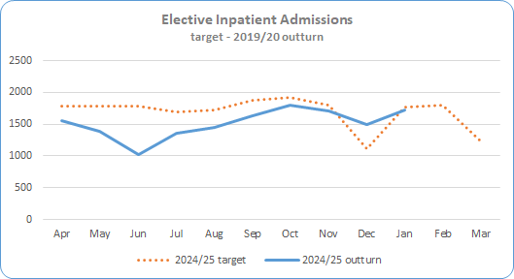
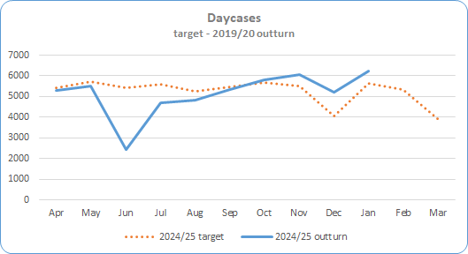

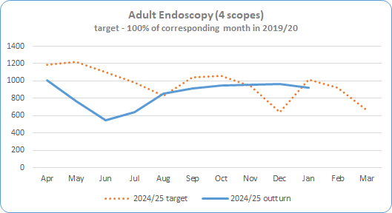
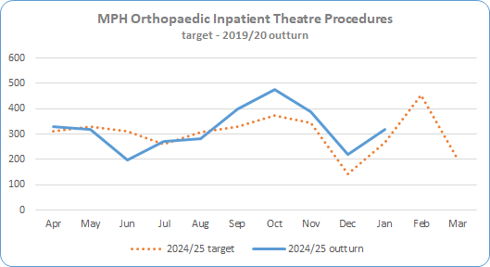
Section 2 – Key SDP Indicators
Service Area | Metric | Jan 25 Expected Activity | Jan 25 In-month Performance | Cumulative Activity YTD | Rag Status | Chart
Elective Care * Targets included in SDP Summary Table | Inpatient Admissions * 100% of 2019/20 outturn | 1,764 | 1,728 admissions 36 below expected activity (98%) | Qtr 1 3,961 Qtr 2 4,441 Qtr 3 4,999 Total Apr - Jan 15,129
 | Day Case Procedures * 100% of 2019/20 outturn | 5,617 | 6,250 procedures 633 above expected activity (111%) | Qtr 1 13,229 Qtr 2 14,825 Qtr 3 17,065 Total Apr - Jan 51,369
 | Endoscopy (4 scopes) * 100% of 2019/20 outturn | 1,020 | 974 98 below expected activity (95.5%) | Qtr 1 2,323 Qtr 2 2,417 Qtr 3 2,872 Total Apr – Jan 8,586
 | MPH Inpatient Theatre Procedures * 100% of 2019/20 outturn | 266 | 318 procedures 52 over expected activity (119.5%) | Qtr 1 846 Qtr 2 950 Qtr 3 1,085 Total Apr - Jan 3,199

Slide 7
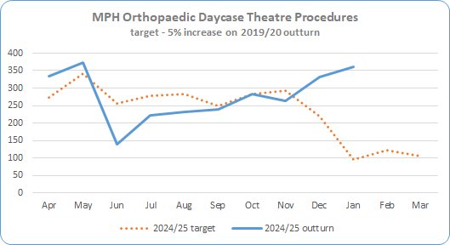
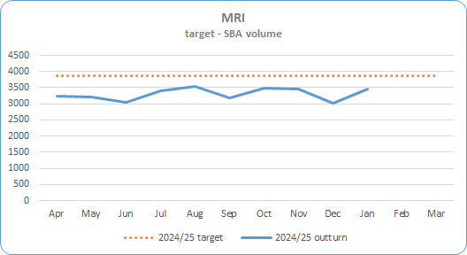

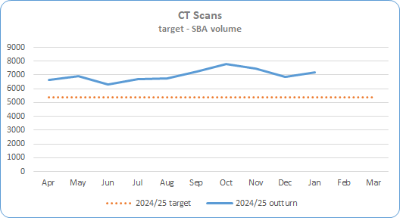
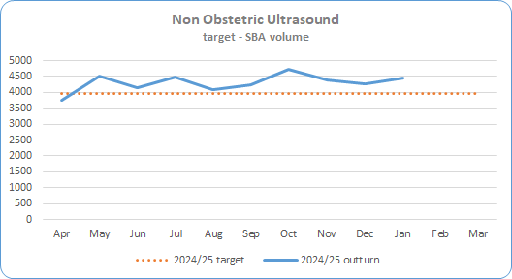
Section 2 – Key SDP Indicators
Service Area | Metric | Jan 25 Expected Activity | Jan 25 In-month Performance | Cumulative Activity YTD | Rag Status | Chart
Elective Care * Targets included in SDP Summary Table | MPH Day Case Theatre Procedures * 105% of 2019/20 outturn | 96 | 360 procedures 264 above expected activity (395.6%) | Qtr 1 843 Qtr 2 694 Qtr 3 880 Total Apr-Jan 2,777
Imaging | MRI Scan * Deliver activity in line with agreed SBA volume. SBA currency is being reviewed for 25/26 to take account of multiple body areas | 3,864 per month | 3,466 398 below expected activity (89.7%) Note – SBA baseline subject to review | Qtr 1 9,465 Qtr 2 10,116 Qtr 3 9,954 Total Apr-Jan 33,001
 | CT Scan * Deliver activity in line with agreed SBA volume | 5,367 per month | 7,203 1,836 above expected activity (134.2%) | Qtr 1 19,880 Qtr 2 20,659 Qtr 3 22,079 Total Apr-Jan 69,821
 | Non Obstetric Ultrasound * Deliver activity in line with agreed SBA volume | 3,977 per month | 4,444 467 above expected activity (111.7%) | Qtr 1 12,415 Qtr 2 12,813 Qtr 3 13,397 Total Apr-Jan 43,069

Slide 8
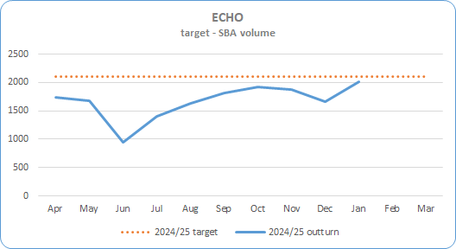
Section 2 – Key SDP Indicators
Service Area | Metric | Jan 25 Expected Activity | Jan 25 In-month Performance | Cumulative Activity YTD | Rag Status | Chart
Cardiac Services * Targets included in SDP Summary Table | ECHO Deliver activity in line with agreed SBA volume | 2,111 | 2,013 98 below expected activity (95.4%) | Qtr 1 4,370 Qtr 2 4,860 Qtr 3 5,461 Total Apr-Jan 16,704

Slide 9
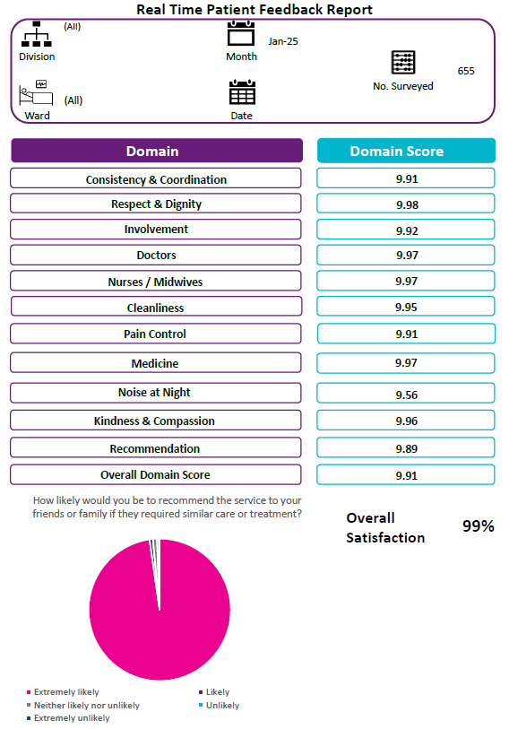
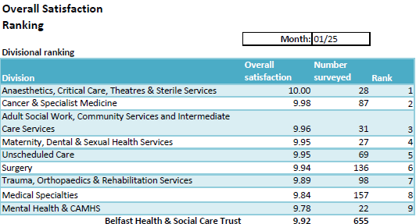
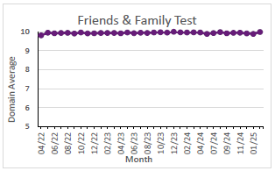
Section 3 – Patient Satisfaction - Real-Time Feedback: Patient Experience Charts - Month of January 2025 = 655 surveys
The collection of fortnightly Patient Experience feedback recommenced mid-July 2020 in 48 phase 1 acute areas, progressed to phase 2, and review is underway of current project spread and capacity to align with corporate priority areas ensuring wide advocacy for service users through gathering patient experience via an independent team on approximately 90 wards.
Monthly volume of surveys has increased to a relatively consistent performance level with approximately 700 surveys being completed across the majority of months across 2024-25 to the end of January 2025.
From April 2024 - January 2025 6,127 adult inpatient surveys have been completed. This includes new areas such as the SWAN Maternity Outpatient Clinic, Elective Overnight Stay Centre, and Neurology and reflects increased frequency of surveys being undertaken in some service areas.
RBHSC reporting is now embedded in Allen, Barbour, Clark Clinic & Paul wards and a total of 222 surveys completed so far this year, 2024-25. Project progress review of the RBHSC bespoke survey results and engagement with stakeholders is underway with further wards to be added to the RBHSC RTPE schedule.
High scores have been maintained in both Overall Satisfaction and the Friends & Family Test. In January 2025, of 655 patients, 99.2% were extremely likely to recommend the ward they were in to their friends or family.
Overall
Satisfaction
99%
How likely are you to recommend this ward to friends and family if they needed similar care or treatment?
7

Slide 10
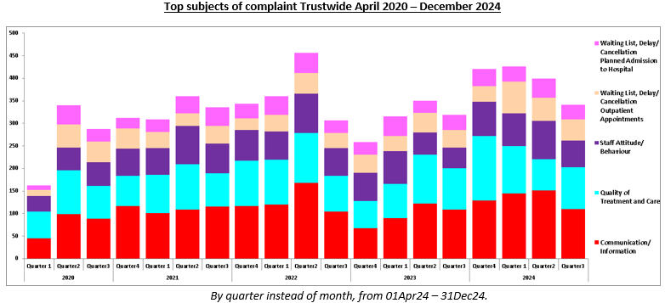
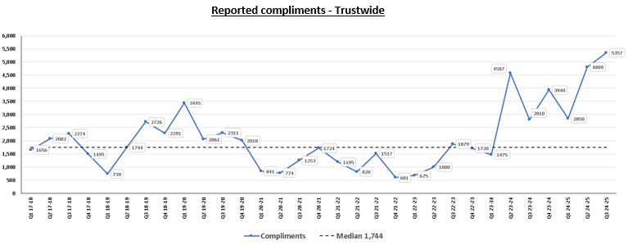
Section 3 – Patient Satisfaction
Service Area
Datix – Complaints and Compliments

Slide 11
Appendix

Slide 12
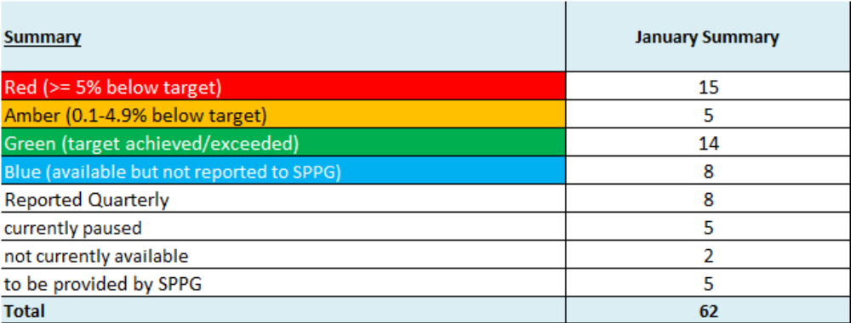
SDP Indicators Summary Table

Slide 13
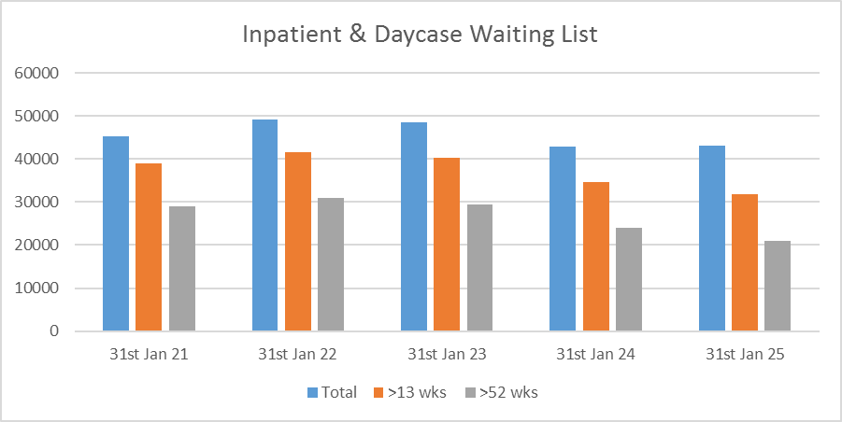
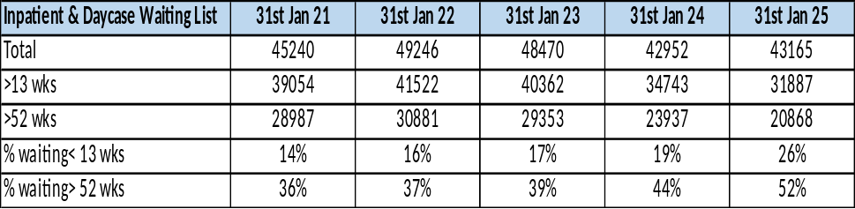
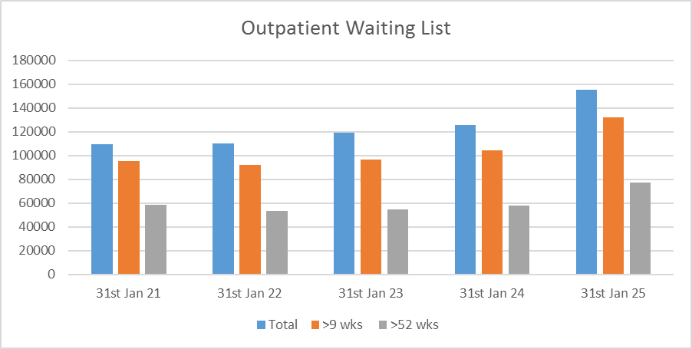
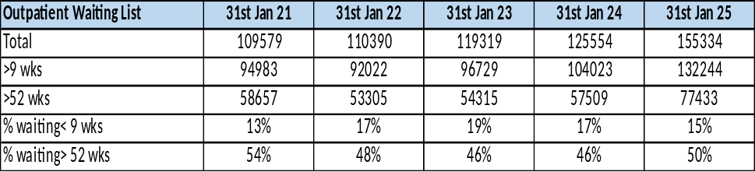
Waiting Lists
Service Area | Metric
Community Services | Children’s Social Care | Not Available due to Strike Action
Waiting Lists | Acute Hospital Inpatient & Daycases | Inpatient & Daycase Waiting Lists
 | Acute Hospital Outpatients | Outpatient Waiting List

Slide 14
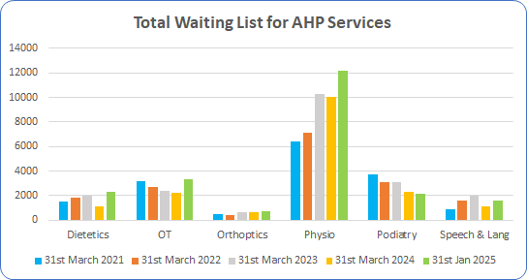
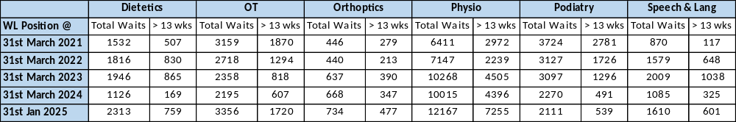
Waiting Lists
Service Area | Metric
Community Services Waiting Lists | AHP Services AHP waiting list numbers are subject to ongoing validation to remove duplicate referrals

Slide 15

Escalations under Support and Intervention Framework
Level 1 | Level 2 | Level 3
Cleft lip and palate | Serious Adverse Incidents | MAH Governance & Accountability
Reduced PICU capacity | PACU activity | PEG insertion Paeds
Reduced Paed Gastro | IS Foster Placements
Cardiology TTE | CAMHS waiting lists
Iveagh | Short breaks for children with disabilities
Escalation
Level 5*: intervention at HSC Board level – Decision by Health Minister- as advised by DOH/SPPG/PHA. Involves exercise of Minister’s power of intervention. Only used in exceptional circumstance. Targeted support suspension, removal of duties from individuals or whole Board. Assessment through quality surveillance, existing knowledge, formal and informal investigations. Draw on expertise/advice of national colleagues and use of external organisational and independent advisors
Level 4*- Senior external support for provider. Targeted interventions – decision taken by Permanent Sec. Failure to provide recovery plan at level 3, significant weaknesses re financial stability, reputation, governance quality of care or patient safety. DOH take/coordinate action and direct intervention to support Trust, Interventions undertaken by SPPG as directed by Perm Sec. Appropriate external support may be given to Trust eg mentoring for Board/ET members – co-opting experts onto Board as Independent Advisors for finite period. DOH Review
Level 3- enhanced monitoring and support for provider – where previous concerns not resolved at levels 1 or 2, scale of concern, systemic concerns, or ongoing performance challenges, Formal recovery plan – proactive approach, clear milestones and responsibilities – significantly enhanced monitoring and scrutiny. Trust CE to cooperate and provide leadership re agreed recovery actions.
Level 2- enhanced monitoring and support for provider – issues not resolved by Level 1 or direct escalation to Level 2 given seriousness. Local recover plan and enhanced monitoring- regular meetings at Director level – need to show proactivity e.g ongoing performance challenges, risks with no identified action/timetable
Level 1- area of concern identified – emerging, potentially serious concern to service delivery, quality, safety effectiveness – informal level of support and guidance – but no intervention e.g. failure to demonstrate budgetary control and/or insufficient focus on productivity/efficiency. Notified in writing. Local recovery plan required. More frequent monitoring
Steady state- no intervention required- Trust generally operating effectively – any issues picked up through routine oversight arrangements
De-escalation
NI Public made aware of
concerns at levels 4 &5 -
serious problems or
concerns re existing
leadership’s ability to
rectify
Escalation and de-escalation to & from level 1 will take place as necessary and be decided by DOH/SPPG/PHA

