Slide 1



The Belfast Plan 2025+
The Trust’s Corporate plan 2025 onwards
Our vision in Belfast Trust
is to be the safest, most effective and compassionate organisation

Slide 2
The Belfast Plan 2025+
Introducing The Belfast Plan ……………………………
Successes of our last Corporate Plan…………………..
Belfast Trust organisational chart
Belfast population Profile…………………………………
Activity in Belfast …………………………………………
Our Priorities……………………………………………….
Our Commitments…………………………………………
Implementation Strategy.…………………………………
Accessibility - This document is available in other formats including Easy Read, Large Print, Braille or electronic formats. Please let us know which format would be best for you. Contact the Planning & Equality Team here.
3
4
5
6
7
8
9
10

Slide 3
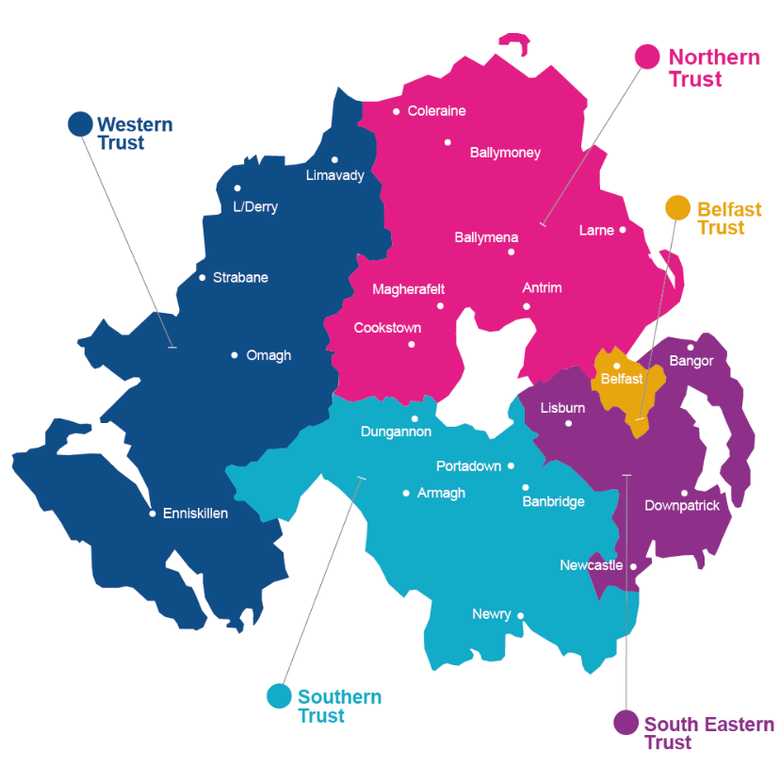
Introducing The Belfast Plan 2025+
Our people – patients, service users, carers, families and staff – are at the centre of everything we do in Belfast Trust.
The recent publication of the Programme for Government 2024 – 2027 and Ministerial Priorities set out the approach to addressing key areas of focus within Health and Social Care. including the priorities to Cut Health Waiting Times, Reform and Transformation of Public Services, Better Support for Children and Young People with Special Educational Needs.
Belfast Health and Social Care Trust is committed to working as part of the Health and Social Care System to support the work to redesign how health and social care is delivered with the people of Northern Ireland in accordance with the Hospitals - Creating a Network for Better Outcomes
We will focus on improving the health outcomes of our population including tackling health inequalities, by working proactively and through effective engagement with our partners. We work alongside a wide range of partners across primary care, statutory, community, voluntary and independent sectors, and with our trade union colleagues. Our shared challenge is to provide a seamless service to the people we serve, both locally and regionally.
The Trust’s priorities will be these 4 key areas:
OUR PATIENTS & SERVICE USERS, Improving the health and well-being of the population, Learning from listening
OUR PERFORMANCE Delivering safe and effective care, reducing waiting times
OUR PEOPLE Supporting our staff
OUR POTENTIAL Delivering value and sustainability, Developing new ways of working
Northern Ireland’s Health and Social Care system remains under severe pressure, with rising demands and ongoing financial pressures. The Belfast Plan sets out the key actions we will take to minimise the impact of these challenges and continue to support the current needs of our population.

Slide 4
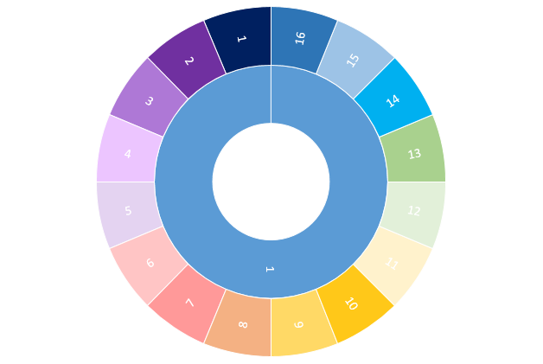
Who we are?
Workforce, Education, regulation and informatics
Governance standards Performance management
Non-clinical support services
BHSCT Organisational Structure
Education, Workforce
Risk, Governance, Litigation
Research
Adult Social Care Services and Community MDTs
Adult Social Work Services, Community Nursing and Intermediate Care Services
AHPs
Nursing & User Experience
Medical Directorate
Urgent & Emergency Care
Medical Specialties
Adult community &, Older People services & AHPs
Unscheduled Care
Surgery
Anaesthetics, Critical Care, Theatres Sterile Services
Trauma, Ortho, Rehab Services
Imaging, Medical Physics, Outpatients
Trauma, Orthopaedics, Rehabilitation & Imaging, Medical Physics, Outpatients
Anaesthetics, Critical Care, Theatres and Sterile Services & Surgery
Chief Executive
Mental Health,
Intellectual Disabilities & Psychological Services
Cancer & Specialist Medicine
Pharmacy and Laboratories
Cancer and Specialist services
Mental Health
Intellectual Disabilities
Psychological services
BHSCT Board
Directorate of Social Work
Workforce, learning, Development, Improvement service
Strategic Adult Safeguarding
Governance
Maternity, Dental, Gynae & Sexual Health
Child Health & NISTAR
Child Health & NISTAR & Maternity, Dental, Gynae & Sexual Health.
Deputy
Chief Executive
Planning, Performance and Informatics
Children's community services
Performance & Planning
Planning & Equality
Digital Services
Public Health
Early Intervention, Safeguarding
Children’s Community Child Health
Corporate Parenting
Finance
Corporate Communications
Accounting, Financial services
Costing, Commissioning & Capital Development
Financial management
Strategic Development
HR & Organisational Development
Public Liaison Services
Communications, resources and Information services
Corporate communications
Capital Planning & Redevelopment
Estates
Employee Relations, Risk & Governance
Occupational Health & Organisational Development
HR People’s services

Slide 5
Population profile- Belfast (from 2021 census data)
Total population
Ethnic diversity
The total population of Belfast Local Government District was 345,418 – a 20.8% increase on the population in 2011.
51% female:49% male.
Ethnic diversity has grown in Belfast, going from 98% white in 2001, to 93% in 2021. This has implications for health and social care delivery with certain diseases and ill health are more prevalent among certain ethnic groups.
Life expectancy
Age
The gap between Northern Irish male and female life expectancy is largest in Belfast – 5.2 years in favour of females compared to 3.9 in favour of females across NI.
In general, our population is living longer, often with long-term health conditions. Older people are more likely to experience long-term health problems.
Long-term health conditions
At 25.9 %, Belfast has 5% higher proportion of people with a limiting health condition or disability than general NI population. Women are more likely to experience long-term health problems. Almost a quarter of women in Belfast, compared to 1 in 5 men, report a disability or a long-term health problem that affects their day-to-day activities.
Notes:
© Copyright PresentationGO.com – The free PowerPoint and Google Slides template library

Slide 6

Successes of last corporate plan
The Trust’s last corporate plan focused on 6 priority areas, as the Trust sought to rebuild its health and social care provision after the Covid 19 pandemic – these were: New Model of Care for Older People, Urgent and Emergency Care, Time Critical Surgery, Outpatients Modernisation, Vulnerable Groups, and Seeking Real Time Feedback from patients and staff.
Older People, our Hospital at Home service has been expanded and allows older people to receive specialist medical and nursing care in their own homes and prevents unnecessary admissions to hospital.
Similarly, the Acute Frailty Unit provides a specialist area for people who are older and frail to be assessed and treated and means that they do not have to wait in a busy Emergency Department.
As regards urgent and emergency care, the Trust and GP colleague worked to establish an Urgent Care Centre alongside RVH ED as another alternative to ED. GPs can now directly make an electronic referral into Scheduled Urgent Clinical Assessment Slots.
The Trust also introduced Phone First for adults, a triage service to help patients with minor injuries or urgent, non-life threatening conditions to get the right care at the right time.
In terms of Time Critical Surgery, the Trust opened the Mater elective overnight stay centre and an orthopaedic hub at Musgrave Park Hospital and these, along with other regional elective care centres, have been instrumental in helping to reduce lengthy waiting lists and ensuring that people have timely access to surgery.
The Trust has also established mega clinics for outpatient assessment and pre-operative assessment.
Similarly, a significant programme of work has been underway across 10 different work streams to modernise how outpatient services are delivered – some of the many improvements include enhanced triage and validation.
Patients have also been given more control as to how and when they access outpatient services with the introduction of Patient Initiated Follow-up.
Alternative pathways of care for patients have also been developed and there has been a strong focus on improving how we communicate with our patients.
The Trust is committed to being a learning organisation and greatly recognises the value of feedback from our patients and our staff, who are genuine experts by experience.
The Trust has moved to a Digital Clinical Records System- encompass.
Patients have also been given more control as to how and when they access outpatient services with the introduction of Patient Initiated Follow-up. This has been supported by the availability of the encompass MyCare app, through which patients can have access to their own health records.
For vulnerable groups, a new Perinatal Mental Health Team and a business case has been submitted to establish a new Mother and Baby Unit on the City Hospital site. For young people with eating disorders, a new day treatment program had been developed and the Trust has increased its community resource to support these children and their families. The Trust has continued to resettle patients from Muckamore into suitable accommodation with individualised wraparound support. Work is ongoing to source appropriate accommodation options for the patients and for people with an intellectual disability in the community. Our Children’s Community Services are working to rebuild the short break service for young people.

Slide 7

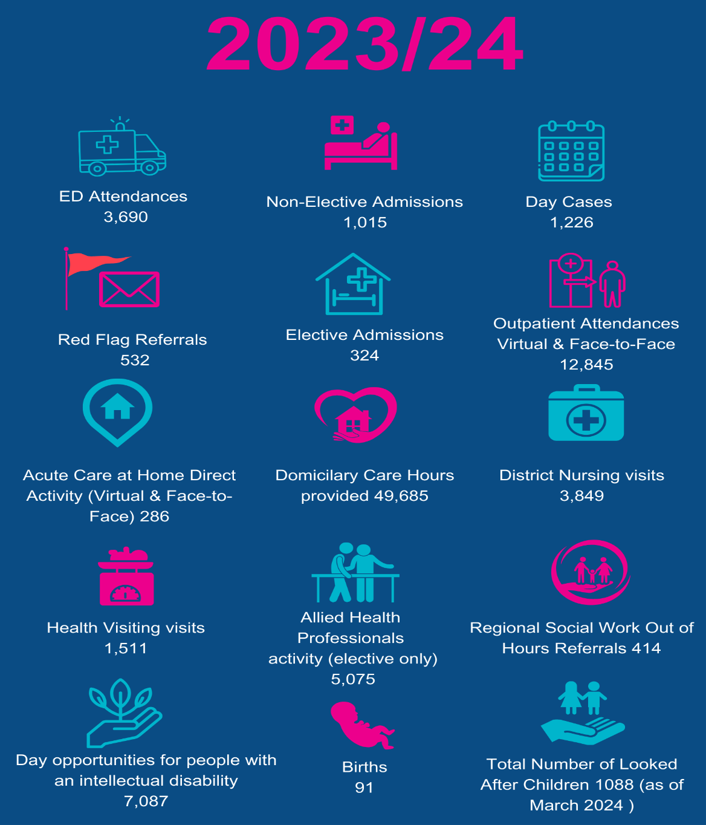
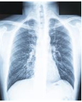
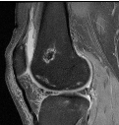

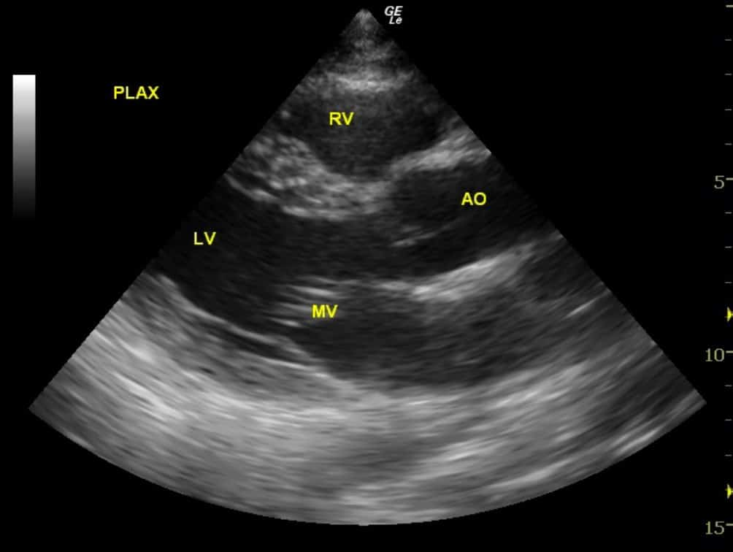
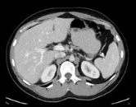
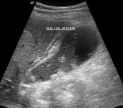
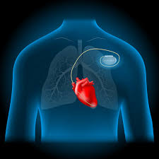
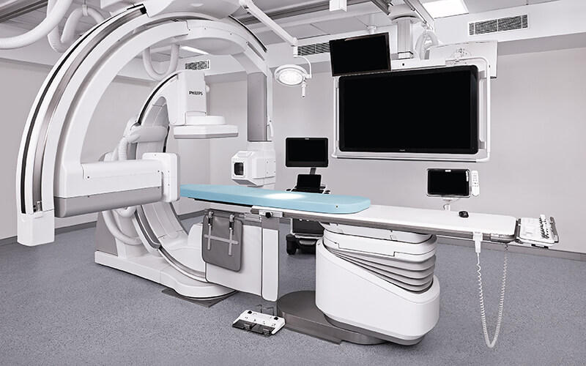
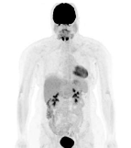
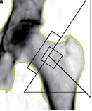
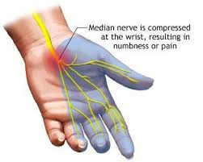
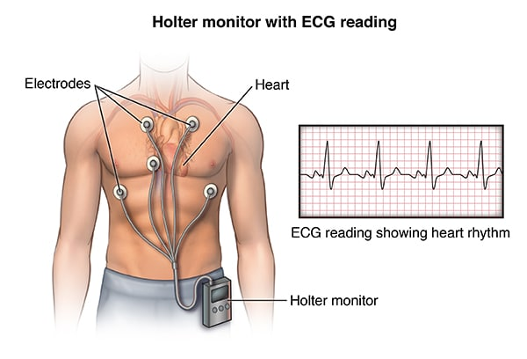
Belfast Trust is a large and complex health and social care organisation –
here is some of our average weekly activity…
Average Weekly No. of scans performed
Average Weekly No. of Clinical Physiology investigations
Plain X-ray
5347
MRI
970
ECG
2158
ECHO 341
CT
1587
Ultrasound
938
Remotes
345
Cath Lab 172
Carpal tunnel Studies
46
NM/PET CT
218
DEXA
125
Ambulatory
82

Slide 8

Our Priorities:
OUR PATIENTS & SERVICE USERS Improving the health and well-being of the population and Learning from listening
Alternative pathways of care for patients will continue to be developed and there will be a strong focus on improving how we communicate with our patients.
We will continue to develop specific services dedicated to supporting people to self-manage their own heath, for example, post Covid interventions, Community Mental Health, and the Inclusion service.
We are committed to improving support to our children and young people, including Looked After Children and those with Special Educational Needs.
We are committed to implementing the new Regional Model for Intellectual Disability, expected in 2025.
We are committed to strengthening and expanding our partnerships, taking a whole systems approach to population health, including through, our Community Planning Partnerships and the Integrated Care System. The introduction of a Belfast Area integrated Partnership Board will set further priorities and actions with regards to tackling health inequalities.
We remain committed to tackling health inequalities and prioritising early intervention and prevention.
We will use data to understand our population’s health needs, to design services which meet the needs of our community and to identify areas of inequity and exclusion.
We will continue to engage and work collaboratively with service users and carers to ensure we take into account the needs of all those who require our services and who are essentially the experts by experience.

Slide 9

Our Priorities:
OUR PERFORMANCE Delivering safe and effective care, reducing waiting times
Our waiting lists are longer than we would like them to be. The Trust is making every effort to improve performance within resources available through new initiatives such as mega clinics and elective care centres and new ways of working.
We will continue to drive forward the significant programme of reform and modernisation of our outpatient services.
We will look at developing new pathways for our people to reach the care they need in a timely way, and avoiding ED when appropriate.
We will work with Department of Health and other Trusts to deliver services in keeping with Hospitals - Creating A Network For Better Outcomes. The aims outlined in this is to maximise efficiency and productivity.
The roles of some hospitals will change to better deliver the health needs of the community and keep pace with modern medicine, as well as contribute to regional delivery. Services may be relocated in some cases from their existing locations, but all hospitals will continue to play a central and vital role in our health service and in their local communities.

Slide 10



Our Priorities:
OUR PEOPLE Supporting our staff
Everything we do in Belfast Trust is about people and for people and so it is through the building of a compassionate culture, where colleagues are valued that we will be able to create the conditions for the safest, most effective and most compassionate care. Within Belfast Trust, we have a dedicated staff population of over 22,000, who care for others every day. We will work to improve, enhance and support the health and wellbeing of our staff by addressing their health experiences and outcomes.
bWell – this is a programme of work and resources dedicated to improving employee health and wellbeing and offering employees with support and information on a wide range of health and wellbeing issues.
Here4U- is a health and wellbeing initiative for Trust staff designed to help staff feel more valued by Belfast Trust. It offers an extensive range of free activities and events to staff, to address physical, emotional and mental health and wellbeing.
Safety- Belfast Trust is committed to supporting its staff and to provide a safe and supportive environment for all individuals. The Trust has recently been accredited as a Trust of Sanctuary, in recognition of its proactive work to ensure a welcoming and inclusive environment for staff and patients alike.
In recognition of a fundamental right to be free from abuse, the Trust has a domestic and sexual abuse support service for its staff to offer practical and emotional support, with a policy, trained support officers a helpline and online toolkit
People and Culture- Developing a positive culture for our workforce is underpinned by our People and Culture priorities. These were developed by reflecting on all of the challenges we have faced as an organisation and by listening and reflecting on over 10,000 pieces of staff feedback on how they feel.

Slide 11

Our Priorities:
OUR POTENTIAL
Delivering value and sustainability
Productivity: redesigning and improving services to do more with what we have, such as increasing day case rates or reducing the number of people not attending appointments.
Cost control: bringing down spend that doesn’t add value to our services, such as reducing our use of high cost agency and locum staff.
Sustainability: controlling our energy costs by investing in renewable energy and energy efficiency improvements.
Developing new ways of working
There are key areas requiring a change in focus and development of new ways of working:
moving care from hospital settings to the community
reducing reliance on acute treatment by developing prevention and early intervention, and
continued transition from analogue to digital

Slide 12
Our Commitments
Our Patients & Service Users
Our Potential
Our Performance
Our People
We will address inequalities across health and social care through working with our partners
We will improve productivity and efficiency across all services
We will increase access to care
We will improve staff experience
Target: End of each financial year, the Trust will evidence working within its agreed budget
Target: Agree baseline figures of services providing early intervention & prevention programmes, within 1 year.
Target: 75% of patients should wait no longer than 9 weeks for a diagnostic test and no patient waits longer than 26 weeks, year on year
Target: Achieve a 10% increase in employee satisfaction scores (measured through Trust staff surveys) in the next year.
Target: Seek to deliver building works within expected timeframes and budget
We will support people to live well and die well
We will ensure staff Training and Development
Target: Reduce by 10% the number of admitted patients who wait >12 hours in ED, by March 2026.
Target: Continued growth, over next year, in confidence in using technology and in using data analysis to aid decision making evidenced by key metrics (eg staff survey and training record)
Target: Provide annual mandatory training to 90% of clinical and non-clinical staff, ensuring they meet required competencies. Year on year.
Target: By March 2026, deliver the initial Palliative Care in Partnership priorities, including:
Establish a single point of access for palliative and end-of-life care
Target: Decrease average patient wait times in outpatient clinics by 10% over the next year.
We will improve attendance levels and ensure safe staffing levels
We will promote sustainability Initiatives- move towards net zero
We will recognise the value of our carers and our volunteers
Target: at least 98% of patients diagnosed with cancer should receive their first definitive treatment within 31 days of a decision to treat, year on year.
Target: Deliver agreed environmental commitments led via a Trust-wide sustainability group. March 2026
Target: Evidence of progress in keeping with the Volunteer Strategy, year on year
Target: Reduce sick absence rate of 8.79% by 1% by March 2026

Slide 13

Enablers to achieving our aims
We need to train, recruit and retain sufficient staff of a quality and quantity to enable us to deliver better outcomes. We also need to ensure that our staff are fully bought in to any new service models that we seek to implement. We therefore commit to work with our Health and Social Care staff as we develop new models of care and implement these in any new locations across NI.
We will endeavour to make best use of technology and digital solutions as we look at new ways of working. Improved service user experience and better patient outcomes must be at the heart of any digital innovation.
Workforce
Cross HSC Trust Working
Communities and people
Digital solutions
Funding
Working with our partners
We recognise that to deliver effective reconfiguration and to develop networks of care, we need to work across HSC Trust boundaries. – e.g. not all hospitals will deliver all services but we will work on the right procedure at the right place
We have a responsibility to spend the Health and Social Care budget in the most effective way and that will be a key consideration in any decisions.
Tight budgets will not stop improvements but will impact on its pace.
We remain committed to delivering reform and will deliver as quickly as we can in the context of available budget and other resources.
The Trust will work with our partners through the new framework of managing health and social care services, Integrated Care System Northern Ireland. Using Population Health data to drive reform and reduce health inequalities.
We need service users and communities to help us identify the need for change; then to support, embrace and enable that change.
The Trust will support our people to have control over their own health.

Slide 14
Implementation Strategy:
By focusing on these four key priorities— Our Patients & Service Users, Our Performance, Our People, and Our Potential—the Trust can improve health and social care delivery, increase operational efficiency, enhance workforce satisfaction, and position itself for long-term sustainability and innovation.
Local management plans: Detailed action plans for each Directorate and Division are developed in accordance with this overarching corporate plan, with each objective having clear milestones and timelines for completion.
Staff Development reviews: The Trust has a workforce of more than 20,000 staff, all of whom contribute to the delivery of safe, effective and compassionate care. Each member of staff develops a Staff Development Review to demonstrate how they add value and help to achieve directorate and corporate objectives.
Performance Monitoring: Regular quarterly performance reviews to monitor progress, adjust strategies, and ensure alignment with organisational goals.
Stakeholder Engagement: Regular communication with patients, staff, and external partners to keep them informed and engaged in the corporate plan’s initiatives. The Belfast Plan and a regular feedback summary will be shared online and directly with our partner organisations, and through the Trust’s engagement groups and forums.
An easyread version is available here.

