Slide 1


Belfast Trust Laboratories (BTL)
February 2025
Moira Kearney, Interim Director Cancer & Specialist Services
Jena Crawford, Co-Director Laboratories & Pharmacy
Dr Gary Benson, Chair of Division

Slide 2
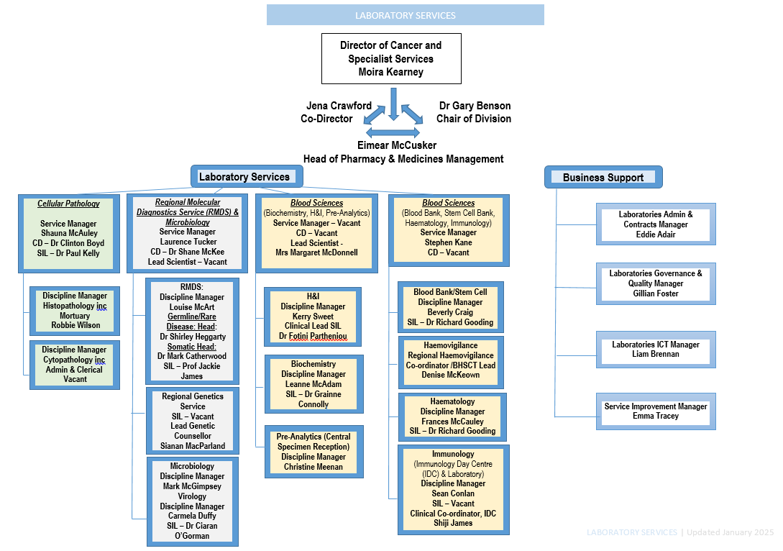
Our Organisational Structure

Slide 3
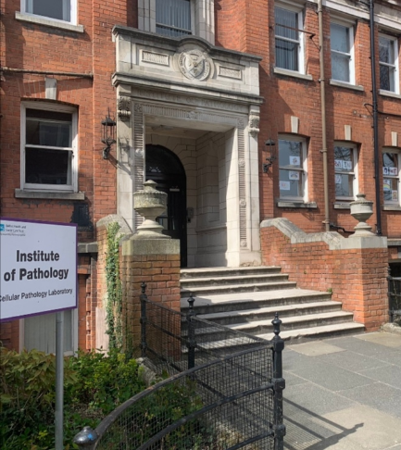

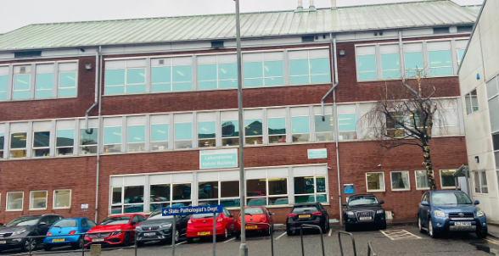
What We Do
Belfast Trust Laboratory provides United Kingdom Accreditation Service (UKAS) accredited laboratory services for primary, secondary, tertiary and Independent Sector healthcare providers both in Belfast Trust and for the wider region;
Routine and specialist testing, and high-quality, timely diagnostic testing, with the key aim to enhance patient care, treatment, and experience;
Laboratory services are based in multiple locations on three hospital sites – Royal Victoria Hospital, Belfast City Hospital, and Mater Hospital:
A Floor, C Floor, NIBTS Building, Precision Medicine Centre (QUB-owned) at BCH;
Kelvin, RBHSC, Institute of Pathology (QUB-owned), Mortuary at RVH;
Laboratory Building at MIH.
Notes:
To include:
High-Level Info on Service Delivery
Good News & Achievements
Challenges
Achievements:
ALMS
LIMS
Cervical Screening
Haemovigilance Encompass Improvements
IQAS Accreditation & OPM Improvements
Awards – NI Transfusion Conference
Challenges:
New-Born Screening
Estates
Extended Working Day
Agency / Recruitment & Retention
Capital & IT
Service Developments:
£900k cost pressures funding
Cancer Strategy Action 27
PKU Sapropterin
STEC

Slide 4
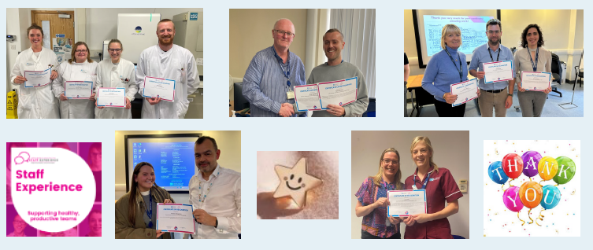
Our Staff
November 2024 Funded Staffing Level 755 WTE and Staff In Post 724.42 WTE.
On Monday 30 September 2024, our first Laboratories Staff Recognition Celebration Event took place, with a great amount of staff being able to attend to receive their certificates.
A total of 71 staff were nominated this year, which is a wonderful achievement and acknowledgement of the continued high level of work across Belfast Trust. Laboratories.

Slide 5
Key Achievements and Good News

Slide 6
Key Achievements and Good News
UKAS Assessment ISO Standard 15189 Accreditation
UKAS No | Status | Location | Department | New Profile month | Last visit date | Comment
8704 | Accredited | RVH | Microbiology | November | December 2024 | Accreditation maintained; awaiting final decision on Extension to Scope (ETS); recommend transition to 2022.
8952 | Accredited | BCH | Regional Molecular Diagnostics Service (RMDS) | June | July/Aug 2024 | Accreditation maintained; recommend transition to 2022.
8757 | Accredited | All sites | Biochemistry | June | November 2024 | Accreditation maintained; further ETS to be submitted; recommend transition to 2022.
8703 | Accredited | All sites | Haematology and Blood Transfusion | June | July/Aug 2024 | Accreditation 2012 maintained; recommend transition to 2022 on submission of evidence to close findings.
9811 | Accredited | BCH | Histocompatibility & Immunogenetics (H&I) | July | November 2024 | Accreditation maintained; recommend transition to 2022 accreditation (awaiting final decision-maker).
8638 | Accredited | RVH | Cellular Pathology | October | October 2024 | Accreditation 2012 maintained; recommend transition to 2022 on submission of evidence to close findings. ETS for primary HPV testing in cervical cytology – visit took place on 28 January 2025, with recommendation for accreditation to be extended to pHPV.
8612 | Accredited | RVH | Immunology | March | July 2024 | Successful transition to 2022 standards.

Slide 7
Human Tissue Authority (HTA) Accreditation
Discipline | HTA status | Status
Stem Cell Bank | Assessed 19.03.24 | 4 minor shortfalls, CAPA returned to HTA in May 2024.. with evidence to be submitted by end of Sept. 2024.
Post Mortem* | Assessed 08.09.22 | No pending actions for Labs.
H&I | Assessed 03.03.22 | No pending actions for Labs.
Medicines Healthcare Regulatory Agency (MHRA) – Unannounced Blood Bank Inspection
The MHRA attended BHSCT Blood Bank on 17 February 2024, and this was the first official on-site inspection in over 10 years. The service were given seven days’ notice to prepare.
The outcome was a success – the Inspector commented on professionalism of the team, with no critical non-conformances being reported.

Slide 8
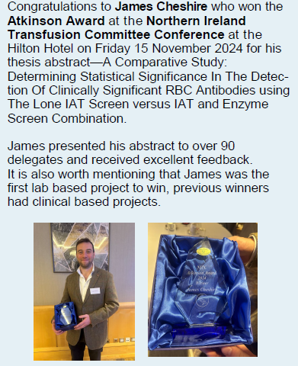
Immunology – IQAS Accreditation and Outpatient Improvements
In September 2024, the Regional Immunology Service achieved Improving Quality in Allergy Services (IQAS) Accreditation for the Allergy Service.
Improvements to the service include implementing strategies, such as Enhanced Triage, Enhanced Validation, Elective Care Reform Initiative (ECRI) Clinics, and Patient-Initiated Follow-Up (PIFU), to reduce the Allergy Waiting List from 2,349 patients (as at October 2023) to 1,154 patients (as at October 2024).
Other improvements achieved include clearance of the typing backlog, improving the signage, and improving communication with patients.
NI Transfusion Conference
The Northern Ireland Transfusion Conference took place in November 2024, bringing together expert speakers from across the region, England and Oman for an engaging day of knowledge-based sharing.
The conference sessions tackled pressing topics such as the Infected Blood Inquiry (IBI) Report, digital systems, smarter component use, and caring for the tiniest patients. Big ideas, lively discussions, and top-notch collaboration – transfusion practice at its best!

Slide 9
Maintaining Haemovigilance with EPIC Implementation
The Haemovigilance Team have been an incredible source of support for staff throughout the EPIC implementation, providing at-elbow support, stepping in as the go-to experts, and addressing critical challenges such as missing patient demographics on QR codes, unscheduled name changes, workflow issues, and incomplete transfusion documentation.
The team collaborated with stakeholders to agree a safer, streamlined process for managing neonatal name changes, reducing the risk of errors; and worked closely with clinical teams, including theatres, to refine workflows and implement improvements that put patient safety at the forefront.
The team recognised potential risks of incomplete transfusion documentation, and mitigated these risks by introducing daily transfusion reports, allowing them to follow-up directly with staff, provide targeted training, and improve compliance rates.
The team also created interactive tools, developed tailored resources, and delivered training sessions designed to build confidence and equip staff for success in the new system.
Through it all, the Haemovigilance team has gone above and beyond, providing unwavering support and demonstrating their dedication to keeping patient safety as the highest priority.

Slide 10
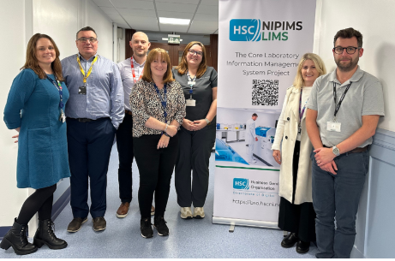
LIMS (Laboratory Information Management System)
All Disciplines have successfully implemented and are now using WinPath Enterprise (LIMS).
Implementation occurred over a 1 year period, across 8 Disciplines.
Approximately 673+ staff have been trained and using LIMS (with exception of RMDS Team).
All Lab staff went above and beyond to maintain services and reduce clinical risks.
Belfast Trust Laboratories led the region in the implementation of LIMS, and continue to share their knowledge and expertise to support BSO and their BAU Teams, and have shared knowledge, learning, and expertise with other Trusts, providing on-site support for their ‘Go-Live’ plans.
6 November 2023: LIMS Phase I Go-Live with Biochemistry, Haematology, Immunology, New-Born Screening, Microbiology, Serology and Virology
6 June 2024: LIMS Phase II Go-Live with Blood Transfusion and Cellular Pathology
21 October 2024: Cervical Cytology Go-Live
December 2024: RMDS moved its Flow Cytometry, Molecular Haematology, and Molecular Pathology off Lab Centre to StarLIMS
December 2024: Outstanding cases for Histopathology and Cytology for Northern, Southern, and Western Trust were completed and closed-off
Sunsetting of LabCentre records to BSO Data Warehouse
Sunsetting of LabCentre Records into BSO Hard Ware/Data Centre
Long-term solution for RMDS

Slide 11
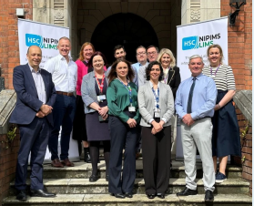
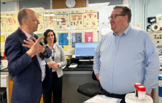
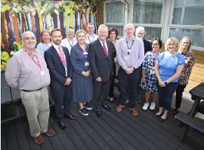
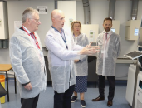
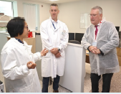
NI Pathology Information Management System (NIPIMS) – Visit by Mr Peter May, Permanent Secretary
On 28 August 2024, after a visit to NIBTS, the Permanent Secretary at the Department of Heath NI, Mr. Peter May, visited Cellular Pathology at the Royal Victoria Hospital Belfast to acknowledge the CoreLIMS Project and all that it has achieved.
Mr May’s visit included a tour of RVH Laboratories to meet and thank the lab staff for their crucial role in the implementation of the project, during a time of great transformation and change.
Visit by Minister for Health – Mr Mike Nesbitt
On Tuesday 20 August 2024 the Minister for Health, Mr Mike Nesbitt, along with the Trust Chairman, Mr Ciaran Mulgrew, visited the Belfast Trust Laboratories in Kelvin, RVH.
The feedback was very positive. The minister said that this was his first visit to pathology laboratories.
It was a great opportunity to showcase some of the excellent work that goes on in our laboratories, and highlight the key involvement in patient care.

Slide 12
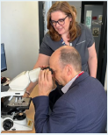
Regional Cervical Screening Programme
Belfast Trust has been successful in becoming the new Regional Cervical Screening Laboratory, in line with the DoH Strategic Priorities and Cancer Strategy 2022/2032.
The service went live on 01 November 2024, and will:
Provide capacity for up to 122,500 HPV tests and 17,800 cytology tests per annum;
Provide failsafe for the region;
Ensure continued regional support of MDMs;
Provide ongoing support to all trusts for the delivery of the audit of invasive cancer (to include completion of slide reviews, consultant input to MDM discussions, and consultant input to patient disclosure meetings).
This service will enable improved patient experience and safety, as standardisation and improved turnaround times will ensure timely diagnosis and treatment, and will provide an equitable service in line with the rest of the UK.
Ongoing work in securing recurrent funding, staff recruitment, auto-authorisation of results, installation of new analysers and pre-analytics, improving turnaround times and quality assurance.
There have also been recent challenges in relation to media and public scrutiny of the service and in particular individual screener performance – Belfast Trust are working closely with PHA to manage these challenges and respond as appropriate.

Slide 13
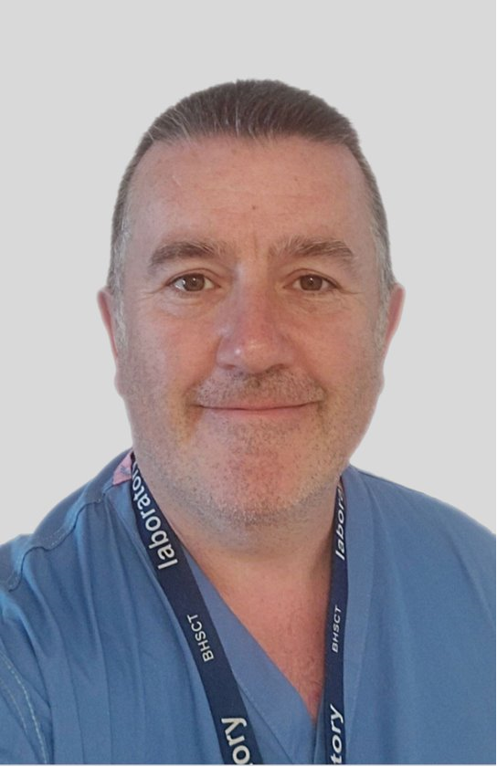
The Mortuary in BHSCT and Paediatric Pathology Pathway
A small team of 5 dedicated staff made up of Anatomical Pathology Technologists (APTs) and an Associate Practitioner.
HTA Accredited Service – 08 September 2022.
Managing 2,600 patients through the Mortuary each year.
Capacity is for 25 patients, plus 3. Recent walk-in refrigerated unit added capacity for a further 12 patients or super-bariatric.
01 January 2019, lack of a paediatric pathologist in NI meant establishment of a pathway to Alder Hey Children's NHS Trust for perinatal and paediatric post-mortem service; work with PHA, SANDS, RJMS, RBHSC, Regional Trusts, NI Coroners Office to successfully develop this pathway.
Act on behalf of NHS Blood and Transplant for 40+ ocular retrievals per annum.
YEAR | NUMBER OF REFERRALS TO ALDER HEY for PAEDIATRIC POST- MORTEM
2018 | 188
2019 | 162
2020 | 151
2021 | 216
2022 | 197
2023 | 198
2024 | 181

Slide 14
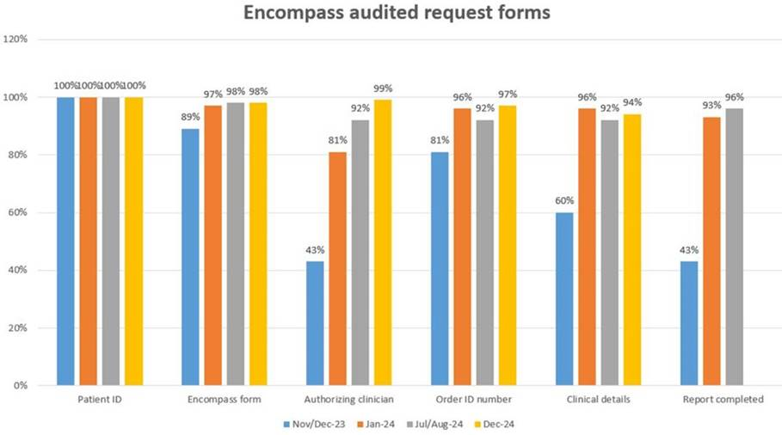
Introduction of OrderComms into Histopathology
Enables team to book in cases on the bench at Specimen Reception for 85%+ of cases.
This has removed a significant admin bottleneck, and removing a number of check and re-check stages - this reduces the risk of mismatching samples as lab work can start immediately.
Encompass requests are showing 100% correct patient details and 95% of other key MAC details.
Dissection Team have recently introduced a 48-hour turnaround time system for all low complexity cases, accounting for 75%+ of workload – team are maintaining this rapid turnaround time, which has helped streamline processes, and the service will now start seeing improvements on the 10-day turnaround time figures.

Slide 15
Service Developments 2023/2024

Slide 16
Service Developments
Service Growth Pressures Funding
The Laboratories Service received £900k recurrent funding from SPPG to support ongoing service growth pressures, and off-set recurrent and unavoidable pressures across a number of Disciplines.
The funding is being utilised to support the below existing cost pressures:
However, the Laboratories Service has an approximate total unavoidable cost pressure of £3m in non-pay spend, due to increase in testing activity, new and emerging pressures (i.e. EU CE-IVD Regulations), and Automated Laboratory Management System (ALMS) Contract Pressures.
SPPG have requested the Division to submit a Business Case for the full £3m +/- cost pressures.
Service Area | Scheme | Cost Pressure
Virology / RVL | HIV - Increase in Viral Load Testing | £204,413
Virology / RVL | General Lab Surge Pressures (including Pertussis Outbreak, Mpox, Avian Flu) | £200,000
RMDS / Genetics | Trio Exome and other Genetic Testing | £338,000
Haematology | Increased CD34 Testing | £40,000
Cellular Pathology | Alder Hey Service Level Agreement (SLA) | £46,000
Cellular Pathology | Sendaway Tests - Lymphoma Translocations & Fish Analysis | £30,000
Cellular Pathology | Sendaway Tests - Neuropathology Molecular Tests | £40,000
TOTAL |  | £898,413

Slide 17
Cancer Strategy Action 27
Cancer Strategy Action 27 focuses on delivering genetic and genomic testing in cancer pathways, to transform lives by:
Enabling quicker diagnosis for patients with rare disease
Enabling targeted treatment and interventions, reducing likelihood of adverse drug reactions
Increasing cancer survival rate each year, due to more accurate and timelier diagnosis, and more effective use of therapies
Following recurrent allocation of £1.4m, the Cancer Strategy Action 27 officially went live in October 2024.
To date, 446 patients identified with a potential germline genetic variant have been discussed at the Molecular Tumour Boards, of which 207 have proceed to genetic variant confirmation testing to confirm if a genetic gene is present.
Over the next seven years, the service will take further steps to extend testing to more tumour types, to enable all advanced cancers are tested in line with this pathway; further discussions with DoH and SPPG will take place to secure any necessary investment to support.

Slide 18
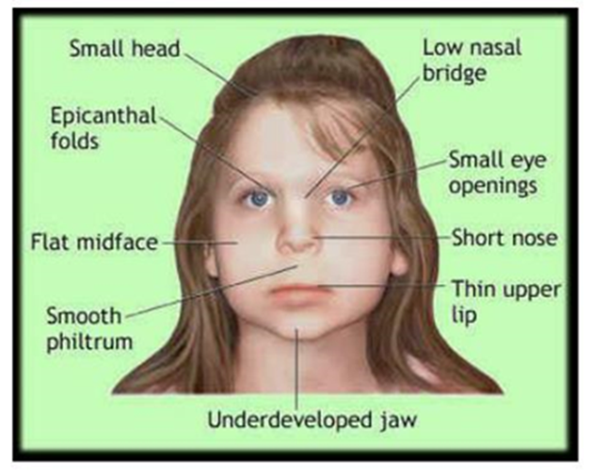
Adult Inherited Metabolic Service (IMD) – PKU Sapropterin Funding
In line with DoH Directive and Strategic direction, the Adult IMD Service have been asked to deliver Sapropterin to all Adult patients with Phenylketonuria (PKU) – a rare inherited disorder that is usually identified at a young age, through new-born screening.
In January 2024, a letter from NI Department of Health (DoH) was issued to advise that ‘the Permanent Secretary has made a bespoke public interest decision under Executive Formation Act to approve a regional position for the commissioning of generic Sapropterin for patients of all ages.’
In October 2024, the Strategic Planning & Performance Group (SPPG) issued a letter to the Belfast Trust to advise of availability of recurrent funding to support additional staffing and other infrastructure requirements to support the roll-out of Sapropterin to all Adult PKU patients. The indicative allocation proposed is as follows:
CYE 2024/2025 – £33,333
FYE 2025/2026 - £119,067 (recurrent)

Slide 19
Challenges and Opportunities

Slide 20
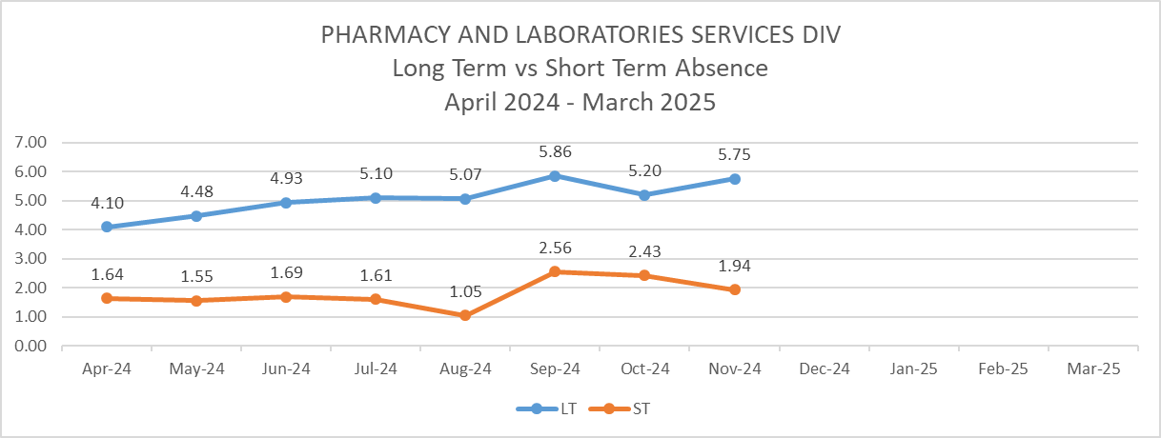
Recruitment and Retention and Use of Agency Staff
November 2024 Funded Staffing Level 755 WTE and Staff In Post 724.42 WTE.
Currently 11 staff absent >12+ months, (0.02%) which is shared with managers and feedback requested on these absences.
Ongoing recruitment challenges across a number of Disciplines – unable to recruit Biomedical Scientists, Medical Laboratory Assistants, and issues with skill mix of staff (too many trainees, and not enough experienced staff).
Reliance on agency staff to manage vacancy and recruitment / retention issues – currently 69 agency staff in post (as at December 2024).

Slide 21
Challenges
New-Born Screening (NBS) Service (SSS/L/120)
Risk:
NBS is at risk due to key equipment failures and laboratory estates limitations.
Tests performed are time critical – significant negative impact on babies if a treatable disease is not detected in a timely manner; this includes risk of infant mortality or permanent, irreversible disability.
No alternative testing sites in the region, and sendaway to other UK Centres is not an option as this will cause unacceptable delays.
Business Continuity Plans are in place, but do not constitute a safe, long-term solution.
Need:
Provision of adequate laboratory accommodation for required NBS equipment.

Slide 22
CE-IVD Regulations and Impact on RMDS (Regional Molecular Diagnostic Service) (SSS/L/138)
Risk:
Risk of non-compliance with EU MDR/IVDR legislation by using in-house assays or tendered assays which are based on in-house assay design.
To be compliant, RMDS need to move to fully CE-marked kits where available. This will have an impact on sendaway tests to NHS England, Scotland, and Wales, as they are not under these requirements.
The current situation presents significant risk to service delivery within RMDS and patients, as well as the existing SLA and hybrid-working arrangement currently in place with PMC / QUB, where the Healthcare Institution Exemption (HIE) cannot be applied.
Need:
Scope IVDR-compliant manufacturer and deliver testing in-house within RMDS – To be compliant, and to enable testing to be delivered in-house, locally, RMDS will need to move to fully CE-Marked kits and equipment, where available, provided in an in-house facility.
Need to move away from use of PMC in QUB.
CL3 Facility (SSS/L/060)
Risk:
CL3 was originally designed and installed in 2003 in Kelvin Laboratory, RVH, with the purpose of being used as an Emergency Laboratory for handling potential Viral Haemorrhagic Fever samples (VHF) and other dangerous pathogens. It was therefore designed to be used infrequently. The CL3 Facility at Belfast Trust is currently the only location in Northern Ireland to accommodate returning travellers with these high consequence infectious diseases (HCID).
Current CL3 room usage – 100% TB workload (and has reached capacity) – HCID use as and when required, but risks associated as these two services cannot mix, so downtime of services required to support the other as and when demand arises. However, there have been two key factors identified that deem the current CL3 facility as not fit for purpose – 1) Design of the Current Facility; 2) Increasing Workload.
SAI (23/080) and the unsustainability to meet the growing demand demonstrates that the current facility is not fit for purpose, and puts service delivery and the safe delivery of service at risk.
Need:
A new build.

Slide 23
Regional Virology Laboratory Extended Working Day (SSS/L/033)
Risk:
Receiving non-recurrent funding since February 2018 for staff and goods and services, due to inescapable cost pressures, but it has never been made recurrent.
Due to increasing demands on the service (emerging viral infections, and the Pandemic), this Business Case has been submitted a further 13 times, with emphasis being made on the need for recurrent funding.
As at January 2025, SPPG Finance have advised they are only in a position to approve non-recurrent funding.
Need:
Recurrent funding is essential to appropriately staff and resource the service on a permanent basis.
Recurrent funding is in the public interest and is required to provide essential testing to support projected demand and need.
In order to continue to meet the annual testing strategies and increasing demand, recurrent funding is essential to provide a sustainable service.

Slide 24
Labs Estates
Risk:
Laboratory Estates are at capacity and/or close to capacity in many areas in relation to available floor space, structural loading capacity, electrical infrastructure, ventilation plant, and heat control.
As advised by Estates Services, the Laboratory Estates is close to reaching the point when it will not be up to task to continuously add-on to existing infrastructure, which will acutely affect ongoing laboratory services across the Trust and represents a clinical risk.
In relation to the Kelvin Laboratory, in the last four years, Estates Projects have completed 10 projects, costing a total of £956,000; and following a survey of the building carried out in 2021, the total cost to carry out essential remedial works to ensure building remains fit for purpose was costed at £3,037,259.
Need:
The strategic goals of the Lab Service are also in line with the BHSCT Corporate Plan Objectives 2024, which states: ‘Delivering value and sustainability across our resources & environment.’
The Labs Services have reviewed their current Estates, and are exploring ways to expand to enable the services to remain robust, resilient, and sustainable.
Need and potential solution – utilise and refurbish the currently unoccupied Medical Microbiology Building on the RVH site, and to future-proof the service, consideration to be given to a newly-built, dedicated Laboratory that can house all Disciplines, and will ensure safety of staff, regional work can continue, and tenders implemented in a timely manner without the need to downturn services.

Slide 25
The Future…

Slide 26
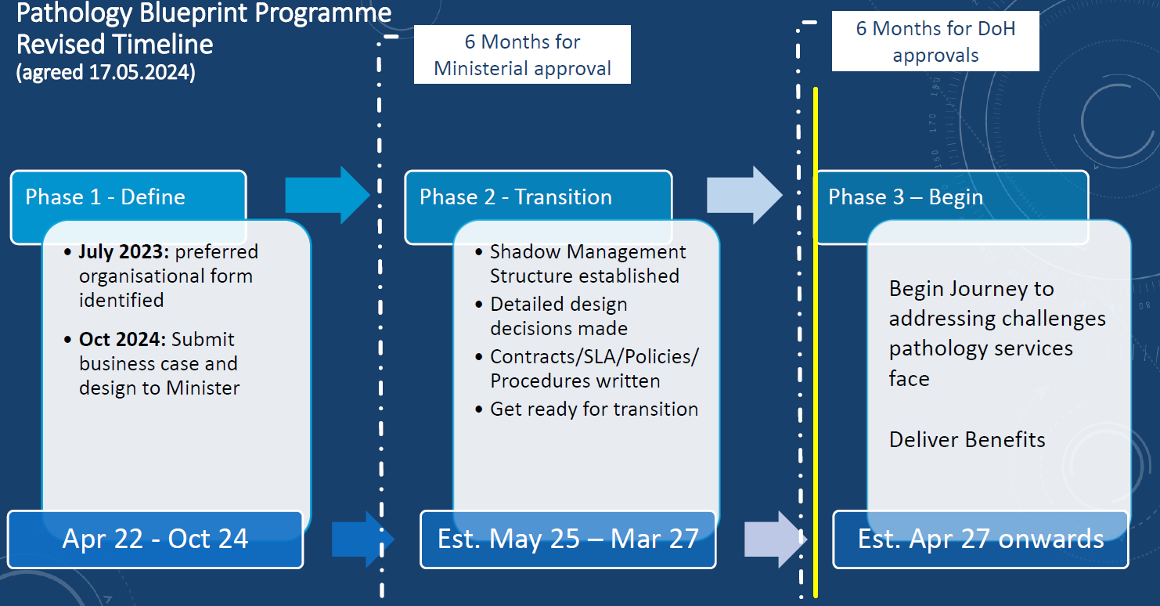
Pathology Network Agency – Blueprint Programme
The Pathology Blueprint Programme is exploring options for moving the management of laboratory services from each Trust into a single, regional pathology management structure, along with the entirety of the Northern Ireland Blood Transfusion Service (NIBTS), and the functions of the NI Pathology Network. Outlined below is the proposed timeline:
In October 2024, the Business Case for a single Pathology Agency was submitted to DoH.
However, the ambiguity around the proposal is having an impact on staff morale, and concerns have also been raised with regards to the uncertainty of the leadership structure in the event the proposal is agreed.

Slide 27
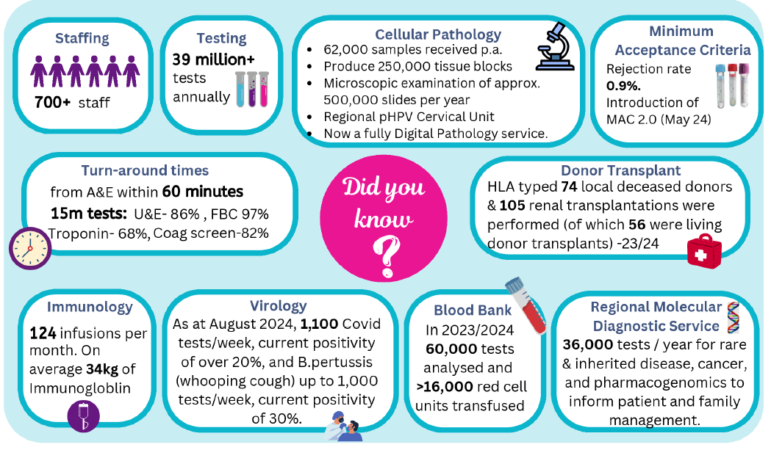

Slide 28
Any Questions?

