Slide 1

Trust Board Report
Service Delivery Plan Report
(end March 2025)
Trust Board - Wednesday 30th April 2025
Alastair Campbell
Director of Performance, Planning & Informatics

Slide 2

Section 1 – Headlines
Validation remains ongoing to ensure all relevant data is captured within reports.
OP and IPDC activity in March exceeded expected SDP target volumes. CT and Non Obstetric Ultrasound delivered above expected activity levels.
IPDC waiting lists are generally stable. OP waiting lists showing an increase. Waiting lists are subject to ongoing validation.
This is the final SDP report. From 01 April, the SDP will be replaced by SOF/SOM.
While the format of the new report is not yet clear, it is expected that SPPG will continue to monitor activity performance to ensure funded capacity is fully maximised.
It is recognised that, in many areas, it is no longer meaningful to compare activity levels against a 2019/20 baseline.

Slide 3
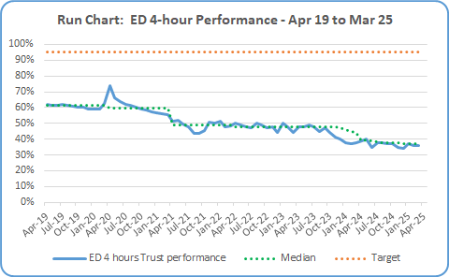

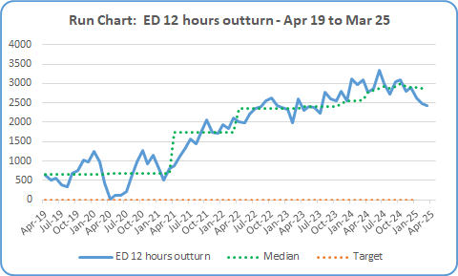
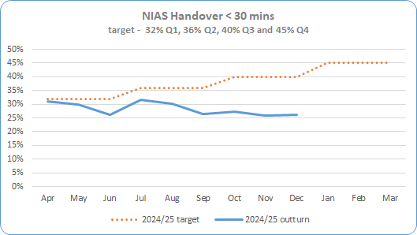
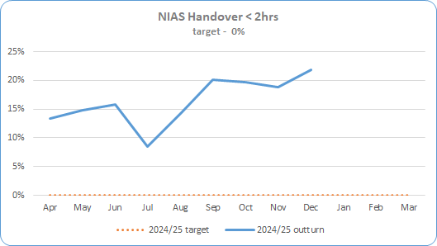
Section 2 – Key SDP Indicators
Service Area | Metric | Mar 25 Expected Activity | Mar 25 In-month Performance | Cumulative Activity YTD | Rag Status |  | Chart
 |  |  |  |  | Mar 25 | Full Year
Unscheduled Care * Targets included in SDP Summary Table | ED – 4 Hour Target % of patients waiting < 4 hours | 95% < 4 hrs | 5,828 out of 16,204 patients attending were seen < 4 hours (36%) during March 2025. | Qtr 1 38% - 17,831 <4 hrs out of 46,617 Qtr 2 38% - 16,339 < 4 hrs out of 43,382 Qtr 3 35% - 16,568 < 4 hrs out of 47,143 Qtr 4 36% - 16,140 < 4 hrs out of 44,534 Total Apr 24– Mar 25 % - 67,006 out of 181,413
 | ED – 12 Hour Target * Reduce the number of patients waiting > 12 hours in ED in 22/23 by 10% | 2,309 | 2,431 patients waited > 12 hours during March 2025. +122 patients /+5% over expected target | Qtr 1 8,175 >12hrs. Target was 5531 – 2,644 over target/+33% Qtr 2 8,861 >12 hrs. Target was 6,469 – 2,392 over target/+23% Qtr 3 8,878 >12 hrs. Target was 6,610 – 2,268 over target/+34% Qtr 4 7,513 >12 hrs. Target was 6,129 – 1,384 over target/+23% Total Apr 24– Mar 25 % - 33,775out of 181,413
 | NIAS % of Ambulance Handover Delay < 30 minutes | 40% (Jan 25 data – Feb/Mar not available) | 23.7% - January 25 data 16.3% below expected target (only %’s reported by SPPG ) | Qtr 1 29.1% Qtr 2 29.6% Qtr 3 26.5% Qtr 4 Not available |  | N/A
 | NIAS % of Ambulance Handover Delay < 2 hours | 0% (Jan 25 data – Feb/Mar not available) | 26.6% - January 25 data 26.6% over expected target (only %’s reported by SPPG ) | Qtr 1 14.6% Qtr 2 14.0% Qtr 3 20.7% Qtr 4 Not available |  | N/A

Slide 4
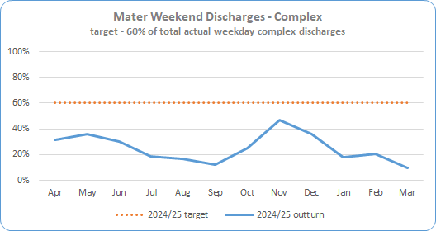
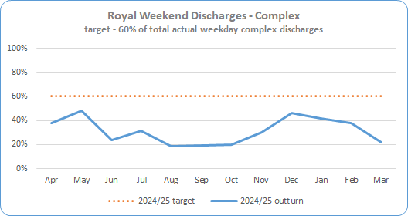
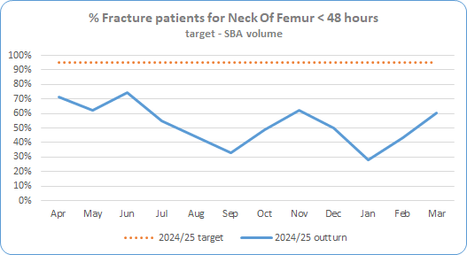
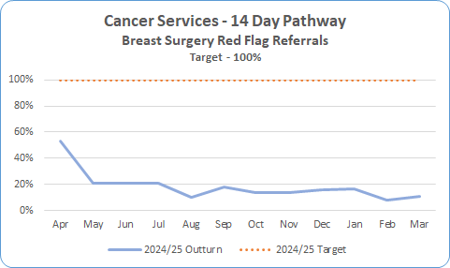
Section 2 – Key SDP Indicators
Service Area | Metric | Mar 25 Expected Activity | Mar 25 In-month Performance | Cumulative Activity YTD | Rag Status |  | Chart
 |  |  |  |  | Mar 25 | Full Year
Unscheduled Care * Targets included in SDP Summary Table | Complex Delayed Discharges – Mater * The number of complex discharges on any Saturday and Sunday should be at least 60% of the average daily number of complex discharges from Mon-Fri in that week. | 60% | 9.6% | Qtr 1 32.3% Qtr 2 15.9% Qtr 3 35.5% Qtr 4 16.2% Total Apr 24 – Mar 25 24.6%
 | Complex Delayed Discharges – RVH * The number of complex discharges on any Saturday and Sunday should be at least 60% of the average daily number of complex discharges from Mon-Fri in that week. | 60% | 21.6% | Qtr 1 36.7% Qtr 2 22.9% Qtr 3 32.3% Qtr 4 33.2% Total Apr 24 – Mar 25 36.0%
 | Hip Fractures – Number of Neck Of Femur (NOF) patients operated within 48 hrs | 95% | 60% 58 out of 96 seen <48hrs | Qtr 1 69% Qtr 2 43% Qtr 3 54% Qtr 4 45% Total Apr 24– Mar 25 53% - 433 out of 823
Cancer | 14 day Performance * Core only 100% of patients to be seen <14 days | 100% | 11% 29 seen < 14 days out of total 241 | Qtr 1 28% Qtr 2 16% Qtr 3 14% Qtr 4 14% (91 of 665) Total Apr 24 – Mar 25 - 520 out of 2,402 (22%)

Slide 5
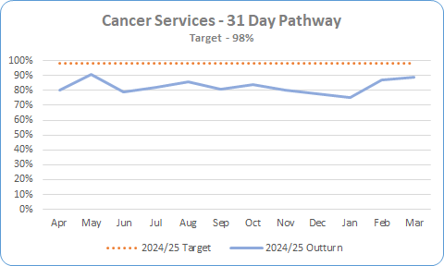
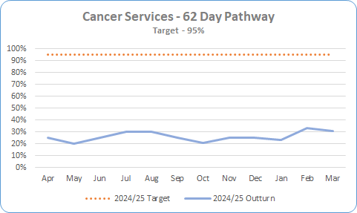
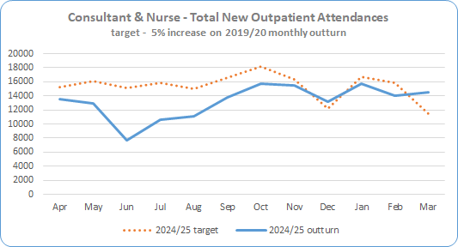

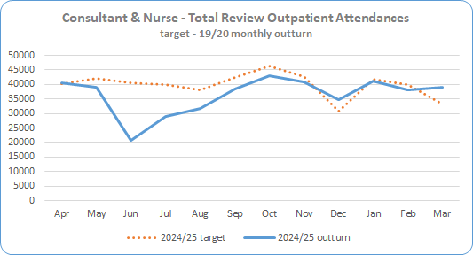
Section 2 – Key SDP Indicators
Service Area | Metric | Mar 25 Expected Activity | Mar 25 In-month Performance | Cumulative Activity YTD | Rag Status |  | Chart
 |  |  |  |  | Mar 25 | Full Year
Cancer * Targets included in SDP Summary Table | 31 day Performance * 98% of patients to be seen <31 days | 98% | 89% 174 out of 196 patients were seen <31 days Figures are provisional as pathways are still being closed down and validation ongoing. | Qtr 1 82% Qtr 2 83% Qtr 3 81% Qtr 4 83% Apr 24– Mar 25 82% - 3,192 out of 3,890
 | 62 day Performance * 95% of patients to be seen <62 days | 95% | 31% 20.5 out of 67 patients were seen <62 days Figures are provisional as pathways are still being closed down and validation ongoing. | Qtr 1 24% Qtr 2 27% Qtr 3 26% Qtr 4 28% Apr 24 – Mar 25 27% - 372.5 out of 1404.5
Elective Care | Total New Outpatient Attendances * (Consultant & Nurse led) 105% of 2019/20 outturn | 11,410 | 14,557 New Outpatient attendances in March, 3,147 above expected activity (134% of expected) Encompass Data is subject to on-going validation | Qtr 1 34,078 Qtr 2 35,509 Qtr 3 44,267 Qtr 4 44,254 Apr 24 – Mar 25 90.1% 158,283
 | Total Review Outpatient Attendances * - Nurse & Consultant 100% of 2019/20 outturn | 33,363 | 39,151 Review Outpatient attendances in January, 5,788 above expected activity (117%) Encompass Data is subject to on-going validation – figures for Jun – Oct have been amended | Qtr 1 100,614 Qtr 2 98,234 Qtr 3 118,416 Qtr 4 118,670 Apr 24 - Mar 25 91.4% 437,036

Slide 6
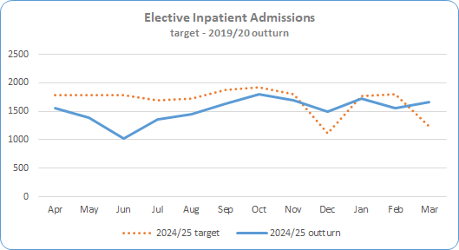
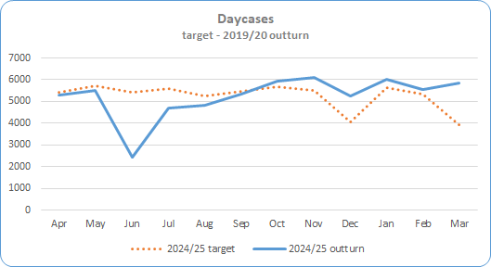
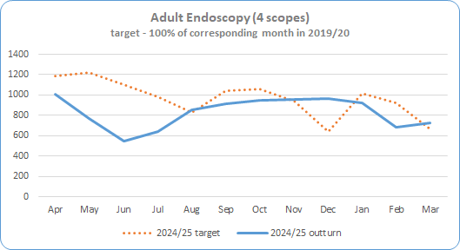
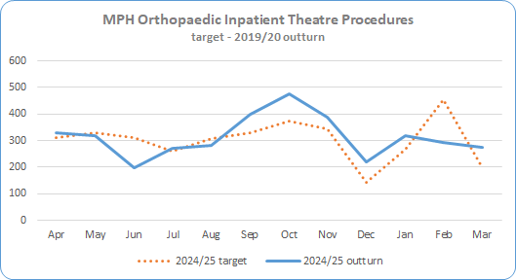
Section 2 – Key SDP Indicators
Service Area | Metric | Mar 25 Expected Activity | Mar 25 In-month Performance | Cumulative Activity YTD | Rag Status |  | Chart
 |  |  |  |  | Mar 25 | Full Year
Elective Care * Targets included in SDP Summary Table | Inpatient Admissions * 100% of 2019/20 outturn | 1,234 | 1,663 admissions 429 above expected activity (134.8%) | Qtr 1 3,961 Qtr 2 4,441 Qtr 3 4,999 Qtr 4 4,928 Total Apr 24 - Mar 25 - 18,314 (90.3%)
 | Day Case Procedures * 100% of 2019/20 outturn | 3,940 | 5,863 procedures 1,923 above expected activity (148.8%) | Qtr 1 13,229 Qtr 2 14,825 Qtr 3 17,065 Qtr 4 17,406 Total Apr 24 - Mar 25 - 62,807 (99.6%)
 | Endoscopy (4 scopes) * 100% of 2019/20 outturn | 663 | 728 65 above expected activity (109.8%) | Qtr 1 2,323 Qtr 2 2,417 Qtr 3 2,872 Qtr 4 2,598 Total Apr 24 – Mar 25 10,152 (87.6%)
 | MPH Inpatient Theatre Procedures * 100% of 2019/20 outturn | 199 | 274 procedures 75 over expected activity (137.7%) | Qtr 1 846 Qtr 2 950 Qtr 3 1,085 Qtr 4 886 Total Apr 24 - Mar 25 3,767 (103.8%)

Slide 7
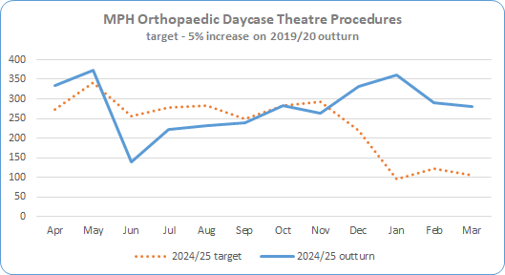
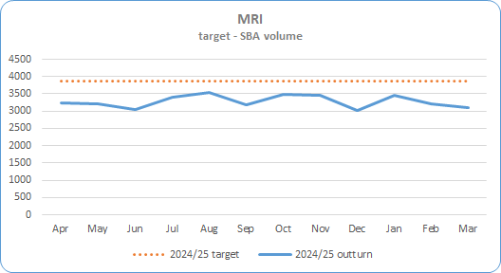
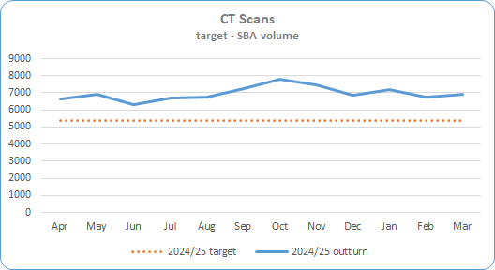
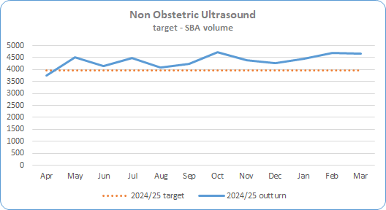
Section 2 – Key SDP Indicators
Service Area | Metric | Mar 25 Expected Activity | Mar 25 In-month Performance | Cumulative Activity YTD | Rag Status |  | Chart
 |  |  |  |  | Mar 25 | Full Year
Elective Care * Targets included in SDP Summary Table | MPH Day Case Theatre Procedures * 105% of 2019/20 outturn | 106 | 360 procedures 280 above expected activity (227.2%) | Qtr 1 843 Qtr 2 694 Qtr 3 880 Qtr 4 930 Total Apr 24 -Mar 25 3,347 (125.5%)
Imaging | MRI Scan * Deliver activity in line with agreed SBA volume. SBA currency is being reviewed for 25/26 to take account of multiple body areas | 3,864 per month | 3,094 770 below expected activity (80.1%) Note – SBA baseline subject to review | Qtr 1 9,465 Qtr 2 10,116 Qtr 3 9,954 Qtr 4 9,783 Total Apr 24 -Mar 25 39,318 (84.8%)
 | CT Scan * Deliver activity in line with agreed SBA volume | 5,367 per month | 6,898 1,531 above expected activity (128.5%) | Qtr 1 19,880 Qtr 2 20,659 Qtr 3 22,079 Qtr 4 20,840 Total Apr 24 -Mar 25 83,458 (129.6%)
 | Non Obstetric Ultrasound * Deliver activity in line with agreed SBA volume | 3,977 per month | 4,670 693 above expected activity (117.4%) | Qtr 1 12,415 Qtr 2 12,813 Qtr 3 13,397 Qtr 4 13,794 Total Apr 24 -Mar 25 52,419 |(109.8%)

Slide 8
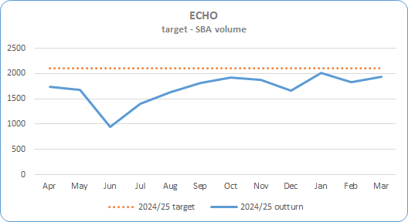
Section 2 – Key SDP Indicators
Service Area | Metric | Mar 25 Expected Activity | Mar 25 In-month Performance | Cumulative Activity YTD | Rag Status |  | Chart
 |  |  |  |  | Mar 25 | Full Year
Cardiac Services * Targets included in SDP Summary Table | ECHO Deliver activity in line with agreed SBA volume | 2,111 | 1,941 98 below expected activity (91.9%) | Qtr 1 4,370 Qtr 2 4,860 Qtr 3 5,461 Qtr 4 5,783 Total Apr 24 -Mar 25 20,474 (80.8%)

Slide 9
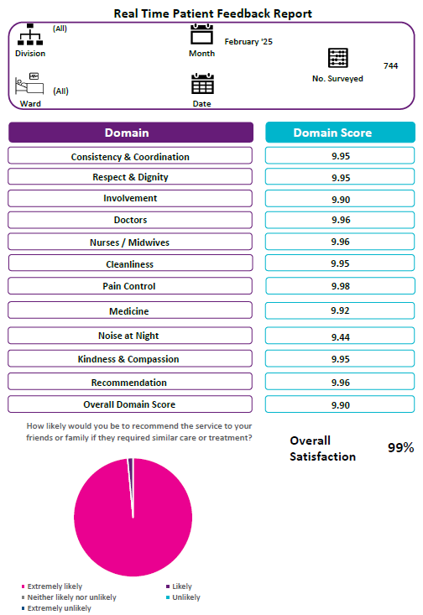
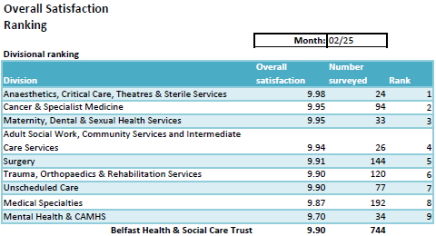
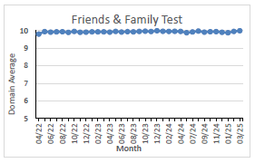
Section 3 – Patient Satisfaction - Real-Time Feedback: Patient Experience Charts - Month of February 2025 = 744 surveys
The collection of fortnightly Patient Experience feedback recommenced mid-July 2020 in 48 phase 1 acute areas, progressed to phase 2, and review is underway of current project spread and capacity to align with corporate priority areas ensuring wide advocacy for service users through gathering patient experience via an independent team on approximately 90 wards.
Monthly volume of surveys has increased to a relatively consistent performance level with approximately 700 surveys being completed across the majority of months across 2024-25 to the end of January 2025.
From April 2024 - February 2025 6,871 adult inpatient surveys have been completed. This includes new areas such as the SWAN Maternity Outpatient Clinic, Elective Overnight Stay Centre, and Neurology and reflects increased frequency of surveys being undertaken in some service areas.
RBHSC reporting is now embedded in Allen, Barbour, Clark Clinic & Paul wards and a total of 252 surveys completed so far this year, 2024-25. Project progress review of the RBHSC bespoke survey results and engagement with stakeholders is underway with further wards to be added to the RBHSC RTPE schedule.
High scores have been maintained in both Overall Satisfaction and the Friends & Family Test. In February 2025, of 744 patients, 100% were extremely likely to recommend the ward they were in to their friends or family.
Overall
Satisfaction
99%
How likely are you to recommend this ward to friends and family if they needed similar care or treatment?
7

Slide 10
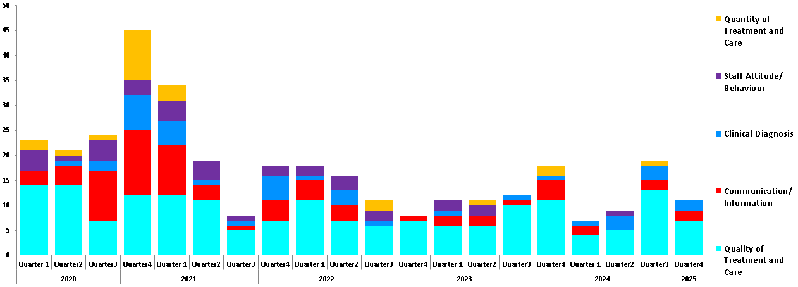
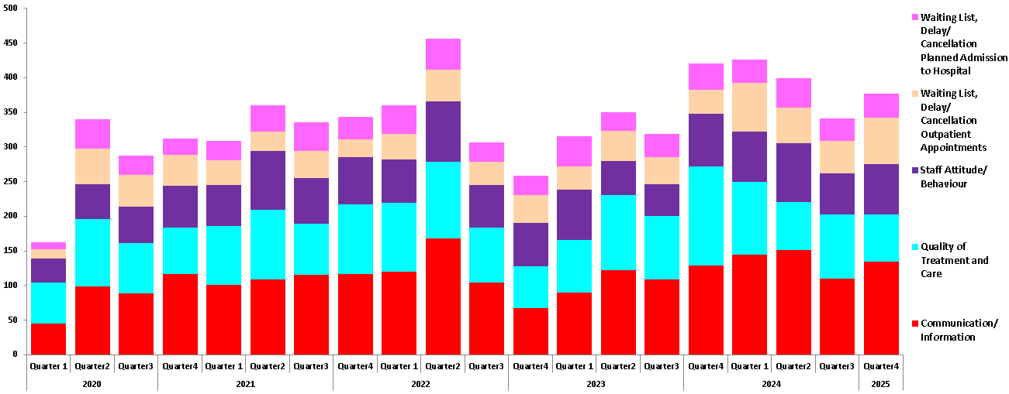
Section 3 – Patient Satisfaction
Service Area
Datix – Complaints and Compliments | High Risk Top Subjects Trustwide April 2020 – March 2025
 | All grades Top Subjects Trustwide 04/2020 – 03/2025

Slide 11
Appendix

Slide 12
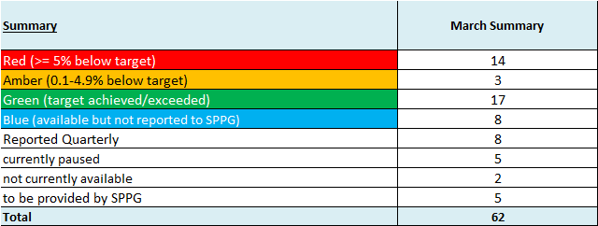
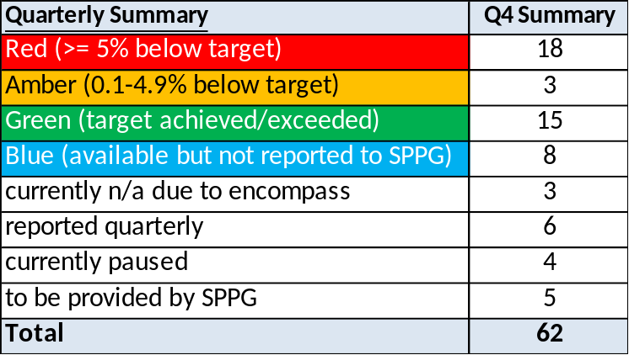
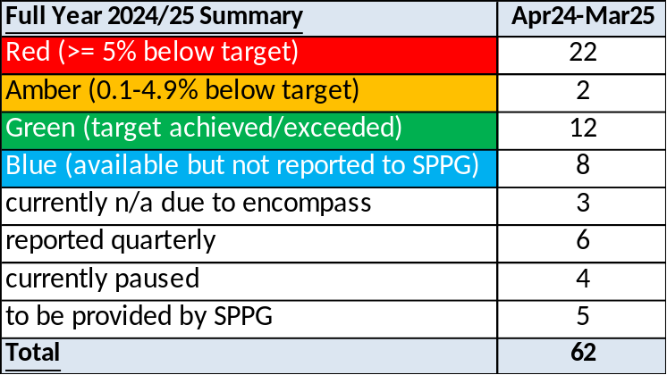
SDP Indicators Summary Tables

Slide 13
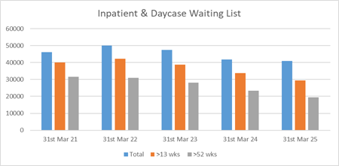
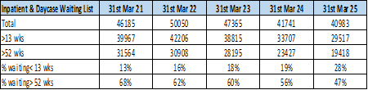
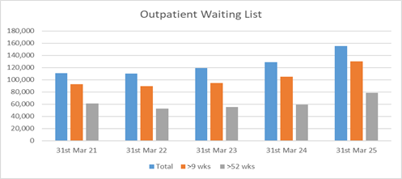
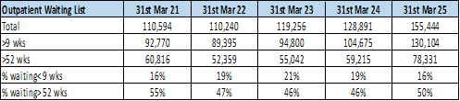
Waiting Lists
Service Area | Metric
Waiting Lists | Acute Hospital Inpatient & Daycases | Inpatient & Daycase Waiting Lists
 | Acute Hospital Outpatients | Outpatient Waiting List

Slide 14
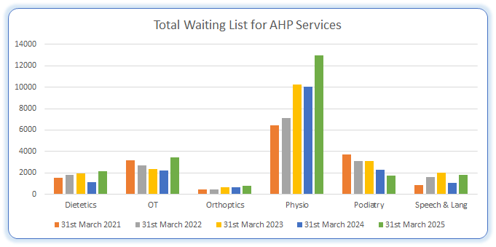
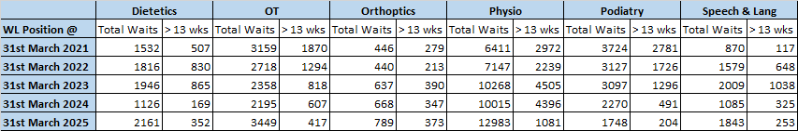
Waiting Lists
Service Area | Metric
Community Services Waiting Lists | AHP Services AHP waiting list numbers are subject to ongoing validation to remove duplicate referrals

