Slide 1

Trust Board Report
Service Delivery Plan Report
Trust Board Report
Service Delivery Plan Report
Alastair Campbell, Director of Performance, Planning & Informatics
Section 1 – Headlines
Section 2 - Effectiveness/timeliness
Key SDP Indicators
Unscheduled Care – 4 & 12 Hr targets, NIAS Handovers <30 mins & < 2 hrs, Delayed discharges and Hip Fractures
Cancer – 14, 31 and 62 day targets
Elective Care – New & Review OP attendances (Consultant & Nurse), admissions, daycases & endoscopy, Ortho admissions & daycases
Imaging – MRI, CT and NOUS
Cardiac Services - ECHO
Section 3 – Experience
Patient Satisfaction – Patient Experience Surveys, Friends and Family, Complaints and Compliments
APPENDIX
Service Delivery Plan Summary table (May 2025); Waiting lists Summary; Escalations
P136-2025 B

Slide 2

Section 1 – Headlines
Reporting period – May 2025 in-month performance and cumulative data April – May 2025
Ongoing confidence issues in reporting in a number of areas as we try to understand how the new data differs from reporting pre-encompass. Validation is ongoing also to ensure all relevant data is captured within reports.
14, 31 and 62 day cancer data is reported, but subject to ongoing validation.
Outpatient activity slightly below SDP targets.
Day Case activity is reporting at SDP target level. IP and Endoscopy activity is below expected activity levels.
Diagnostics services are delivering increases in activity. CT / Non Obstetric Ultrasound activity is above expected activity levels.
IPDC waiting lists are generally stable. >52 weeks showing a gradual reduction from March 2021.
OP and AHP waiting lists showing a significant increase. Waiting lists are subject to ongoing validation.
Patient experience report for May – 99% overall satisfaction

Slide 3
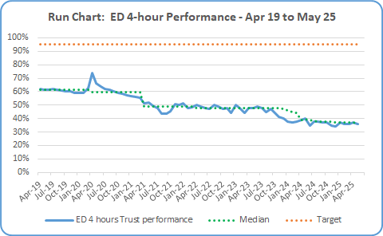

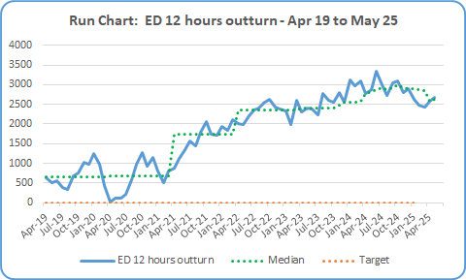
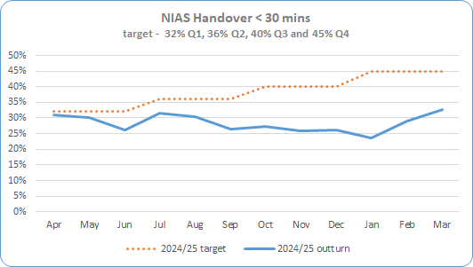
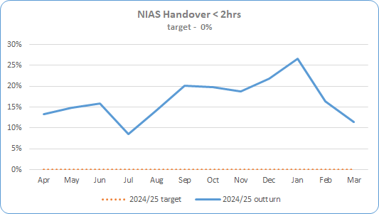
Section 2 – Key SDP Indicators (Slide 1)
Service Area` | Metric | May 25 Expected Activity | May 25 In-month Performance | Cumulative Activity YTD | Rag Status May 25 | Chart
Unscheduled Care * Targets included in SDP Summary Table | ED – 4 Hour Target % of patients waiting < 4 hours | 95% < 4 hrs | 5,911 out of 16,372 patients attending were seen < 4 hours (36%) during May 2025. | Total Apr 25 – May 25 36.5% - 11,747 out of 31,965
 | ED – 12 Hour Target * Reduce the number of patients waiting > 12 hours in ED in 22/23 by 10% | 2,309 | 2,682 patients waited > 12 hours during May 2025. +373 patients /+5% over expected target | Total Apr 25 – May 25 16.4% - 5,258 out of 31,965
 | NIAS % of Ambulance Handover Delay < 30 minutes | 40% March 25 data | 32.6% - March 25 data 7.4% below expected target (only %’s reported by SPPG ) | Total Apr 24 – Mar 25 28.5%
 | NIAS % of Ambulance Handover Delay < 2 hours | 0% March 25 data | 11.4% - March 25 data 11.4% over expected target (only %’s reported by SPPG ) | Total Apr 24 – Mar 25 16.7%

Slide 4
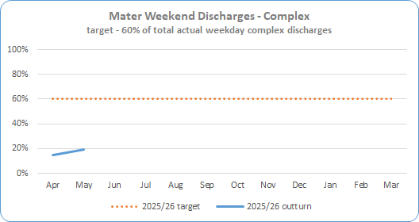
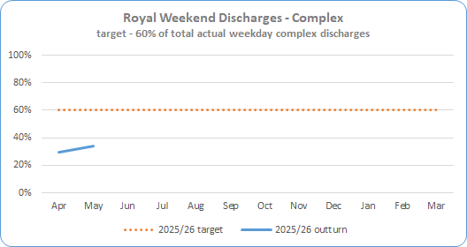
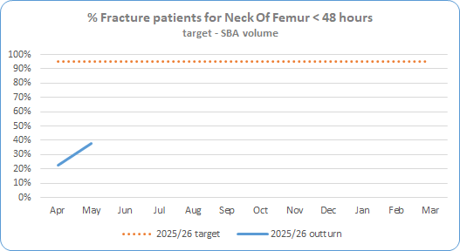
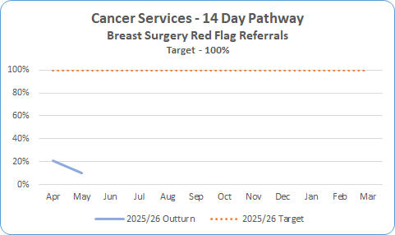
Section 2 – Key SDP Indicators
Service Area | Metric | May 25 Expected Activity | May 25 In-month Performance | Cumulative Activity YTD | Rag Status May 25 | Chart
Unscheduled Care * Targets included in SDP Summary Table | Complex Delayed Discharges – Mater * The number of complex discharges on any Saturday and Sunday should be at least 60% of the average daily number of complex discharges from Mon-Fri in that week. | 60% | 19.2% | Apr 25 – May 25 16.9%
 | Complex Delayed Discharges – RVH * The number of complex discharges on any Saturday and Sunday should be at least 60% of the average daily number of complex discharges from Mon-Fri in that week. | 60% | 34.1% | Apr 25 – May 25 31.8%
 | Hip Fractures – Number of Neck Of Femur (NOF) patients operated within 48 hrs | 95% | 38% 20 out of 53 seen <48hrs | Apr 25 – May 25 30% - 33 out of 110
Cancer | 14 day Performance * Core only 100% of patients to be seen <14 days | 100% | 10% 29 seen < 14 days out of total 273 | Apr 25 – May 25 65 out of 475 (14%)

Slide 5
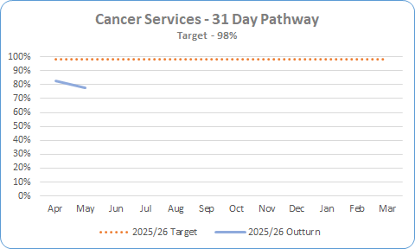
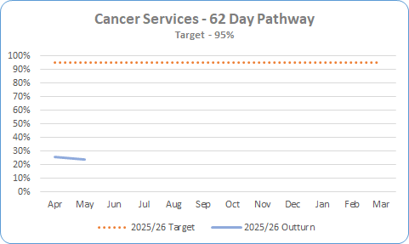
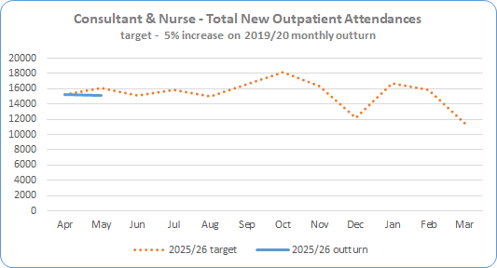
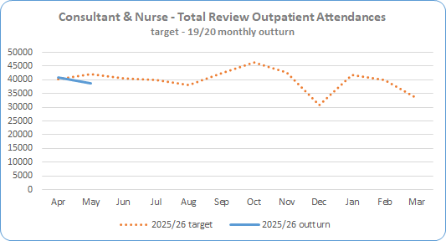
Section 2 – Key SDP Indicators (Slide 2)
Service Area | Metric | May 25 Expected Activity | May 25 In-month Performance | Cumulative Activity YTD | Rag Status May 25 | Chart
Cancer * Targets included in SDP Summary Table | 31 day Performance * 98% of patients to be seen <31 days | 98% | 78% 170 out of 218 patients were seen <31 days Figures are provisional as pathways are still being closed down and validation ongoing. | Apr 25 – May 25 81% - 406 out of 501
 | 62 day Performance * 95% of patients to be seen <62 days | 95% | 24% 27 out of 114 patients were seen <62 days Figures are provisional as pathways are still being closed down and validation ongoing. | Apr 25 – May 25 25% - 65 out of 258
Elective Care | Total New Outpatient Attendances * (Consultant & Nurse led) 105% of 2019/20 outturn | 16,037 | 15,134 New Outpatient attendances in May, 903 below expected activity (99.1% of expected) | Apr 25 – May 25 97.3% - 30,431 actual, 31,282 expected
 | Total Review Outpatient Attendances * - Nurse & Consultant 100% of 2019/20 outturn | 41,988 | 38,750 Review Outpatient attendances in May, 3,238 below expected activity (92.3) | Apr 25 – May 25 91.4% - 79,588 actual, 82,235 expected

Slide 6
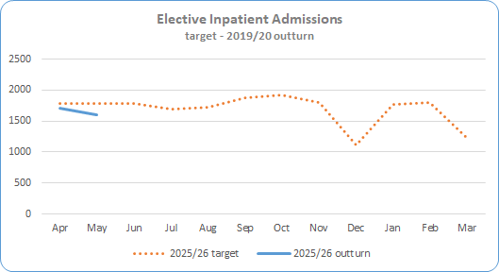
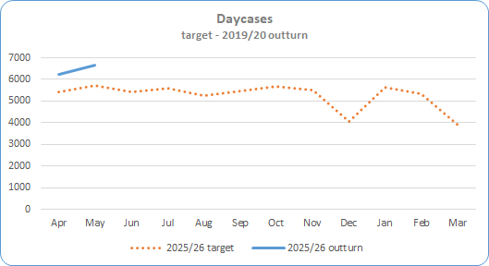

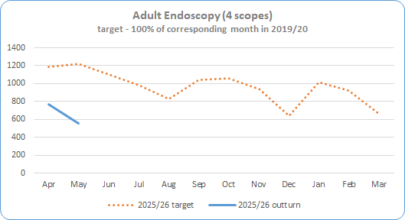
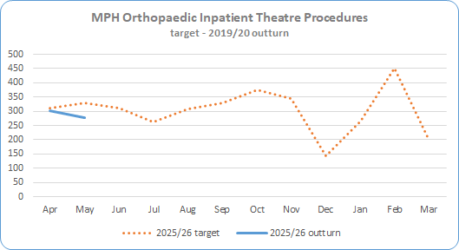
Section 2 – Key SDP Indicators (Slide 3)
Service Area | Metric | May 25 Expected Activity | May 25 In-month Performance | Cumulative Activity YTD | Rag Status May 25 | Chart
Elective Care * Targets included in SDP Summary Table | Inpatient Admissions * 100% of 2019/20 outturn | 1,791 | 1,601 admissions 190 below expected activity (89.4%) | Total Apr 25 - May 25 3,314 (92.6%)
 | Day Case Procedures * 100% of 2019/20 outturn | 5,708 | 6,643 procedures 935 above expected activity (116.4%) | Total Apr 25 - May 25 62,807 (99.6%)
 | Endoscopy (4 scopes) * 100% of 2019/20 outturn | 1,217 | 554 663 below expected activity (45.5%) | Total Apr 25 – May 25 1,319 (54.9%)
 | MPH Inpatient Theatre Procedures * 100% of 2019/20 outturn | 328 | 278 procedures 50 below expected activity (84.8%) | Total Apr 25 - May 25 579 (90.7%)

Slide 7
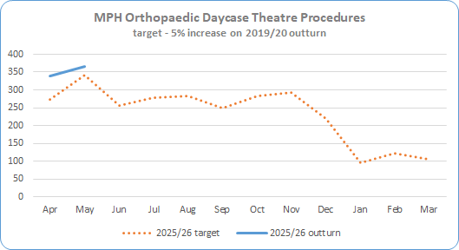
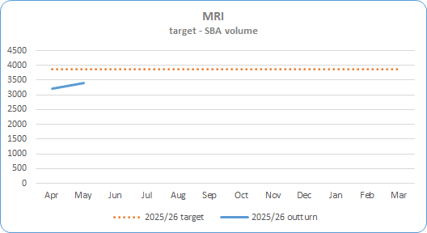
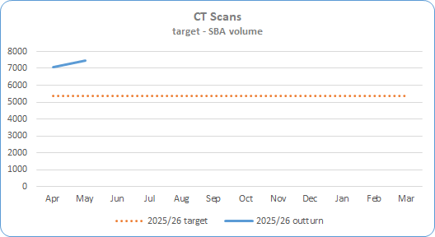
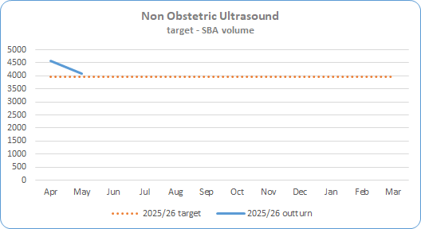
Section 2 – Key SDP Indicators (Slide 4)
Service Area | Metric | May 25 Expected Activity | May 25 In-month Performance | Cumulative Activity YTD | Rag Status May 25 | Chart
Elective Care * Targets included in SDP Summary Table | MPH Day Case Theatre Procedures * 105% of 2019/20 outturn | 342 | 365 procedures 23 above expected activity (112%) | Total Apr 25 -May 25 705 (114.4%)
Imaging | MRI Scan * Deliver activity in line with agreed SBA volume. SBA currency is being reviewed for 25/26 to take account of multiple body areas | 3,864 per month | 3,408 456 below expected activity (88.2%) Note – SBA baseline subject to review | Total Apr 25 - May 25 6,620 (85.6%)
 | CT Scan * Deliver activity in line with agreed SBA volume | 5,367 per month | 7,472 2,105 above expected activity (139.2%) | Total Apr 25 - May 25 14,565 (135.6%)
 | Non Obstetric Ultrasound * Deliver activity in line with agreed SBA volume | 3,977 per month | 4,093 116 above expected activity (102.9%) | Total Apr 25 - May 25 8,670 (109%)

Slide 8
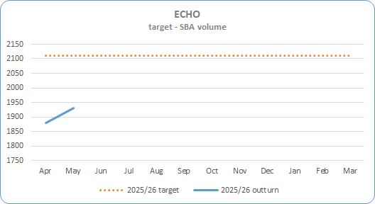
Section 2 – Key SDP Indicators (Slide 5)
Service Area | Metric | May 25 Expected Activity | May 25 In-month Performance | Cumulative Activity YTD | Rag Status May 25 | Chart
Cardiac Services * Targets included in SDP Summary Table | ECHO Deliver activity in line with agreed SBA volume | 2,111 | 1,930 181 below expected activity (91.4%) | Total Apr 25 – May 25 3,809 (90.2%)

Slide 9
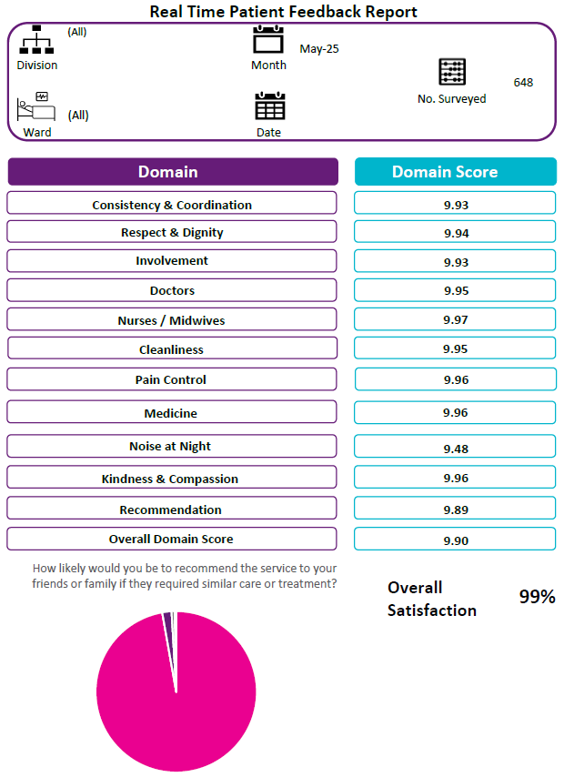
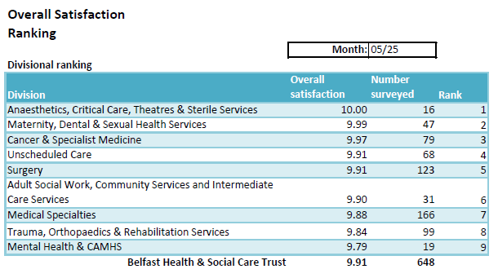
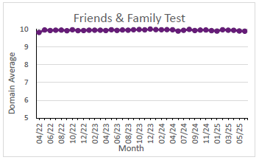
Section 3 – Patient Satisfaction - Real-Time Feedback: Patient Experience Charts - Month of May 2025 = 648 surveys
From April 2024 - March 2025 a total of 7,572 adult inpatient surveys were completed. Across all Real Time Patient Experience survey tools (including adult inpatient) 8,964 engagements took place, an 8% increase on the previous financial year.
Real Time Patient Experience is undertaking a service review at present aiming to extend reach across the Trust, subject to resource and collaboratively agreed priorities. Primarily engagement is face to face, supported with telephone engagement for Emergency Department discharged patients.
Since the fourth quarter 2024-25 increased resource has been directed towards engagement with Emergency Department patients (those admitted and those discharged). Across 2024-25, a total of 219 ED Admitted surveys and 460 ED Discharged surveys were completed giving regular weekly feedback to this key service, highlighting good practice and noting patients concerns as needed.
982 engagements have taken place in the Children’s Hospital since June 2023, with thanks to all colleagues in RBHSC supporting. In addition to Allen, Barbour, Paul & Clark Clinic wards, engagement has been extended to Knox & Belvoir wards from April 2025.
High scores have been maintained in both Overall Satisfaction and the Friends & Family Test. In May 2025, of 648 patients, 99% were extremely likely to recommend the ward they were in to their friends or family.
How likely are you to recommend this ward to friends and family if they needed similar care or treatment?
Friends & Family
Recommendation
99%

Slide 10
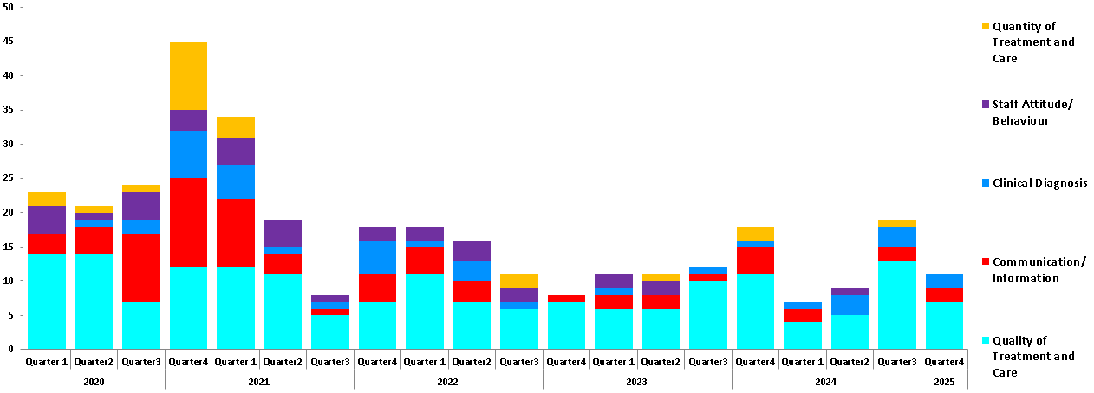
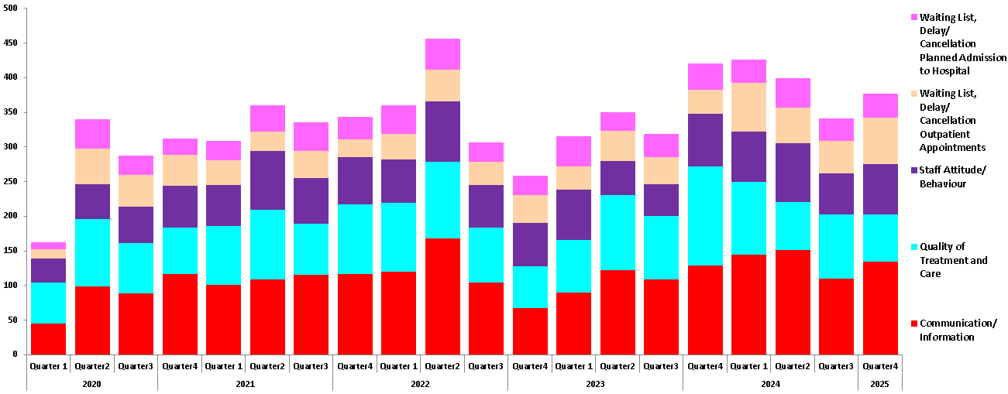
Section 3 – Patient Satisfaction
Service Area | NOTE: This information is produced quarterly – no update is available at this time
Datix – Complaints and Compliments | High Risk Top Subjects Trustwide April 2020 – March 2025
 | All grades Top Subjects Trustwide 04/2020 – 03/2025

Slide 11
Appendix
Appendix

Slide 12
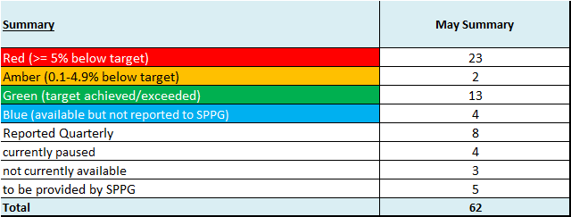
SDP Indicators Summary Tables

Slide 13
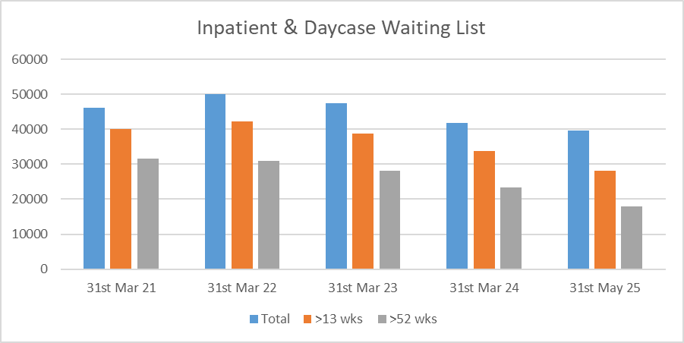
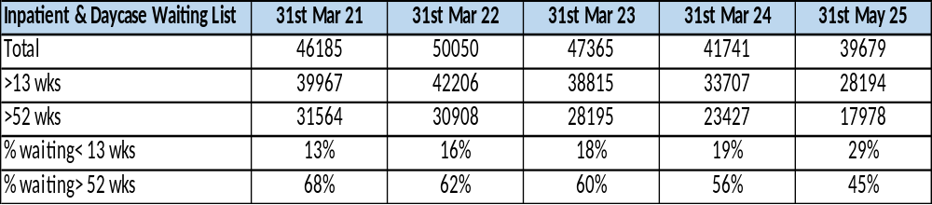
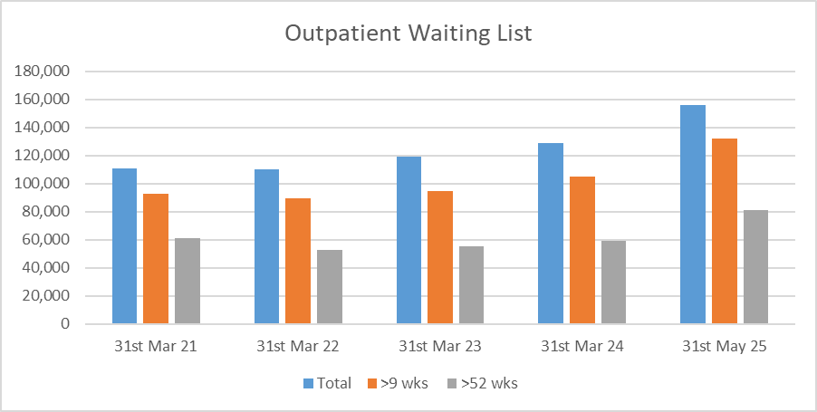
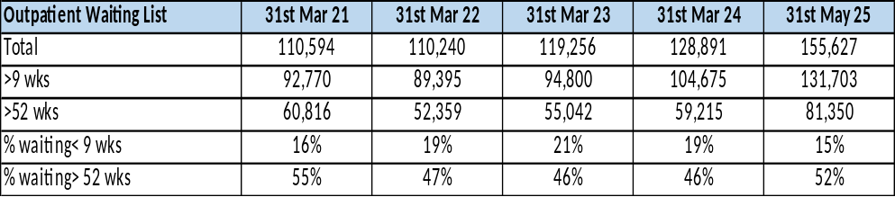
Waiting Lists
Service Area | Metric
Waiting Lists | Acute Hospital Inpatient & Daycases | Inpatient & Daycase Waiting Lists
 | Acute Hospital Outpatients | Outpatient Waiting List

Slide 14
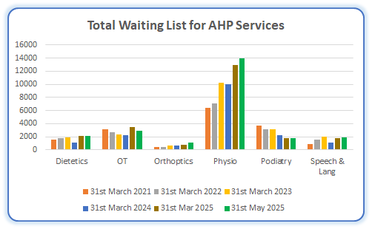
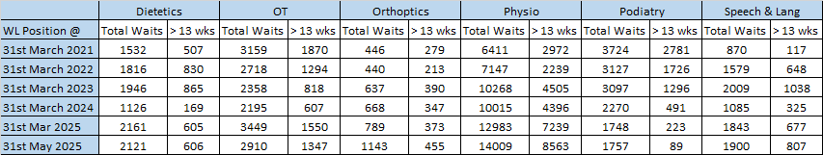
Waiting Lists
Service Area | Metric
Community Services Waiting Lists | AHP Services AHP waiting list numbers are subject to ongoing validation to remove duplicate referrals

Slide 15
Escalations: Support and Intervention Framework – March 25
Level 1 (4) | Level 2 (6) | Level 3 (2) | Level 4 (0) | Level 5 (1)
Cleft lip and palate | Serious Adverse Incidents | MAH Governance & Accountability |  | Cardiac Surgery
Reduced PICU capacity | PACU activity | USC *
Iveagh ID CAMHS Inpatient Unit –timely admissions(↓from level 2) | IS Foster Placements
CAMHS waiting lists (↓from level 2) | Service Delivery Plan *
 | Short breaks for kids with disabilities
 | Insertion of peg tubes (↓from level 3)
*USC and SDP to be reconfigured to reflect the individual component parts in order to identify areas for targeted action and allow for agreement on improvement trajectories.
Level 5*: intervention at HSC Board level – Decision by Health Minister- as advised by DOH/SPPG/PHA. Involves exercise of Minister’s power of intervention. Only used in exceptional circumstance. Targeted support suspension, removal of duties from individuals or whole Board. Assessment through quality surveillance, existing knowledge, formal and informal investigations. Draw on expertise/advice of national colleagues and use of external organisational and independent advisors
Level 4*- Senior external support for provider. Targeted interventions – decision taken by Permanent Sec. Failure to provide recovery plan at level 3, significant weaknesses re financial stability, reputation, governance quality of care or patient safety. DOH take/coordinate action and direct intervention to support Trust, Interventions undertaken by SPPG as directed by Perm Sec. Appropriate external support may be given to Trust eg mentoring for Board/ET members – co-opting experts onto Board as Independent Advisors for finite period. DOH Review
Level 3- enhanced monitoring and support for provider – where previous concerns not resolved at levels 1 or 2, scale of concern, systemic concerns, or ongoing performance challenges, Formal recovery plan – proactive approach, clear milestones and responsibilities – significantly enhanced monitoring and scrutiny. Trust CE to cooperate and provide leadership re agreed recovery actions.
Level 2- enhanced monitoring and support for provider – issues not resolved by Level 1 or direct escalation to Level 2 given seriousness. Local recover plan and enhanced monitoring- regular meetings at Director level – need to show proactivity e.g ongoing performance challenges, risks with no identified action/timetable
Level 1- area of concern identified – emerging, potentially serious concern to service delivery, quality, safety effectiveness – informal level of support and guidance – but no intervention e.g. failure to demonstrate budgetary control and/or insufficient focus on productivity/efficiency. Notified in writing. Local recovery plan required. More frequent monitoring
Steady state- no intervention required- Trust generally operating effectively – any issues picked up through routine oversight arrangements
De-escalation
Escalation
NI Public made aware of
concerns at levels 4 &5 -
serious problems or
concerns re existing
leadership’s ability to
rectify
Escalation and de-escalation to & from level 1 will take place as necessary and be decided by DOH/SPPG/PHA

