Slide 1



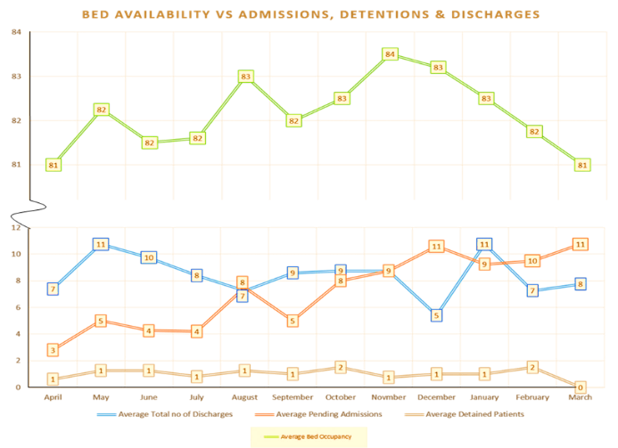

Delegated Statutory Functions
Service area: Mental Health and CAMHS
1st April 2024- 31st March 2025
Data overview
What went well
Development of Psychiatric Assessment & Treatment Hub (PATH)
SW Supervision compliance increased from 83.5% to 93%
Think Family
308 | Referrals and Assessments in Hospital Social Work | Reduced by 19
6788 | Community social work referrals | Increased by 2028
3980 | People who commenced receipt of social work/ social care service | Increased by 1071
593 | Carers assessments completed | Reduced by 119
31 | Direct payments | No change
750 331 | Carers grants Approved social work assessments | Reduced by 162 Increased by 33
Increase in the number of Approved Social Workers from 38 to 43
Developing a Think Family Champion in each childcare and mental health team
ASW support
Increase in social care workforce supporting social work and social care
Risk triage system and review of very referral received
Risk matrix developed
Bed huddles 2x per day
Use of PATH where resource allows
Legal consultation
80% less delays in ED and 46% of patients admitted to PATH do not require onward admission to AMHIC.
Bed waits
Daily data submission to SPPG
Use of PATH
Facilitated early discharge by Home Treatment team
Plans to increase bed capacity by 10
What could be even better
Limited assurance with Encompass data so manual count required
Bed capacity for patients requiring admission under the MHO
Increase in referrals for SW support with no additional resource
Financial capacity assessments
Locum Doctor accessed for assessments
Dev. of Community finance Policy
Impact NIPSA direction
on ASW workforce and patient wellbeing of
Workforce Capacity Summary
Summary Risks escalated to the Board Assurance Framework ASW WAITS FOLLOWING MHO ASSESSMENT DUE TO BED DELAYS
Vacancies at 31st March 24
5 Band 5/6 social work (SW) vacancies .
31/331 ASW Assessments not completed within 5 working days- this is 10% of all assessments
Referrals for Office of Care and Protection
Implementation of the Think Family model

Slide 2

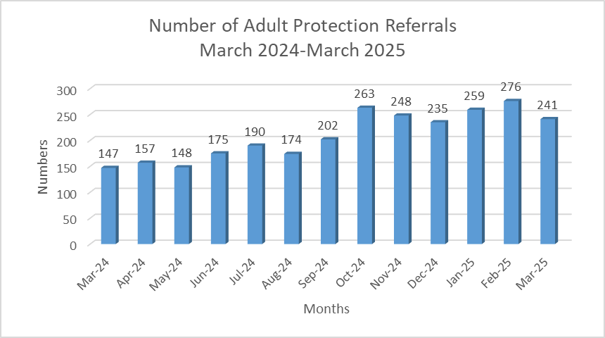
Delegated Statutory Functions
Service area: ACOPS - Adult Social Work Services, Community Nursing and Intermediate Care Services
1st April 2024- 31st March 2025
Data overview
What went well
Summary Risks escalated to the Board Assurance Framework; (incl Corporate Register); Unallocated & Vacant Casework; Completion of Annual Reviews; Domiciliary Care - Unmet Need
8199 | Referrals and Assessments in Hospital Social Work | Increase of 495
6453 | Community social work referrals | Increase of 507
5470 | People receiving a CSW/ social care service
496 | Carers assessments | Reduced by 396
218 | Direct payments | Reduced by 11
726 1861 188 | Carers grants Outstanding reviews CSW Outstanding review CHPT | Reduced by 101
SW Supervision compliance in CSW increased 73 %to 92%
Reduction in unallocated cases and outstanding reviews in CHPT
Care Management Circular
3402 older people avail of domiciliary care
Reduced by 122
There is a decrease in unmet need hours in community social work
Regional recruitment
Use of Bank SW staff
Exploration of delegation in CSW teams to maximise skills mix
Transfer of people to CHPT where appropriate
Safeguarding
Outline vacant and unallocated ASG cases
Data analysis
IO role essential criteria modification
Threshold audit
What could be even better
Unallocated cases
Increase of 653
Completed carers assessments in community SW have reduced by 396
Update on management and assurance of unallocated cases
Transfer of cases to CHPT
CHPT to provide breakdown of unallocated and vacant
Use of skills mix in teams
Carer’s assessments
Reduced by 267
Increase in adult protection referrals with decreased workforce capacity 157 April 24- 241 March 25
Co-designed training developed for staff
Staff to review CA progression in supervision
Regional liaison to resolve Encompass recording issues and validate data
Vacancies at 31st March 25
27 Band 5/6 social work (SW) vacancies
4 Band 7 (SW) vacancies
3 Band 8a vacancies
1 Band 8b vacancy
Increase of 653 to 1861 outstanding reviews in CSW
Older people waiting for a service remains consistently high although this is slightly reduced to 1743 from 2023
There is limited assurance with Encompass
data

Slide 3

Delegated Statutory Functions
Service area: ACOPS; Division of Adult Social Care and Community MDTs
1st April 2024- 31st March 2025
Data overview
Vacancies at 31st March 24
2.3 Band 5/6 social work (SW) vacancies
1.5 Band 8a (SW) vacancies
What went well
303 | Outstanding reviews | Increased by 182
2646 | Community social work referrals | Stable with decrease of 49
1977 | People receiving a social work/ social care service | Increase by 338
78 | Carers assessments completed | Decrease by 128
161 | Direct payments | Reduction of 1
292 203 262 | Carers grants Day care placements Day opportunities | Decrease of 77 Decrease of 36 Increased by 211
Care home and domiciliary annual reviews. PSD has developed monthly reporting on annual reviews completed. An action plan is in place and monthly monitoring and reporting is ongoing
Unallocated cases
Annual supervision compliance is 76% and at end of March 25 had increased to 83%
Review of sick leave
Progression on delays to transfer to older people’s services
Provide assurance re risk mitigations
Unmet need domiciliary care is monitored and reported daily. There is an ongoing action plan to address where possible increased uptake can be managed
Carers Assessment
Co-designed training developed for staff
Staff to review CA progression in supervision
Regional liaison to resolve Encompass recording issues and validate data
Increased uptake of day opportunities
Annual reviews
Physical and Sensory Disability Services have continued to experience challenges with the limited provision of community placements, these include Care Homes, Supported Housing and Domiciliary Care to meet the needs of service users under 65 years of age.
Overtime for staff
Action plan to reduce sickness levels
What could be even better
Complex placement provision
Thresholding for new provider
Completion of restrictive practice work
Summary Risks escalated to the Board Assurance Framework; (incl Corporate Register); Compliance with 2010 DHSSPS Care Management Circular remains on Trust Risk Register with regards Care Home Placement Team
Access to Domiciliary Care within ACOPS remains on Trust Risk Register.
Increase in number of outstanding reviews
Decrease in carers assessments completed
There is limited assurance with Encompass data

Slide 4

Delegated Statutory Functions
Service area: Adult Learning Disability Services
1st April 2024- 31st March 2025
Supervision compliance tracker
Data overview
Vacancies at 31st March 24
Band 5/6 social work (SW) vacancies 25% (4 posts)
Band7 posts -1 vacancy due to staff progression
Adult Safeguarding in MAH- i Band 7 WTE and 3 Band 6 IO
339 | Unallocated cases | Reduction of 240
146 | Community social work referrals | Reduction of 167 due to cleansing of referral list
1524 | People receiving a social work/ social care service | Slight decrease by 76 of people receiving support
110 | Accepted offer of carers assessment | Remained stable with decrease of 17
297 | Direct payments | Increase of 23
220 391 | Carers grants People in receipt of day opportunities | Slight increase of 13 Increase of 109
What went well
SW supervision compliance is 83% for the supervision of Band 6 staff
Unallocated cases
Reduction by 240 unallocated cases in this reporting period
Update action plan for SPPG
Monthly meetings to monitor risks
Stabilisation of workforce in community social work teams
Reduction in the number of outstanding annual reviews
Statutory reviews
Increase of 109 adults with a learning disability accessing day opportunities
Update to SPPG
Monthly tracking of outstanding reviews with professional oversight
Muckamore Abbey Hospital
What could be even better
Liaison with DoH and SPPG
Complex placement plans in place for community living
Workforce planning in relation to DAPO and IO vacancies
Support from CSW in regard to ASG to continue
There are 55 outstanding annual reviews
There is an increase in number of people waiting for a package of care from 13 to 17
Mental health inpatient beds
There is limited assurance with Encompass data
Engagement in regional work
Awaiting outcome of business case for 4 beds
SW supervision of Band 7 team leaders is 53%
9 patients at Muckamore Abbey Hospital awaiting community placement- plans in place
There are challenges regarding resourcing suitable
assessment and treatment beds for adults with a learning
disability.
Summary Risks escalated to the Board Assurance Framework; (incl Corporate Register); Community services; Muckamore Abbey Hospital

Slide 5


Delegated Statutory Functions
Service area: Children’s Community Services
1st October 2024- 31st March 2025
Summary Risks escalated to the Board Assurance Framework; (incl Corporate Register); CCS ability to deliver on delegated statutory functions
Data 10 overview- comparison with interim report November 2024
What went well
Vacancies Band 5-7at 31st March 24
Gateway 22 %
Family Support 49.44%
LAC 21.9%
14+/16+ LCAC 17.5%
Fostering/Adoption 36.9%
CwD 21.9%
Residential/ Peripatetic Teams 20.4%
30 Sept24 31 Mar 25
3475 | 3530 | Referral for a child in need assessment | Increase of 55
1158 | 1172 | Looked after children supported | Increase of 14
627 423 201 | 656 441 198 | Registered foster carers Post adoption support Early years inspections | Increase of 29 Increase of 18 Decrease of 3
84 | 92 | Awaiting personal advisor | Increase of 9
189 | 77 | Unallocated Looked After Children | Decrease of 112
159 | 151 | Fostering unallocated | Decrease of 8
Reconfiguration of the LAC teams with one team focusing on statutory visits and reviews for LAC cases assess as having lower-level need. This has contributed to the reduction in the number of unallocated cases and significantly increased compliance with statutory visits and reviews. At the end of the reporting period this team held responsibility for 243 LAC.
Decrease in unallocated cases in CwD 41% reduction to 44 cases
Increase by 29 in registered foster carers
Unallocated cases/ Statutory review
49 outstanding Foster Carer reviews reduction of 77
Increased supervision compliance reporting
Monthly report to SPPG
Use of Bank SW
Overtime offered
Skills mix / delegated framework
Provision of local workforce strategy
Provision of assurance re unallocated numbers and reducing risk
Placement moves remain high at 172 but has been reduced by 7 – (68 children remain inappropriately placed)
Short break provision
Challenges with provision of residential and short break provision for children with disabilities
Quarterly updates at statutory function meetings
What could be even better
PA Support
Supervision compliance is 62.5 %
Recruitment strategy
Evaluation of duty system
Overview of UASC support
Provision of assurance of quality of support
Increase of young people without a Personal Advisor
Increase in unregulated placements with 101 unregulated households at the end of the reporting period; an increase of 30 over the past six months (an increase of 57 across the year)
Increased LAC
Placements
Plan to reduce numbers and evaluate 24/25
Options panel for complex
placements
Implementation plan re safeguarding audit
Scoping exercise and report on placement moves
Provision of report re breakdown of unregulated placement status
Confirm adherence to KPRA
112 unallocated fostering assessments

Slide 6
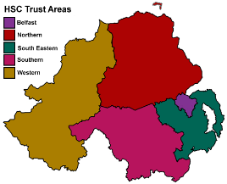

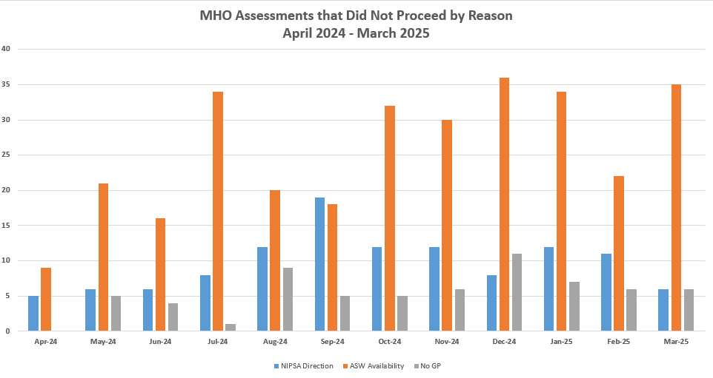
Delegated Statutory Functions
Service area: Regional Emergency Social Work Service (RESWS)
1st April 2024- 31st March 2025
Data overview
Vacancies at 31st March 24
5.46 Band 7 senior practitioner (SW) vacancies (increase of 2 WTE from the last reporting period)
What could be even better
637 | Number of ASW assessments completed | Increased by 89
435 | Number of applications made | Increased by 167
Limited assurance with Encompass data
There is a lack of foster placements available out of hours in the Trust area where a child is resident, and this results in resourcing other provision, where available, in alternative Trust areas. This entails children travelling long distances outside their Trust area at night. This issue has been escalated to the Executive Directors at Consortium Board.
ASW support
Re-engagement of Direction no1 staff
ASW daily regional huddle
Engagement with NIPSA
Ongoing recruitment
Regional liaison with SPPG and DoH
On-call manager at Band 8a and a w/end referral manager
Throughout this reporting period the service note concerns raised in the implementation of the Department of Health (DOH) D1 Approved Social Workers. This had stalled by July 2024 due to the financial payment attached to this work
What went well
Emergency care placements
The independent review of RESWS has remained ongoing throughout this reporting period. The review team has engaged with key stakeholders and staff within the RESWS service
Development of on call ASW management support across aligns the service with the ASW Quality Standards.
The RESWS NIPSA Health and Safety Directive (October 2023) has led to instances of delay / significant delay undertaking Mental Health Order Assessments
SW Supervision compliance rose from 55%- 64% /Reporting supervision compliance increased from 7% to 77%
All Trusts to provide details of out of hours care placements available.
Issue escalated through 1/4ly operational management group
A Datix audit highlighted 195 incidents (increase of 52). 176 of these incidents involved a request for assessment under The Mental Health (NI) Order 1986 (MHO) and the ASW on duty was unable to undertake the MHO assessment at the time of initial request.
(increase of 60)
Protracted waits for bed-based psychiatric in-patient care, NIPSA directives and GP availability directly impact on the ASW services’ ability to provide timely Mental Health Order assessments
Service review
Awaiting publication of Independent Service Review
RESWS has recently recruited to 5 of 6 current vacant posts. Of these successful candidates only 1 was an ASW.
Summary Risks escalated to the Board Assurance Framework; (incl Corporate Register); ASW issues in relation to bed pressures and NIPSA action short of strike

