Slide 1

The Role of Staff in PCSS in
Safeguarding Children and Adults

Slide 2
Housekeeping

Slide 3

Objectives
What is Safeguarding?
How would I recognise abuse or neglect?
What is my role in keeping service users and others safe?
Who will I talk to if I have concerns?

Slide 4

What is Safeguarding?
Safeguarding is protecting adults or children from abuse or neglect. It means making sure people are supported to have good access to health care and stay well

Slide 5



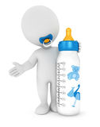


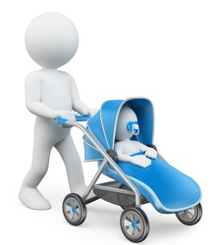

Safeguarding Children

Slide 6


Who is a Child?

Slide 7

All children and young people until they reach their 18th birthday

Slide 8
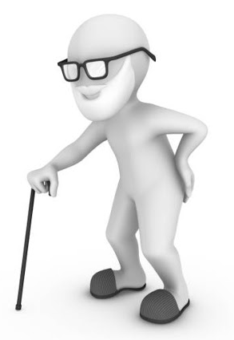


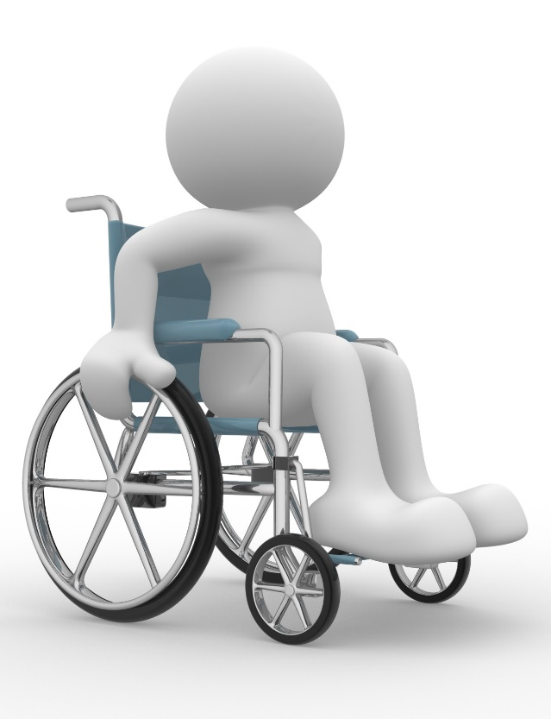

Safeguarding Adults

Slide 9

What Adults require Safeguarding?

Slide 10
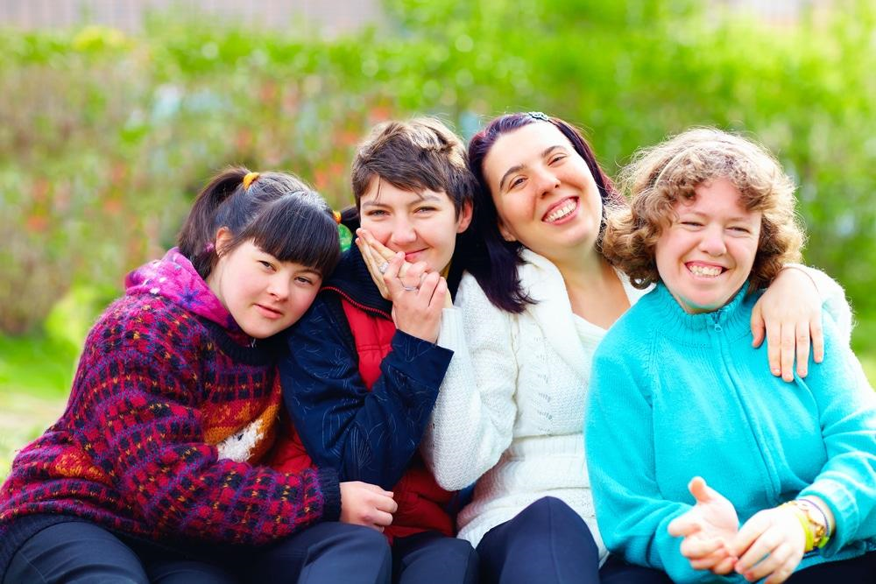
Persons who, because of age, disability, or illness are at risk and unable to protect themselves from
significant
harm

Slide 11


Slide 12

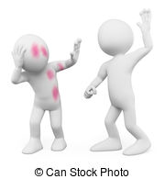


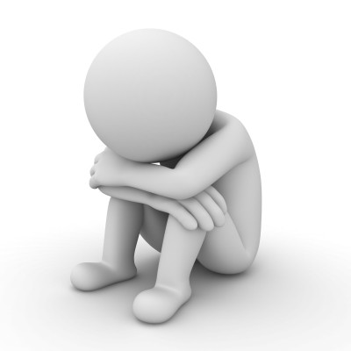
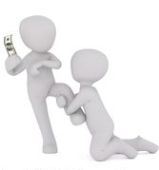
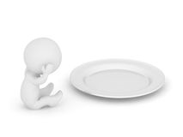
Types of abuse
Physical
Institutional
Financial
Neglect
Emotional
Sexual
Exploitation

Slide 13
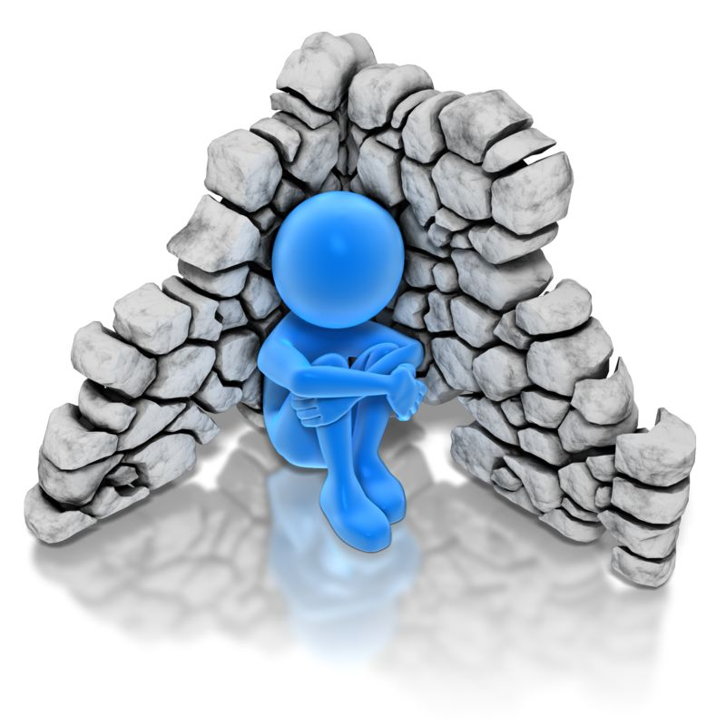
Related Definitions
There are 3 other Related Definitions which could be an indication that an adult is at risk of abuse:
Domestic Violence & abuse - ‘any incident of threatening behaviour, violence or abuse inflicted on one person by another where they are or have been intimate partners or family members, irrespective of gender or sexual orientation’
Human Trafficking - The movement of a person from one place to another into conditions of exploitation. You can be a victim trafficked from another county or be born in Northern Ireland and trafficked from one area to another
Hate Crime is when someone is abused in any way because of who they are, where they come from, what they believe or who they choose to love.

Slide 14


Slide 15

Everyone has the right to live life safe from harm
Harm is unacceptable and YOU can help STOP it
If you see possible signs of harm, exploitation or neglect …..
SAY SOMETHING

Slide 16

What must we do if we have a concern?

Slide 17


What must we do if we have a concern?
Report your concerns to your line manager
Whistle Blow. All staff members have a duty to report poor practice to line manager (or higher if appropriate)
This safeguards:
Service users
The staff member
Colleagues
The Trust

Slide 18


Confidentiality

Slide 19
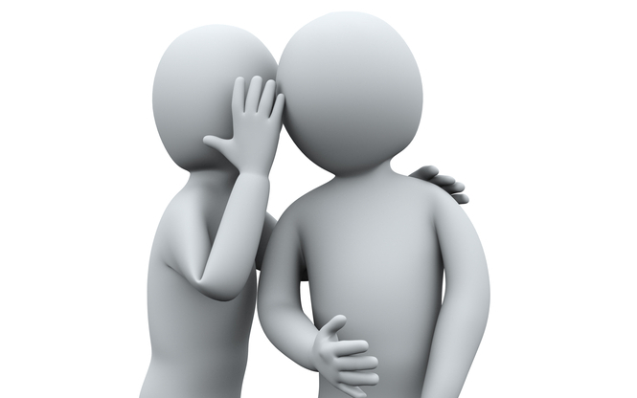
Confidentiality
Every service user needs to feel confident that information about their Health & Social Care is securely safeguarded and is the responsibility of all staff working in the Trust

Slide 20
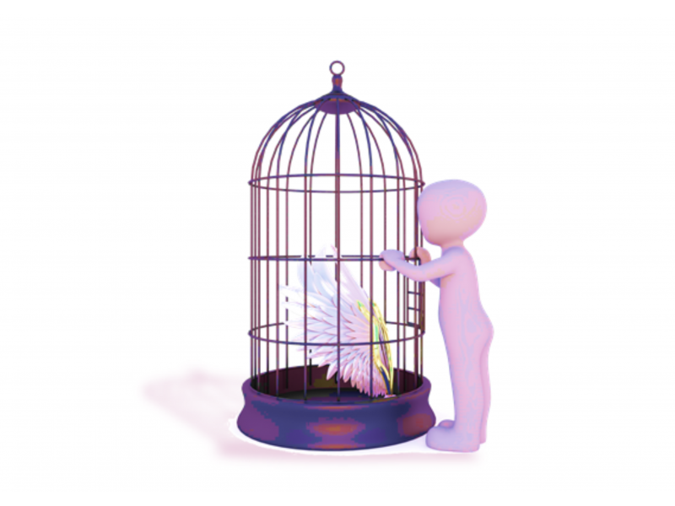
Deprivation of
Liberty

Slide 21
What is Deprivation of Liberty?
People are deprived of their liberty when:
They are under continuous supervision or control in a care home/hospital
And
They lack capacity to consent to staying in the hospital/home
When a person is deprived of their liberty, the Trust needs to
assess to see if Deprivation of Liberty Safeguards (DoLS) are
required.
A deprivation of liberty could happen anywhere e.g. a person’s
own home, a care home, a hospital or a day centre.

Slide 22

These restrictions are often necessary
The Law says…..
A person can be deprived of their liberty where they lack capacity, the deprivation of liberty is in their best interests and to prevent serious harm. A person might be deprived of their liberty and have a Trust Panel Authorisation, a Short Term Detention Authorisation or be under Emergency Provisions. In these instances, the Trust is authorised to prevent a patient from leaving or to bring a patient to a place they may be deprived of their liberty.

Slide 23
Examples of Deprivation of Liberty
Keypad entry system and not having code
Locked doors
Being under continuous supervision and control
Care plan saying someone can only go into the community with an escort
1-1 supervision
Not being allowed to leave
Use of restraints and restrictive practices in the event of objections or resistance to personal care
Limited choice of meals and where to eat them (including restrictions on residents’ ability to go out for meals)
Set times for visits

Slide 24

Adult Safeguarding:
What would you do?
Nora is a patient on the ward. Nora has Dementia. You see her daughter swearing at her and poking her on the shoulder
What would you do?
Report to Ward Manager
An older patient has been pressing her buzzer for assistance to get to the bathroom. A Nurse has turned off the buzzer but has not taken the lady to the bathroom
What would you do?
Report to Ward Manager

Slide 25
Adult Safeguarding:
What would you do?
Elizabeth requires a pureed diet. You see another member of staff handing her a meal that is not pureed
What would you do?
Speak up immediately and Report to Ward Manager
You have contact with other members of staff via Instagram/Facebook. Today you read comments that refer to service user as ‘cuckoo’
What would you do?
Report to Line Manager

Slide 26
Child Safeguarding:
What would you do?
Jim was asked to transfer Lucy, a female patient from A&E to the ward. Lucy’s partner and two children were accompanying them. Whilst waiting for the lift the children were talking quietly to each other. Lucy’s partner grabbed them and told them to “shut up or else.” The children remained silent. When the lift arrived the oldest child was pushed forward by Lucy’s partner, causing him to trip and bang his arm on the bed. The child didn’t say anything, just rubbed his arm quietly. Lucy said he was clumsy and always banging into things
What would you do?
Report to Ward Manager

Slide 27
Child Safeguarding:
What would you do?
Sheila is cleaning the floor in a busy children’s ward, she notices a commotion and witnesses a child being slapped by an adult
What would you do?
Report to Ward Manager
David is serving lunch in the hospital canteen, he notices a child sitting crying and sobbing at table after being shouted at by a member of staff
What would you do?
Report to line manager

Slide 28



Remember!!
Safe
Guarding
Is
Everyone’s
Responsibility

Slide 29
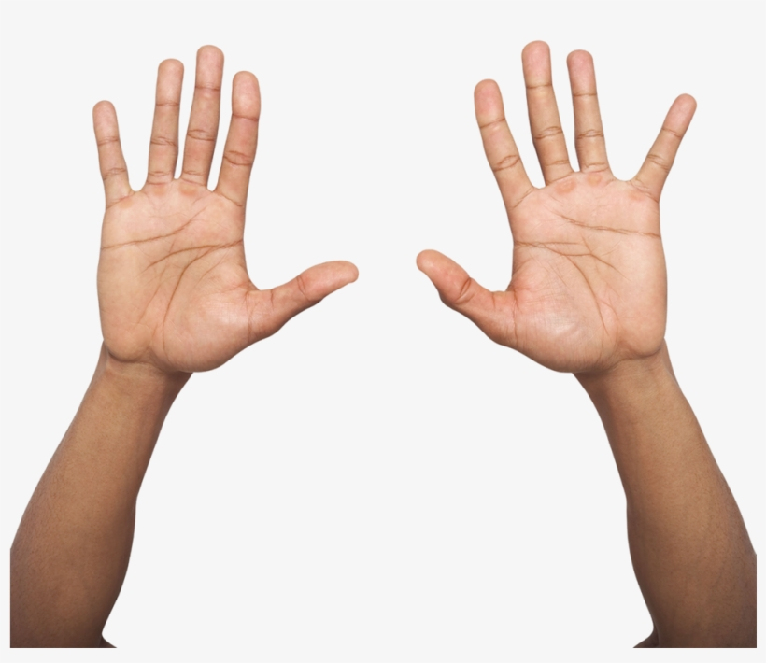
See it
Stop it

Slide 30
Safe guarding Video

Slide 31

Any Questions

