Slide 1

Trust Board Report
Systems Oversight Measures Report
Trust Board - Thursday 6th November 2025
Alastair Campbell
Director of Performance, Planning & Informatics

Slide 2

Contents
Section 1 – Overview & Headlines
Section 2 - Performance
Key SOMs Indicators
Unscheduled Care – Patients not waiting in ED, 12 Hr delays, Delayed discharges and Hip Fractures
Scheduled Care – DNA rates, theatres
Community Care – unmet need, direct payments, unallocated cases
Section 3 - Efficiency & Productivity
Key SOMs Indicators
Scheduled Care – average LoS
Section 4 – Access Improvements
Key SOMs Indicators
Elective Care – outpatient, diagnostic, Inpatient/Daycase, AHP waits
Cancer Services – 14, 31 & 62 day targets (14 day is a regional position)
Unscheduled Care – ED 4hr performance
Mental Health Services – 9 & 13 week waits (Psychological Therapies reported from September)
Cancer monthly activity
Waiting list summaries, Backlog clearance & Validation
Section 5 - Experience
Patient Satisfaction – Patient Experience Surveys, Friends and Family, Complaints and Compliments
APPENDIX
System Oversight Measures Summary table (September 2025 & Year to date)
Escalations
SOMs to be implemented in quarter 3

Slide 3
Section 1 – Overview
This Trust Board Report assesses the Trust position for September 2025 in relation to a number of key metrics included within the new System Oversight measures (SOMs).
The new System Oversight Measures have been devised around four key domains.
Performance
Efficiency and Productivity
Access improvement/Ministerial Targets
Safety and Quality
All performance metrics are presented in run chart format with the expected target shown in red.
As there are no agreed baselines for levels of activity to be delivered within the SOMs framework, an activity summary for Outpatient attendances and Elective admissions & daycases will be included going forward from November.
This will include a comparison of the current month to the equivalent month in the previous year and will enable us to provide a robust comparison of encompass activity

Slide 4

Section 1 – Overview – System Oversight Measures – Summary of Metrics reported
Indicator | Metric | Status
Performance
Unscheduled Care | Patients who leave ED without treatment | reported
 | ED 12 hour performance | reported
 | Weekend Discharges - Simple | not reported – low confidence
 | Weekend Discharges – Complex | reported
 | Fractures – Neck of Femur and Other Fractures | reported
Scheduled Care | Outpatient DNA rates | reported
 | Theatre DNA rates | reported
 | Theatre Utilisation Run Times | reported
 | Theatre Utilisation Operating Times | reported
Community Care | Unmet Need | reported
 | Direct Payments | reported
 | Unallocated Cases | reported
Indicator | Metric | Status
Efficiency & Productivity | Elective Average Length of Stay (5 specialties) | reported
Access Improvement/Ministerial Access Targets
Elective Care | Diagnostic Waits | reported
 | New Consultant Outpatient Waits | reported
 | Inpatient/Daycase Waits | reported
 | AHP Waits | reported
Cancer Services | 14, 31 & 62 Day Waits | reported
Unscheduled Care | ED Attendances Waiting < 4 hours | reported
Mental Health Services | Child & Adolescent Mental Health Waits | reported
 | Adult Mental Health Waits | not reported – low confidence
 | Psychological Therapies | not reported – low confidence
Safety & Quality | Antimicrobial Consumption | undergoing validation
 | Healthcare Acquired Infections (HCAI) | not reported – low confidence

Slide 5
Section 1 – Headlines
Reporting period – September 2025 in-month performance and cumulative data April – September 2025
Ongoing confidence issues in reporting in a number of areas as we try to understand how the new data differs from reporting pre-encompass. Validation is ongoing also to ensure all relevant data is captured within reports
31 and 62 day cancer data is reported, but subject to ongoing validation
ED 12hr performance & did not waits remain consistently above targets
Review DNA rates remain just above target
Endoscopy theatres continue to run above target
Targets not met in relation to all waiting lists. Waiting lists are subject to ongoing validation.
Patient experience report for September – 99% overall satisfaction

Slide 6
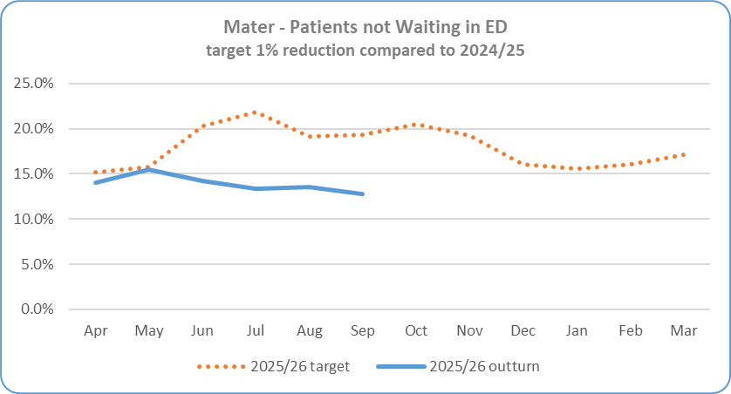

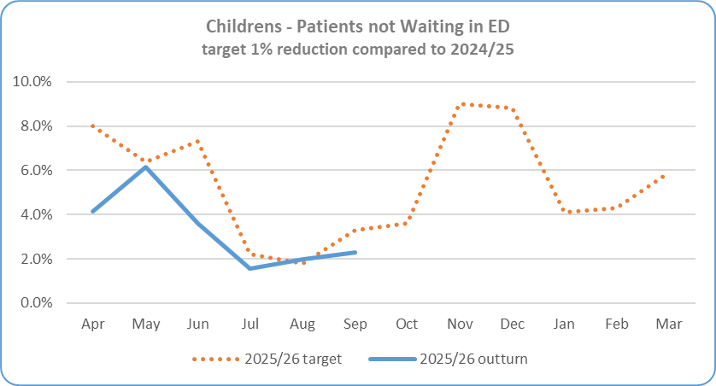
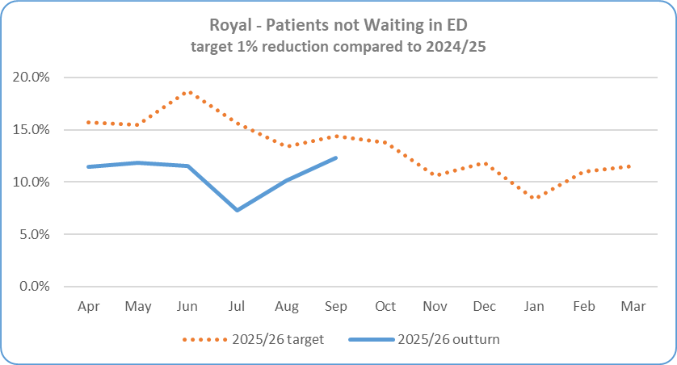
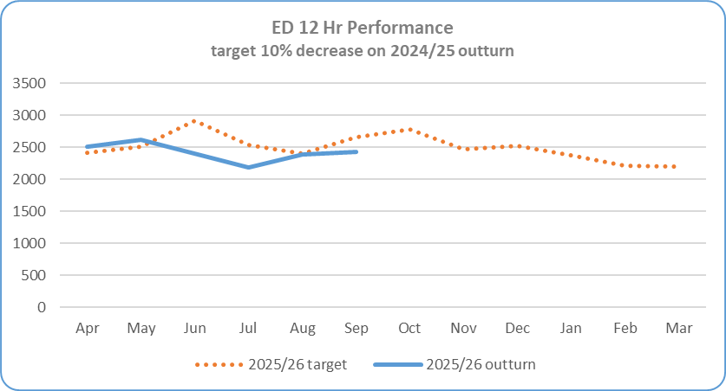
Section 2 – Key SOMs Indicators - Performance
Service Area | Metric | Sept 25 Target | Sept 25 In-month Performance | Cumulative Activity YTD/Qtr end | Rag Status Sept 25 | Rag Status YTD/Qtr end | Chart
Performance - Unscheduled Care | Patients Not Waiting in ED – Mater 1% reduction compared to 2024/25 | 19.3% | 12.7% - 6.6% under target | 13.9% against a target of 18.2% (3,016 out of 21,687)
 | Patients Not Waiting in ED - RBHSC 1% reduction compared to 2024/25 | 3.3% | 2.3% - 1% below target | 3.4% against a target of 5.5% (686 out of 19,925)
 | Patients Not Waiting in ED - RVH 1% reduction compared to 2024/25 | 14.43% | 12.28% - 2.15% under target | 10.77% against a target of 15.8% (4,344 out of 40,322)
 | ED – 12 Hour Target * Reduce the number of patients waiting > 12 hours in ED during 24/25 by 10% | 2,664 | 2,430 patients waited > 12 hours during September. 234 patients under expected target | -15.28% - 14,543 out of 81,934

Slide 7
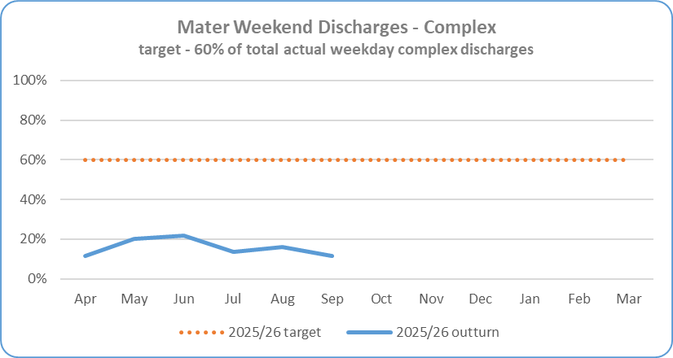

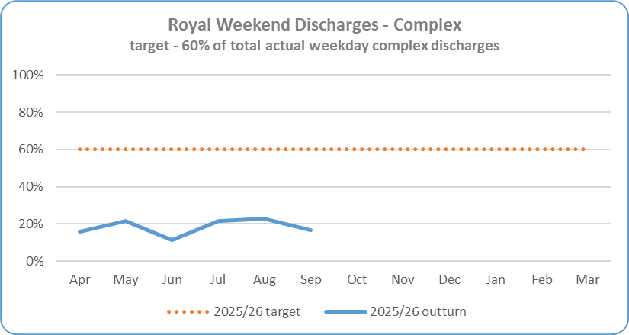
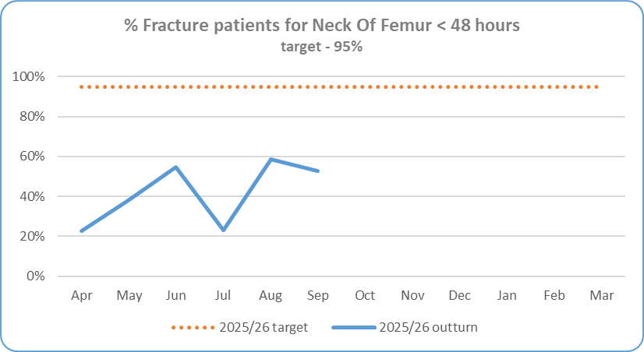
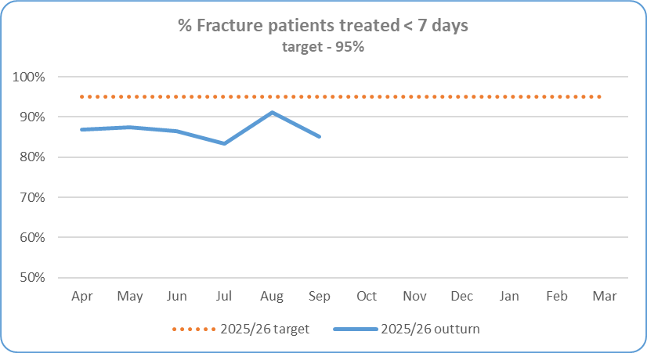
Section 2 – Key SOMs Indicators – Performance
Service Area | Metric | Sept 25 Target | Sept 25 In-month Performance | Cumulative Activity YTD/Qtr end | Rag Status Sept 25 | Rag Status YTD/Qtr end | Chart
Performance -Unscheduled Care | Complex Delayed Discharges – Mater Target - The number of complex discharges on any Saturday and Sunday should be at least 60% of the average daily number of complex discharges from Mon-Fri in that week. | 60% | 11.65% | 15.51%
 | Complex Delayed Discharges – RVH Target - The number of complex discharges on any Saturday and Sunday should be at least 60% of the average daily number of complex discharges from Mon-Fri in that week. | 60% | 16.47% | 18.28%
 | Hip Fractures Target - 95% of patients where clinically appropriate, wait no longer than 48 hours for inpatient treatment | 95% | 52.83% 28 out of 53 seen <48hrs | 42.06% 151 out of 359
 | Other Fractures Target - 95% of other fractures, where clinically appropriate, wait no longer than 7 days for inpatient treatment for fractures | 95% | 85.16% 109 out of 128 treated within 7 days | 86.83% 699 out of 805

Slide 8
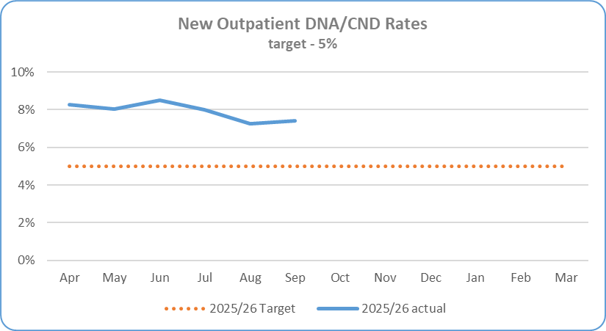
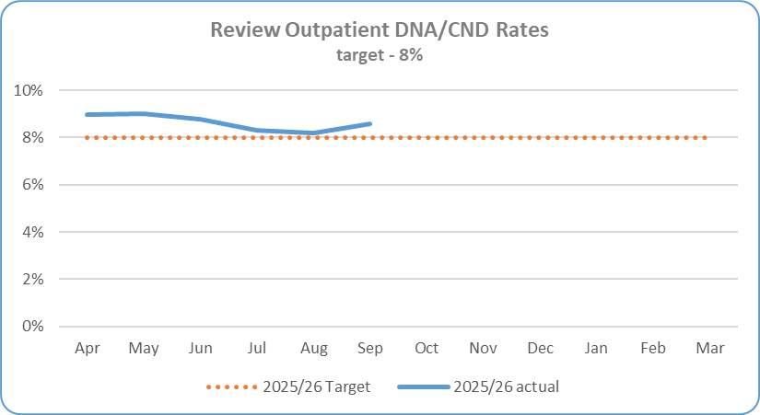

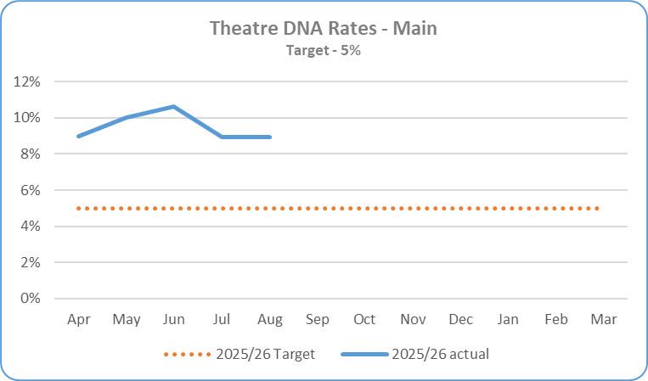
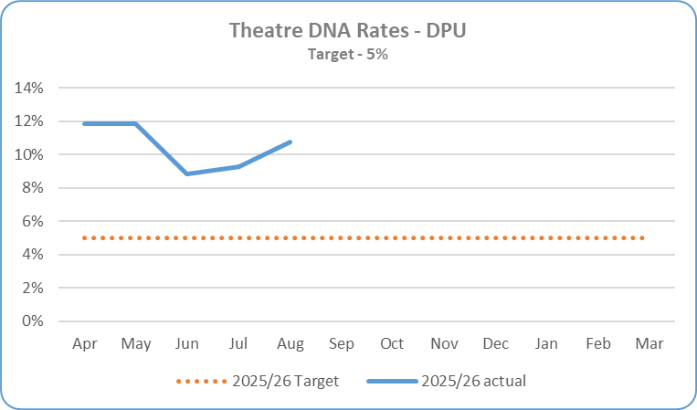
Section 2 – Key SOMs Indicators Performance
Service Area | Metric | Sept 25 Target | Sept 25 In-month Performance | Cumulative Activity YTD/Qtr end | Rag Status Sept 25 | Rag Status YTD/Qtr end | Chart
Performance -Scheduled Care | DNA rates for New consultant outpatient appointments Target – maximum 5% | 5% | 7.41% | 7.93%
 | DNA rates for Review consultant outpatient appointments Target – maximum 8% | 8% | 8.18% | 8.57%
 | Theatre DNA Rates– Main Theatres Target – maximum 5% | 5% Monitored a month in arrears | 8.92% (August 25) | 9.65% (Apr-Aug)
 | Theatre DNA Rates – DPU Target – maximum 5% | 5% Monitored a month in arrears | 10.75% (August 25) | 10.60% (Apr-Aug)

Slide 9
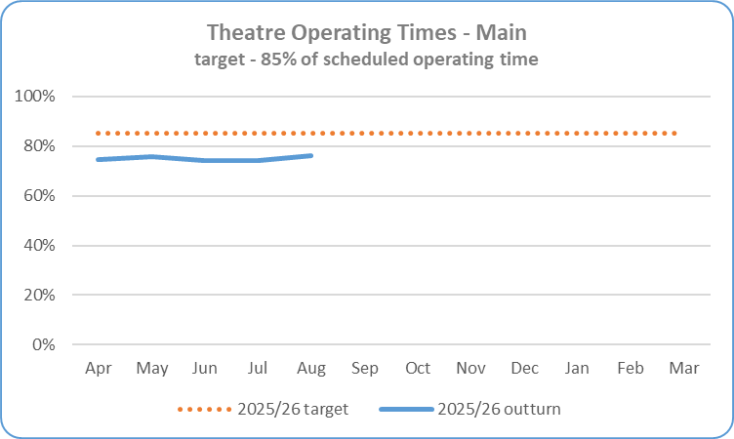
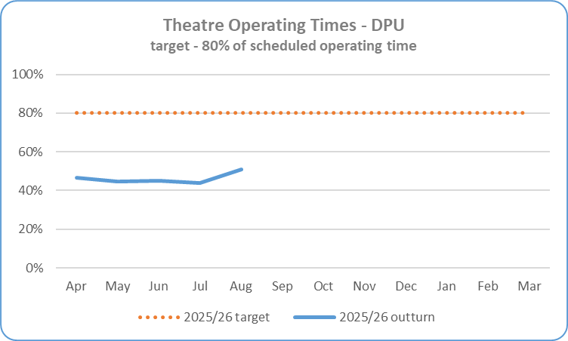
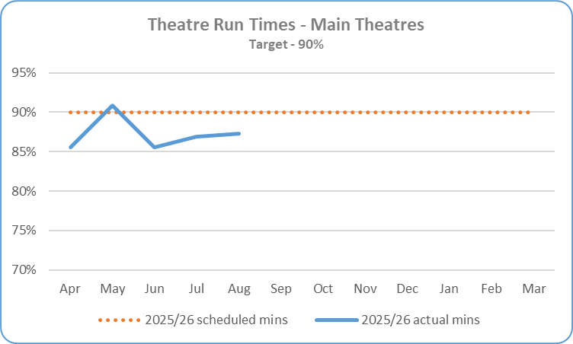
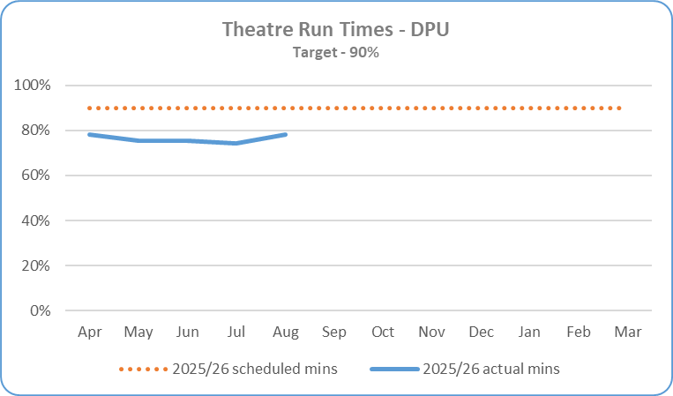
Section 2 – Key SOMs Indicators – Performance (2)
Service Area | Metric | Sept 25 Target | Sept 25 In-month Performance | Cumulative Activity YTD/Qtr end | Rag Status Sept 25 | Rag Status YTD/Qtr end | Chart
Performance -Scheduled Care | Theatre Utilisation - Operating Times – Main Theatres Target – maximum operating rate of 85% | 85% Monitored a month in arrears | 76.26% (August 25) | 74.89% (Apr-Aug)
 | Theatre Utilisation - Operating Times – DPU Target – maximum operating rate of 80% | 80% Monitored a month in arrears | 50.88% (August 25) | 46.02% (Apr-Aug)
 | Theatre Utilisation - Run Times – Main Theatres Target – minimum run time rate of 90% | 90% Monitored a month in arrears | 87.31% (August 25) | 87.22% (Apr-Aug)
 | Theatre Utilisation - Run Times – DPU Target – minimum run time rate of 90% | 90% Monitored a month in arrears | 78.20% (August 25) | 76.20% (Apr-Aug)

Slide 10
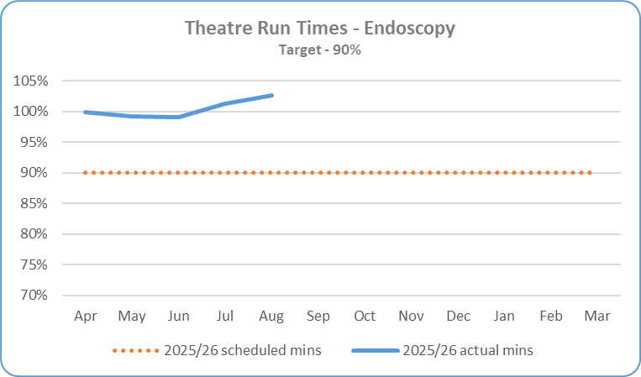


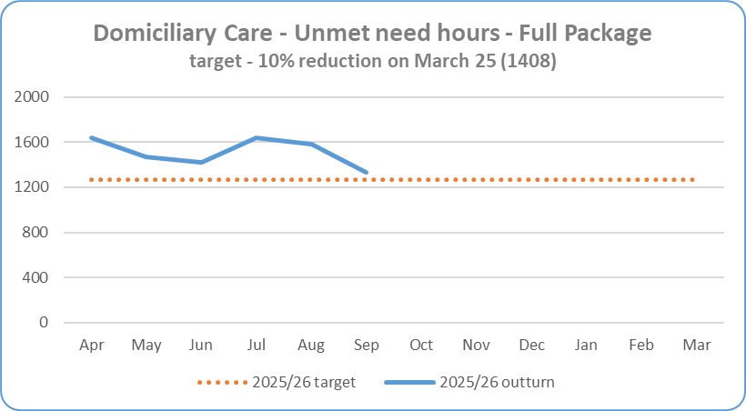

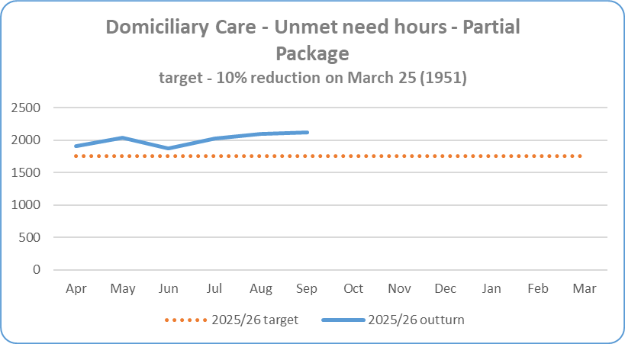


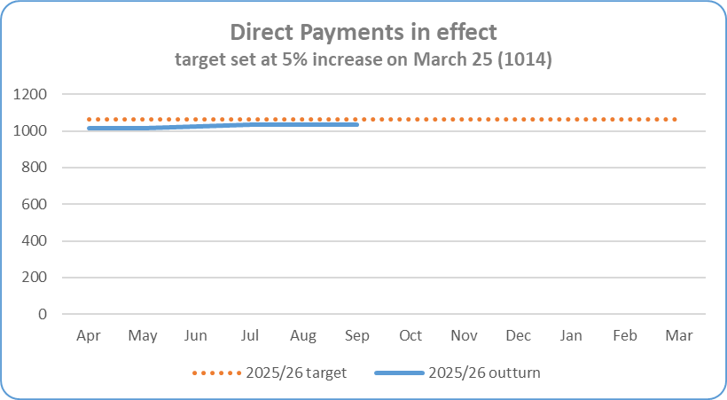
Section 2 – Key SOMs Indicators – Performance (3)
Service Area | Metric | Sept 25 Target | Sept 25 In-month Performance | Cumulative Activity YTD/Qtr end | Rag Status Sept 25 | Rag Status YTD/Qtr end | Chart
Performance – Scheduled Care | Theatre Utilisation - Run Times – Endoscopy Target – minimum run time rate of 90% | 90% Monitored a month in arrears | 102.56% (August 25) | 100.28% (Apr-Aug)
Community Care | Domiciliary Care – Unmet Need – Full Package Target- 10% reduction in unmet need hours by March 2026 compared to position at 31 March 25 (1408 hrs) | 1,267 hrs | 1,330 hrs 25% above target | 1,330 hrs (Sept position)
 | Domiciliary Care – Unmet Need – Partial Package Target - 10% reduction in unmet need hours by March 2026 compared to position at 31 March 25 (1951 hrs) | 1,756 hrs | 2,118 hrs 19% above target | 2,118 hrs (Sept position)
 | Direct Payments Target - 5% increase in Service User Direct Payments in effect by March 2026 compared to position at 31 March 2025 (1014 service users) | 1,065 | 1,032 1.78% increase on March 25 position | 1,032 (Sept position)

Slide 11
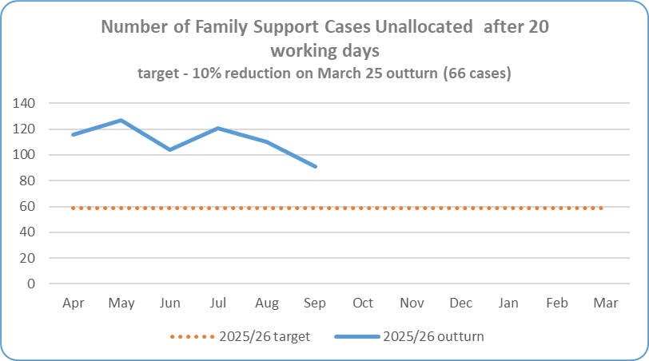
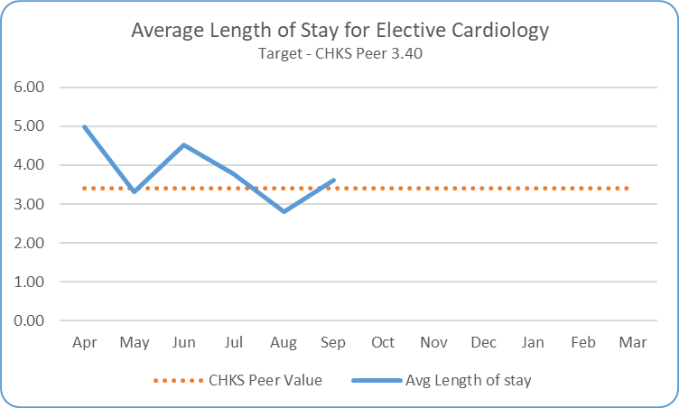

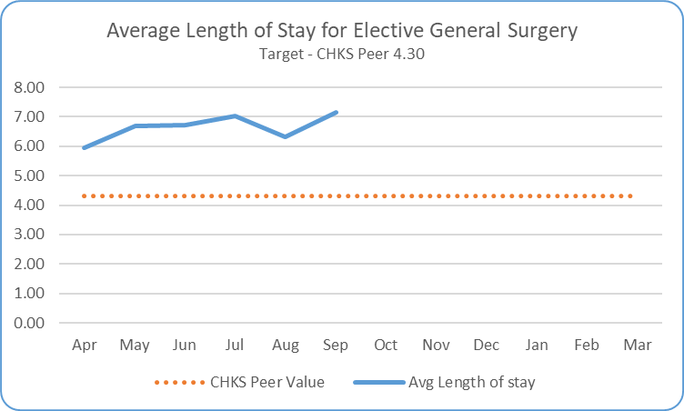
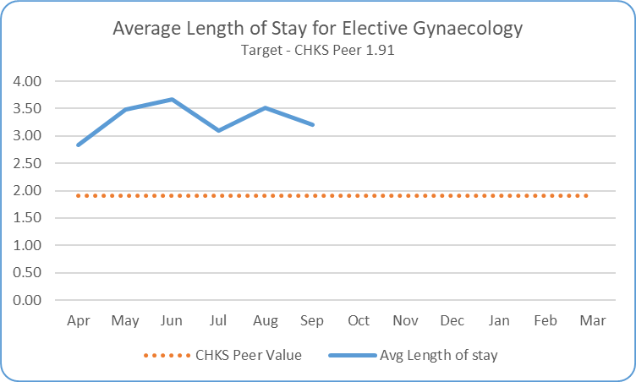
Section 2/3 – Key SOMs Indicators - Performance and Efficiency & Productivity
Service Area | Metric | Sept 25 Target | Sept 25 In-month Performance | Cumulative Activity YTD/Qtr end | Rag Status Sept 25 | Rag Status YTD/Qtr end | Chart
Performance – Community Care | Family Support – Unallocated Cases Target - reduce by 10% by March 2026 compared to position at end March 2025 – 66 cases | 59 cases | 91 cases 66.7% increase on March 25 position | 91 cases September position
Efficiency & Productivity - Scheduled Care | Average LoS for Elective Patients Cardiology (includes Paediatrics) Target - Reduce LoS against CHKS peer group level | 3.40 days | 3.61 days | 3.81 days
 | Average LoS for Elective Patients General Surgery (includes Breast & Vascular) Target - Reduce LoS against CHKS peer group level | 4.30 days | 7.16 days | 6.64 days
 | Average LoS for Elective Patients Gynaecology (includes oncology) Target - Reduce LoS against CHKS peer group level | 1.90 days | 3.21 days | 3.30 days

Slide 12
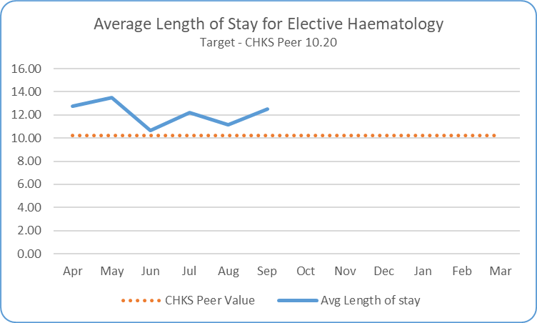
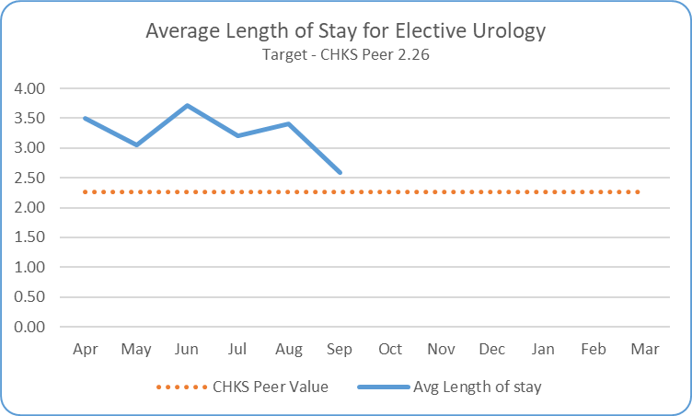
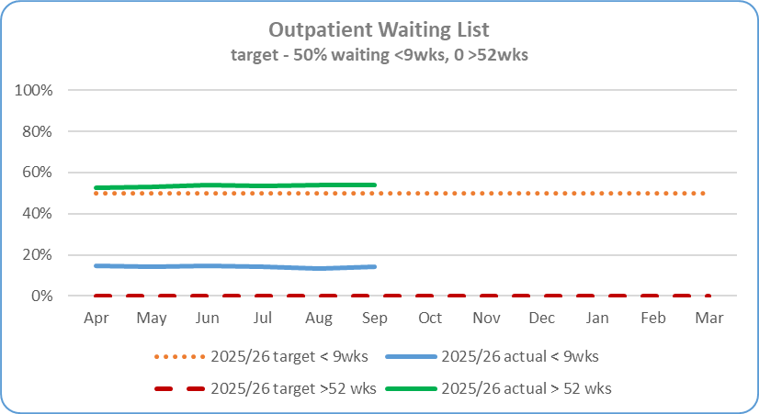
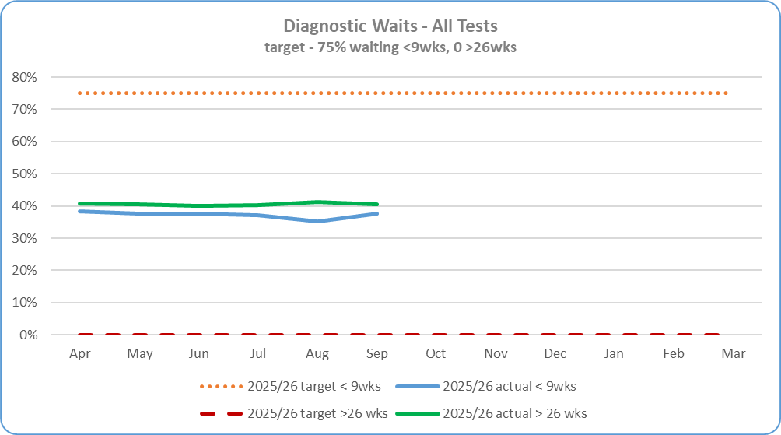
Section 3/4 – Key SOMs Indicators - Efficiency & Productivity and Access Improvement
Service Area | Metric | Sept 25 Target | Sept 25 In-month Performance | Cumulative Activity YTD/Qtr end | Rag Status Sept 25 | Rag Status YTD/Qtr end | Chart
Efficiency & Productivity – Scheduled Care | Average LoS for Elective Patients Haematology (includes paediatrics) Target - Reduce LoS against CHKS peer group level | 10.20 days | 12.51 days | 12.09 days
 | Average LoS for Elective Patients Urology Target - Reduce LoS against CHKS peer group level | 2.26 days | 2.59 days | 3.24 days
Access Improvement/ Ministerial Targets – Elective Care | New Outpatient Waiting List Target – 50% patients waiting < 9 wks 0 patients waiting over 52 wks | 50% < 9 wks 0 over 52 wks | 14.11% patients under 9 wks 88,804 patients waiting over 52 weeks | 13.41% 88,804 (Sept position)
 | Diagnostic Waiting Lists - Imaging Physiological Measurements Endoscopy Target – 75% patients waiting < 9 wks 0 patients waiting over 26 wks | 75% < 9 wks 0 over 26 wks | 37.7% patients under 9 wks 23,317 patients waiting over 26 wks | 37.7% 21,666 (Sep position) 40.6% 23,317 (Sep)

Slide 13
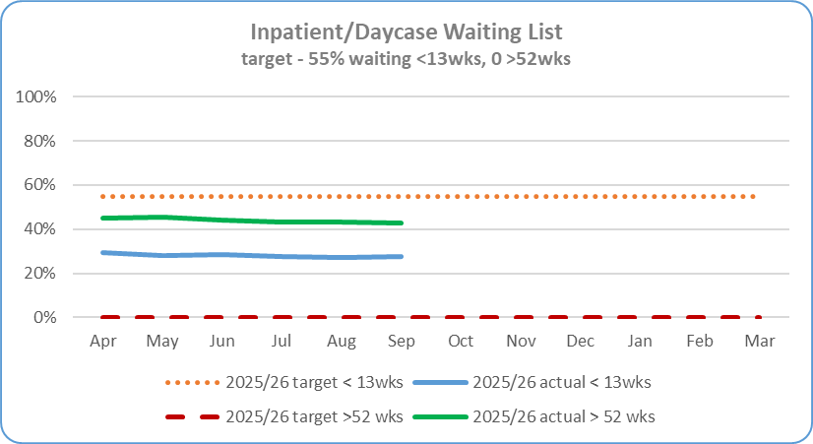
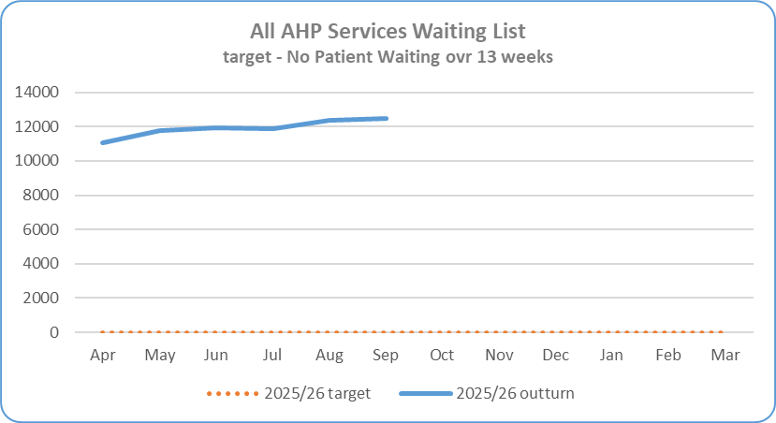
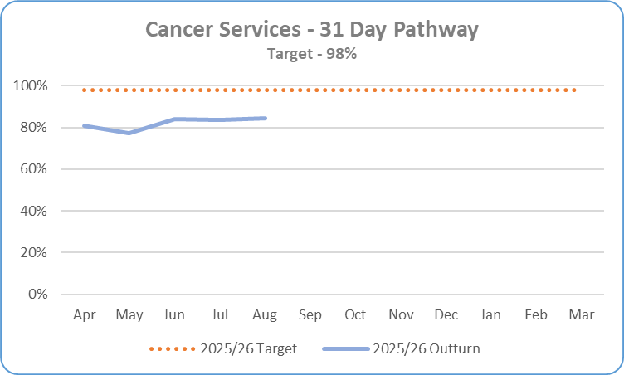
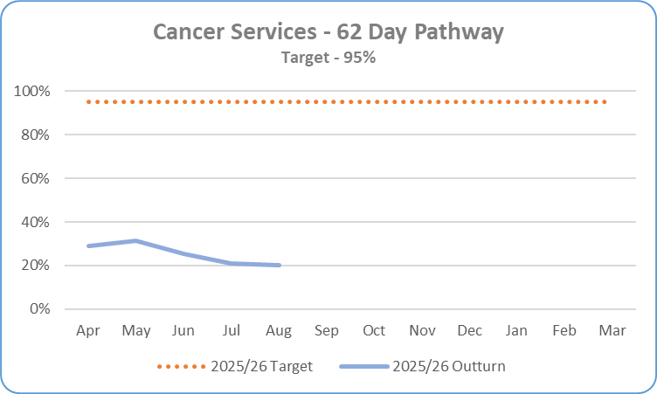
Section 4 – Key SOMs Indicators - Access Improvement
Service Area | Metric | Sept 25 Target | Sept 25 In-month Performance | Cumulative Activity YTD/Qtr end | Rag Status Sept 25 | Rag Status YTD/Qtr end | Chart
Access Improvement/ Ministerial Targets – Elective Care | Inpatient & Daycase waiting lists Target – 55% patients waiting < 13 wks 0 patients waiting over 52 wks | 55% < 13 wks 0 over 52 wks | 27.78% patients waiting < 13wks 16,523 patients waiting over 52 wks | 27.78% 16,523 (Sep position)
 | AHP Waiting Lists – All Services Target - No patients waiting over 13 wks | No patients waiting over 13 wks | 12,459 waiting over 13 wks out of a total of 23,559 (51.3%) | 12,459 patients (Sept position)
Cancer Services | 31 day Performance Target - 98% of cancer diagnosis patients to receive their first definitive treatment <31 days of a DTT | 98% Monitored a month in arrears | 84.59% (Aug 25) 313 out of 370 patients were seen <31 days Figures are provisional as pathways are still being closed down and validation ongoing. | Apr - Aug 25 82.3% - 1,612 out of 1,965
 | 62 day Performance Target - 95% of suspect cancer patients red flag referred to be begin definitive treatment <62 days of referral | 95% Monitored a month in arrears | 28.26% (Aug 25) 39 out of 138 patients were seen <62 days Figures are provisional as pathways are still being closed down and validation ongoing. | Apr - Aug 25 26.8% - 195 out of 715

Slide 14
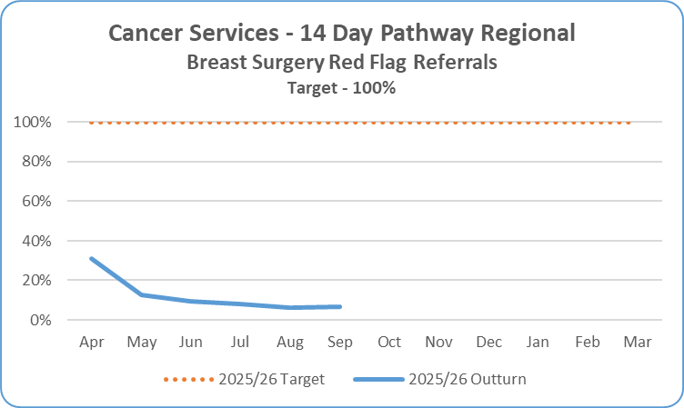
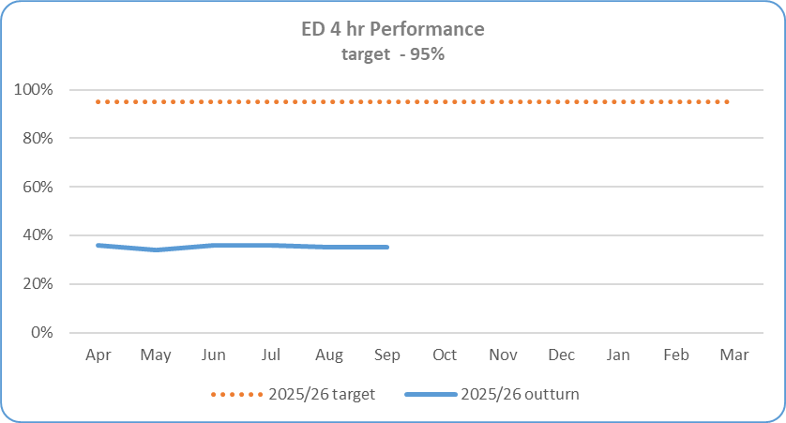
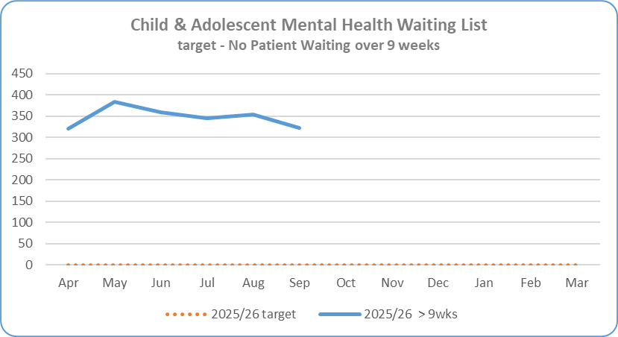

Section 4 – Key SOMs Indicators - Access Improvement (2)
Service Area | Metric | Sept 25 Target | Sept 25 In-month Performance | Cumulative Activity YTD/Qtr end | Rag Status Sept 25 | Rag Status YTD/Qtr end | Chart
Cancer Services | 14 Day Performance – Regional Position so not reported in Belfast Trust SOMs Target – 100% of suspect breast cancer referrals to be seen within 14 days | 100% | 6.53% 66 out of 1011 patients were seen <14 days | Apr - Sep 25 13.20% 759 out of 5,750
Access Improvement/ Ministerial Targets – Unscheduled Care Care | ED <4 Hour Performance Target – 95 % of patients waiting <4 hours from arrival to discharge/admission | 95% | 35.03% 4,881 out of 13,934 attendances | 35.24% 28,876 out of 81,934 attendances
Mental Health Services | Child & Adolescent Mental Health Services Waiting List Target – No patients waiting over 9 weeks | No patients waiting over 9 wks | 323 50.63% of total waiting | 323 (Sep position) 50.63%

Slide 15
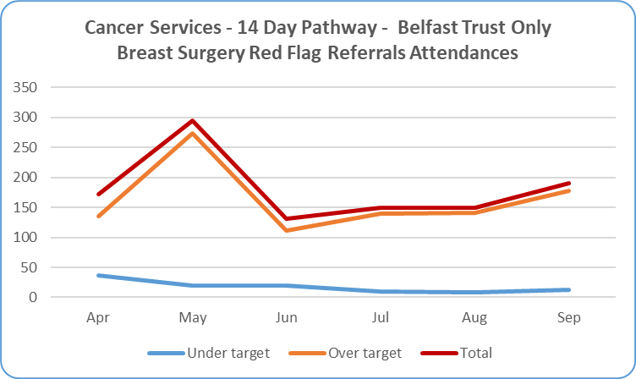
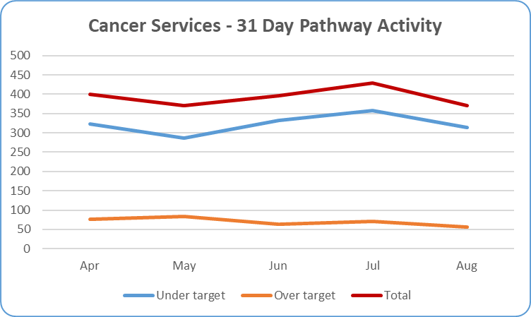
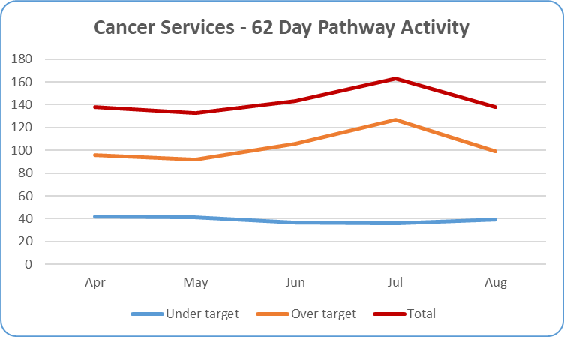
Cancer Monthly Activity
31 & 62 day activity reported a month in arrears

Slide 16
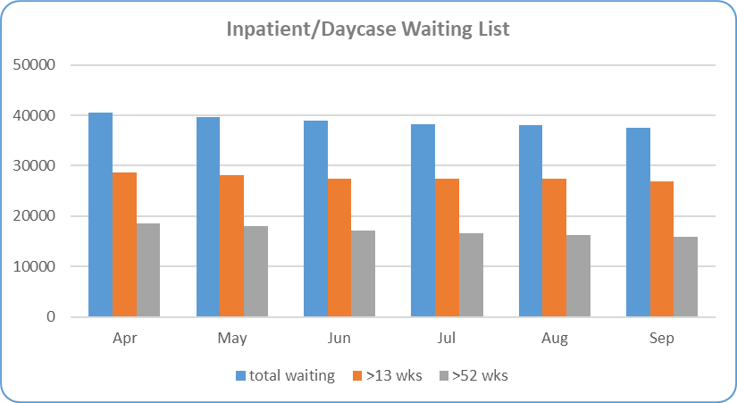
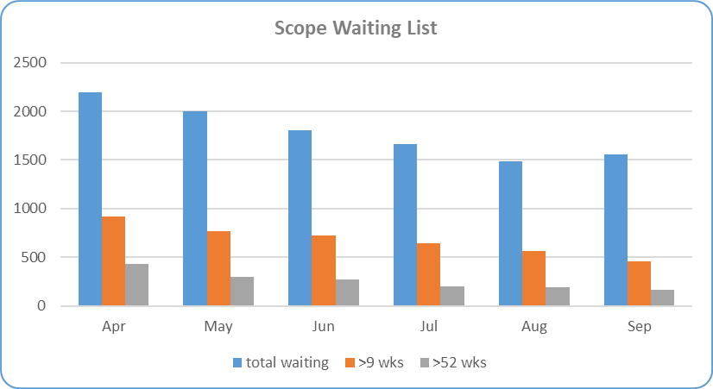
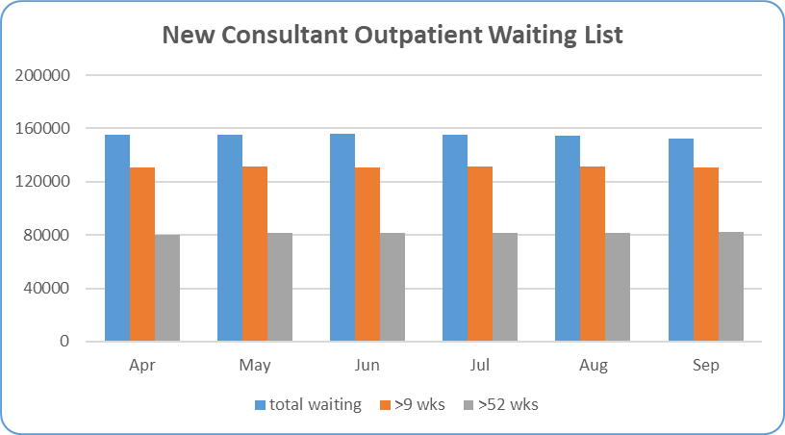
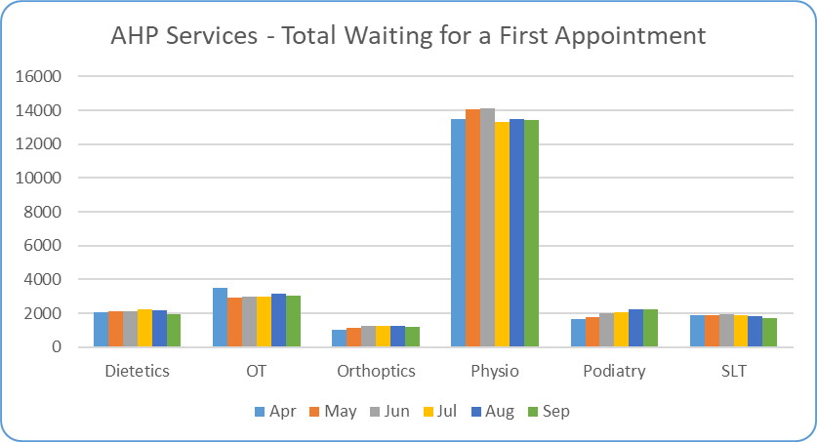
Waiting List Summaries

Slide 17
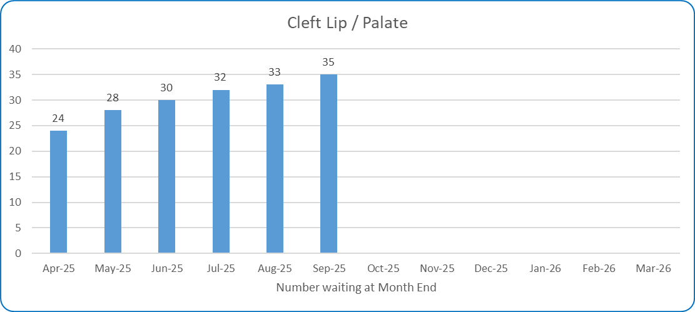
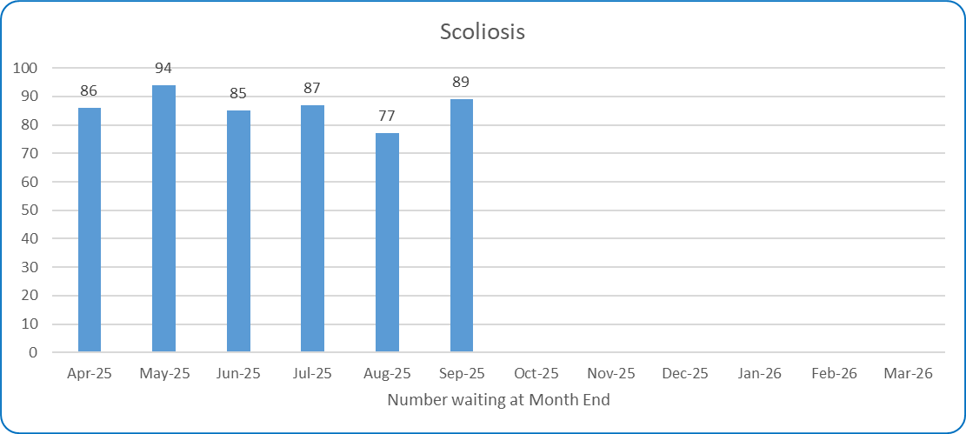
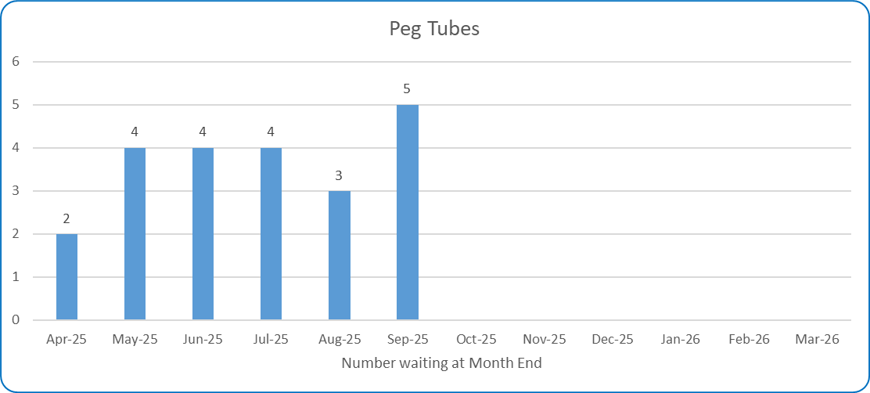
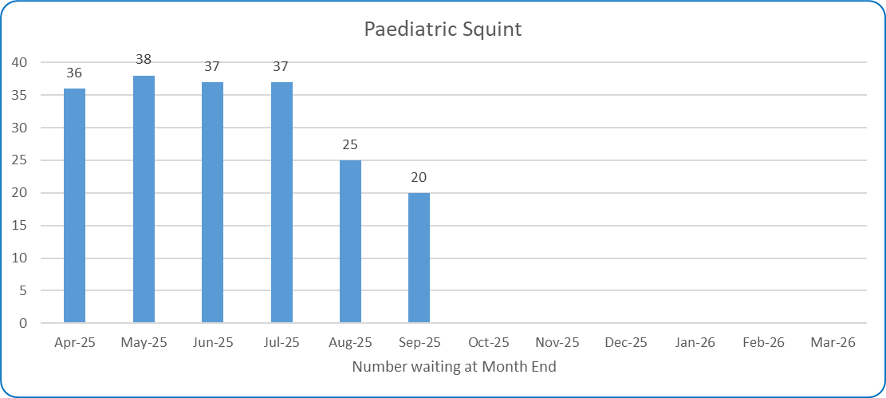
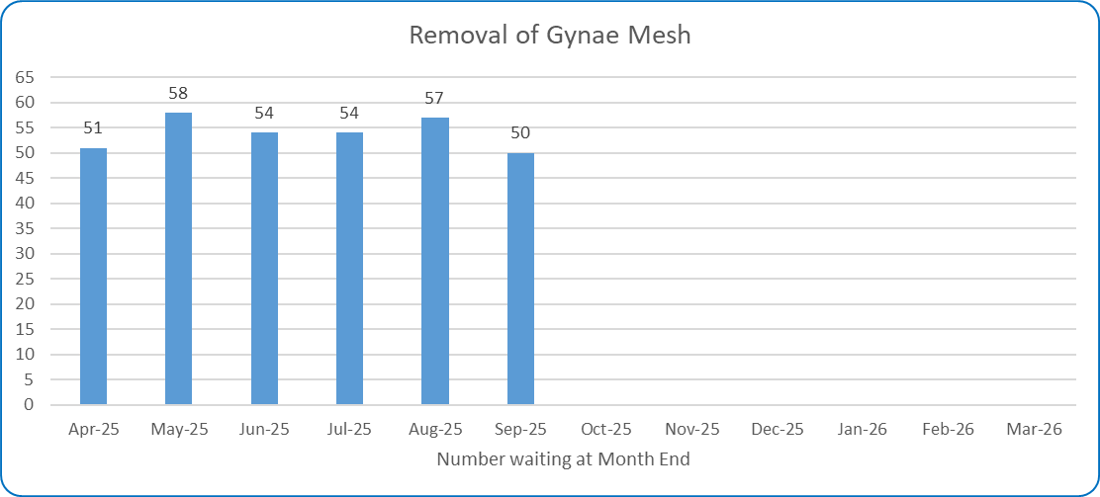
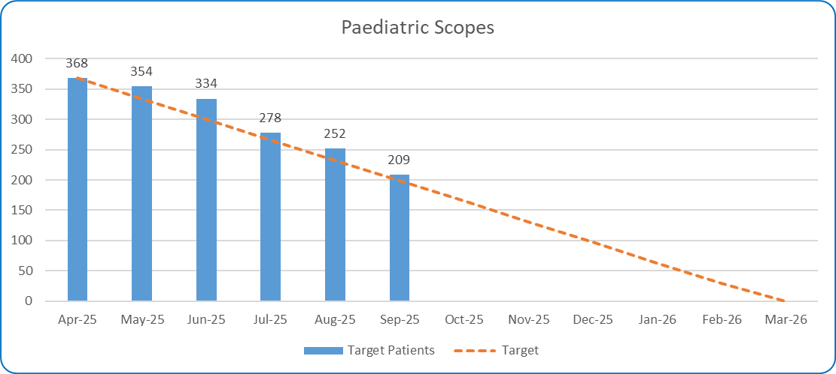
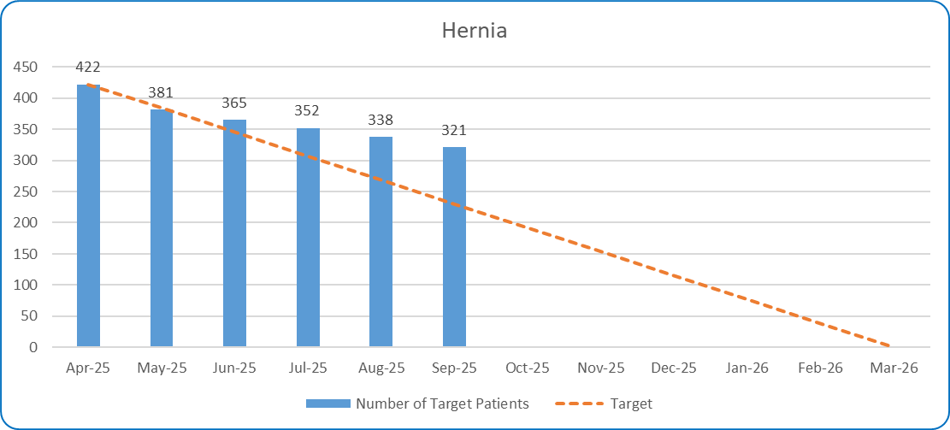
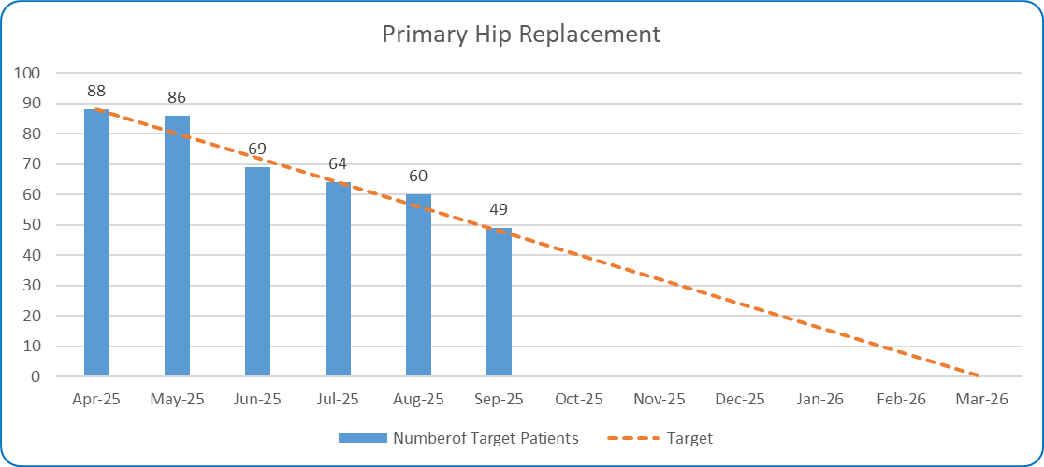




Waiting List for Names Procedures – £50million Backlog Procedure Clearance

Slide 18
Waiting List Validation – Inpatients & Scope as at 9th October

Slide 19
Waiting List Validation – Outpatient as at 16th October

Slide 20


Section 5 – Patient Satisfaction - Real-Time Feedback: Patient Experience Charts - Month of September 2025 = 488 surveys
1st April 2025- 30th September2025: 4,736 surveys were completed across all Real Time Patient Experience engagement tools.
In September 2025, of 488 adult inpatients, 99% were extremely likely to recommend the ward they were in to their friends or family and overall satisfaction remains at 99%.
The highest scoring Domains in September 2025 were:
(9.98) Doctors and Kindness & Compassion; followed by (9.96) Respect & Dignity, Pain Control and Medicine.
Noise at Night remains a challenging Domain scoring (9.65) in September 2025.
Real Time Patient Experience continues to engage with Services exploring expansion within resources. Discussion ongoing regarding sustainability of current capture/reporting platform (Formic) and future reporting options and opportunities.
7

Slide 21


Section 5 – Patient Satisfaction
Service Area | NOTE: This information is produced quarterly
Datix – Complaints and Compliments | High Risk Top Subjects Trustwide April 2020 – September 2025
 | All grades Top Subjects Trustwide April 2020 – September 2025

Slide 22
Appendix

Slide 23
System Oversight Measures Indicators Summary Tables

Slide 24

Escalations: Support and Intervention Framework – September 25
Level 1 (4) | Level 2 (8) | Level 3 (4) | Level 4 (0) | Level 5 (1)
Cleft lip and palate | Serious Adverse Incidents | MAH Governance & Accountability |  | Cardiac Surgery
Reduced Paediatric ICU capacity | PACU activity | Ambulance Handover
Iveagh ID CAMHS Inpatient Unit –timely admissions(↓from level 2) | Full implementation of Perinatal Mortality Review Tool | Family and Childcare workforce
CAMHS waiting lists (↓from level 2) | Increasing Usage of IS Foster Placements | Iveagh Inpatient Unit- delayed discharge
 | Short breaks for kids with disabilities
 | Insertion of peg tubes (↓from level 3)
 | Unallocated cases (CCS)
 | Reducing Time Spent in ED for patients (especially >12 hours) (↓ Level 3)
Escalation
Level 5*: intervention at HSC Board level – Decision by Health Minister- as advised by DOH/SPPG/PHA. Involves exercise of Minister’s power of intervention. Only used in exceptional circumstance. Targeted support suspension, removal of duties from individuals or whole Board. Assessment through quality surveillance, existing knowledge, formal and informal investigations. Draw on expertise/advice of national colleagues and use of external organisational and independent advisors
Level 4*- Senior external support for provider. Targeted interventions – decision taken by Permanent Sec. Failure to provide recovery plan at level 3, significant weaknesses re financial stability, reputation, governance quality of care or patient safety. DOH take/coordinate action and direct intervention to support Trust, Interventions undertaken by SPPG as directed by Perm Sec. Appropriate external support may be given to Trust eg mentoring for Board/ET members – co-opting experts onto Board as Independent Advisors for finite period. DOH Review
Level 3- enhanced monitoring and support for provider – where previous concerns not resolved at levels 1 or 2, scale of concern, systemic concerns, or ongoing performance challenges, Formal recovery plan – proactive approach, clear milestones and responsibilities – significantly enhanced monitoring and scrutiny. Trust CE to cooperate and provide leadership re agreed recovery actions.
Level 2- enhanced monitoring and support for provider – issues not resolved by Level 1 or direct escalation to Level 2 given seriousness. Local recover plan and enhanced monitoring- regular meetings at Director level – need to show proactivity e.g ongoing performance challenges, risks with no identified action/timetable
Level 1- area of concern identified – emerging, potentially serious concern to service delivery, quality, safety effectiveness – informal level of support and guidance – but no intervention e.g. failure to demonstrate budgetary control and/or insufficient focus on productivity/efficiency. Notified in writing. Local recovery plan required. More frequent monitoring
Steady state- no intervention required- Trust generally operating effectively – any issues picked up through routine oversight arrangements
De-escalation
NI Public made aware of
concerns at levels 4 &5 -
serious problems or
concerns re existing
leadership’s ability to
rectify
Escalation and de-escalation to & from level 1 will take place as necessary and be decided by DOH/SPPG/PHA

Slide 25
Performance:
Readmission Rates
Review OP Appointments
Patient Initiated Follow Up (PIFU)
Efficiency & Productivity:
Daycase Rates
Inpatient Admissions
Access Improvement:
Dementia Waiting List
New SOMs Indicators to be implemented and reported in Quarter 3
Safety & Quality:
Falls
SSKIN Bundle
MUST
Palliative Care

