Slide 1


The Belfast Community Palliative Care Hub
Trust Board Update, 6 November 2025.
Colin McMullan, Director Adult Community, Older People Services & Allied Health Professionals
Dr Grainne Bonnar, Co-Chair Belfast Partnership Palliative End of Life Locality Board/ Co-Chair Project Board
Catherine Collins, Co-Director, Adult Social Work Services, Community Nursing Services and Intermediate Care Services
Aisling Pelan, Project Manager, Belfast Community Palliative Care Hub

Slide 2

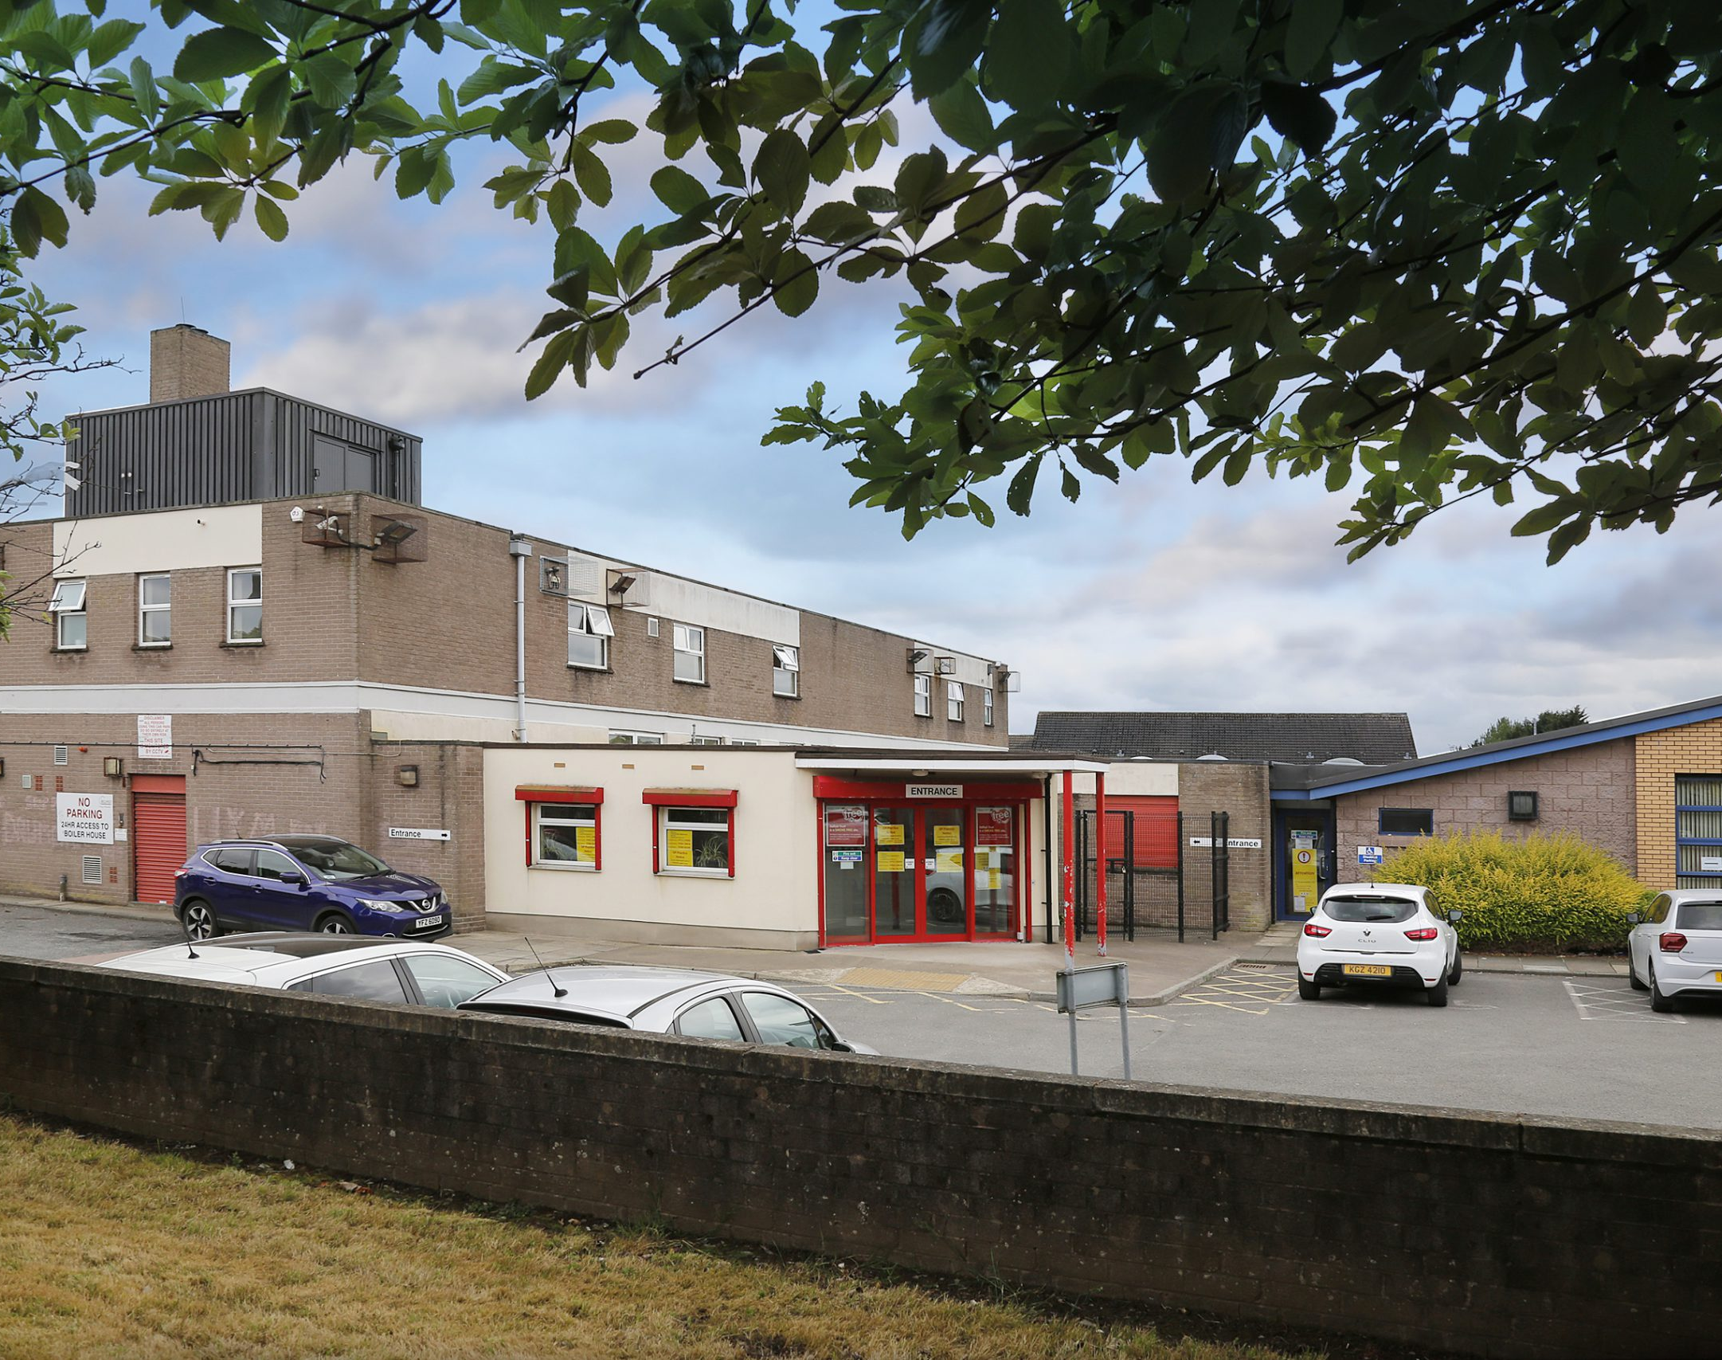
Belfast Community Palliative Care Hub
Having a Single Point of Access for Palliative and End-of-Life patients is a Trust Priority (The Belfast Plan 2024).
Hub opened on Monday 28th April 2025 - Soft launch, initially taking referrals from GPs, DNs, teams within the Trust.
3 partner organisations have come together to coordinate palliative and end-of-life care for patients in the community (800 patients
in the first 6 months).
Base is Crumlin Road Health Centre.

Slide 3
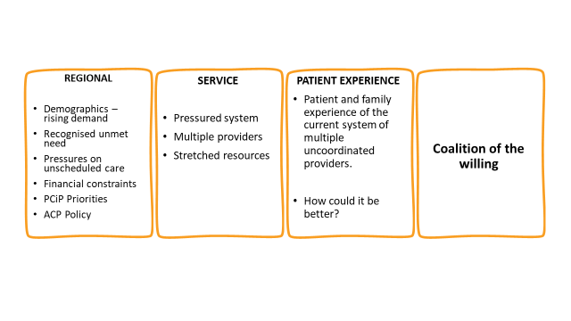


Drivers for Change

Slide 4


Journey to this point
Regional workshop (07.02.20) inviting applications for Macmillan collaborative funding - based on coordinating care, using multi-skilled professional teams, dedicated consultant medical support and early referral in to SPC
Virtual workshop 'Together Let's Make it Better' in October 2020 followed by Desktop mapping exercise
Action identified: Development of a Single Point of Referral for coordinating palliative and end-of-life care
Cancer Fund Application by Marie Curie to support funding for a Project Manager, appointed June 2023. Further funding for post, until Oct 2027, provided by BHSCT Research Capacity Fund.

Slide 5

What is ‘new’ in this model of care?
‘One-team’ co-ordinated approach to care.
Holistic same-day triage for multiple services.
Tripartite MDT working at core.
Easier access to medical advice and reviews.
Links with GP and DN 24h service.
One point of contact for referrers.
Equitable service provision.
Digital connectivity.
The Future (early 2026): Patients and carers will be able to access the Hub directly, have their needs assessed, calls will be logged on Encompass and followed through until resolution of issue or referral and handover to community teams.

Slide 6
Principles of the New Service Model
A patient-centred ‘one-team’ approach – a multidisciplinary team working collaboratively and keeping patients at the centre of care-planning.
One referral to the Hub without the need for other referrals as care will be coordinated by the Hub team. This improves patient access.
The needs of the patients are assessed at referral by an SPC professional to ensure timely intervention by the most appropriate service(s).
An equitable service for patients across N,S,E & W Belfast.
Patient care is not owned by a particular provider but is provided by a combination of providers based on patient need.

Slide 7
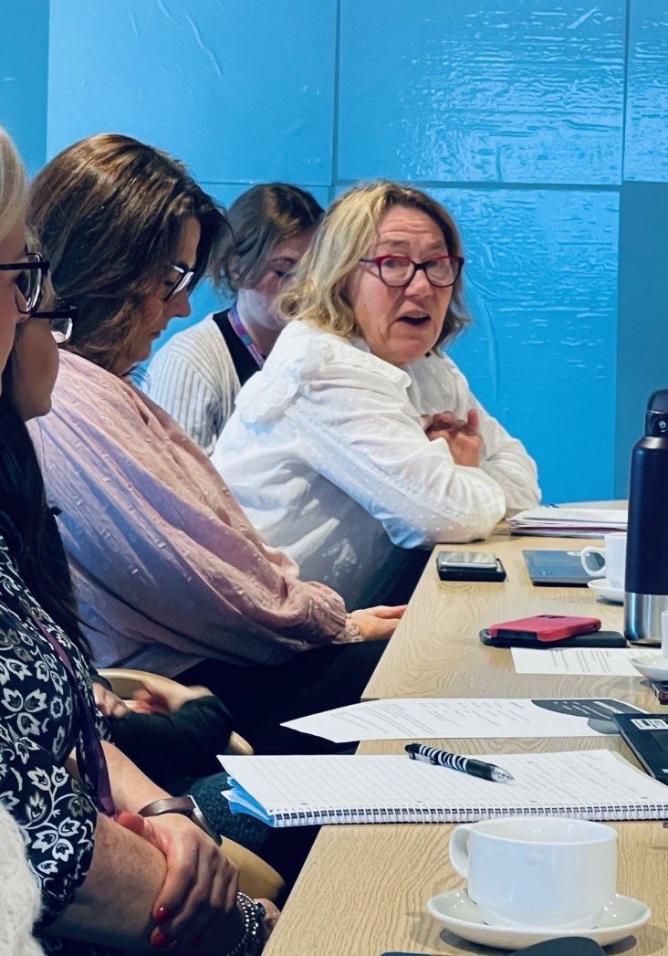
The contribution of our Service User Representatives
Our service users bring knowledge and lived experience to the table.
Our main service user rep is a core member of Project Board, representing the service at networking and learning events.
Our service users keep us focused on our vision – making things better for patients and their families.
Our service user involvement strategy has been recognised nationally – we were a finalist in the Picker Experience Network Awards 2025.

Slide 8

What matters to patients receiving end of life care?
Confidence that they are ‘in the right system’.
Their team is connected and communicating.
They will have equitable access to resources, where and when they need it.
Easy re-referral, using one telephone number, if their needs increase.
They can die in their preferred place of death.
Time matters..

Slide 9

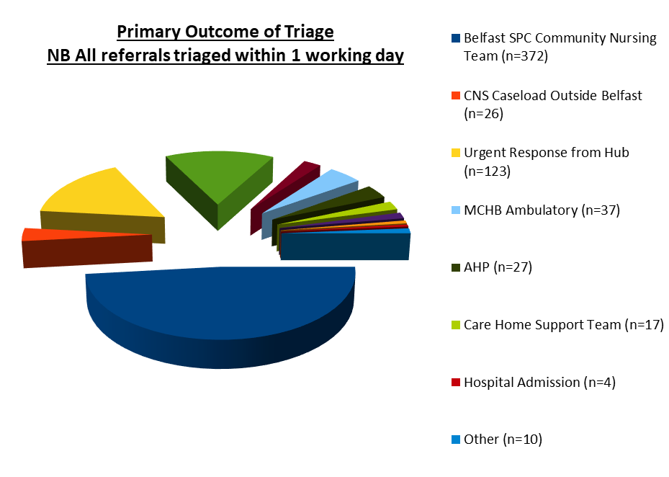

Belfast Community Palliative Care Hub – Our First 6 months
Belfast Community Palliative Care Hub – Our First 6 months
Service Objectives
Through collaborative partnership with NI Hospice and Marie Curie to reduce silo working, reduce duplication of care and provide a unified approach to the provision of palliative and end-of-life care for community patients within Belfast locality.
To prevent unnecessary ED attendance and hospital admission for palliative and end-of-life patients through provision of specialist assessment and management of complex symptoms in the patient’s home.
To enable patients to die well at home, if this is their wish, with symptoms effectively managed and timely access for them (and the teams caring for them) to specialist advice and treatment.

Slide 10


How have we made a difference?
Case study. 55 year old with diagnosis of Cancer of Colon and Liver Metastases. Patient was actively dying.
Social issues: IV Drug User and Drug Abuse within family and wider circle. No stable home environment.
Symptom control and pain management needs.
Referral made to Hub, MDT, all options explored (DN/Social Care Package/Inpatient Hospice Bed/Hospital Admission).
Risk Assessment undertaken: accessing and management of controlled drugs in the home, drug abuse within the home and potential for PSNI involvement in case of missing drugs.
Adult safeguarding concerns and protection plan.
Communication with patient, family, NIAS, inpatient ward – timely action.
Support for professionals involved in patient care.
Timeline: Referral to Hub 1135 hrs, decision to admit 1355 hrs.
Our patient had a good death.

Slide 11

How will we know it is better?
Data Collection.
KPIs and metrics.
Independent evaluation (QUB/UU), supported by Trust Research and Capacity Fund.
Ongoing Service User Engagement.
Patient feedback, Compliments and Complaints.
Stakeholder feedback.
Monitoring and Oversight of Service.
Governance and Assurance Processes.

Slide 12

Next Steps
Formal Launch of the Service by Health Minister Mike Nesbitt in January 2026.
Extending Encompass Access to Hub-affiliated Specialist Palliative Care Nursing Team – November 2025.
Integration of the Specialist Palliative Care Allied Health Professionals in January 2026.
Patient and Carers will be able to self-refer to the Hub in early 2026.
Formal research evaluation of the new model of care UU/QUB (Jan – Dec 2026). Publish the study.
Sharing the learning and promoting the model of care locally, regionally and nationally.

Slide 13

Opportunity for questions and discussion….

