Slide 1

Support and Intervention Level 5 Escalation: Cardiac Surgery Trust Board Presentation 08 January 2026

Slide 2
Background
Royal College of Surgeons England Invited Service Review of cardiothoracic surgery March 2020
The outcome report provided 37 recommendations. A comprehensive programme of actions was then undertaken by the Trust
Public Health Agency and Strategic Planning and Performance Group commissioned DCO Partners Ltd to review clinical governance, safety and culture/behaviours within cardiac surgery
This review made 16 recommendations, including the reopening of 7 Royal College Surgeons recommendations.
Both reviews indicated the service was clinically safe but found unacceptable culture and behaviours continued
Notes:
CLT suggest we do not include this tomorrow or Friday, happy to discuss

Slide 3
DCO Recommendations
9. Board knowledge of medical leadership needs to be improved, with more effective oversight by Board committee. The Board should have visibility of all disciplinary processes and internal/external professional reviews against doctors and nurses, to be able to discern patterns and to form a review about improving behaviours, and to ensure that these are not used inappropriately.
10. There is a pattern of external reviews not being shared widely with staff, possibly due to the mistaken notion that this will stop enmities developing. Our view is that failure to share such reports has the effect of reducing learning and inhibits the ability to "move on"
11. The current leadership team has so much history of being involved in these complex relationships that the only sensible course is to use unconnected (possibly external) individuals to supervise any further disciplinary processes in the Cardiac Unit.
12. Is the Clinical Director role a sole determinant of escalation, in effect a single point of failure still (this was an RCS ISR Conclusion in 2020) in terms of reflecting concerns or raising issues with higher management? If so, this must be changed to allow more than one point of referral for concerns - a key principle of Freedom To Speak Up
13. Given the behaviours directed at those raising concerns, they should be considered as whistleblowers in order to protect them in law.
14. Current and ongoing litigation within the Trust should be the subject of a risk conference at a higher level, in order to map the extent of the problem and its likely effects on behaviours.
15. There should be a rapid review of the return-to-work process that was conducted for the former Clinical Director (CD), and the impact it caused.
16. The Trust needs to engage and work closely with NIMDTA.
1. Trust Board should consider whether its current governance arrangements provide for a clear enough picture to be built of clinical risk and patient safety.
2. The Trust should create an equivalent Freedom of Speak Up (FTSU) process across the Trust, with an individual specifically appointed to lead it and overseen by a nominated NED.
3. The Trust should deliver a campaign to emphasise the risks to patient safety from poor behaviours in the workplace - see NHS Civility and Respect campaign.
4. Raising of concerns should be encouraged as an accepted practice within all management and teaching meetings.
5. The Cardiac Unit would benefit from greater connectivity with another unit of similar or larger size. This is to facilitate shared learning, to encourage exchanges and create effective mechanisms to avoid issues or poor practice becoming entrenched.
6. Deaths on Cardiac Waiting Lists should be regularly analysed and included in formal data reviewed by the Board, Health Authority and also externally.
7. Cardiac Surgeons should regularly review their own outcome data in the form of VLAD or CUSUM plots. This in turn should form part of a broader set of analytical data to monitor effectiveness of the Unit including Waiting List deaths.
8. The Trust Board should review how staff are communicated with and steps taken to ensure more opportunities for staff to hear about developments and to contribute their views (focus groups, "town hall" meetings etc.), as well as more time being spent in assessing and thus managing likely reactions to announcements, thus mitigating their effect.
Notes:
CLT suggest we do not include this tomorrow or Friday, happy to discuss

Slide 4
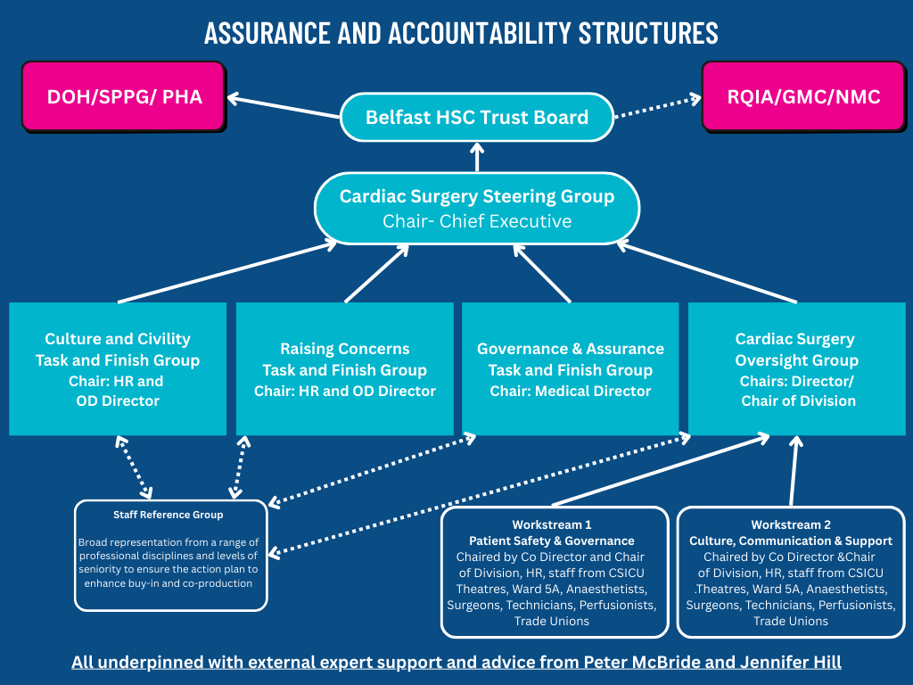
New Governance Structure to address DCO Outcome Report
Notes:
CLT suggest we do not include this tomorrow or Friday, happy to discuss

Slide 5
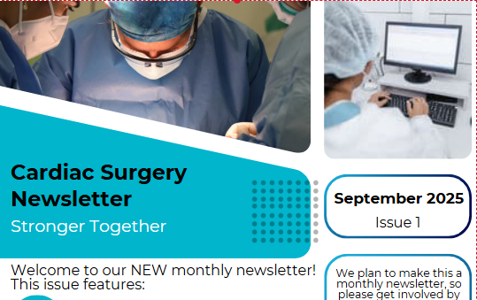



Workstream 2 Culture, Communication and People
5 Town Hall meetings
3 May 2025
2 September 2025
Individual Consultant – Director meetings
Senior Leadership attending individual professional team meetings
Daily Raising Concerns Forum included in situation report
163 staff have attended Respect and Civility/Bystander Training
4 Cardiac Surgery Monthly Newsletters published with ongoing evaluation
Notes:
CLT suggest we do not include this tomorrow or Friday, happy to discuss

Slide 6
Workstream 2 Culture, Communication and People cont.
Frequently Asked Questions developed to reassure patients, promoted through Trust website and Patient Client Council
Patient Involvement – Cardiac Surgery Involvement Group established including 6 volunteer members with personal or carer experience of cardiac surgery, first meeting 25 November 2025.
Review of updated Pre-Assessment Booklet and new Interhospital Transfer leaflet to Ward 5A, will be forwarded to the Trust Reader Panel after the Involvement Group
Realtime patient feedback, Ward 5A received 100% patient satisfaction scores September to December 2025. Cardiac Intensive Care Unit received 99% September to December 2025
Notes:
CLT suggest we do not include this tomorrow or Friday, happy to discuss

Slide 7
Culture & Civility and Raising Concerns
Respect and Civility Training and Bystander Training
163 Cardiac Surgery Staff have attended this training, further training planned in January 2026
Raising Concerns
Raising Concerns (Whistleblowing) Policy – co-production focus groups completed and facilitated by HSC Leadership Centre
Outcome report of this review anticipated in late January 2026
People and Culture
People and Culture Steering Group established to delivery the People and Culture Strategy for the organisation
Projected delivery date of delivery April 2026
Notes:
CLT suggest we do not include this tomorrow or Friday, happy to discuss

Slide 8
Workstream 1 Patient Safety and Governance
Recommendation 5 Connectivity with other Units
Planned visit to Sheffield Teaching Hospital in Spring 2026
Established links with Mater Private Hospital, Blackrock Clinic and Children’s Hospital Dublin
Established links with Guys and St Thomas’ Hospital. Liverpool Transplant Centre, St Bartholomew’s Hospital and Freeman’s Hospital for congenital surgery
Recommendation 6 Review Deaths on the Waiting List
Yearly reporting to the National Cardiac Benchmarking Collaborative (NCBC) and National Congenital Heart Disease Heart Disease Audit
Standard Operating Procedure in place for the regular review of the surgical waiting list
All deaths on the waiting list will also be discussed at the Mortality and Morbidity
Recommendation 7 Regular review of outcome data
Data provided 6 monthly (VLAD report) CD discusses with individual consultants
Notes:
CLT suggest we do not include this tomorrow or Friday, happy to discuss

Slide 9
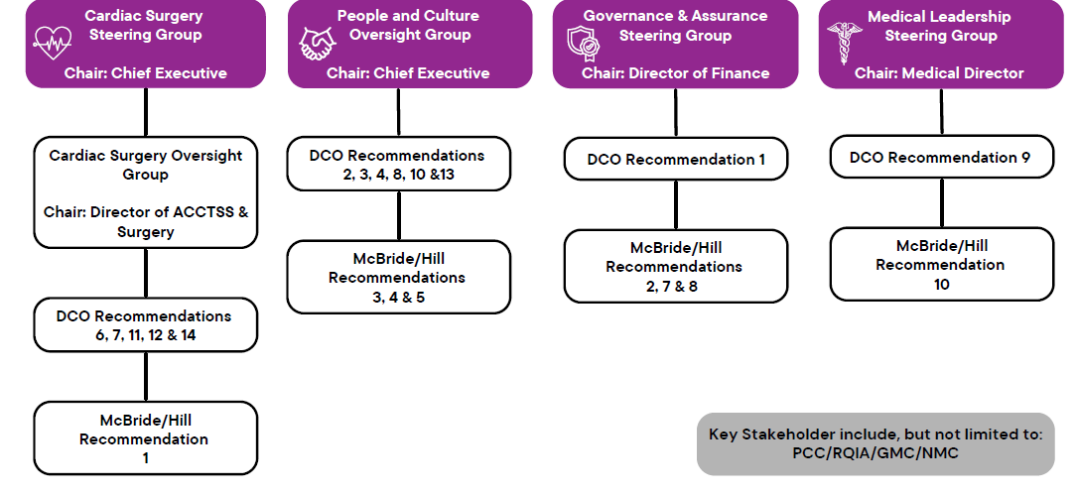
Proposed Hill/McBride Governance Structure
Notes:
CLT suggest we do not include this tomorrow or Friday, happy to discuss

Slide 10
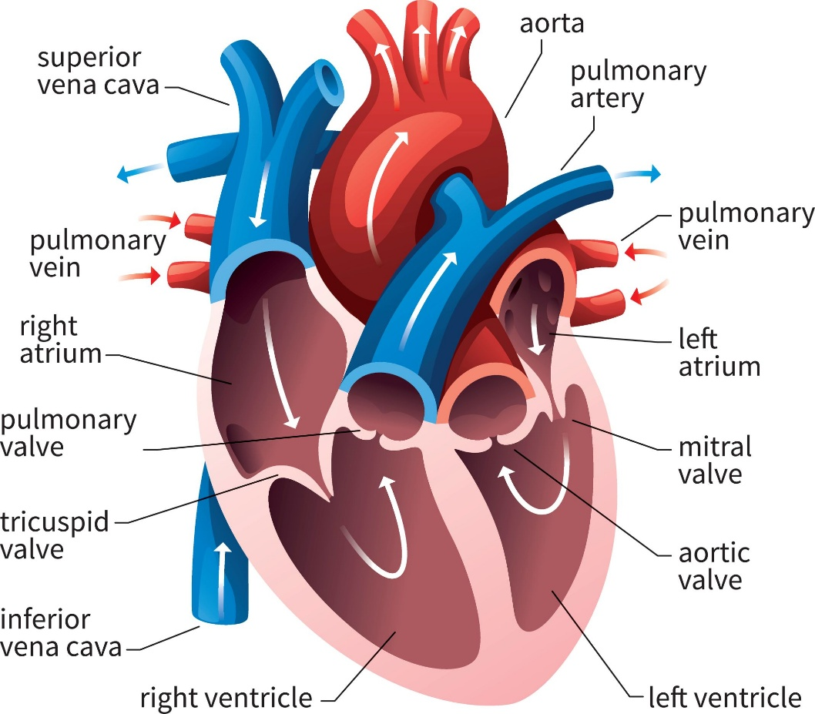
Team Structure
Three Teams
Aortic
3 Consultants
Mitral
3 Consultant
Revascularisation
2 Consultant
Congenital Team
Cross boarder partnership
1 Consultant
Notes:
CLT suggest we do not include this tomorrow or Friday, happy to discuss

Slide 11
New Patient Safety and Governance Arrangements
1st monthly all-day meeting 13 February 2026
AM
Outpatient New/Review Waiting List
Surgical Waiting List
Procedural Timings
Deaths on the Waiting List
Readmission of patients after surgery
Activity Data
Inactivity Data
Review of all reasons for patient cancellations
Complaints per 100 staff
Incidents/SAIs
Length of stay to include Pre and Post operation
Bed Occupancy
Monthly Profile – new techniques/equipment
PM
Mortality and Morbidity
3 Yearly Tracking mechanism
Business Meeting
Consultant closed meeting to discuss performance and VLAD plots
Validation of EuroScore categorisation
Notes:
CLT suggest we do not include this tomorrow or Friday, happy to discuss

Slide 12
Service Improvements
Three team structure
Reintroduction of the Theatre Scheduling Meeting
To ensure Cardiac surgery lists are utilised effectively
One case days will be the exception
Theatre Planning Meeting
To ensure staffing rotas across all teams reflect the planned work
Surgeon of the Week Model
Annualised Job Plans
Surgeons Meeting
Notes:
CLT suggest we do not include this tomorrow or Friday, happy to discuss

Slide 13
Questions and Feedback
Notes:
CLT suggest we do not include this tomorrow or Friday, happy to discuss

