Slide 1
Cardiac Surgery – what we do, how we do it and how we deliver quality assurance – UK and in Belfast
Peter Braidley
Cardiac Surgeon STHFT
Clinical Director BHSCT

Slide 2


Slide 3
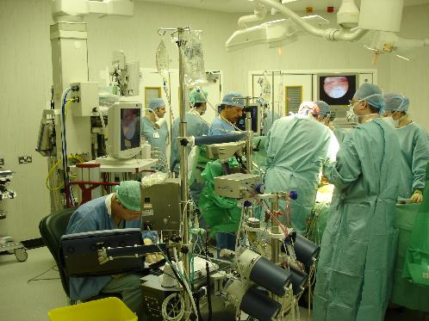
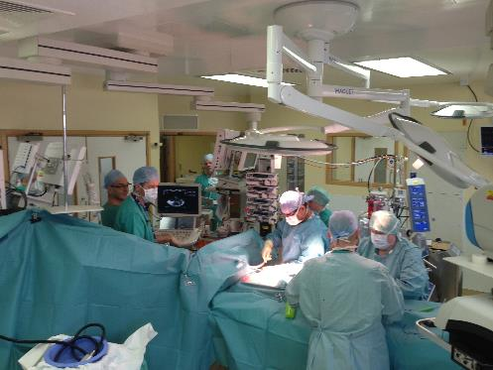
Cardiac theatres

Slide 4
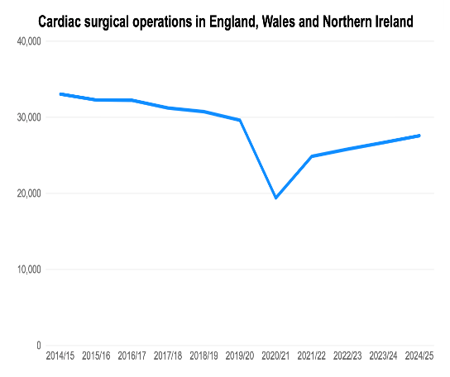
Current scope of practice……
Adults
Mainly acquired heart disease
Small volume of adult congenital surgery
Coronary bypass surgery
Heart valve repair / replacement
Aorto-vascular surgery
Tumours / complications following MI / arrythmia surgery

Slide 5
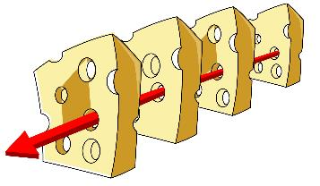
Many variables to be lined up to deliver cardiac surgical activity
Patient with optimized clinical conditions
Effective PAC
Admission facilities
Cardiac theatres
Cardiac anaesthetist
Cardiac surgeon
Experienced theatre team
Specialist services (CPB / TOE / IABP)
Cardiac critical care bed and staff
Cardiac Intensivists
Ward bed and staff
Rehab
Lots of slices of cheese!

Slide 6
Heart team discussion
Well embedded in NI with regional MDM’s
Importance stressed in the updated guidelines
Peer support and collective responsibility
Stresses the importance of audit, outcome analysis, research etc
Helps balance individual patient and utilitarian considerations…
Very significant costs to newer technologies
Perhaps it is time for disease specific management teams
To focus attention on a patient centered approach providing individualised treatment

Slide 7
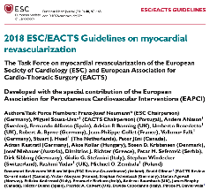
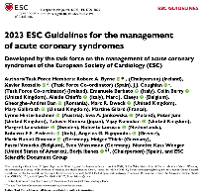
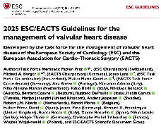
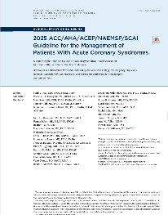
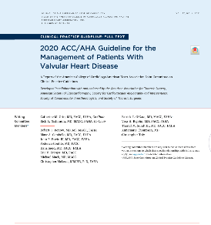
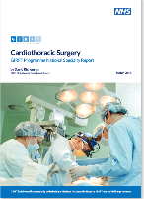
Awash with guidelines…..

Slide 8
Cardiac data collection and outcomes analysis
UK cardiac surgical register 1979
UK heart valve registry 1986
National Adult Cardiac Surgical Database 1994
Bristol enquiry and report 2001
The Guardian FOI surgeon specific outcomes published 2005
SCTS continued with this until 2011
NICOR from 2011 – now hosts all nationally mandated cardiac audits

Slide 9
Cardiac data collection and outcomes analysis
Data published of surgeon specific risk adjusted in hospital mortality on a rolling 3-year basis
Process for addressing variance
2023 – move to publishing unit specific outcomes
Additional metrics added

Slide 10

Cardiac data collection in Belfast
Mature well organized system
Incorporated into EPIC EPR
Usually the registrar in theatre enters the data into the database
Downloads into cardiac database managers system
Post op complications and other data entered into system by ward team and database manager
Database manager cross checks as much as possible
Downloads data into NICOR

Slide 11
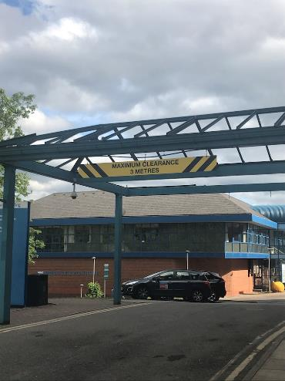
Things don’t always go to plan………

Slide 12
Things don’t always go to plan………

Slide 13
Risk
“The uncertainty that something may result in loss, harm or injury”

Slide 14
Risk
“The uncertainty that something may result in loss, harm or injury”
Risk is relative, personal and contextual
Individual patient factors
System factors
Operative factors
The cardiac surgeon’s job is to explain risk
The process of selecting and preparing a patient for surgery has to deliver a patient whose risk has been minimized
Outcomes monitoring seeks to track variance from individualised risk

Slide 15
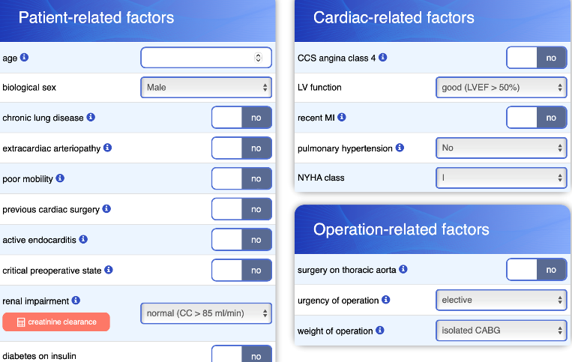
Risk prediction model – Euroscore 2

Slide 16
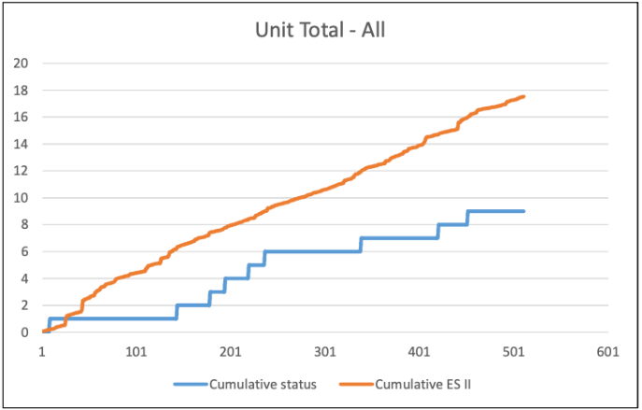
Internal monitoring
CUSUM plots

Slide 17
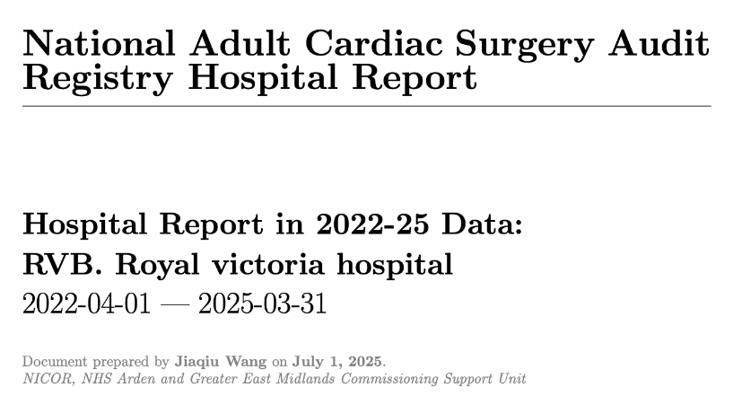
Validation reports

Slide 18
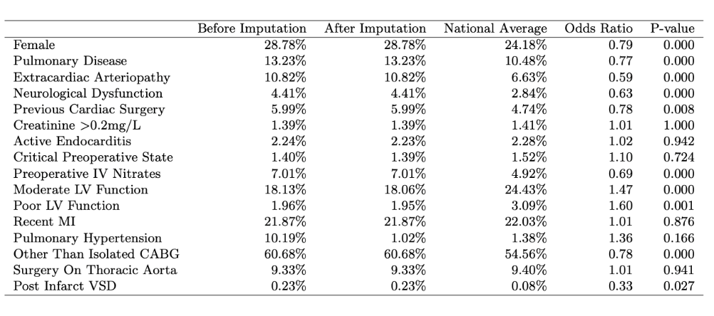
Risk profile unit vs UK

Slide 19
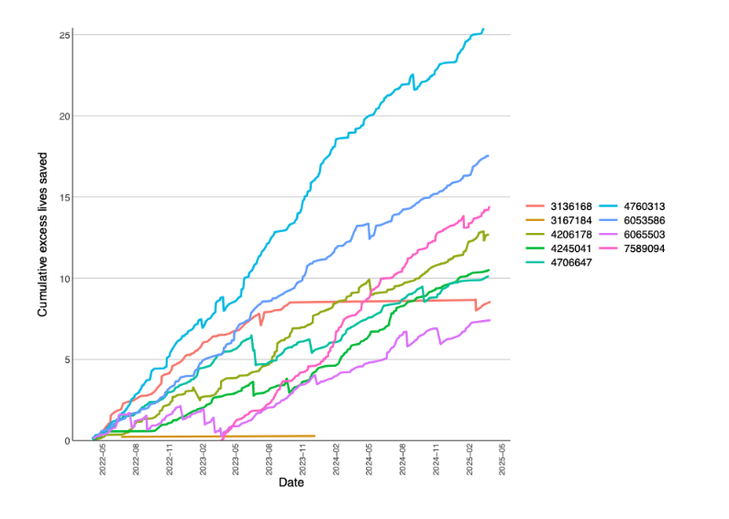
Individual surgeon’s plot 22-25

Slide 20
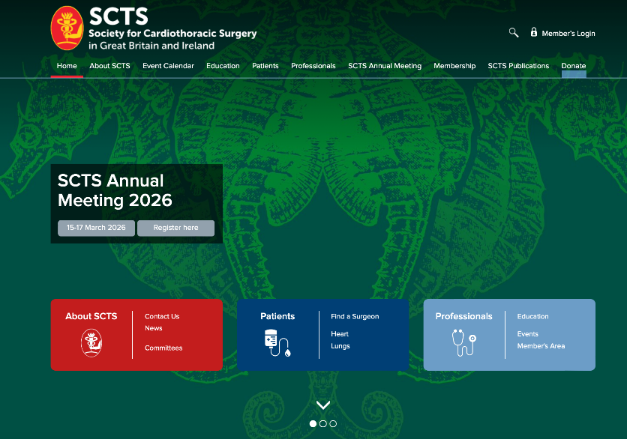

Slide 21
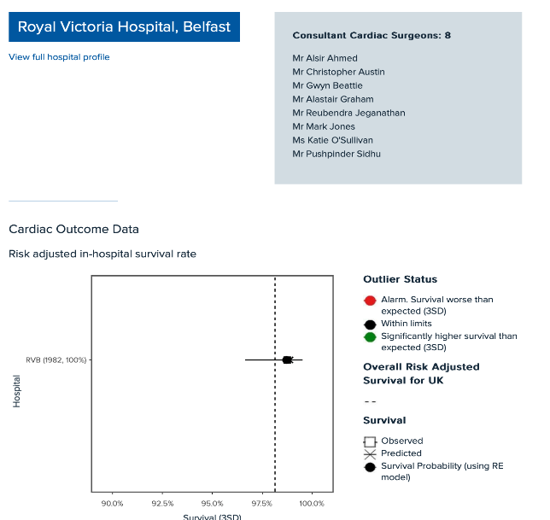
SCTS Webpage Data 22-25

Slide 22
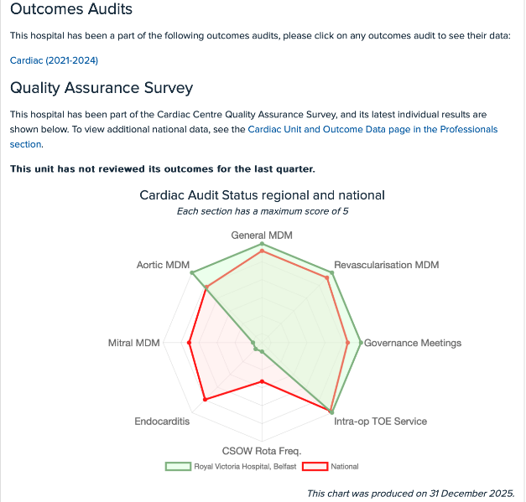
SCTS Webpage Data 22-25

Slide 23
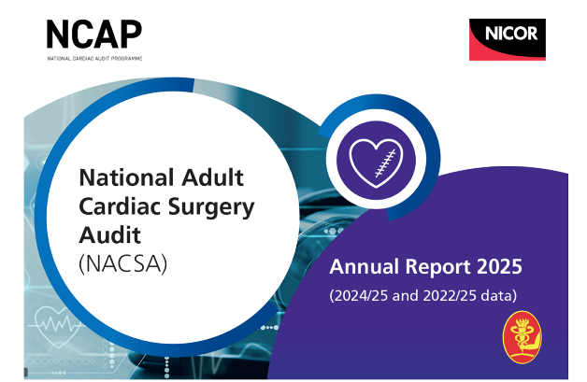
Outcomes monitoring
https://www.nicor.org.uk/interactive-reports/national-adult-cardiac-surgery-audit-nacsa

Slide 24
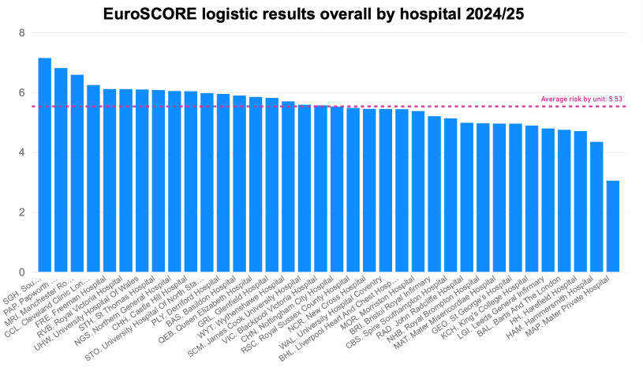
Risk profile across UK

Slide 25
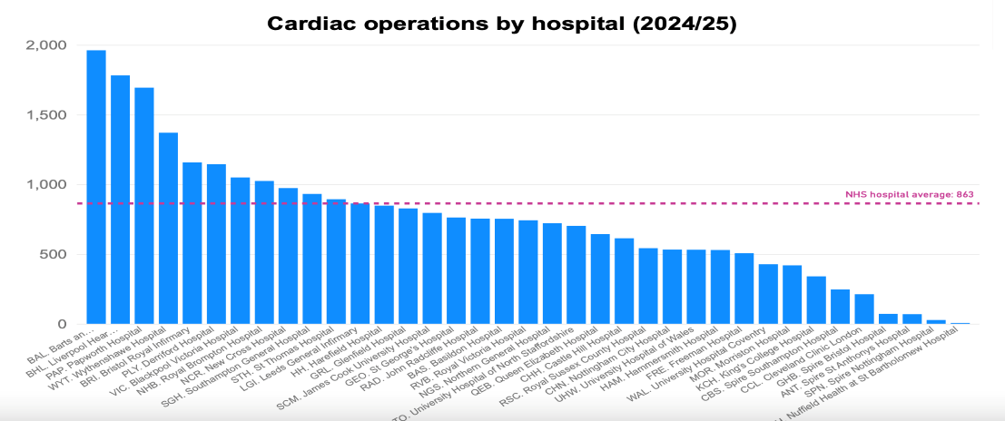
UK Activity

Slide 26
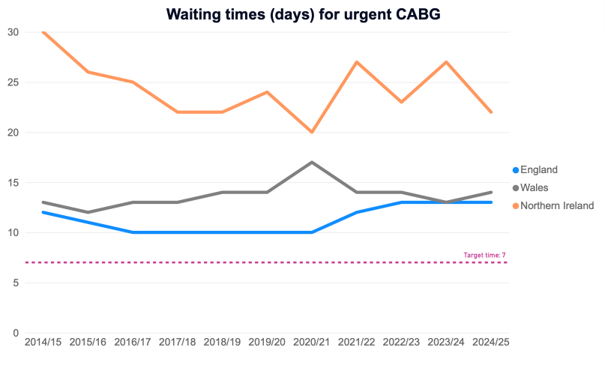
Non-elective surgery delays

Slide 27
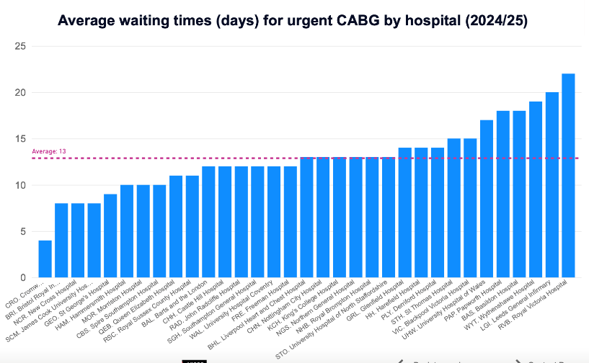
Non-elective surgery delays

Slide 28
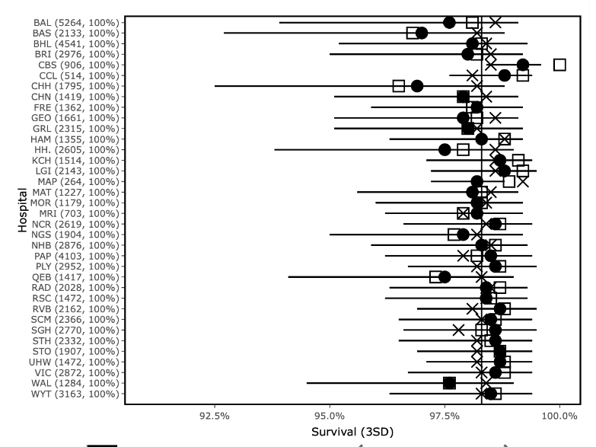
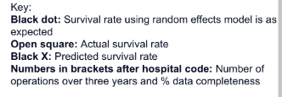
National survival data

Slide 29

Support and Intervention Level 5 Escalation: Cardiac Surgery Trust Board Presentation 08 January 2026

Slide 30
Background
2019 - Belfast Trust invited the Royal College of Surgeons (RCS) to carry out a review of the Cardiac Surgery unit
The outcome report provided the service with 37 recommendations. A comprehensive programme of actions was then undertaken by the Trust but not all were completed.
2024 - Public Health Agency (PHA) and Strategic Planning and Performance Group (SPPG) commissioned DCO Partners to review clinical governance, safety and culture/behaviours within the Cardiac Surgery unit
The review findings provided the BHSCT with 16 recommendations, including the reopening of 7 RCS recommendations. The review confirmed the Cardiac Surgery unit is clinically safe, but found unacceptable culture and behaviours continued
Notes:
CLT suggest we do not include this tomorrow or Friday, happy to discuss

Slide 31
DCO Recommendations
9. Board knowledge of medical leadership needs to be improved, with more effective oversight by Board committee. The Board should have visibility of all disciplinary processes and internal/external professional reviews against doctors and nurses, to be able to discern patterns and to form a review about improving behaviours, and to ensure that these are not used inappropriately.
10. There is a pattern of external reviews not being shared widely with staff, possibly due to the mistaken notion that this will stop enmities developing. Our view is that failure to share such reports has the effect of reducing learning and inhibits the ability to "move on"
11. The current leadership team has so much history of being involved in these complex relationships that the only sensible course is to use unconnected (possibly external) individuals to supervise any further disciplinary processes in the Cardiac Unit.
12. Is the Clinical Director role a sole determinant of escalation, in effect a single point of failure still (this was an RCS ISR Conclusion in 2020) in terms of reflecting concerns or raising issues with higher management? If so, this must be changed to allow more than one point of referral for concerns - a key principle of Freedom To Speak Up
13. Given the behaviours directed at those raising concerns, they should be considered as whistleblowers in order to protect them in law.
14. Current and ongoing litigation within the Trust should be the subject of a risk conference at a higher level, in order to map the extent of the problem and its likely effects on behaviours.
15. There should be a rapid review of the return-to-work process that was conducted for the former Clinical Director (CD), and the impact it caused.
16. The Trust needs to engage and work closely with NIMDTA.
1. Trust Board should consider whether its current governance arrangements provide for a clear enough picture to be built of clinical risk and patient safety.
2. The Trust should create an equivalent Freedom of Speak Up (FTSU) process across the Trust, with an individual specifically appointed to lead it and overseen by a nominated NED.
3. The Trust should deliver a campaign to emphasise the risks to patient safety from poor behaviours in the workplace - see NHS Civility and Respect campaign.
4. Raising of concerns should be encouraged as an accepted practice within all management and teaching meetings.
5. The Cardiac Unit would benefit from greater connectivity with another unit of similar or larger size. This is to facilitate shared learning, to encourage exchanges and create effective mechanisms to avoid issues or poor practice becoming entrenched.
6. Deaths on Cardiac Waiting Lists should be regularly analysed and included in formal data reviewed by the Board, Health Authority and also externally.
7. Cardiac Surgeons should regularly review their own outcome data in the form of VLAD or CUSUM plots. This in turn should form part of a broader set of analytical data to monitor effectiveness of the Unit including Waiting List deaths.
8. The Trust Board should review how staff are communicated with and steps taken to ensure more opportunities for staff to hear about developments and to contribute their views (focus groups, "town hall" meetings etc.), as well as more time being spent in assessing and thus managing likely reactions to announcements, thus mitigating their effect.
Notes:
CLT suggest we do not include this tomorrow or Friday, happy to discuss

Slide 32
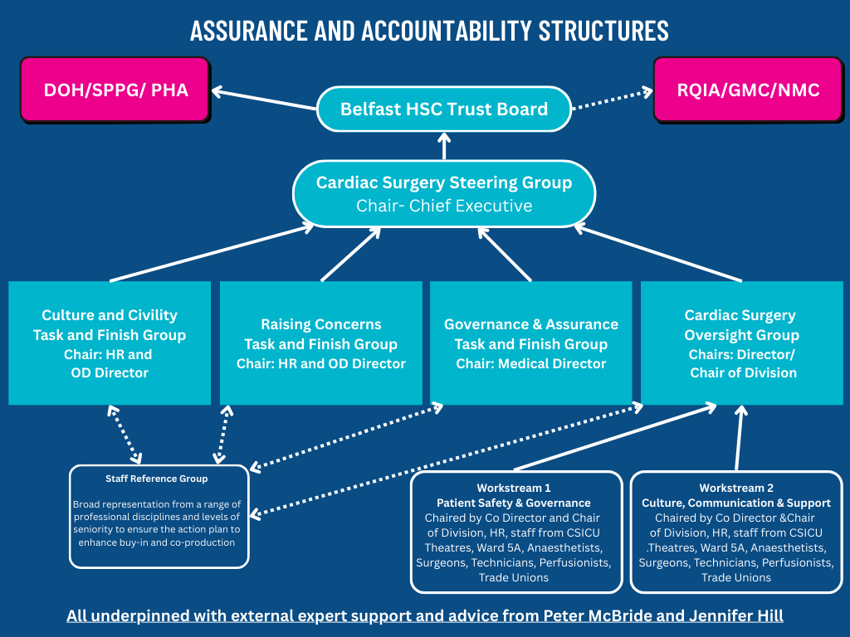
New Governance Structure to address DCO Outcome Report
Notes:
CLT suggest we do not include this tomorrow or Friday, happy to discuss

Slide 33
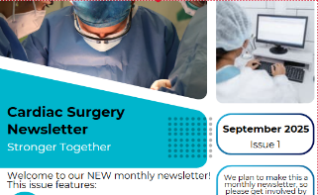
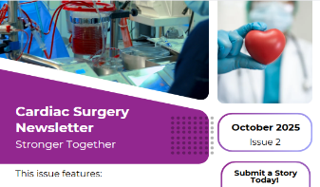


Workstream 2 Culture, Communication and People
5 Town Hall meetings
3 May 2025
2 September 2025
Individual Consultant – Director meetings
Senior Leadership attending individual professional team meetings
Daily Raising Concerns Forum included in sit rep
163 Staff have attended Respect & Civility/ Bystander Training
4 Issues of Cardiac Surgery Newsletter published monthly with ongoing evaluation
Notes:
CLT suggest we do not include this tomorrow or Friday, happy to discuss

Slide 34
Workstream 2 Culture, Communication and People cont.
Frequently Asked Questions (FAQs) developed to reassure patients, promoted through Trust website and Patient Client Council (PCC)
Patient Involvement – Cardiac Surgery Involvement Group established including 6 volunteer members with personal or carer experience of cardiac surgery, first meeting 25 November 2025.
Review of updated Pre-Assessment Booklet and new Interhospital Transfer leaflet to Ward 5A, will be forwarded to the Trust Reader Panel after the Involvement Group
Real-time patient feedback, Ward 5A received 100% overall Patient Satisfaction scores September to December 2025. Cardiac Intensive Care Unit (CSICU) received 99% overall Patient Satisfaction Scores September to December 2025
Notes:
CLT suggest we do not include this tomorrow or Friday, happy to discuss

Slide 35
Culture & Civility and Raising Concerns
Respect and Civility Training and Bystander Training
163 Cardiac Surgery Staff have attended this training, further training planned in January 2026
Raising Concerns
Raising Concerns (Whistleblowing) Policy – multiple co-production focus group completed and facilitated by HSC Leadership Centre
HSC Leadership Centre outcome report anticipated by the end of January 2026
People and Culture
People and Culture Steering Group established to delivery the People and Culture Strategy for the organisation
Projected delivery date of delivery April 2026
Notes:
CLT suggest we do not include this tomorrow or Friday, happy to discuss

Slide 36
Workstream 1 Patient Safety and Governance
Recommendation 5 Connectivity with other Units
Plan to visit Sheffield Teaching Hospital in Spring 2026
Established links with Mater Private Hospital Blackrock Hospital Cardiac Centres (ROI)
Established links with Guys and St Thomas’ Hospital (UK) and Children’s Hospital Dublin (ROI) Liverpool Transplant Centre, St Bartholomew’s Hospital and Freeman’s Hospital for congenital surgery
Recommendation 6 Review Deaths on the Waiting List
Yearly reporting to the National Cardiac Benchmarking Collaborative (NCBC) and National Congenital Heart Disease Heart Disease Audit
Standard Operating Procedure in place for the regular review of the Waiting list
Any deaths on the waiting list will also be discussed at the Mortality and Morbidity
Recommendation 7 Regular review of outcome data
Data provided 6 monthly (VLAD report) CD discusses with individual consultants
Notes:
CLT suggest we do not include this tomorrow or Friday, happy to discuss

Slide 37
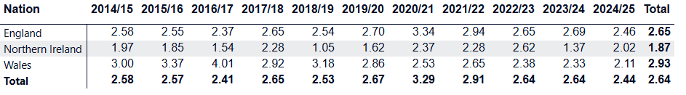
Recommendation 6
Review Deaths on the Waiting List
2017-2020 - WL Mortality of 2.5%
2022-2025 - WL Mortality of 0.99%
NCBC Figures reported- 1 October 2023 – 30 September 2024
Total waiting 232 patients
6 deaths on the waiting list
WL Mortality for this 12 month period was 2.58%
1 April 2025 – 07 January 2026
Total elective waiting 190
1 death on the waiting list – discussed at MDT
Current WL Mortality 0.52%
UK crude surgical mortality rate %
Notes:
CLT suggest we do not include this tomorrow or Friday, happy to discuss

Slide 38
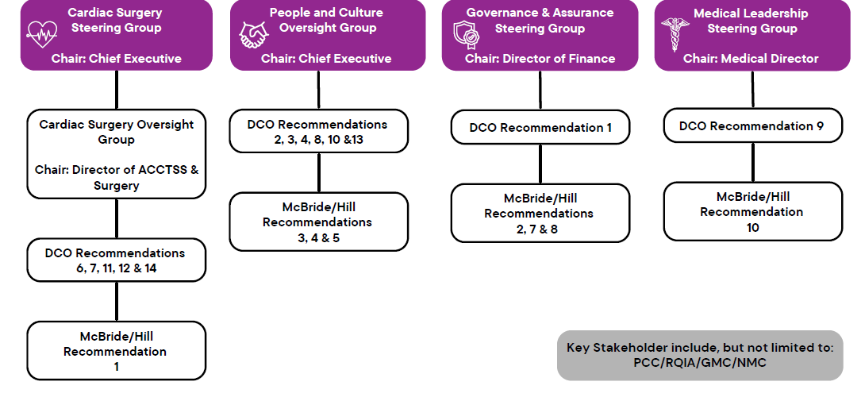
Proposed Hill/McBride Governance Structure
Notes:
CLT suggest we do not include this tomorrow or Friday, happy to discuss

Slide 39
Belfast waiting list position (18/12/24)
3 >52 weeks
10 > 26 weeks
175 < 26 weeks
19 in house urgent patients waiting in hospital
1 death on waiting list since April 25

Slide 40
Evolution to new governance arrangements – Feb 26
SMT meeting Monday 1200 - Weekly
Ward governance meeting - alternate Tuesday 1600
Audit, governance, mortality and morbidity meeting - Monthly
Embedding improvement culture
Safety
Learning
Support
PDSA

Slide 41
Audit, governance, mortality and morbidity meeting
One version of the truth………

Slide 42
Audit, governance, mortality and morbidity meeting
Operational review
Waiting list data
Activity data
Inactivity data
Theatre efficiency
LOS
Bed occupancy
Mandatory morbidity audits
Return to theatre (bleeding and all cause)
Blood / product use rates
Deep wound infection
Stroke
Renal replacement therapy
Readmission rates
Euroscore risk profiles
Local audit presentations

Slide 43
Audit, governance, mortality and morbidity meeting
Mortality
Rolling 3 years CUSUM’s
Lifetime CUSUM’s
Validation data presentations
Mortality discussions
Standardised presentation
Key questions addressed
Grading of quality of care
Near miss discussion
Learning from CTICU
Sub-specialty team audits
Ward governance data
Patient feedback
Complaints
Incidents
Duty of candour
Training audits
Patient stories / good news
New procedure introductions
Freedom to raise issues

Slide 44
Board Reports
Annual report
Patient safety
Incident and risk management
PALS
Patient experience
Effectiveness of care
Inquests / claims
Monthly report
Safety
Caring
Effective
Responsive
People and culture
Finance

Slide 45
Future developments for cardiac surgery……..
Elective waiting list reduction
Non-elective surgery improvement plan
Reducing LOS
Post discharge care
Reducing re-admission
Waiting list surveillance
“Hospital at home”
Aortic valve disease management service with cardiology
Sub-specialty teams
Annualised and flexible job plans
Surgeon of the week system
Single on call consultant
Acute dissection rota
Day of surgery admission
Minimal access surgery
PROMS / PREMS
ERACS (with anaesthesia)

Slide 46
That’s all folks…….
Any further questions?

Slide 47
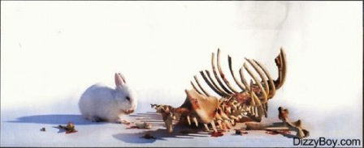
Thank you!

