Slide 1
Breast Health & Wellbeing Event
What Next?
Dr Rebekah Ross
Medical Oncology Specialist Registrar (ST5)

Slide 2
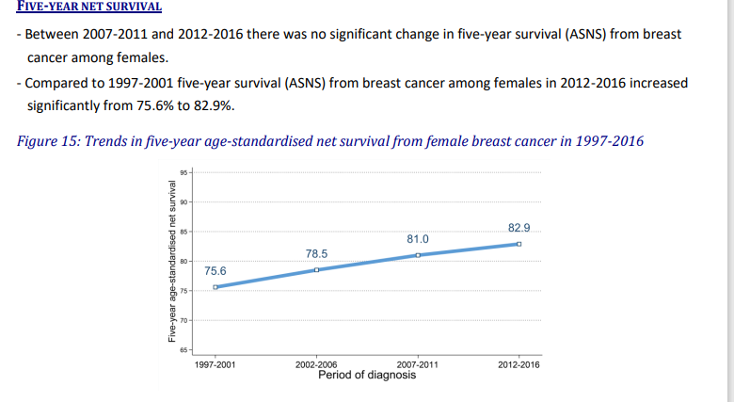
Overall Cancer Survival
NI Cancer Registry Data

Slide 3

First part is over, what next?
All patients have an individual path
Dictated by disease and treatment options taken
Difficult to give talk that applies universally but…
There are some common themes that our patients raise at this time point

Slide 4
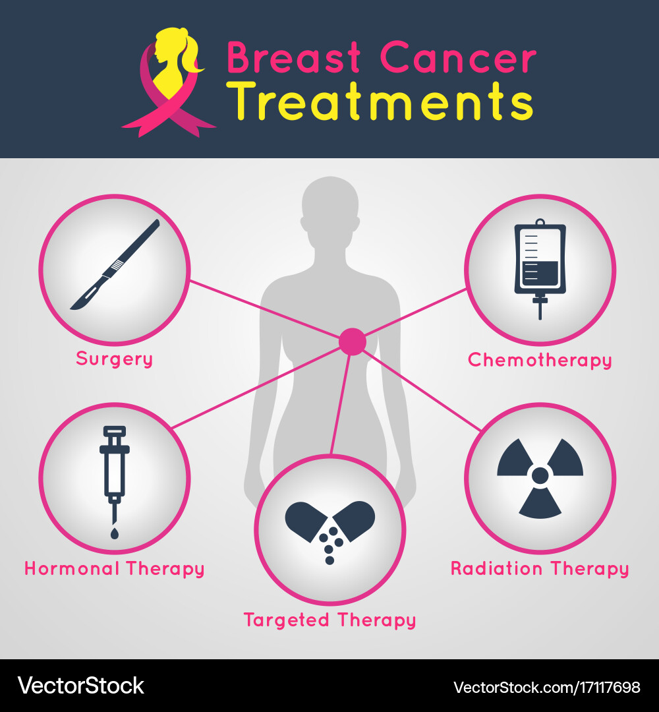

Common Themes Relate To
Mental Health & Emotional Wellbeing
Notes:
Again issues aren’t universal but can be grouped together linked to the various treatment modalities

Slide 5
Post Surgery Problems (even if everything has gone well!)
Changes in look & feel
Sit differently in clothing
Move differently from remaining breast
Nipple moving differently
Further surgery can bring some improvement but with additional problems of more surgery
Changes in sensation
Total numbness
‘Pins and ‘needles’ ‘creeping’ ‘tightness’
Re-educating nerves
Very rarely requires surgical intervention

Slide 6

Post Surgery Pain
Some people continue to have pain and discomfort in their breast, chest, upper back, arm or armpit.
The pain may feel burning, shooting, tingling or throbbing, a dull ache, intermittent stabbing or numbness.
Can be permanent
Largely improved by 18 months
Can benefit from pain relief, wearing a well fitting bra, physio & exercise, scar therapy & complementary therapies.

Slide 7
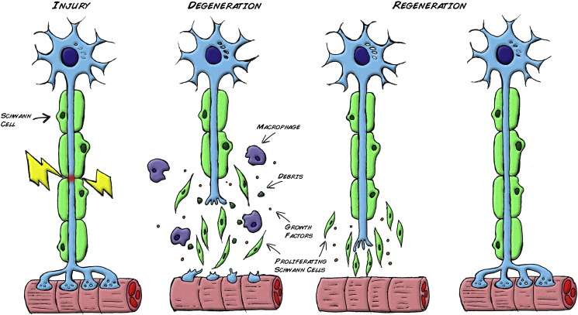
Nerve Injury
Notes:
The only thing about this final picture is the nerve looks entirely like the pre-op. In adults they never entirely return to normal function. This whole process takes approx. 2 years. Re-educating nerves through massage speeds this process up and reduces abnormal nerve signals being sent.

Slide 8

Post Reconstruction Problems
Reconstructive patients normally followed up at reconstruction clinics.
Problems related to treatment – Radiotherapy side effects
Loss of sensitivity in the reconstructed breast can be difficult to come to terms with
Patient not happy with the appearance
Further surgery required over course of your lifetime
Implant exchange
Scar Revision
Symmetrising surgery
Nipple reconstruction

Slide 9
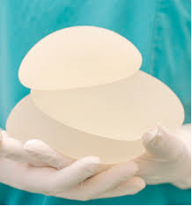
Implants
Problem related to implant
Infection (redness, heat, new pain)
Change in shape or size of breast (seroma, implant tilt)
Capsule contracture
Rippling
Breast Implant Illness
Extremely rare risk of breast implant associated – anaplastic large cell lymphoma BIA-ALCL
Any new breast changes associated with an implant will be investigated.

Slide 10
Autologous Flap Reconstruction
DIEP Flap Reconstruction & LD flap reconstruction
Problems related to the donor site
back/shoulder function
shoulder weakness/pain.
abdominal wall- hernias/bulging/numb patches below umbilicus.
‘tunnels’ where tissue were moved along that have no visible scar (chest wall discomfort, pulling sensation)

Slide 11
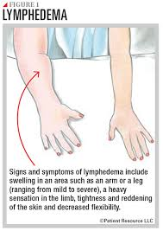
Lymphoedema
Much less common now than previously
SLNB rather than ANC
You may notice lymphoedema in the months after surgery, radiotherapy or sometimes chemotherapy. Or it can happen many years later
Very mild to severe swelling
Physio discussion

Slide 12
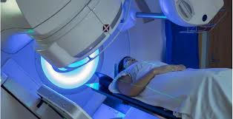
Radiotherapy
Changes in skin – dryness / firmness / skin tone
Hair loss in armpit
Breast shrinkage
Breast tissue can become tethered
Can change shape as years progress
These changes can cause discomfort
Benefit from massage and occasionally medication
Notes:
Radiotherapy causes injury to the tissue that cant be seen at the time, but can become more obvious as time goes on. The gift that keeps on giving! – but is having the benefit of reducing the risk of recurrence further down the line.
Patient isn't always aware of it, but serial photos show it e.g.. Patient who notices she's having more difficulty getting a bra to fit, nipple being pulled off centre

Slide 13
Systemic Anti-Cancer Therapy
Multiple drug combinations
Tailored to individual
May have be given before or after surgery
Each treatment may have associated long term side effects
Chemotherapy
Anti HER2 Therapy
Endocrine Therapy
CDK4/6 Inhibitors

Slide 14
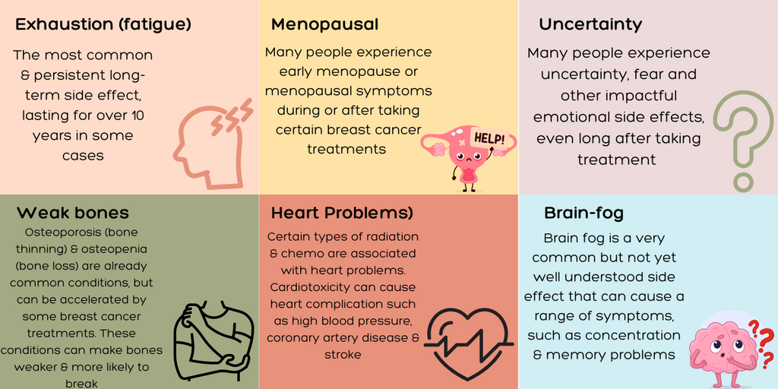
Late effects may be minor and not affect your daily life much.
Or they may be more difficult to live with and affect your daily life more.

Slide 15
Chemotherapy
Peripheral neuropathy
Nerves are prone to ‘injury’ and can present as post-chemo pain
Funny feeling in hands and feet (dysesthesia)/numbness
Majority settles with time
Pain relief
Skin care
Reflexology
Occupational therapy can help with strategies to deal with it
Cognitive ‘fogginess’
We don’t know why this happens
Sudden change in pace/new information/drugs/GA
You may find it difficult to concentrate and be forgetful at times – commonly called chemo brain
Improves with time
Coping strategies
Keep a diary
Healthy balanced diet and exercise
Brain Training
Mindfulness

Slide 16
Anti-HER2 Therapy
Targeted therapy used in the treatment of HER2 positive breast cancer.
Phesgo, Herceptin & Kadcyla
Given as an injection or infusion every 3 weeks
Heart monitoring during duration of treatment (echo)
Common Side Effects include:
Soreness at the injection site
Flu like symptoms
Pains in the joints & muscles
Extreme tiredness
Contact oncology helpline if needed

Slide 17
CDK4/6 Inhibitors
Targeted therapy used to treat breast cancer that is oestrogen receptor positive and HER2-negative.
You may be offered a treatment such as Abemaciclib. This would have been discussed by your treatment team if they feel you would benefit from this.
Given for 2 years alongside hormone therapy
Common Side Effects
Diarrhoea
Effects of the blood
Risk of infection
Extreme Tiredness
Nausea & Vomiting
Dry Skin & Rash
You will continue to have review appointments with your oncology team & contact oncology helpline if needed

Slide 18

Hormonal Treatment
Pre menopausal Female or Male
Tamoxifen for 5 or 10 years
Menopausal Symptoms
Weight gain
Increased risk of DVT
Increased risk of infertility
+/- ovarian suppression
Post menopausal Female
Treatment “Switch”
Tamoxifen for 2 years
Exemestane for 3 years
Aromatase Inhibitor for 5 years
+/- further 5 years
All patients on aromatase inhibitors require DEXA scan
Risk of osteoporosis

Slide 19
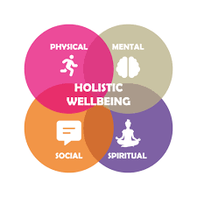
Follow Up & Self-directed Aftercare
Remain under a Consultant’s care
Regular mammograms
Assessment of Holistic Needs
Rapid access to services
Education and support
Signposting to support services

Slide 20

Fear of Cancer Returning
Annual mammograms
Finding a lump
New ‘twinge’
Lingering cough
Take control
Good evidence that making positive lifestyle changes improves your outcomes from breast cancer after diagnosis
Seek medical attention for physical symptoms that concern you
The most dangerous disease is the one we don’t know about

Slide 21







The Future
Improving outcomes
Treatment Advances
Genetic Testing
Clinical Trials
Looking beyond Cancer

Slide 22
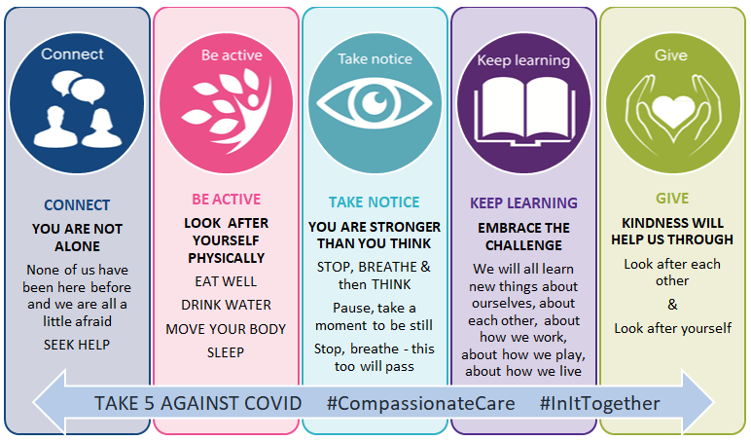
Summary
For many patients diagnosed with breast cancer, there will be never be a recurrence of disease
However some patients will live the rest of their natural lives with the side effects of their breast cancer treatment
Avoiding side effects, or managing them effectively is vital
Team approach with doctors (oncologist, surgeon and GP), nurses and allied professional involvement in moving forward from a breast cancer diagnosis.

Slide 23

Questions later

Slide 24

MOVING FORWARD WITH CONFIDENCE

Slide 25
‘It’s ok not to feel normal at this stage. Take one day at a time and try to focus on looking forward.’

Slide 26

What Now?
Follow up Care
Worries about cancer returning
Coping with physical effects
Coping emotionally
Notes:
We know it’s not back to normal and that is why the breast care team are still here for you

Slide 27
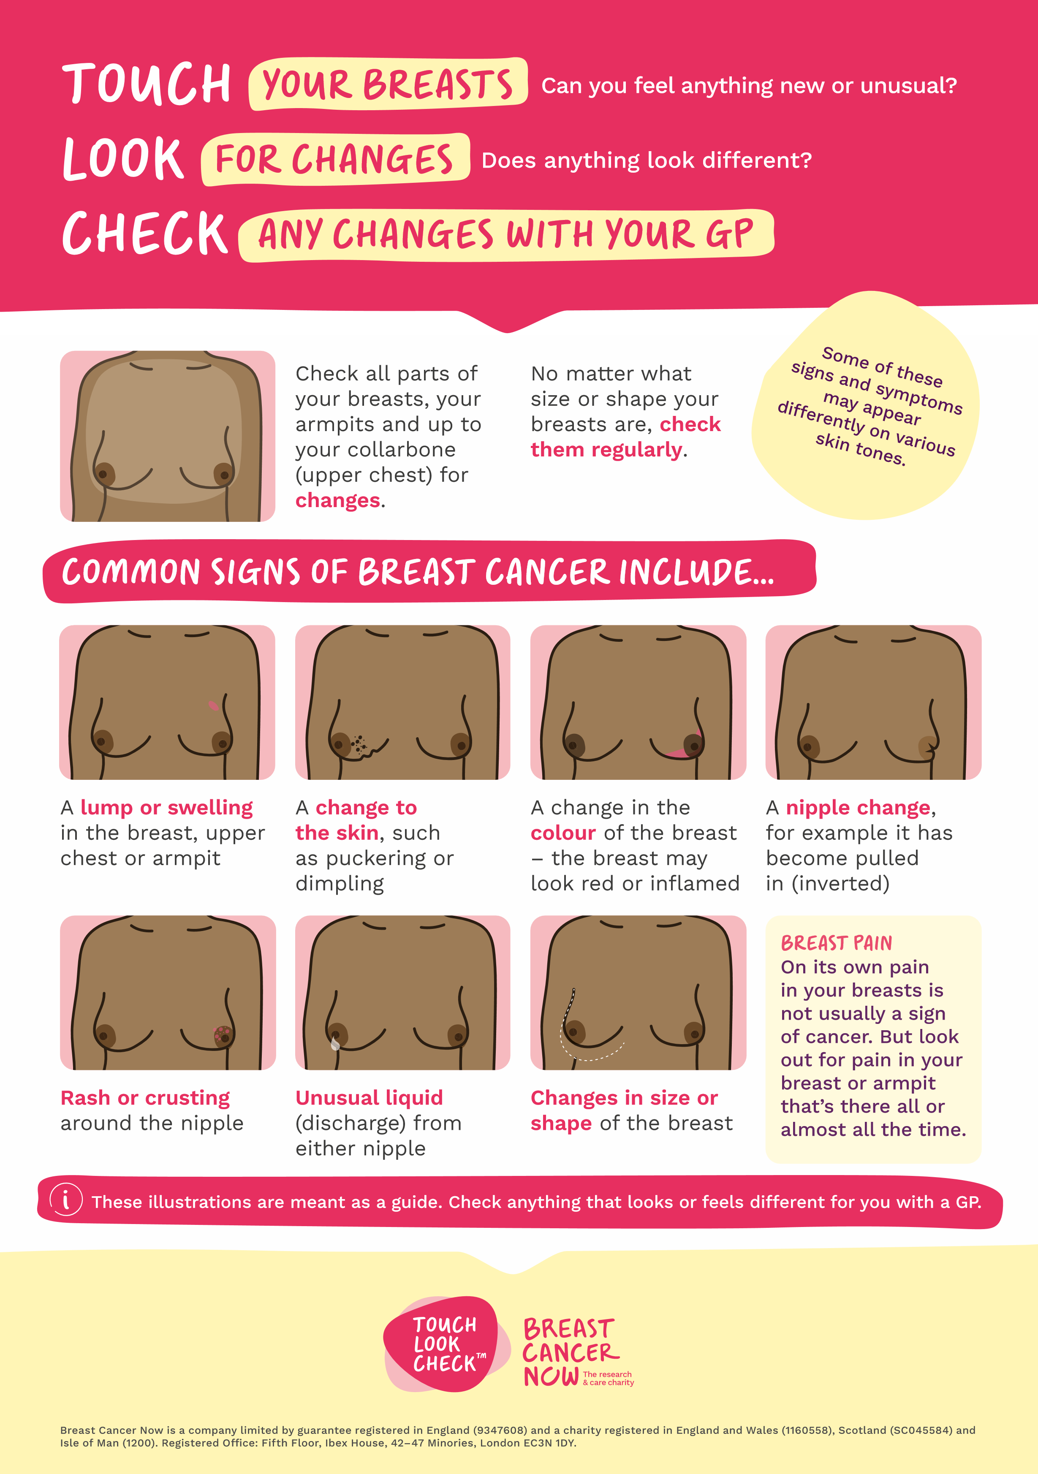
Breast Awareness
Notes:
Breast awareness is an important part of moving forward and your follow up.
It is important to touch, look & check your whole breast/chest area, including your collarbone and under your armpit.
There is no right or wrong way to do this, some people prefer to this when you’re in the bath or shower, standing in front of a mirror or lying down with your arm about your head.
We recommend we do this once a month
Changes to look and feel for include:
A lump or swelling
A change to the skin such as puckering or dimpling
A change in the colour
Any nipple changes including a rash or crusting around the nipple, nipple discharge
A change in size or shape

Slide 28
Monitoring For Possible Signs of Recurrence & Secondary Breast Cancer
Notes:
We know that there is a risk that breast cancer can come back in your breast/scar area or other places in your body.
The main areas in your body are brain, bone, lung, lymph nodes and liver.
That is why it is important to be breast and body aware.
If you develop any new symptoms that persist over a 4 week period please contact your breast care nurse.

Slide 29
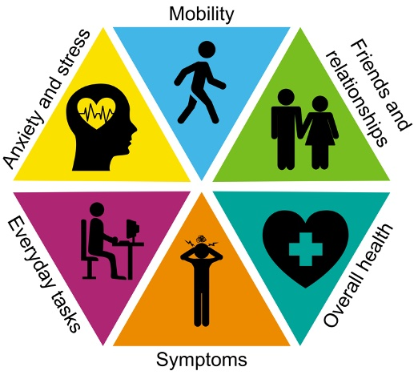
Challenges After Breast Cancer

Slide 30

The Three P’S
PRIORITISE
PLAN
PACE
Notes:
Getting back to normal life can be overwhelming, this can be in relation to the not knowing what is normal, the physical side effects of treatment, the fear of cancer recurrence and the impact on your emotional wellbeing.
The 3 peas can be a useful coping strategy - Plan, Prioritise and Pace.
Plan ahead: days, weeks considering energy levels, side effects and how you are feeling
Prioritise: When we look at some tasks do we really need to be doing them, are they essential.
Prioritise what is important to you.
Can we delegate some tasks!
Pace Yourself
Support from others

Slide 31
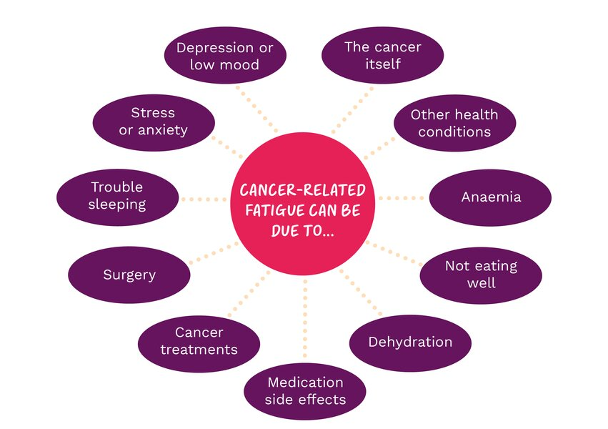
Cancer Related Fatigue

Slide 32
Tips For Managing Fatigue
See if there’s a treatable cause
Plan time to rest
Try relaxation techniques
Use a fatigue diary
Try to be active
Stay hydrated
Eat well
Seek support
Notes:
This involves recording your level of fatigue every day from 1 (no fatigue) to 10 (extreme fatigue).
Plan your day to balance your activities and rest times.
Try to get plenty of rest between your daily activities, but limit the number of naps you have. Keep naps to less than half an hour and avoid taking them in the late afternoon, so that it doesn’t disrupt your sleep at night

Slide 33
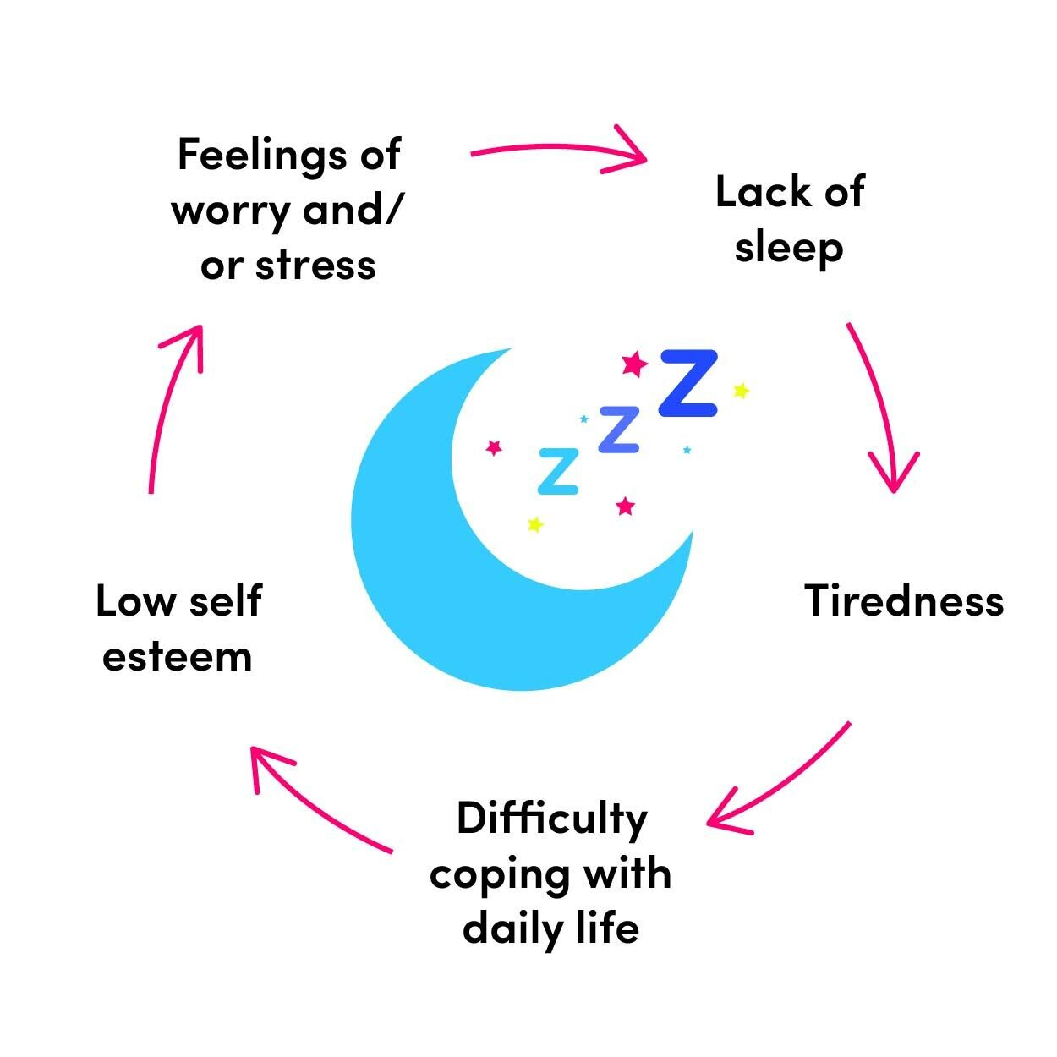
Difficulty Sleeping
Regular bedtime routine
Environment
Don’t eat two hours before bedtime
Exercise earlier in the day
Relaxation & Mediation
Set your phone to silent
Don’t check the time
Get out of bed if you can’t sleep after 20 minutes
Notes:
It can be caused by:
Stress and anxiety
Changes to your sleep pattern
Changes to your daily routine
Side effects of treatment

Slide 34
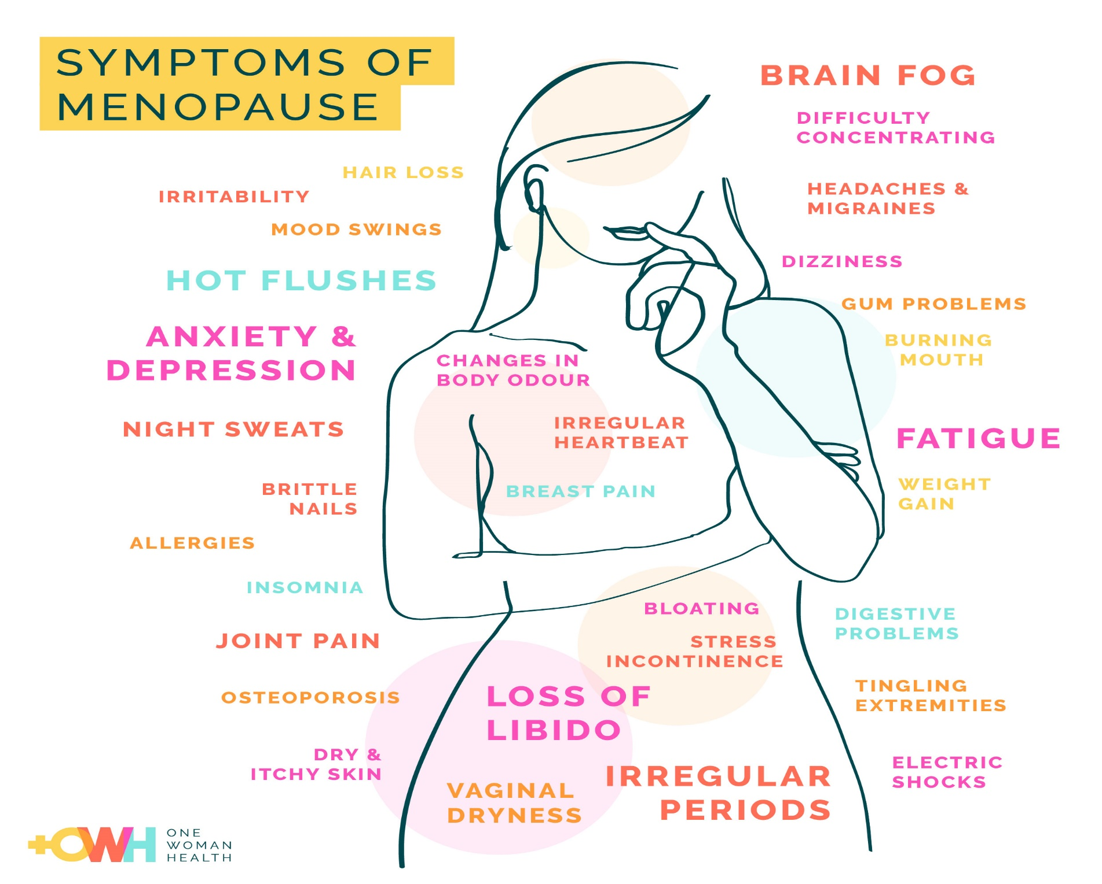
Notes:
The menopause is a natural event for all women and symptoms can span over several months or years.
We know that some treatments for breast cancer can cause earlier and/or significant menopausal symptoms. These treatments include hormone therapies, ovarian suppression and chemotherapy.
Please note that not everyone may experience these symptoms.
These symptoms may include:
Hot flushes
Night sweats
Headaches
Sleep disturbance
Vaginal dryness/ discomfort
Lower desire for sex
Urinary changes/infections
Changes in texture of skin and hair
Mood changes / depression
Feeling anxious or irritable
Weight gain
Memory and concentration problems
Joint aches and pains
Fatigue / extreme tiredness

Slide 35
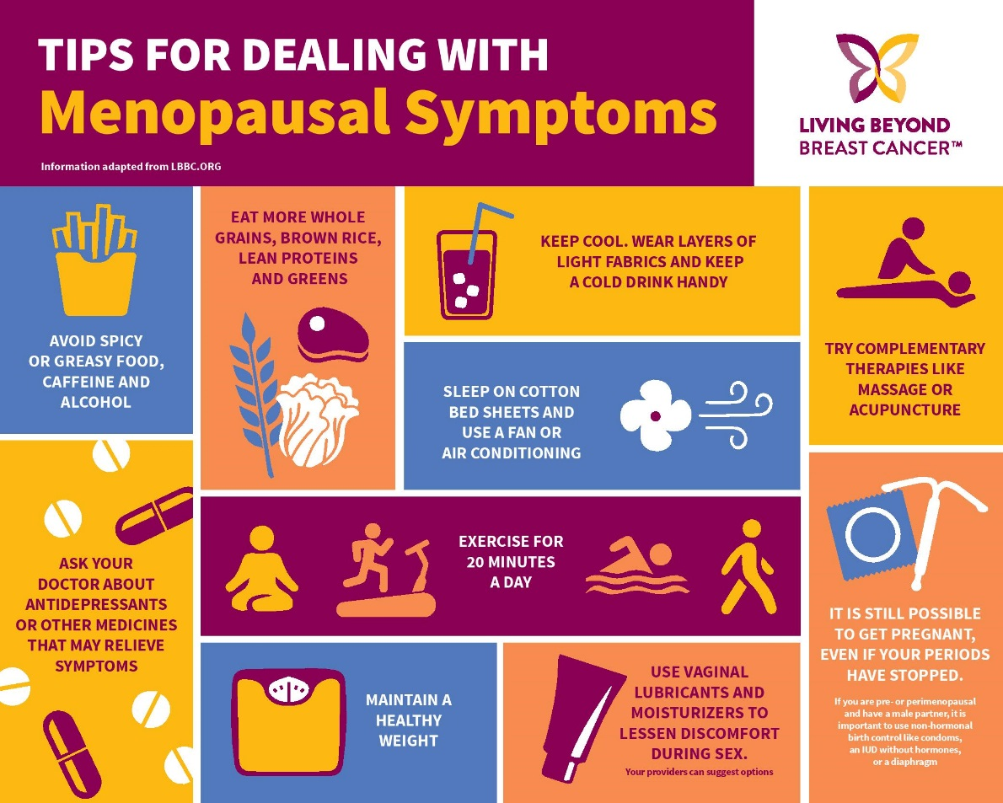
Notes:
It may be useful to keep a diary of when you experience hot flushes, this may help identify and patterns or triggers.
Triggers can include spicy foods, caffeine and alcohol.
Coping mechanisms may include:
keep a battery operated fan with you,
wear layers so you can remove clothing,
wear cotton clothing,
using a silk pillowcase.
The importance of diet and exercise.
Try complimentary therapies and relaxation
Talking to others and seeking support

Slide 36
Bone Health
DIET
VITAMIN D
EXERCISE
SMOKING
ALCOHOL
CACLCIUM
Bone loss increases as part of the natural ageing process- this can lead to Osteoporosis
Women > 50 years- twice as likely as men to develop Osteoporosis
Some breast cancer treatments can lead to bone loss resulting in Osteoporosis
Notes:
A varied and balanced diet will give you the nutrients that are important for strong, healthy bones
Calcium is a vital mineral for teeth and bones because it gives them strength and hardness
Vitamin D is needed to help your body absorb calcium. You can get vitamin D from: Sunlight, Food & Supplements
Drinking too much alcohol can affect your bone strength and thickness
Regular physical activity and exercise are important for managing osteoporosis. Regular weight-bearing exercise or activities help stimulate growth and maintain the strength of the bones and muscles. Weight-bearing exercises can be moderate-impact or low-impact, running, walking
Smoking has been linked to a higher risk of fractures, so it’s a good idea to stop or cut down if you smoke

Slide 37
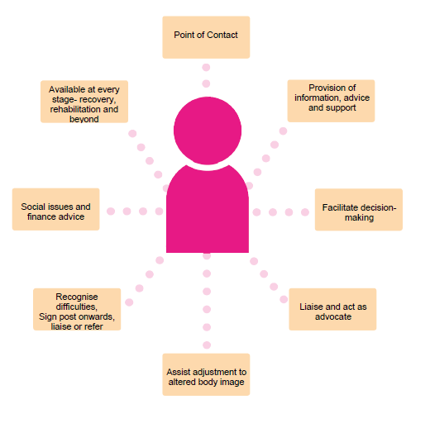
Role Of Your Breast Care Nurse
Notes:
Your breast care nurse continues to be your keyworker going forward.
We will continue to be a point of contact, provide information and support, prosthesis fitting and complete referrals
Therefore if you have any breast concerns please don’t hesitate to contact us.

Slide 38
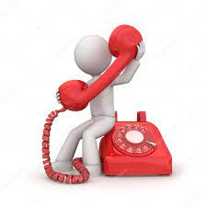

Breast Care Nurse Contact Details
(028) 9615 7030 (voicemail – option 7)
breastcarenurses@belfasttrust.hscni.net
Please leave your full name, contact details and a short message and the Breast Care Nurse will return your call.

Slide 39

Tree of Support
The MacMillan Support & Information Centre 02896150077
Social Work Team (GP or nurse referral))
Cancer Lifeline 02890351999
Action Cancer 02890803344
Counselling
Cancer Focus 02890663281
Flat Friends Facebook
Benefits Advice
Friends of the Cancer Centre
Cancer Fund for Children
Relate NI 02890323454
Younger Women’s Breast Cancer Forum
Complementary Therapies
Lagan Dragons Belfast Boat Club www.lagandragons.com
Specialist Psychosexual Clinic
Pretty N Pink 0289047780
Nutrition and Living with Cancer Helpline: 0333 034 1988
NI Cancer Survivorship

Slide 40

Moving Forward
Being kind to yourself
Your identity, body image & relationships
Reassess priorities & stop multi-tasking
Managing physical effects after treatment
Managing diet and exercise
Looking after your mental health
Getting Support

Slide 41

Breast Cancer, Body Image, Sexuality and Relationships
Notes:
The aim of this presentation is to help improve understanding of how breast cancer treatment can affect some aspects of a woman’s health, identity and relationships

Slide 42
The Hidden Impact….
70% of breast cancer survivors have reported sexual issues (Cancer connect March 2021)
The two most common concerns expressed are loss of libido / lack of interest and vaginal dryness
Most common factors that influence sexual issues are body image and hormonal therapies
It is a very common issue, but it is rarely discussed
Notes:
A high percentage of women experience some negative issues with their sexual health and their body image during treatment and also into their recovery but it is not widely discussed and we want to change that

Slide 43
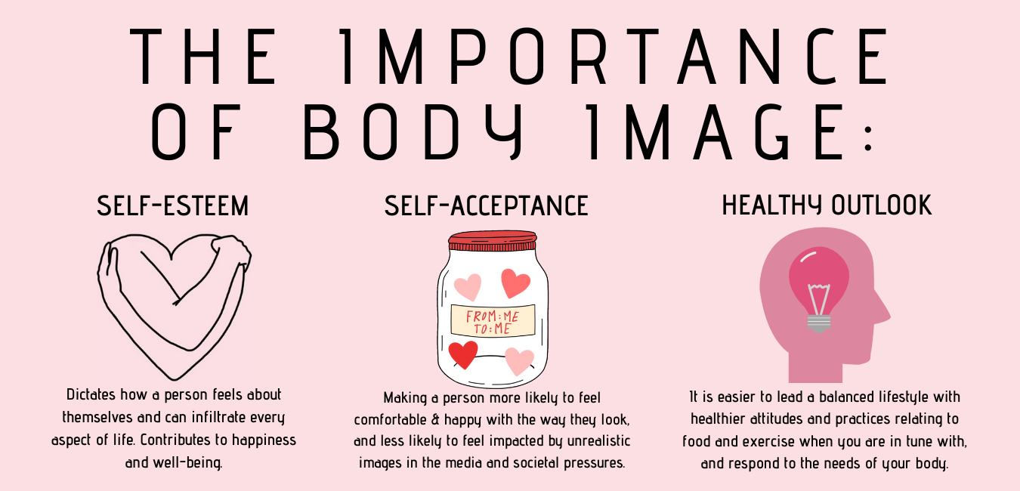
Body Image
44% of women said breast cancer negatively impacted their body image
40% did not discuss their body image or how they felt about it because they felt uncomfortable
31% felt it didn’t feel important
31% said they weren’t asked
12% said they didn’t know who to speak to
9% felt embarrassed
Notes:
It is a really common issue so no one should feel alone in this. The Mental Health Foundation highlight how common body image issues are and they record 1 in 5 adults have negative body image issues. If you are not happy with the way you look on a regular basis you can end up giving yourself negative feedback. This can lead to low self esteem and low mood.

Slide 44


Challenges After Breast Cancer Treatment
Scarring, loss of breast, unevenness, change in sensation, complications, ongoing surgery
Weight changes, body shape changes
Loss of hair, eyebrows & eyelashes, skin rashes, lymphoedema
Changes to posture and mobility
Impact on your relationship with your partner
Isolation – we are social creatures that need social experiences
Avoidance – not looking or touching the breast and the scars
Notes:
Some changes to your body from breast surgery and treatment side-effects can make you feel and look less like you……Physical changes examples
These changes can impact on you emotionally – You may find you avoid situations such as going out and meeting friends and family or even going out shopping in case you meet someone you know. You may avoid intimate situations. If you feel less attractive you may think your partner feels the same

Slide 45

Steps to positivity
Check what you are experiencing is normal for you
Acknowledge your feelings. This is a very important first step for moving forward
Replace negative thoughts – be kind to yourself. Positive affirmations
Take back control & choose your support system. This can be –Engage in positive activities / make time for the things you enjoy; practice healthy exercise & eating habits; seek help / talk to others
Learn to like the body you have / acceptance
It takes time for the mind and heart to catch up with the physical changes
Notes:
So how do we switch these feelings around –
If the breast / scar line feels firm or looks different it might put you off looking at yourself. So check with your health professional what is to be expected and normal post surgery and treatment
2 & 3 Honesty leads to acceptance
4. Use counselling, BCNs, sharing with others – peer group support in Action Cancer, Someone Like Me with Breast Cancer Now, Flat Friends support group and also keeping a journal and writing your feelings down can be very helpful
5.Exercise releases endorphins that make you feel more energised & stronger and exercise is also good for uplifting the mood
6.Learn to love the body you have as the slide says ‘self love’. Reprogram your thoughts with positive affirmations. They are positive phrases to repeat to yourself over & over & are a good way of pushing negativity out of your daily life. & improve your self belief. They should be short and easy to remember, be in the present tense and only contain positive words. You could say things like –
I love myself just as I am today
I am grateful to be the person I am

Slide 46
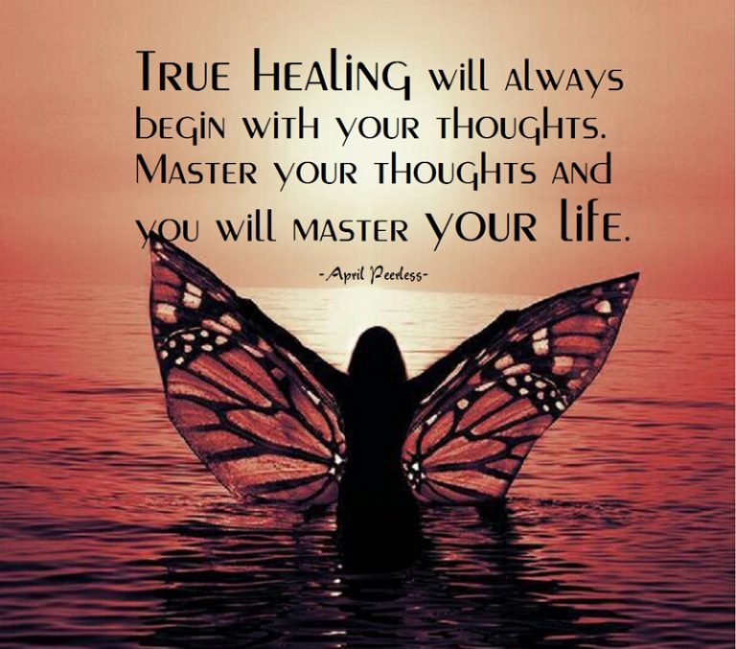
‘My body, myself’
Dear Body,
I wasn’t always happy with you. I wanted longer legs, a flatter tummy, firmer arms. But recently we’ve been through a lot you and I. We’ve faced cancer together. We lost our right breast. Our hair fell out. But we got through it. And now I’ve learned to love and accept you for what you are. Not perfect, but beautifully imperfect. You are my body. And I am proud of you.
Notes:
I think this quote really sums it up….

Slide 47
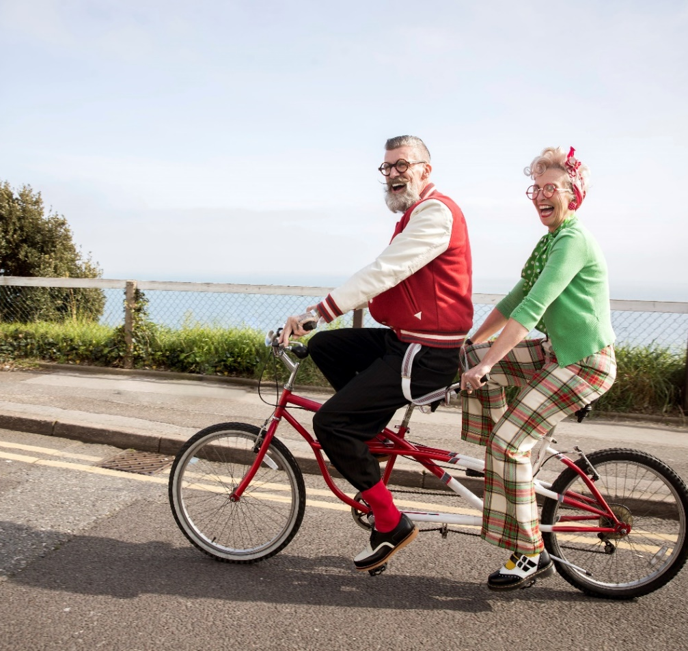
What is Sexuality & Why does it Matter?
Sexuality encompasses more than just sex. It is central to quality of life for everyone.
In the real world this means:
How you see yourself
How your partner views you
How do you date after cancer
How do you fulfil your need for relationships and intimacy after cancer
Impact on fertility & family planning
Sexual wellbeing impacts:
Body Image
Self –esteem
Relationships
Notes:
It’s the way we think, talk, walk and dress. It’s the way we connect physically and emotionally with others and it’s in the way we express ourselves

Slide 48

Cancer Related Sexual Problems
Physical changes
vaginal dryness &
discomfort, pain
with intercourse,
urogenital issues
Hormonal changes
Loss of libido /
desire, hot flushes,
low mood
Achy joints, pain,
Fatigue, less energy
Body image issues
Loss of breast/scarring
loss of hair, weight
changes. Not feeling
sexy or attractive
Increase in emotions
increase in anxiety &
low mood, fear of
intimacy, feeling of
rejection,
misunderstanding
Avoidance behaviours
Is it
normal
Notes:
Cancer surgery and treatments can affect someone's sexuality both physically and emotionally
Urogenital issues such as urgency and an increase in urinary infections

Slide 49
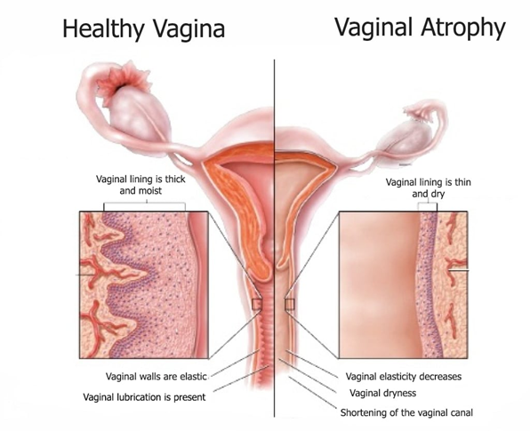
Vaginal Health
Moisture – use a non oestrogen vaginal moisturiser regularly such as REPLENS, YES, HYALOFEMME
Stretch – use vaginal dilators to gently and gradually stretch the tightened vaginal tissues
Increase blood flow – this is good for vaginal health. Using stimulation and vibrators can stimulate blood flow into the area
Lubrication – to enhance comfort during any sexual activity, such as K-Y Sensitive & SYLK
Pelvic floor exercises – to strengthen these muscles & increase blood flow

Slide 50
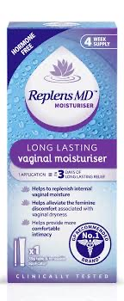
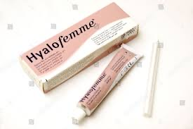

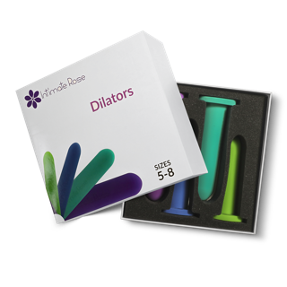
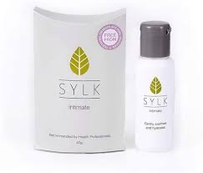
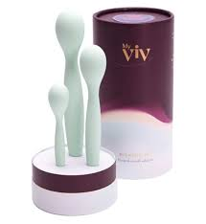

Slide 51
Management and Solutions
Communication is key
Reconnect with your sensuality
Recognise what works for you
Address issues of anxiety, stress and low mood
Seeking support is part of your recovery counselling, Relate NI, Regional psychosexual clinic
Use techniques to manage menopausal symptoms
Notes:
1.Be open, start the conversation, let your partner know how you are feeling. Explain if you have any pain, talk about your fears & feelings
2. Think about the things that make you feel good about yourself – put on your favourite scented body lotion / perfume, get your make-up on / or done, play your favourite music. Make time for each other, have date nights, make the other person feel special, physical touch is important – who doesn’t love a hug

Slide 52


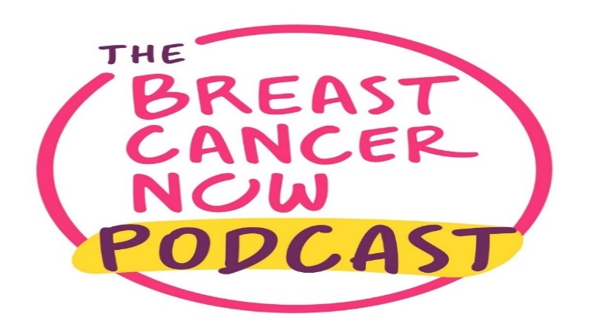
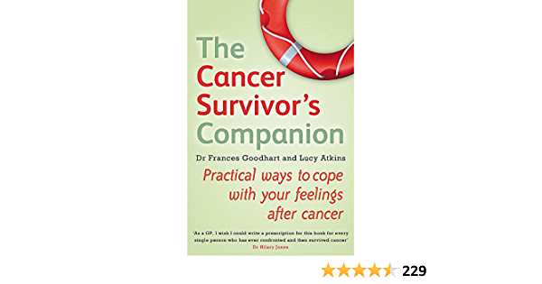



Signposting
Breast Care Nurse

Slide 53
Treating the Person, Not Just the Cancer
It is important to talk about sexuality after a breast cancer diagnosis.
Open conservations matter
It is important to understand the impact on you and your relationships
Remember you are not alone
Everyone’s experience is different – and you all matter

