Slide 1

Trust Board Report
Systems Oversight Measures Report
Trust Board - Thursday 5th March 2026
Alastair Campbell
Director of Performance, Planning & Informatics

Slide 2

Contents
Section 1 – Overview & Headlines
Section 2 - Performance
Key SOMs Indicators
Unscheduled Care – Patients not waiting in ED, 12 Hr delays, Delayed discharges and Hip Fractures
Scheduled Care – DNA rates, theatres
Community Care – unmet need, direct payments, unallocated cases
Section 3 - Efficiency & Productivity
Key SOMs Indicators
Scheduled Care – average LoS
Section 4 – Access Improvements
Key SOMs Indicators
Elective Care – outpatient, diagnostic, Inpatient/Daycase, AHP waits
Cancer Services – 14, 31 & 62 day targets (14 day is a regional position)
Unscheduled Care – ED 4hr performance
Mental Health Services – 9 & 13 week waits
Cancer monthly activity
Waiting list summaries, Backlog clearance & Validation
Section 5 - Experience
Patient Satisfaction – Patient Experience Surveys, Friends and Family and Complaints
APPENDIX
System Oversight Measures Summary table (January 2026 & Year to date)
Activity
Escalations
SOMs to be implemented

Slide 3
Section 1 – Overview
This Trust Board Report assesses the Trust position for January 2026 in relation to a number of key metrics included within the new System Oversight measures (SOMs).
The new System Oversight Measures have been devised around four key domains.
Performance
Efficiency and Productivity
Access improvement/Ministerial Targets
Safety and Quality
All performance metrics are presented in run chart format with the expected target shown in red.
As there are no agreed baselines for levels of activity to be delivered within the SOMs framework, an activity summary is now available showing a comparison of the current month to the equivalent month in the previous year to enable us to provide a robust comparison of encompass activity

Slide 4

Section 1 – Overview – System Oversight Measures – Summary of Metrics reported
Indicator | Metric | Status
Performance
Unscheduled Care | Patients who leave ED without treatment | reported
 | ED 12 hour performance | reported
 | Weekend Discharges - Simple | not reported – low confidence
 | Weekend Discharges – Complex | reported
 | Readmission Rates – 0-7 days & 8-30 days | not reported – low confidence
 | Fractures – Neck of Femur and Other Fractures | reported
Scheduled Care | Outpatient DNA rates | reported
 | Admission on day of surgery (5 specialties) | not reported – low confidence
 | Theatre DNA rates | reported
 | Theatre Utilisation Run Times | reported
 | Theatre Utilisation Operating Times | reported
Community Care | Unmet Need | reported
 | Direct Payments | reported
 | Unallocated Cases | reported
Indicator | Metric | Status
Efficiency & Productivity | Elective Average Length of Stay (5 specialties) | reported
Access Improvement/Ministerial Access Targets
Elective Care | Diagnostic Waits | reported
 | New Consultant Outpatient Waits | reported
 | Inpatient/Daycase Waits | reported
 | AHP Waits | reported
Cancer Services | 14, 31 & 62 Day Waits | reported
Unscheduled Care | ED Attendances Waiting < 4 hours | reported
Mental Health Services | Child & Adolescent Mental Health Waits | reported
 | Adult Mental Health Waits | not reported – low confidence
 | Psychological Therapies | not reported – low confidence
 | Dementia | not reported – low confidence
Safety & Quality | Falls Prevention | not reported – low confidence
 | Palliative Care | not reported – low confidence
 | Antimicrobial Consumption | undergoing validation
 | Healthcare Acquired Infections (HCAI) | not reported – low confidence

Slide 5
Section 1 – Headlines
Reporting period – January 2026 in-month performance and cumulative data April 2025 – January 2026
Ongoing confidence issues in reporting in a number of areas as we try to understand how the new data differs from reporting pre-encompass. Validation is ongoing also to ensure all relevant data is captured within reports
31 and 62 day cancer data is reported, but subject to ongoing validation
ED 12hr performance year to date & did not waits remain consistently above targets
Endoscopy theatres continue to run above target
Targets not met in relation to all waiting lists. Waiting lists are subject to ongoing validation.
Patient experience report for January – 99% overall satisfaction

Slide 6
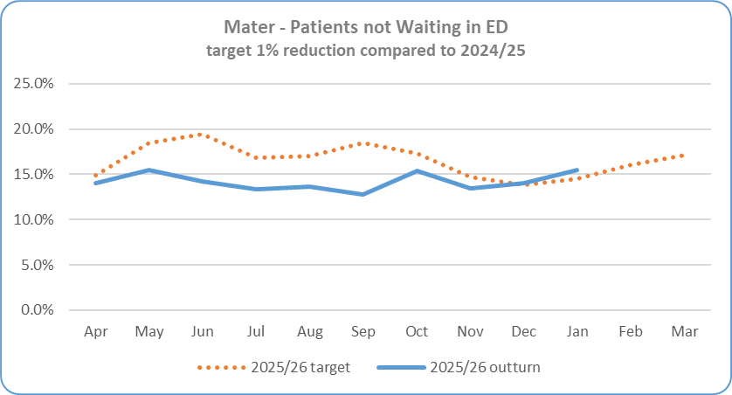


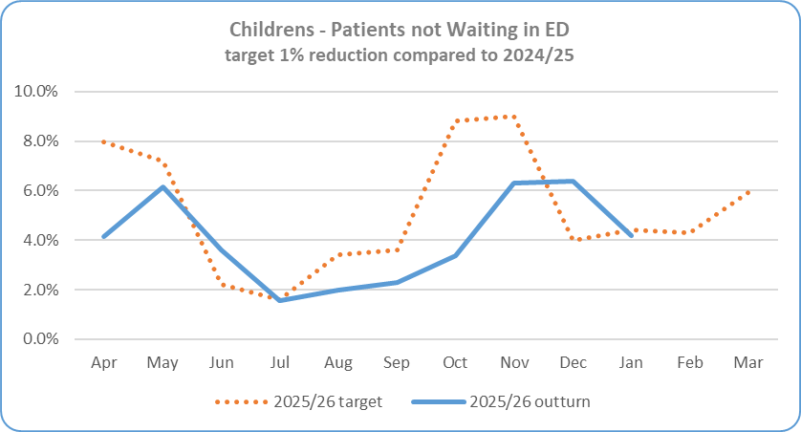
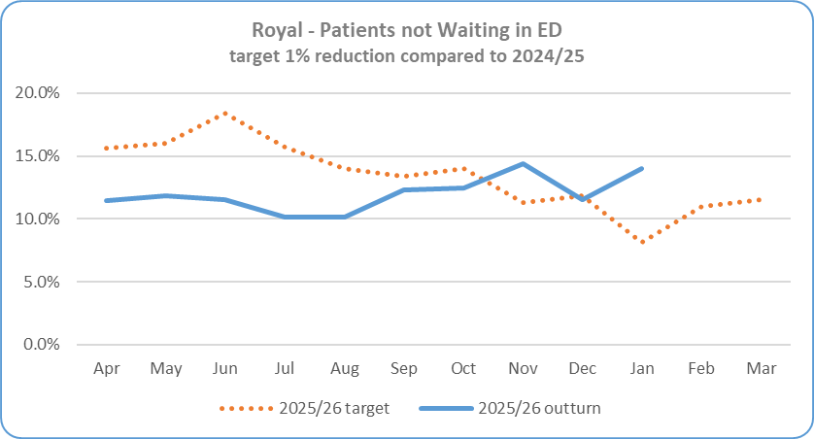
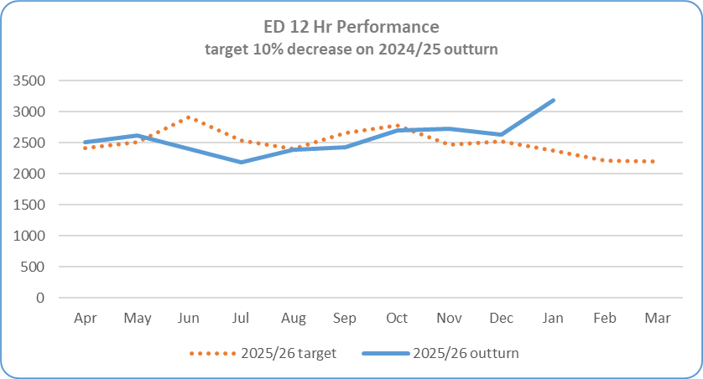

Section 2 – Key SOMs Indicators - Performance
Service Area | Metric | Jan 26 Target | Jan 26 In-month Performance | Cumulative Activity YTD | Rag Status Jan 26 | Rag Status YTD | Chart
Performance - Unscheduled Care | Patients Not Waiting in ED – Mater 1% reduction compared to 2024/25 | 14.5% | 15.47% - 0.97% below target | 14.19% against a target of 16.6% (5,152 out of 36,305)
 | Patients Not Waiting in ED - RBHSC 1% reduction compared to 2024/25 | 4.4% | 4.2% - 0.2% below target | 4.2% against a target of 5.6% (1,492 out of 35,558)
 | Patients Not Waiting in ED - RVH 1% reduction compared to 2024/25 | 8.1% | 14.02% - 5.92% below target | 12.01% against a target of 13.9% (8,215 out of 68,417)
 | ED – 12 Hour Target * Reduce the number of patients waiting > 12 hours in ED during 24/25 by 10% | 2,384 | 3,184 patients waited > 12 hours during December. 800 patients over expected target | -9.42% (25,795 patients waited >12 hours Apr-Jan, 164 over the YTD target)

Slide 7
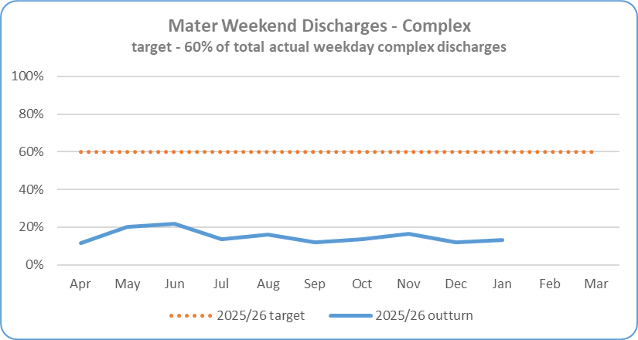

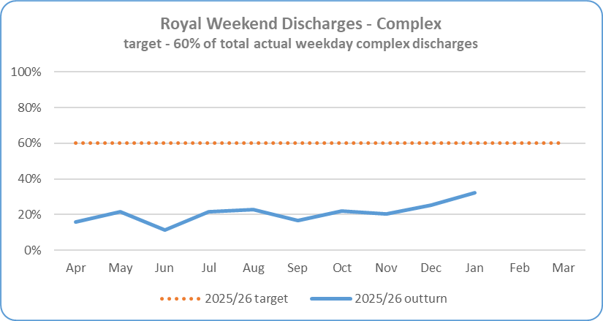
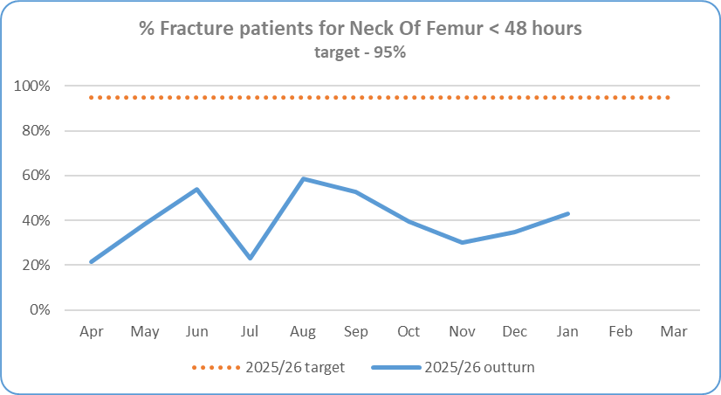
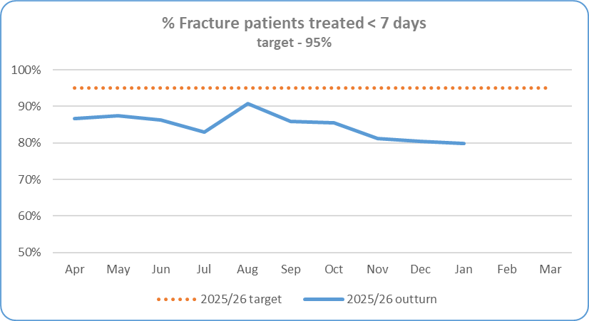
Section 2 – Key SOMs Indicators - Performance
Service Area | Metric | Jan 26 Target | Jan 26 In-month Performance | Cumulative Activity YTD | Rag Status Jan 26 | Rag Status YTD | Chart
Performance -Unscheduled Care | Complex Delayed Discharges – Mater Target - The number of complex discharges on any Saturday and Sunday should be at least 60% of the average daily number of complex discharges from Mon-Fri in that week. | 60% | 12.04% | 15.08%
 | Complex Delayed Discharges – RVH Target - The number of complex discharges on any Saturday and Sunday should be at least 60% of the average daily number of complex discharges from Mon-Fri in that week. | 60% | 32.27% | 21.26%
 | Hip Fractures Target - 95% of patients where clinically appropriate, wait no longer than 48 hours for inpatient treatment | 95% | 43.02% 37 out of 86 seen <48hrs | 39.84% 253 out of 635
 | Other Fractures Target - 95% of other fractures, where clinically appropriate, wait no longer than 7 days for inpatient treatment for fractures | 95% | 76.86% 115 out of 144 treated within 7 days | 84.74% 1,155 out of 1,363

Slide 8
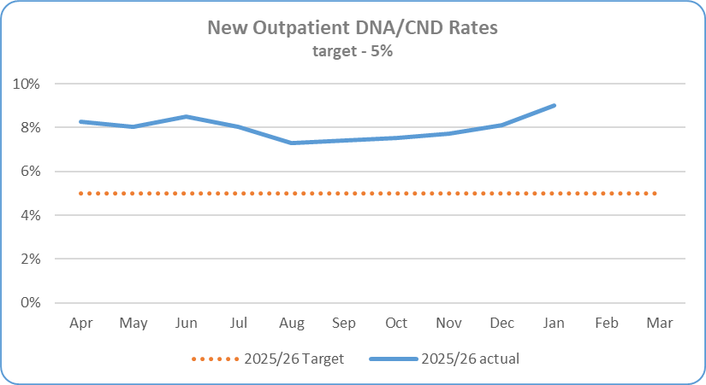
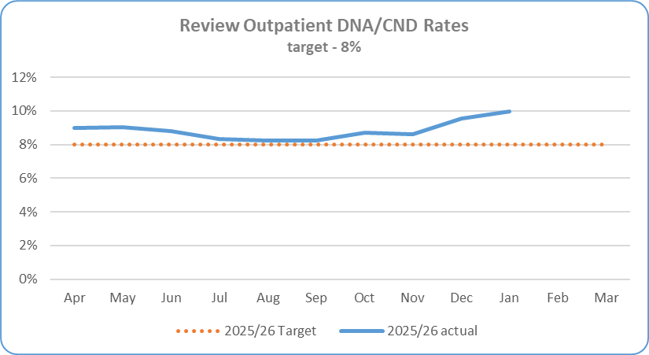

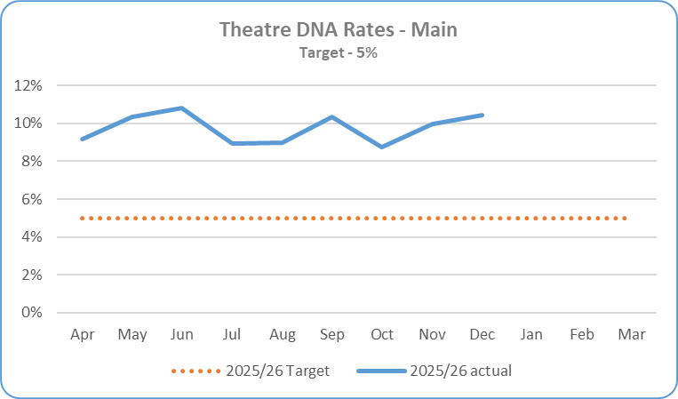
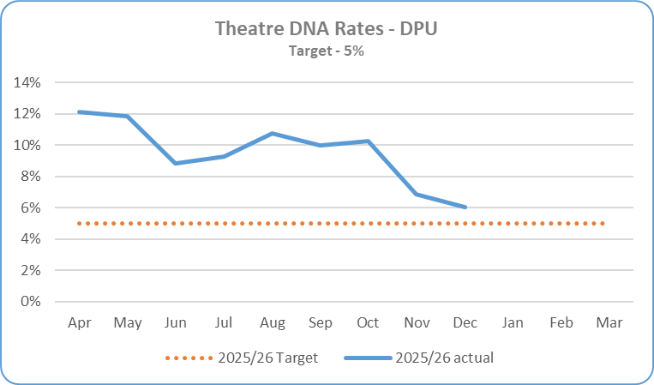
Section 2 – Key SOMs Indicators - Performance
Service Area | Metric | Jan 26 Target | Jan 26 In-month Performance | Cumulative Activity YTD | Rag Status Jan 26 | Rag Status YTD | Chart
Performance -Scheduled Care | DNA rates for New consultant outpatient appointments Target – maximum 5% | 5% | 9.00% | 7.99% 11,770 out of 147,367 appointments
 | DNA rates for Review consultant outpatient appointments Target – maximum 8% | 8% | 9.96% | 8.85% 30,112 out of 340,195 appointments
 | Theatre DNA Rates– Main Theatres Target – maximum 5% | 5% Monitored a month in arrears | 10.42% (December 25) | 9.75% (Apr-Dec)
 | Theatre DNA Rates – DPU Target – maximum 5% | 5% Monitored a month in arrears | 6.04% (December 25) | 9.56% (Apr-Dec)

Slide 9
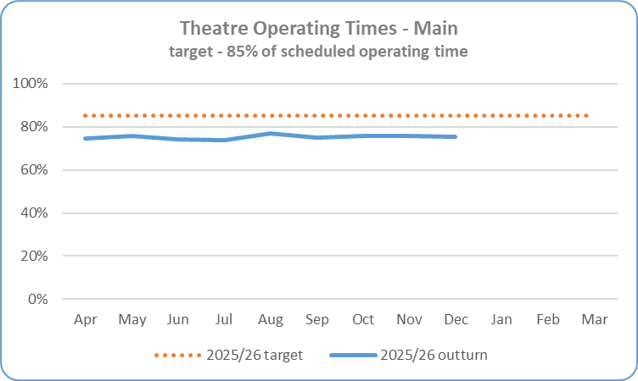
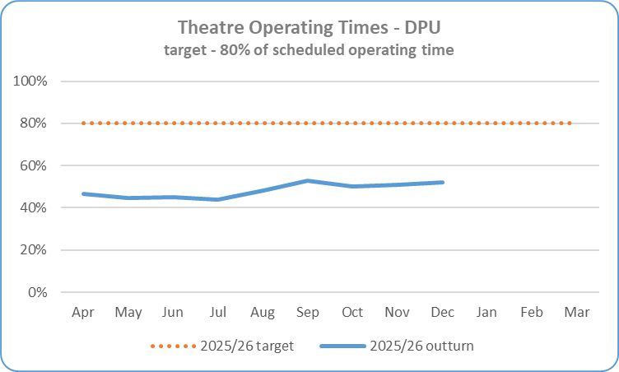
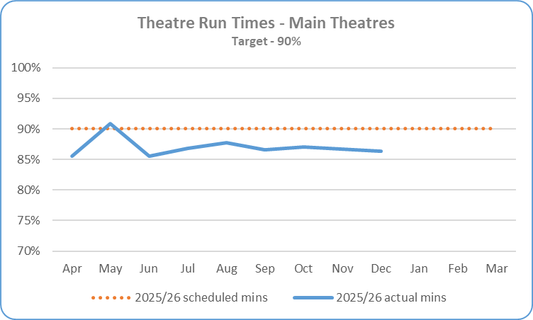

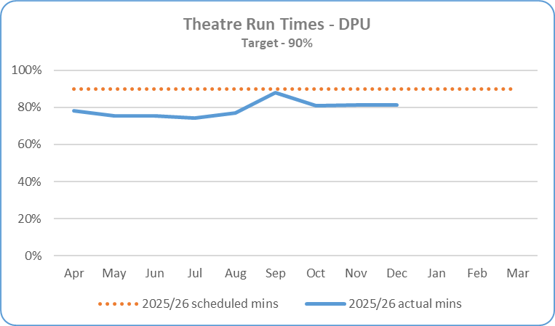

Section 2 – Key SOMs Indicators - Performance
Service Area | Metric | Jan 26 Target | Jan 26 In-month Performance | Cumulative Activity YTD | Rag Status Jan 26 | Rag Status YTD | Chart
Performance -Scheduled Care | Theatre Utilisation - Operating Times – Main Theatres Target – maximum operating rate of 85% | 85% Monitored a month in arrears | 75.45% (December 25) | 75.23% (Apr-Dec)
 | Theatre Utilisation - Operating Times – DPU Target – maximum operating rate of 80% | 80% Monitored a month in arrears | 52.08% (December 25) | 48.38% (Apr-Dec)
 | Theatre Utilisation - Run Times – Main Theatres Target – minimum run time rate of 90% | 90% Monitored a month in arrears | 86.40% (December 25) | 87.00% (Apr-Dec)
 | Theatre Utilisation - Run Times – DPU Target – minimum run time rate of 90% | 90% Monitored a month in arrears | 81.27% (December 25) | 79.14% (Apr-Dec)

Slide 10
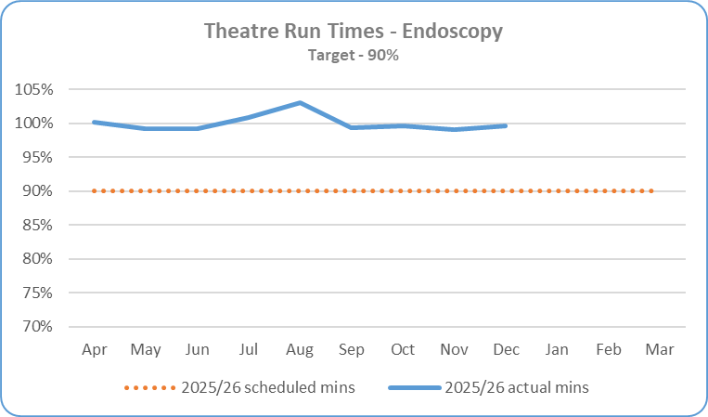


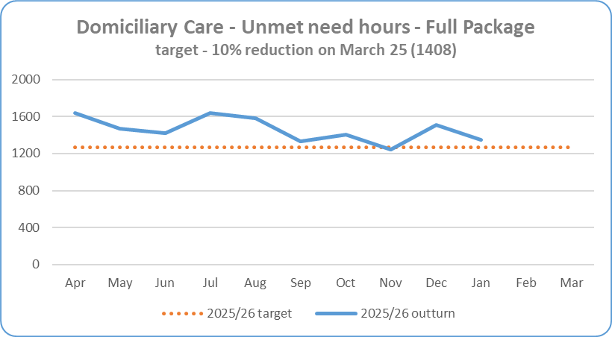

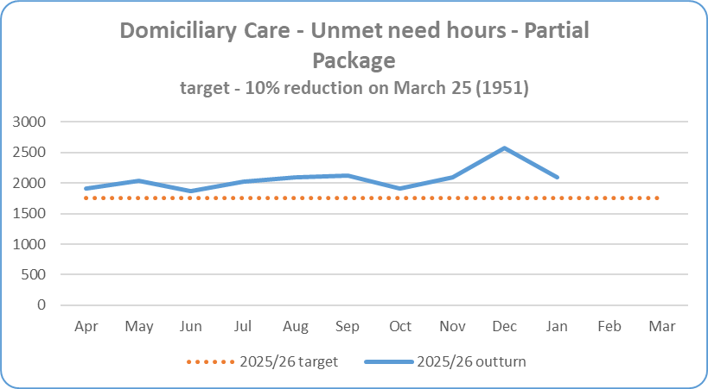

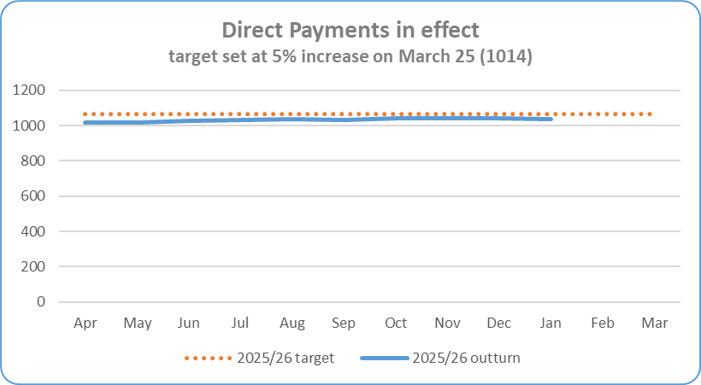
Section 2 – Key SOMs Indicators - Performance
Service Area | Metric | Jan 26 Target | Jan 26 In-month Performance | Cumulative Activity YTD | Rag Status Jan 26 | Rag Status YTD | Chart
Performance – Scheduled Care | Theatre Utilisation - Run Times – Endoscopy Target – minimum run time rate of 90% | 90% Monitored a month in arrears | 99.58% (December 25) | 99.92% (Apr-Dec)
Community Care | Domiciliary Care – Unmet Need – Full Package Target- 10% reduction in unmet need hours by March 2026 compared to position at 31 March 25 (1408 hrs) | 1,267 hrs | 1,351 hrs -4.05% under target | 1,351 hrs (Jan position)
 | Domiciliary Care – Unmet Need – Partial Package Target - 10% reduction in unmet need hours by March 2026 compared to position at 31 March 25 (1951 hrs) | 1,756 hrs | 2,092 hrs 7.23% above target | 2,092 hrs (Jan position)
 | Direct Payments Target - 5% increase in Service User Direct Payments in effect by March 2026 compared to position at 31 March 2025 (1014 service users) | 1,065 | 1,037 2.27% increase on March 25 position | 1,037 (Jan position)

Slide 11
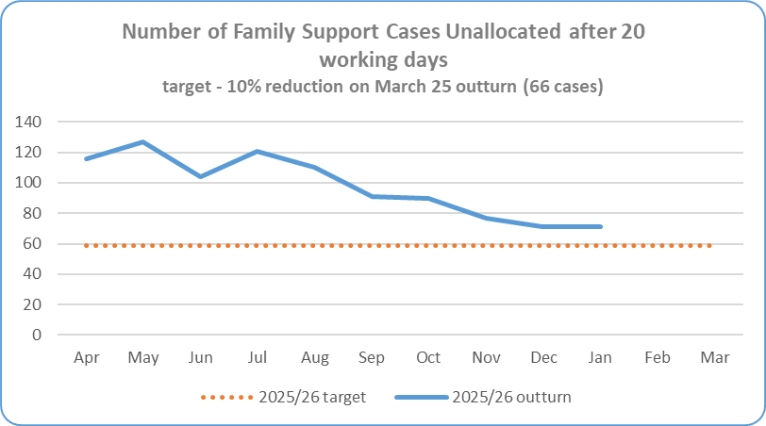
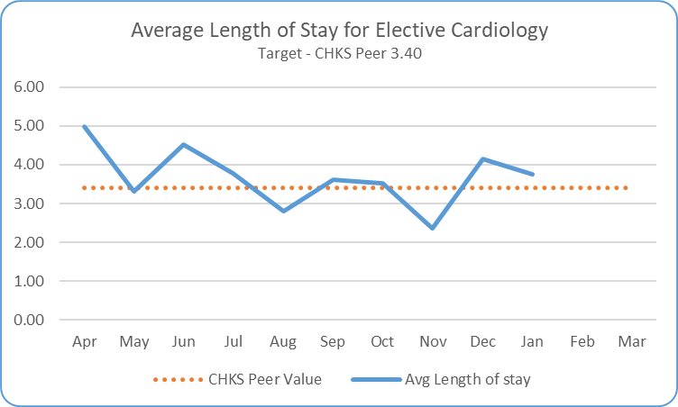
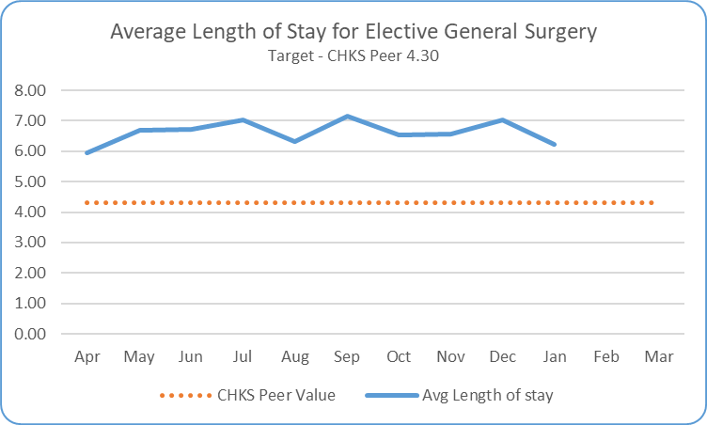
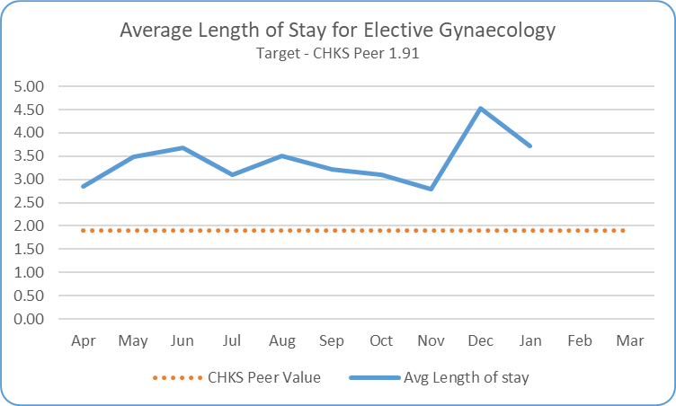
Section 2/3 – Key SOMs Indicators - Performance and Efficiency & Productivity
Service Area | Metric | Jan 26 Target | Jan 26 In-month Performance | Cumulative Activity YTD | Rag Status Jan 26 | Rag Status YTD | Chart
Performance – Community Care | Family Support – Unallocated Cases Target - reduce by 10% by March 2026 compared to position at end March 2025 – 66 cases | 59 cases | 71 cases 7.58% increase on March 25 position | 71 cases January position
Efficiency & Productivity - Scheduled Care | Average LoS for Elective Patients Cardiology (includes Paediatrics) Target - Reduce LoS against CHKS peer group level | 3.40 days | 3.75 days | 3.67 days
 | Average LoS for Elective Patients General Surgery (includes Breast & Vascular) Target - Reduce LoS against CHKS peer group level | 4.30 days | 6.22 days | 6.62 days
 | Average LoS for Elective Patients Gynaecology (includes oncology) Target - Reduce LoS against CHKS peer group level | 1.90 days | 3.72 days | 3.37 days

Slide 12
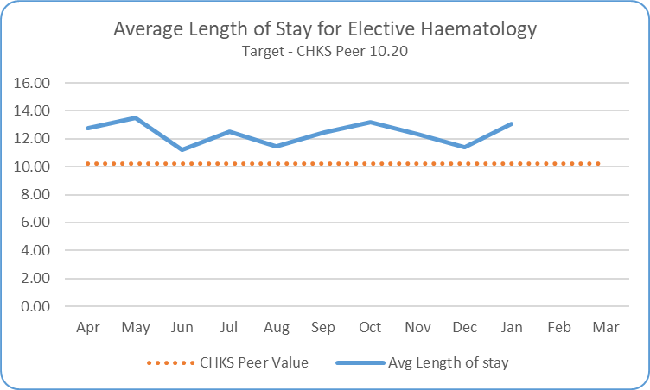
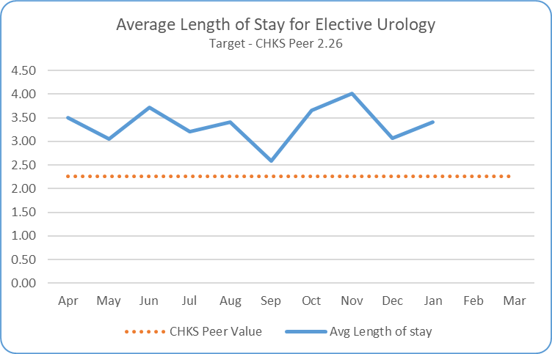
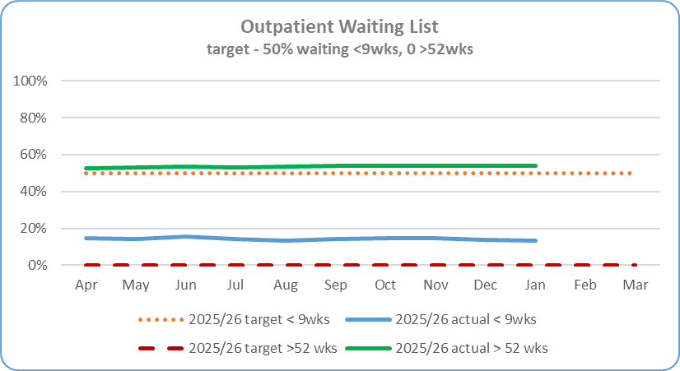
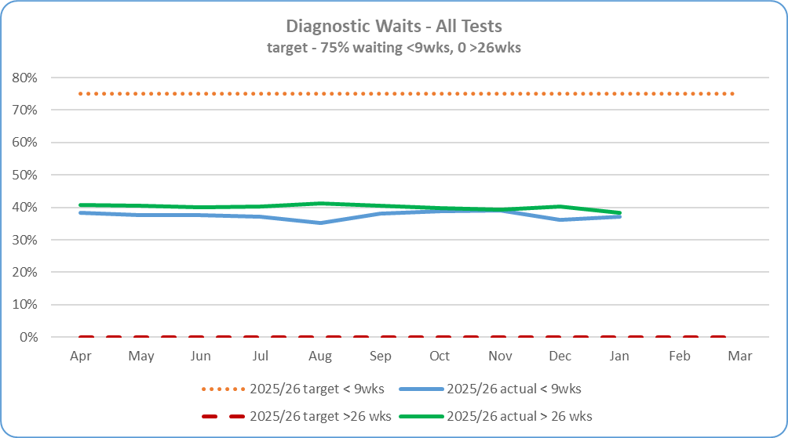
Section 3/4 – Key SOMs Indicators - Efficiency & Productivity and Access Improvement
Service Area | Metric | Jan 26 Target | Jan 26 In-month Performance | Cumulative Activity YTD | Rag Status Jan 26 | Rag Status YTD | Chart
Efficiency & Productivity – Scheduled Care | Average LoS for Elective Patients Haematology (includes paediatrics) Target - Reduce LoS against CHKS peer group level | 10.20 days | 13.08 days | 12.36 days
 | Average LoS for Elective Patients Urology Target - Reduce LoS against CHKS peer group level | 2.26 days | 3.41 days | 3.35 days
Access Improvement/ Ministerial Targets – Elective Care | New Outpatient Waiting List Target – 50% patients waiting < 9 wks 0 patients waiting over 52 wks | 50% < 9 wks 0 over 52 wks | 13.37% patients under 9 wks (21,382 out of 138,546) 86,551 patients waiting over 52 weeks | 13.37% 86,551 (Jan position)
 | Diagnostic Waiting Lists - Imaging Physiological Measurements Endoscopy Target – 75% patients waiting < 9 wks 0 patients waiting over 26 wks | 75% < 9 wks 0 over 26 wks | 37.1% patients under 9 wks 22,096 patients waiting over 26 wks | 37.1% 21,323 (Jan position) 38.45% 22,096 (Jan)

Slide 13
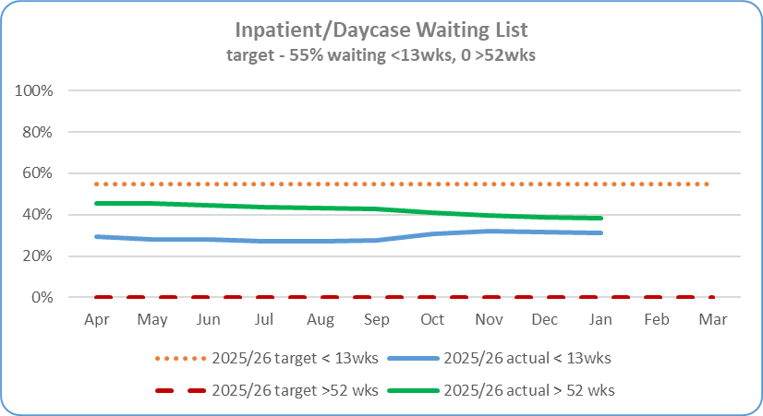
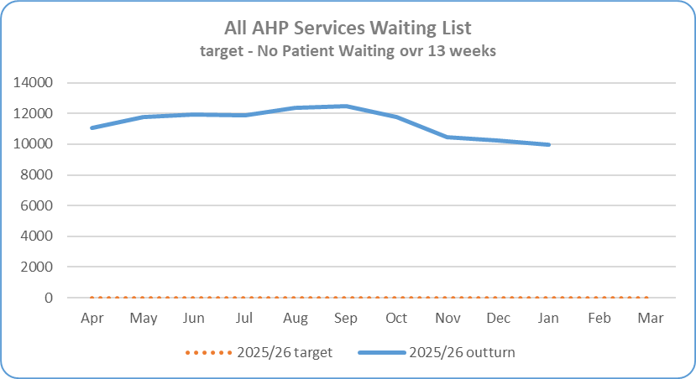
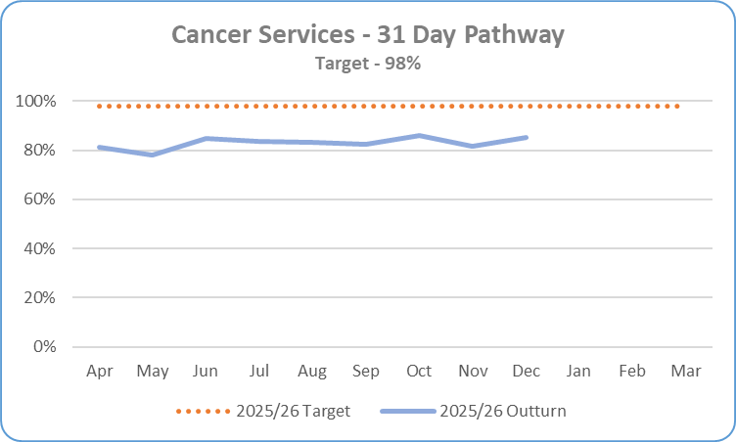
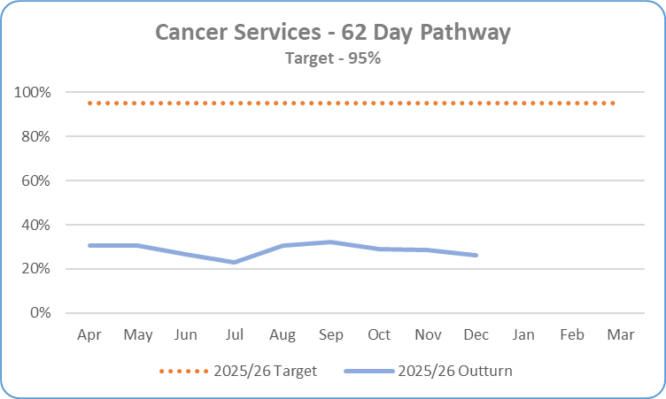
Section 4 – Key SOMs Indicators - Access Improvement
Service Area | Metric | Jan 26 Target | Jan 26 In-month Performance | Cumulative Activity YTD | Rag Status Jan 26 | Rag Status YTD | Chart
Access Improvement/ Ministerial Targets – Elective Care | Inpatient & Daycase waiting lists Target – 55% patients waiting < 13 wks 0 patients waiting over 52 wks | 55% < 13 wks 0 over 52 wks | 31.08% patients waiting < 13wks (11,548 out of 37,159) 14,209 patients waiting over 52 wks | 31.08% 14,209 (Jan position)
 | AHP Waiting Lists – All Services Target - No patients waiting over 13 wks | No patients waiting over 13 wks | 9,976 waiting over 13 wks out of a total of 21,387 (46.65%) | 9,976 patients (Jan position)
Cancer Services | 31 day Performance Target - 98% of cancer diagnosis patients to receive their first definitive treatment <31 days of a DTT | 98% Monitored a month in arrears | 85.19% (Dec 25) 345 out of 405 patients were seen <31 days Figures are provisional as pathways are still being closed down and validation ongoing. | Apr - Dec 25 83.10% 3,098 out of 3,728
 | 62 day Performance Target - 95% of suspect cancer patients red flag referred to be begin definitive treatment <62 days of referral | 95% Monitored a month in arrears | 26.38% (Nov 25) 33.5 out of 127 patients were seen <62 days Figures are provisional as pathways are still being closed down and validation ongoing. | Apr - Dec 25 28.61% 369.5 out of 1,291.5

Slide 14
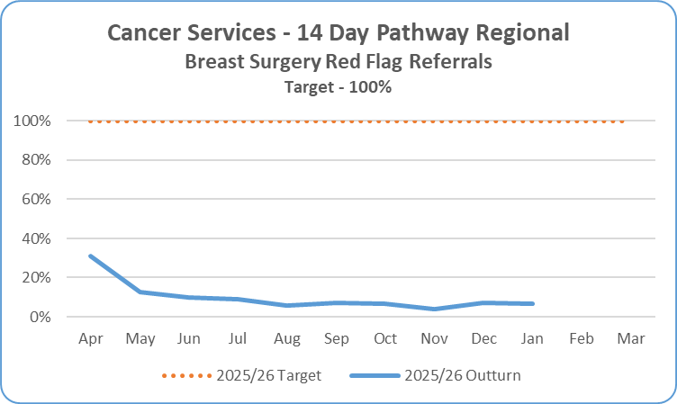
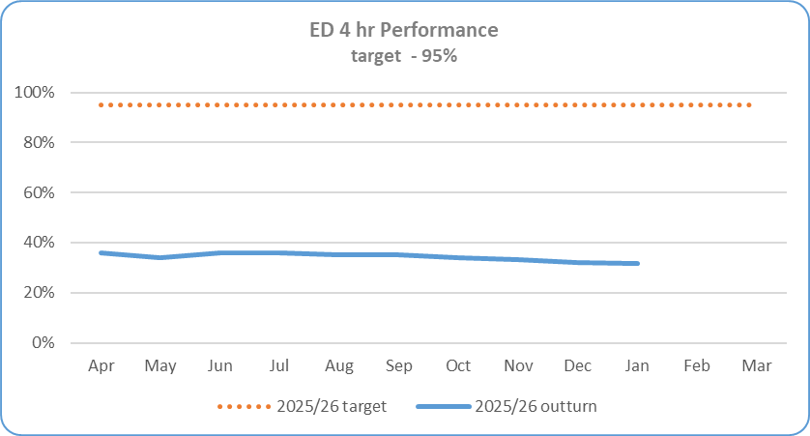
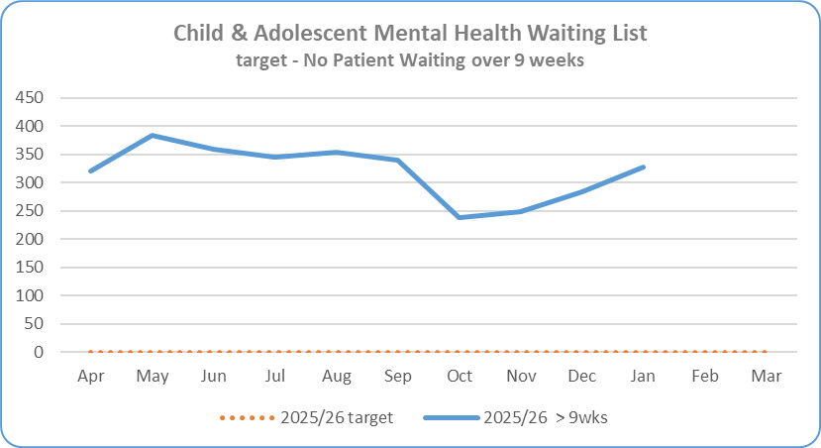
Section 4 – Key SOMs Indicators - Access Improvement
Service Area | Metric | Jan 26 Target | Jan 26 In-month Performance | Cumulative Activity Qtr3/YTD | Rag Status Jan 26 | Rag Status YTD | Chart
Cancer Services | 14 Day Performance – Regional Position so not reported in Belfast Trust SOMs Target – 100% of suspect breast cancer referrals to be seen within 14 days | 100% | 6.87% 92 out of 1,339 patients were seen <14 days | Apr - Jan 26 9.94% 1,100 out of 11,065
Access Improvement/ Ministerial Targets – Unscheduled Care Care | ED <4 Hour Performance Target – 95 % of patients waiting <4 hours from arrival to discharge/admission | 95% | 31.70% 4,504 out of 14,210 attendances | 34.22% 48,004 out of 140,280 attendances (Apr-Jan)
Mental Health Services | Child & Adolescent Mental Health Services Waiting List Target – No patients waiting over 9 weeks | No patients waiting over 9 wks | 328 46.92% of total waiting | 328 (Jan position) 46.92%

Slide 15
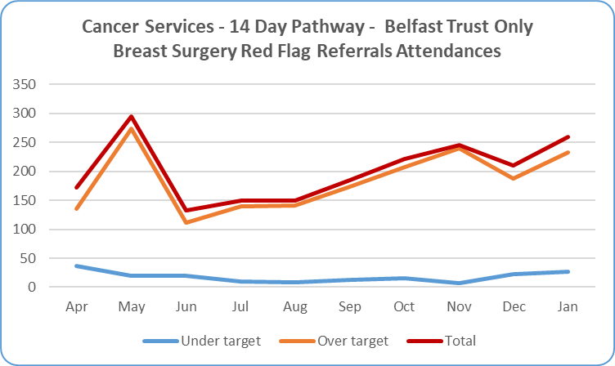
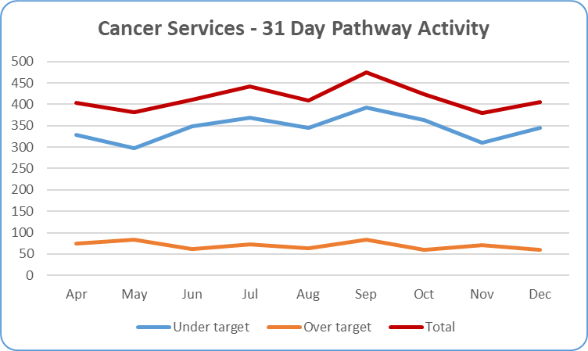
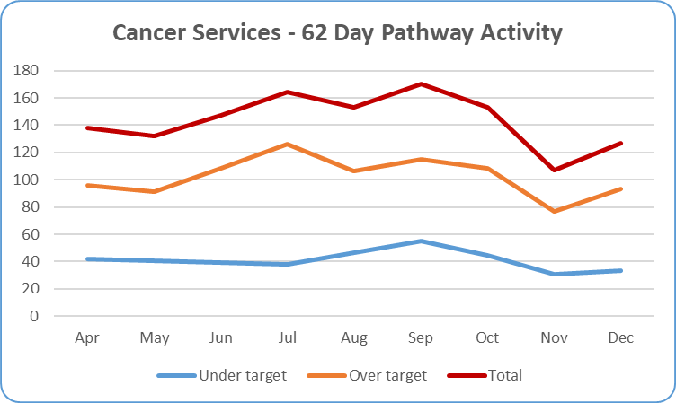
Cancer Monthly Activity
31 & 62 day activity reported a month in arrears

Slide 16
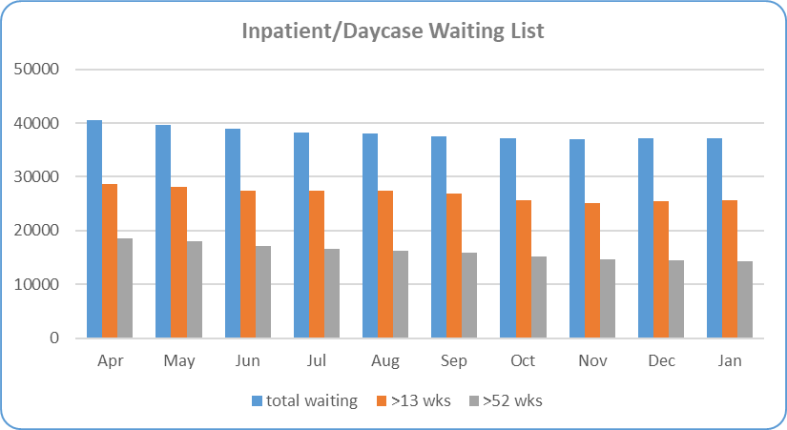
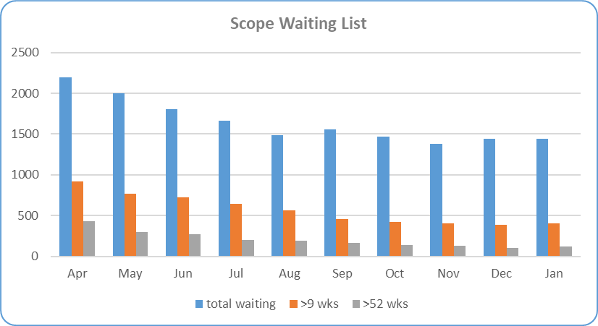
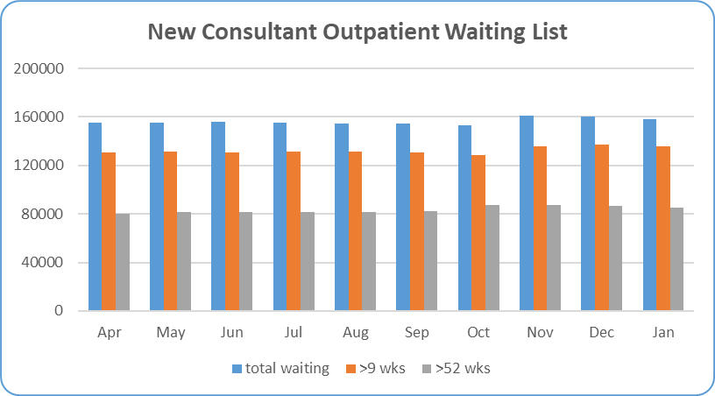
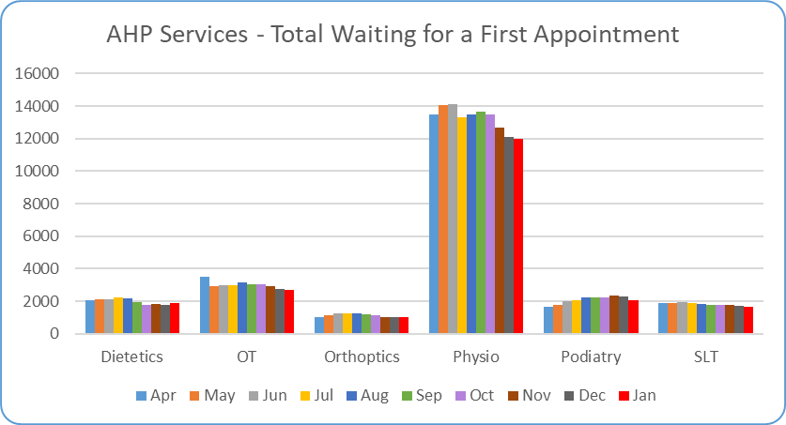
Waiting List Summaries

Slide 17
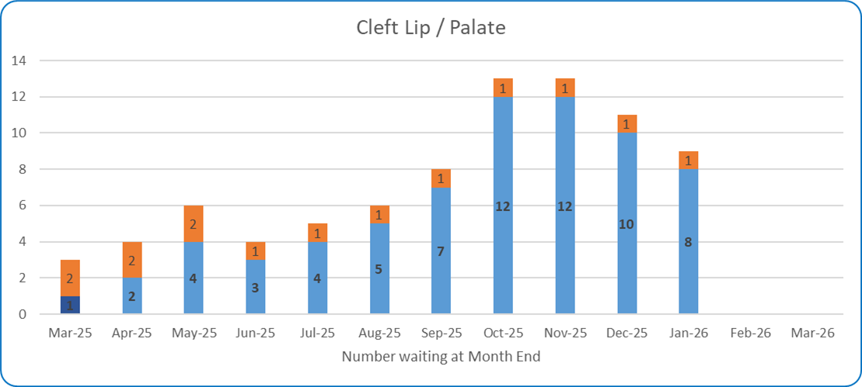
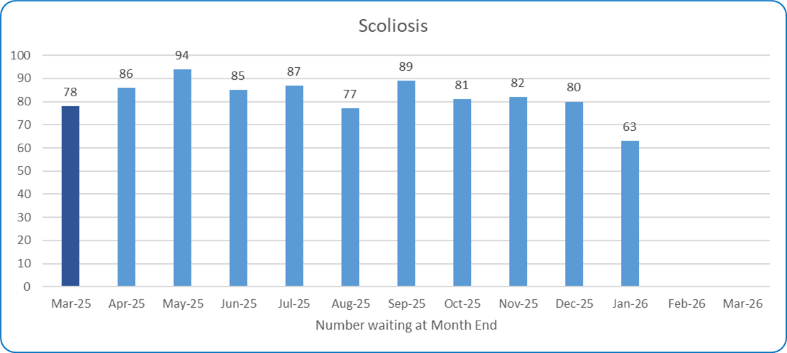
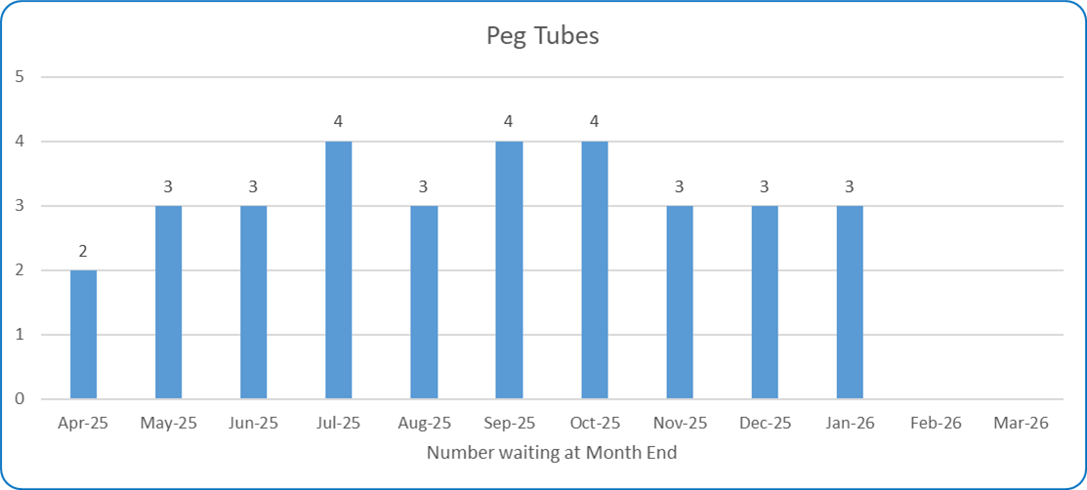
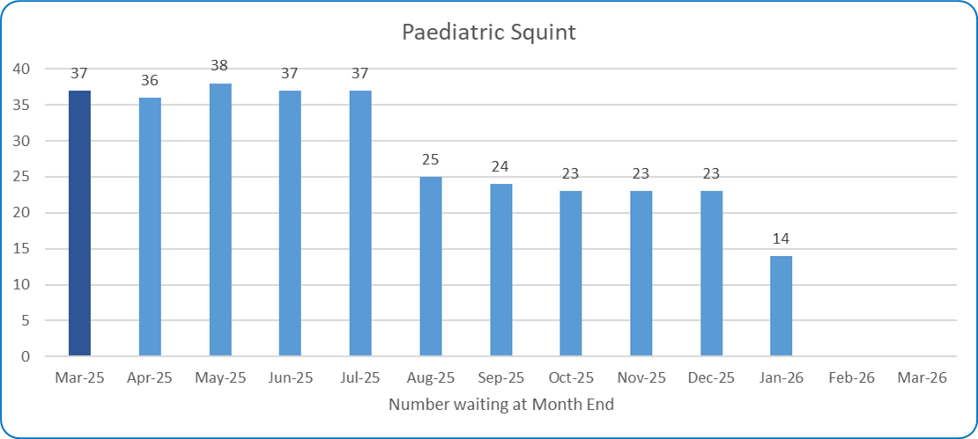
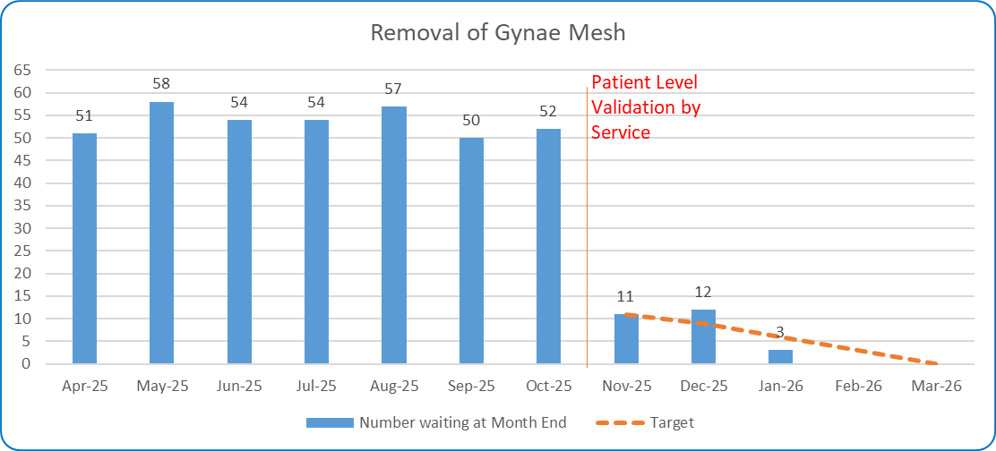
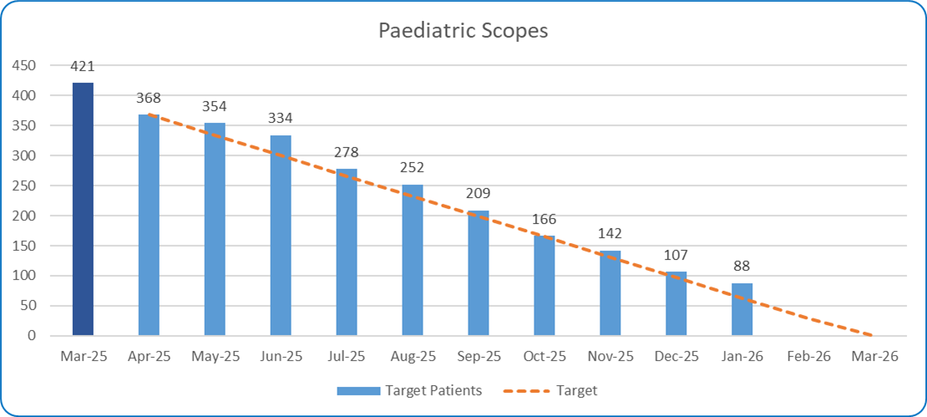
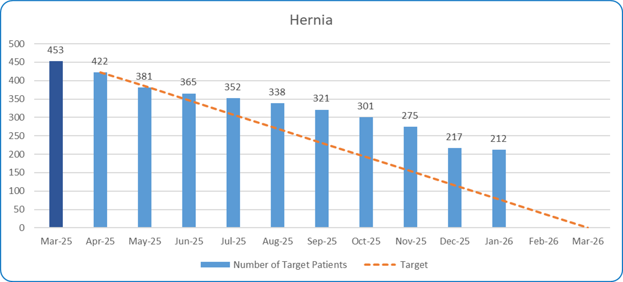
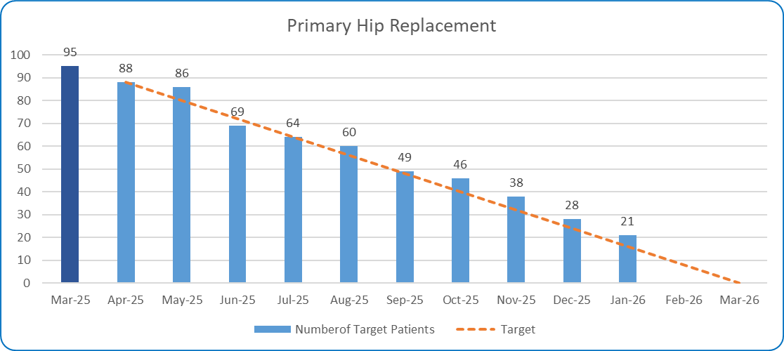




Waiting List for Names Procedures – £50million Backlog Procedure Clearance

Slide 18
Waiting List Validation – Inpatients & Scope as at 16th February

Slide 19
Waiting List Validation – Outpatient as at 1st February 2026

Slide 20
Waiting List Validation – Outpatient as at 1st February 2026 cont’d

Slide 21


Section 3 – Patient Satisfaction - Real-Time Feedback: Patient Experience Charts - Month of January 2026 = 620 surveys
1st April 2025-31st January 2026: 7,662 surveys were completed across all Real Time Patient Experience engagement tools.
In January 2026, of 620 adult inpatients, 99% were extremely likely to recommend the ward they were in to their friends or family and overall satisfaction remains at 99%.
The highest scoring Domains in January 2026 were: (9.99) for Doctors and Cleanliness, followed by (9.98) Nurses/Midwives, Medicine, Kindness & Compassion and Respect & Dignity.
Noise at Night remains a challenging Domain scoring (9.66) in January 2026.
Real Time Patient Experience continues to engage with Services exploring expansion within resources, with a service review ongoing.
7

Slide 22

Section 5 – Patient Satisfaction
Service Area | NOTE: This information is produced quarterly
Datix – Complaints and Compliments | New classification of complaints have been implemented by SPPG – the new categories and subjects are detailed below.

Slide 23


Section 5 – Patient Satisfaction
Service Area | According to this new classification of complaints the data for 2025/26 Quarter 3 as follows:
Datix – Complaints

Slide 24
Appendix

Slide 25
System Oversight Measures Indicators Summary Tables

Slide 26
Activity Summary Tables
Outpatient Attendances
Elective Admissions & Daycases

Slide 27
Activity Summary Tables
AHP Contacts
Imaging Activity

Slide 28

15 Escalations: Support & Intervention Framework January 26
Level 1 (3) | Level 2 (7) | Level 3 (4) | Level 4 (0) | Level 5 (1)
Cleft lip and palate | Serious Adverse Incidents | MAH Governance & Accountability |  | Cardiac Surgery
CAMHS waiting lists (↓from level 2) | Increasing usage of IS Foster Placements | Iveagh Inpatient Unit- delayed discharge
Neonatal NISTAR | Full implementation of Perinatal Mortality Review Tool
Closed Peg tube insertion | Reducing time spent in ED (particular focus on >12 hours (↓ from level 3) | Family and Childcare workforce
 | Short breaks for kids with disabilities
 | Ambulance Handover (↓ from level 3)
 | No of unallocated children in family and childcare services
Escalation
De-escalation
Level 5*: intervention at HSC Board level – Decision by Health Minister- as advised by DOH/SPPG/PHA. Involves exercise of Minister’s power of intervention. Only used in exceptional circumstance. Targeted support suspension, removal of duties from individuals or whole Board. Assessment through quality surveillance, existing knowledge, formal and informal investigations. Draw on expertise/advice of national colleagues and use of external organisational and independent advisors
Level 4*- Senior external support for provider. Targeted interventions – decision taken by Permanent Sec. Failure to provide recovery plan at level 3, significant weaknesses re financial stability, reputation, governance quality of care or patient safety. DOH take/coordinate action and direct intervention to support Trust, Interventions undertaken by SPPG as directed by Perm Sec. Appropriate external support may be given to Trust eg mentoring for Board/ET members – co-opting experts onto Board as Independent Advisors for finite period. DOH Review
Level 3- enhanced monitoring and support for provider – where previous concerns not resolved at levels 1 or 2, scale of concern, systemic concerns, or ongoing performance challenges, Formal recovery plan – proactive approach, clear milestones and responsibilities – significantly enhanced monitoring and scrutiny. Trust CE to cooperate and provide leadership re agreed recovery actions.
Level 2- enhanced monitoring and support for provider – issues not resolved by Level 1 or direct escalation to Level 2 given seriousness. Local recover plan and enhanced monitoring- regular meetings at Director level – need to show proactivity e.g. ongoing performance challenges, risks with no identified action/timetable
Level 1- area of concern identified – emerging, potentially serious concern to service delivery, quality, safety effectiveness – informal level of support and guidance – but no intervention Notified in writing. Local recovery plan required. More frequent monitoring
Steady state- no intervention required- Trust generally operating effectively – any issues picked up through routine oversight arrangements
NI Public made aware of
concerns at levels 4 &5 -
serious problems or
concerns re existing
leadership’s ability to
rectify
Escalation and de-escalation to & from level 1 will take place as necessary and be decided by DOH/SPPG/PHA

Slide 29
New SOMs Indicators to be implemented and reported during Quarter 3
Performance:
Review OP Appointments
Patient Initiated Follow Up (PIFU)
Efficiency & Productivity:
Daycase Rates
Inpatient Admissions
Safety & Quality:
SSKIN Bundle
MUST

