Slide 1


Belfast HSC Trust
Corporate Plan 2026/31
DRAFT
Accessible formats: Please contact equality.team@belfasttrust.hscni.net if you require this plan in a different format to meet your needs
Patients and Service Users | People | Population and Partners | Potential | Performance

Slide 2
Contents | Page number
Our Story | 3
Our communities | 4
Our people | 5
Our impact | 6
Our challenges | 7
Our strategic drivers | 8
How and why did we develop our five year plan? | 9
Our priorities | 10
Belfast Trust strategic framework | 11
Our plan on a page | 12
Our patients and service users | 13
Our people | 15
Our population and partners | 17
Our performance | 19
Our potential | 21
Transforming strategy into reality | 23
2
DRAFT
Patients and Service Users | People | Population and Partners | Potential | Performance

Slide 3
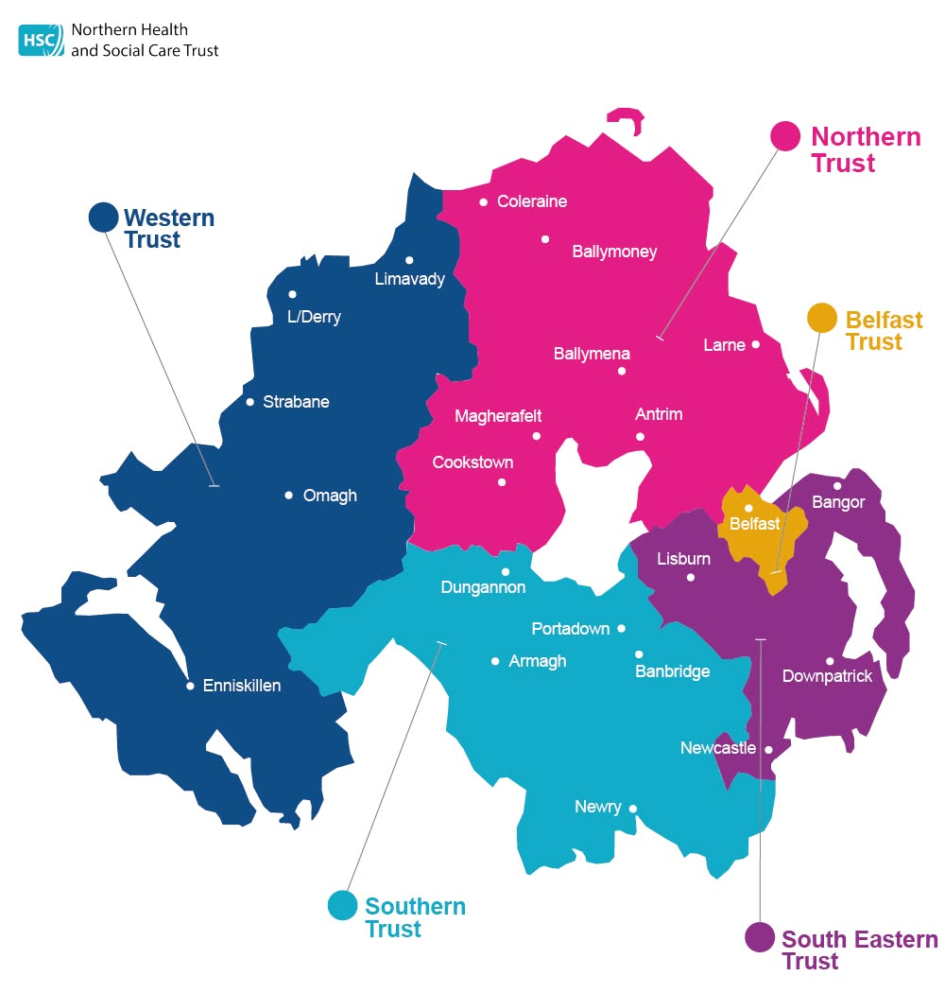
3
Our Story
Belfast Health & Social Care Trust is largest integrated health and social care Trust within the United Kingdom. We serve the population of Belfast of over 350,000, as well providing regional and specialist services to the 1.9 million people of Northern Ireland.
Our services are delivered across 4 acute hospital sites and more than 100 community facilities within Belfast. The Trust is supported by our amazing 22,000 staff who are employed across 16 Directorates. In addition to this, we are also comprised of the major teaching and training hospitals in Northern Ireland and work closely in partnership with the two leading universities in the region.
We are known for our specialist staff who have expert training and experience, and due to this are home to more than 90% of regional specialist services in Northern Ireland.
Our patients and service users are central to everything we do, and we are committed to providing compassionate, person-centred care. To ensure that Belfast Trust is a place where people feel confident and satisfied with the health and social care they receive, our patients and service users are fully embedded into our service through involvement. They help us to ensure that everyone who accesses our service has the best possible experience and outcome.
Patients and Service Users | People | Population and Partners | Potential | Performance
Notes:
? Split in to Intro and context setting (what needs to be written narrative and what could be script for video?)
To include scope of BHSCT- local population and regional services= regional approach.
How do we address ‘learning’ in a positive light?

Slide 4

Our Communities
4
DRAFT
Total population
The total population of Belfast Local Government District was 345,418 – a 20.8% increase on the population in 2011.
51% female:49% male.
Ethnic diversity
Ethnic diversity has grown in Belfast, going from 98% white in 2001, to 93% in 2021. This has implications for health and social care delivery with certain diseases and ill health are more prevalent among certain ethnic groups.
Life expectancy
Age
The gap between Northern Irish male and female life expectancy is largest in Belfast – 5.2 years in favour of females compared to 3.9 in favour of females across NI.
In general, our population is living longer, often with long-term health conditions. Older people are more likely to experience long-term health problems.
(**Data based on 2021 Census)
Long-term health conditions
At 25.9 %, Belfast has 5% higher proportion of people with a limiting health condition or disability than general NI population. Women are more likely to experience long-term health problems. Almost a quarter of women in Belfast, compared to 1 in 5 men, report a disability or a long-term health problem that affects their day-to-day activities.
Patients and Service Users | People | Population and Partners | Potential | Performance
Notes:
© Copyright PresentationGO.com – The free PowerPoint and Google Slides template library

Slide 5
Our People
5
Total workforce as of 31st March 2026: 22, 202
Medical and Dental: 1,281
Administrative and Clerical: 3,735
Social Services: 2,811
Professional and technical: 4,115
Support Services: 2,120
Patients and Service Users | People | Population and Partners | Potential | Performance
Notes:
© Copyright PresentationGO.com – The free PowerPoint and Google Slides template library

Slide 6
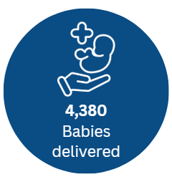
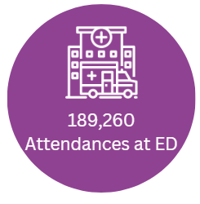
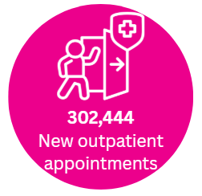
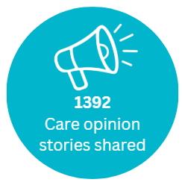
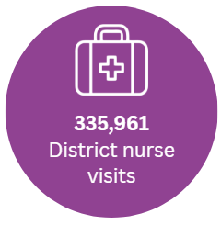
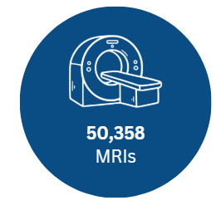


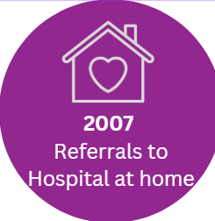
Our Impact
6
The Trust supports and promotes a learning culture helping us to evolve and grow. In recent years, there have been significant developments to showcase this in areas such as digital innovation, patient experience, workforce development, and clinical excellence such as:
The successful deployment of a single digital record encompass, and rollout of a new app MyCare to empower people in their own health care
A new breakthrough diagnostic technology that reduces the time needed to diagnose brain tumours from several weeks to just a few hours—developed in partnership with Queen’s University and a local charity significantly speeding up access to treatment and improving patient outcomes
A new specialist home-based care service for adult palliative and end of life patients in Belfast developed through partnership working with Northern Ireland Hospice and Marie Curie
Recruitment of over 200 newly qualified social workers and securing the prestigious ‘Trust of Sanctuary’ Award in recognition of its commitment to providing a safe, welcoming environment for everyone, regardless of background, ethnicity, or origin.
Snapshot of our annual activity
Data based on 25/26 activity.
Patients and Service Users | People | Population and Partners | Potential | Performance
Notes:
Can we word this as a positive framing- Our annual/ weekly impact?
NB need for diagnostics, across directorate, ? Focus on ‘neighbourhood’ and outpatients
To include key achievements- examples of good practice and positive care opinion submissions.

Slide 7
7
Our Challenges
Whilst we continue to achieve improvements and celebrate success, our five-year corporate plan (and annual operational plans) need to address the external and internal challenges we currently face within the organisation and across the Health and Social Care System in NI.
Parts of the community we serve experience significant health inequalities and due to this, we are serving some people living in the highest areas of deprivation –impacting on their health and wellbeing and life chances.
Life expectancy for both males and females are the lowest in Belfast Trust Local Government District (LGD) in comparison with the rest of NI.
Within the Belfast Trust LGD, there are stark gaps between the most and least deprived areas for life expectancy.
Additionally, there is higher prevalence of mental ill health and substance abuse within the Trust area.
Northern Ireland has the highest rate of domestic femicide in all of Europe.
We remain committed to tackling these inequalities but recognise that health and social care interventions only contribute partially to the aim of improving wellbeing. Therefore, Trust collaboration with primary care, other statutory organisations, the independent sector and the community and voluntary sector through a neighbourhood centred system of care are critical in successfully addressing inequalities and improving health and wellbeing.
The HSC Reset Plan sets out how Northern Ireland’s health and social care system will respond to severe financial pressure, rising demand, workforce shortages and long waiting lists, while delivering reform set out in the Health Minister’s three‑year strategy.
We will work as part of the HSC system to focus on prevention, health literacy and empowering people to manage their own health
We realise that change is needed within the system to deliver transformation across the Health & Social Care System and we are committed to playing our part in this journey.
As an organisation committed to learning and improvement, we will take lessons from recent challenges and move forward and grow to nurture an open just and compassionate culture, where patients and service users feel confident in our services and where our staff feel proud to provide them.
Patients and Service Users | People | Population and Partners | Potential | Performance

Slide 8



Our Strategic Drivers
8
Our corporate plan needs to be directed by and underpin the key strategic priorities over recent years.
  Programme for Government: 2024 – 2027 Our Plan and Doing What Matters Most and Ministerial Priorities set the approach to addressing key areas of focus within Health and Social Care, including priorities to Cut Health Waiting Times, Reform and Transformation of Public Services, Ending Violence against Women and Girls, Better Support for Children and Young People with Special Educational Needs.
  A key driver for our plan will be the ‘Reset Plan’, launched by the Minister for Health in July 2025. It is imperative that we as an organisation address this and ensure our corporate plan aligns with the 3 strategic pillars of Stabilise, Reform and Deliver. The Health and Social Care system in Northern Ireland is facing significant and unprecedented financial pressures, and we must collectively take action to stabilise services in the short term and fundamentally reset how care is delivered through a new NI Neighbourhood Model of Care, shifting away from hospital-centred care toward prevention, community provision and more care delivered closer to people’s homes.
  We recognise that none of this would be possible without our people – our staff, and we are indebted to them for their dedication, commitment, and resilience. We want to ensure that the Trust is somewhere where they are proud to come to work.
Patients and Service Users | People | Population and Partners | Potential | Performance
Notes:
Manchester- ‘refreshing our strategy’. HOW & WHY? Outline of engagement process
Reflecting on progress, learning from where improvement is needed, joint objectives with our partners. Include recognition that vision and strategy needed revised and updated and aim to ‘strengthen corporate identity and trust’ (staff and public).
Reliant on our values.

Slide 9
How and why did we develop our five-year Corporate Plan?
9
Previously in 2024/25, the Trust developed and implemented a one-year Corporate Plan due to the imminent arrival of a new Chief Executive and Chair. This one-year plan was based on four key priorities, known as the ‘four Ps’ – Patients & Service users, Performance, People, and Potential. Since then, we have worked on engaging on and developing a new five-year plan.
This 2026-31 Corporate Plan provides a longer-term roadmap for the organisation, aligning our strategic direction with regional priorities - it shows to all our internal and external stakeholders where we are now and where we want to be in five years' time – what we plan to do and how we will measure our success. There are real challenges ahead and this plan will provide a framework for our resource planning and allocation, helping us to align our workforce, finance, and infrastructure with strategic priorities. With constrained public sector budgets, it is essential that we focus all of our energies on delivering reform and providing services that have a real positive impact on the population’s health outcomes. In terms of accountability and governance, the plan will help not only us to hold ourselves to account but also facilitates accountability and transparency to our stakeholders. Alongside this five-year corporate plan, annual operational plans. The Trust will provide regular updates to our Trust Board, and to the Strategic Performance and Planning Group (who commission our services) and to the Department of Health.
This plan builds on last year’s foundations and expands from four Ps to five priorities (Ps): Patients and Service Users, People, Population and Partners, Performance and Potential. The additional P: Population and Partners has been included to reflect the direction of travel of moving to a Neighbourhood Model of Care, shifting from hospital-based care to more care provided closed to home and in recognition, that cross-sectoral collaboration is essential in improving health and wellbeing and tackling inequalities. The plan will also support existing and new partnership working and will enable joint goal setting and collaboration with other HSC Trusts, primary care, local councils, voluntary organisations, education and universities.
Given the complexity and scale of the organisation, it is important that each directorate and division consider the corporate plan and develop an annual local management plan; and that each of our individual staff members develop in discussion with their line manager their own annual staff development review, also based on the five Ps. This in turn means that each team and each member of staff knows how the overall priorities of the Trust and how they individually or collectively contribute to them.
To establish if these priorities and aims and measures of success resonated with people, the Trust undertook engagement with service users, carers, staff, Trust Board members and the Executive Team and our partners in Primary and Local Government between November 2025 and April 2026. This was achieved through a range of methods including face-to-face workshops, drop-in sessions, an online questionnaire and online meetings and this yielded a great deal of valuable feedback and supported development of this new corporate plan. The Trust is grateful to the many people who took time to help us shape this important document and are committed to providing updates on our progress along the five- year journey.
Patients and Service Users | People | Population and Partners | Potential | Performance

Slide 10
10
Our Priorities – the Five Ps
The “five Ps" form the focus of our corporate plan, help us review our annual corporate objectives and measure our progress. They will be carried into local management plans and individual personal development plans so that every member of our teams understand how they contribute to the overall ambition and aims of the Trust.
PATIENTS AND SERVICE USERS Being caring and open. We aim to be widely recognised for delivering safe, person-centred, high-quality, and compassionate care leading to excellent experience and best outcomes. Our patients and service users will be at the heart of all that we do.
PEOPLE: Being kind, professional and respectful. We aim to create an inclusive and people centered experience at work to help our workforce flourish
POPULATION HEALTH & PARTNERS: Being collaborative and inclusive. We aim to improve the lives of our community, working together with all of our partners.
PERFORMANCE: Being effective and safe. We aim to consistently deliver efficient effective and equitable patient care.
POTENTIAL: Being curious and embracing innovation. We aim to encourage and support our staff to bring bold ideas with continuous creativity.
DRAFT
Patients and Service Users | People | Population and Partners | Potential | Performance
Notes:
Strategic framework rather than vision. Bringing out patients and service user.
Aims and measures of success.
Enablers?
Objectives- themed and concise version of the aims.

Slide 11
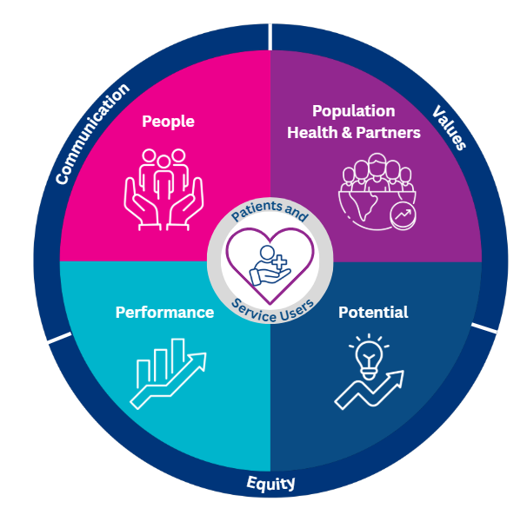
Belfast Trust Strategic Framework
11
Our strategic vision has Patients & Service Users at the centre of all that we do. Surrounding this are our four other priorities:
People
Population
Performance
Potential
It has been identified that key to delivering these priorities, we require three enablers to support our aims. These are Communication, Equity and Values. These three elements will be key within each of the strategic priorities.
These five Ps - alongside the enablers – will be the focus of the annual objectives. Each service will develop annual local management plans demonstrating how they will contribute to delivering our overall goals.
DRAFT
Patients and Service Users | People | Population and Partners | Potential | Performance
Notes:
Wigan’s page 27
Enablers- equity, communication, values, funding

Slide 12
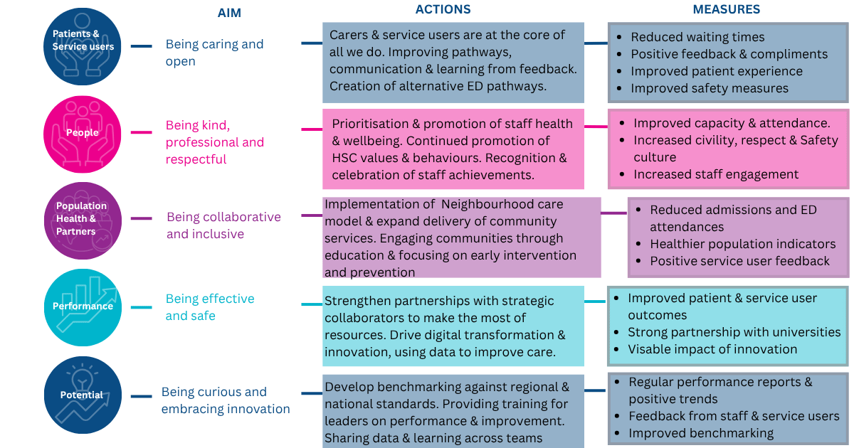
Our Plan on a Page
12
DRAFT
Each of our Strategic priorities have clarified Aims, Actions & Measurement.
These will be closely monitored to review our performance against where we expect to be and refreshed accordingly.
Patients and Service Users | People | Population and Partners | Potential | Performance
Notes:
Page 67 of Manchester’s visual summary
Aims> Impact statement> actions>measures

Slide 13
DRAFT
Our Patients and Service Users
13
Belfast Trust has patients, service users and their carers are at the heart of everything we do. We are privileged to provide health and social care from the cradle to the grave in acute and community settings to people of all ages, people from different backgrounds, with different needs from Belfast and beyond through our regional services.
We recognise the importance of a healthy start in life. We will support children, parents, and families from before and through pregnancy, help children grow into healthier, more resilient adults and support everyone to make healthier choices to help them live longer and age well.
With the move to new Neighbourhood Care model, we plan to deliver more care in community settings, do more to prevent illness, and ensure that hospital attendance is only required when absolutely necessary.
This helps make care more accessible and supports you to stay well, not just to receive treatment when you are ill. We already do this for older people in our Hospital at Home and for people with mental ill health through our Home Treatment Team. We are also currently developing the introduction of virtual wards where a patient, who would previously have had to be admitted to a hospital ward, is able to stay in their own home and receive the same level of hospital-level monitoring and treatment. All of this may lead to changes in the way our services are provided, and how we interact with you. We are committed to working with you in developing these services, and in communicating any changes clearly and openly.
We will provide care that is appropriate, proportionate and adds real value for the individual – this is known as "Sensible Care" and will avoid care that is unnecessary, ineffective, or potentially harmful. At the core of sensible care is the commitment to shared decision-making between the care provider and the individual. We will work to empower people to take more control of their health with a focus on prevention, early support, and partnership working with you, your family, and carers.
We will communicate with you in an honest and timely way that you can understand. We will respect your views and learn from you and your loved ones as the experts by experience in improving our services.
Patients and Service Users | People | Population and Partners | Potential | Performance

Slide 14

Patient and Service User
14
Deliver service change informed by feedback from patients, service users and carers
Provide safe, high-quality, person-centred care
Empower patients for self-management and shared decision-making
Keep people well for longer at home
Provision of timely and equitable access to services
Positive experience for all lives we touch
DRAFT
Aims
Include carers and improve navigation and seamless pathways Use technology (e.g. encompass/ MyCare) to enable access and self-management Improve communication and consistency of messaging Increase dialogue with the public and co-production of services Avoid unnecessary interventions through DOH Sensible Care policy Improve learning processes including from complaints Develop alternative pathways to ED attendance Introduce more services in community Virtual wards Engage with people and communities under the This is Our Health Programme
Actions
Measures of success
Reduced waiting times
Positive feedback and compliments
Demonstrable learning from complaints
Increased use of MyCare and digital tools
Improved safety measures
Improved patient experience
Patients and Service Users | People | Population and Partners | Potential | Performance

Slide 15
Our People
15
Belfast Trust recognises that our people are our greatest asset and are the bedrock of everything we do. A positive staff experience will have a direct correlation on the experience of the people we serve – our patients, service users, clients, and residents. We recognise the pressures facing our workforce, including a limited supply of healthcare professionals and shortages in key professions. We must try to alleviate these pressures and continue to focus on the health, wellbeing, and resilience of our staff and to improve attendance and staff experience. We also recognise that people coming into work are balancing work and personal commitments and we will continue to maximise opportunities for people to have access to flexible working options. Regrettably there will be some of our staff, who will need support in terms of domestic abuse at home, or abuse in the workplace- we remain steadfast in our commitment to ensuring the prevention, reduction and management of violence and aggression towards staff and will provide staff with emotional and practical support through a number of channels such as the Domestic and Sexual Abuse Support Service, Staffcare, Trade Unions, Occupational Health, the development of a Sexual Safety Charter and the introduction of a pilot of Body Worn Cameras in our Emergency Departments.
We are privileged to have increasing diversity in our workforce and recognise the many benefits that this diversity yields. We will continue to positively engage in international recruitment exercises.
Engagement on and development of a People and Culture Strategy is well underway – this strategy focuses on creating conditions where staff feel valued, supported, and empowered to thrive. By investing in leadership, wellbeing, and a culture of openness and learning, we aim to strengthen our workforce, improve staff experience, and ultimately enhance the quality of care we provide to our patients and service users. We strive to be, and importantly to be experienced by our staff, our trainees, and our potential workforce as an open, high performing organisation, which nurtures its people and fosters, ambition, transparency, trust, and inclusivity.
The Leadership Academy represents a new approach, one that sees leadership not as a position, but as a practice and a set of behaviours that can be developed and shared at every level. We remain committed to supporting personal and professional development and encouraging people to achieve their aspirations.
We want to be an organisation where everyone shares a commitment to delivering the very best care, knows their contribution matters, and has access to opportunities to develop new skills, innovate within services, and build a career here.
We will continue to engage with our staff through the staff experience survey and listen and act on their feedback. We will recognise and celebrate the many achievements of our staff
DRAFT
Patients and Service Users | People | Population and Partners | Potential | Performance

Slide 16

People
16
Focus on attracting, retaining, and developing staff
Fostering a culture of openness, respect and civility that helps support staff wellbeing
Strengthen our identity and leadership
Staff feel valued and connected to the Trust’s purpose
Ensuring people feel comfortable in making suggestions and safe to raise concerns
Aims
Continued prioritisation and promotion of our staff’s health and wellbeing Encouraging attendance and managing absence Continue to promote HSC values and behaviours Support and celebrate our diverse workforce Build on the progress of international recruitment Recognise and celebrate achievements Provide learning, development, and ensure effective succession planning Focus on workforce planning Achieve safe staffing levels Be recognised as employer of choice Implementation of actions within the People and Culture Strategy
Actions
Improved attendance levels
Improved staff engagement and staff feedback metrics
Increased civility, respect, and safety culture (as per staff survey)
Increase in staff recognition certificates issued
Reduced incidents of aggression against staff
Measures of success
Patients and Service Users | People | Population and Partners | Potential | Performance

Slide 17
Our Population and Partners
17
The Health and Social Care system cannot improve health and wellbeing in isolation – in fact, it is estimated that somewhere between 10 and 20% of overall health and wellbeing is determined by health and social care providers. The remaining 80-90% of health outcomes are driven by broader social, economic and environmental factors (known as the social determinants of health – e.g. housing, income, education etc). Cross sectoral partnership and successful integration are essential to plan and deliver co-ordinated, joined up and seamless services to support our population to live healthy, independent and dignified lives and to improve outcomes for all. Everyone should receive the right care, in the right place, at the right time.
The Trust has a proven track record of working meaningfully in partnership with our primary care colleagues, with other Trusts and the HSC system, with the community and voluntary sector and with local councils, universities, and education. Throughout the life span of this plan, we will build on those partnerships and forge new ones to address the biggest causes of illness and health inequalities, supporting people to live well from birth through to the end of their lives. By focusing on prevention, early support, and wellbeing, we aim to reduce avoidable illness and the need for healthcare interventions.
Over the next five years, we will strengthen how we engage and involve individuals, their carers and families and our staff in shaping services and future plans, promoting shared ownership, and genuine collaboration. We are also keen to do more to engage with the communities we serve and are planning to put in place regular public meetings in the Belfast area.
Together with our partners, we will redesign services so that more care is delivered closer to home, in neighbourhoods and in our communities. This will include working across health and social care to improve access, experience, and outcomes for the people who use both our local and regional services.
Work had commenced on a new public engagement programme called This our Health. It aims to build a healthier more resilient Northern Ireland by encouraging people to take more steps to say well, so that services can focus their efforts where most needed and use this extra capacity to support system reset, protect vital services and improve wellbeing across NI.
Patients and Service Users | People | Population and Partners | Potential | Performance

Slide 18
Population and Partners
18
Promote population health with clear definitions and measurable outcomes
Address health and care inequalities locally while delivering specialist services equitably across NI
Strengthen partnerships with Carers, Community and Voluntary, Independent sector, GPs, Pharmacists and other sectors
Improved understanding of demands on services across system and identifying of gaps
Deliver more care closer to communities
Aims
DRAFT
Implement Neighbourhood Care Model and expand delivery of community services Develop multi-agency investment and data-sharing hubs Rollout advance care planning Focus on prevention strategies Engage communities through education and innovative means of communication Improved education, support and signposting to prevent readmission Develop data-driven outcomes and joint reporting with partners Ensure cohesion and alignment with other partners in delivery of population health
Actions
Measures of success
Reduced hospital admissions and ED attendances
Healthier population indicators (longer healthy lives, independence)
Positive service user feedback
2% shift of service delivery from acute to community
Patients and Service Users | People | Population and Partners | Potential | Performance

Slide 19
DRAFT
Our Performance
19
We expect that this will be a challenging period for health and social care, with little additional investment in our services. High performance in health and social care will be crucial in this period as it directly correlates with the ability to maintain high quality care whilst operating within budgetary constraints. High performance also positively impacts on patient safety, patient experience and staff experience. We will only achieve financial sustainability by increasing productivity through continuous improvement, reforming our services, effective planning, and responsible management of public resources. This includes working differently, operating efficiently, reducing waste, and investing in approaches that deliver long‑term benefit.
We will strengthen our specialised services and support the implementation of sensible, evidence‑based medicine, that supports and promotes shared decision making. Therefore, ensuring that care is effective, appropriate, and focused on the best outcomes for patients and service users.
We will provide safe, integrated, regional and local services that diagnose and treat people as quickly as possible. We will standardise processes where appropriate by developing and adhering to evidence‑based protocols and clinical guidelines. This will improve reliability, reduce unwarranted variation, and support consistent, high‑quality care across all services.
Through robust governance and assurance processes, a commitment to continuous improvement, safety, quality and equity, we will ensure our services remain sustainable and responsive to the needs of our communities now and in the future.
Patients and Service Users | People | Population and Partners | Potential | Performance

Slide 20
Performance
20
Enable teams to identify and own performance measures
Focus on outcomes-based improvement and value for money
Build confidence in using data for learning, not blame
Improved organisation wide business intelligence, understand the gaps in knowledge
Ensure compliance with statutory duties
Aims
DRAFT
Develop benchmarking and review against regional and national standards Use Patient Reported Outcome Measures (PROMs)and patient involvement in defining success Share data and learning across teams and partners Provide training for leaders on performance and improvement Focus on understanding the meaning of measures, i.e. what is added value and benefit that they show Delivering on Trust strategic priorities Develop new performance management framework, aligned with the corporate plan
Actions
Measures of success
Regular performance reports and positive trends
Feedback from staff and service users
Improved benchmarking against peers
Increased number of PIFU pathways and eligible patients
Reduction in number of DNAs
Compliance with statutory requirements- e.g. Financial breakeven, Involvement of Service users and Carers, Promotion of equality of opportunity and Good Relations.
Patients and Service Users | People | Population and Partners | Potential | Performance

Slide 21
Our Potential
21
Advances in science and technology (such as digital technology, artificial intelligence and genomic medicine) offer ways to make services more personalised, and to improve outcomes, patient experience and value for money. We remain committed to innovation and improvement that will focus on what matters most to the people we serve and makes a real difference to their lives.
We will support and encourage our staff to be curious, to innovate and to embrace new ways of working. Continuous improvement will be embedded across the organisation. We acknowledge that staff need opportunities to develop skills, knowledge and experience required to identify opportunities, test new approaches, and improve services safely and effectively.
We will use data to take evidence-based decisions and to undertake advances responsibly and to support more effective and efficient service delivery.
Digital tools, including encompass and the MyCare App, are transforming how we deliver care and will play an increasingly important role in how people access services and help people to manage their health more easily and independently.
We also recognise our responsibility to the environment. We will take steps to reduce our environmental impact, respond to the challenges of climate change, and support sustainable ways of working that protect the health of current and future generations.
DRAFT
Patients and Service Users | People | Population and Partners | Potential | Performance

Slide 22
Potential
22
Shape the future through innovation, research, and technology
Improve patient journeys via people, structure, and digital transformation
Unlock staff potential and foster a culture of ambition and excellence
Establish clear vision and positioning as a leader in research and care
Deliver best outcomes and efficient use of resources
Contribute to a green economy
Provide care closer to home
Aims
DRAFT
Strengthen partnerships with universities and strategic collaborators to make the most of resources Drive digital transformation and new care models Promote behavioural change and prevention strategies Encourage risk-based approach to rapid adoption of innovation Use data and technology responsibly to improve care Celebrate achievements of individuals and teams and empower leaders at all levels Develop action plan to reduce Green House gas emissions and prepare for climate change Develop and roll out use of virtual wards
Actions
Measures of success
Strong partnerships and flourishing relationships with universities
Increased staff confidence and engagement
Visible impact of innovation and research on patient outcomes and experience
Number of trials or time to trial
Increased number of people being treated safely at home
Number of digital innovation projects
Patients and Service Users | People | Population and Partners | Potential | Performance

Slide 23
Transforming strategy into reality
23
We have developed rigorous processes to regularly monitor the delivery of our corporate plan on an annual basis to ensure we are on track and positioning ourselves for long-term sustainability results.
Alongside this we will develop :
An annual operational plan: The purpose of the annual operational plan is to ensure steady progress is made against the objectives within the five-year plan and ensuring that the Trust has SMART (Specific, Measurable, Achievable, Relevant and Timebound) goals throughout the year to monitor improvements and identify and address any barriers.
Local management plans: Detailed action plans for each Directorate and Division are developed in accordance with this overarching corporate plan, with each objective having clear milestones and timelines for completion.
Staff Development reviews: The Trust has a workforce of more than 22,000 staff, all of whom contribute to the delivery of safe, effective and compassionate care. Each member of staff develops a Staff Development Review to help to achieve directorate and corporate objectives and help them acknowledge the significant contribution that they make.
Performance Monitoring: Regular quarterly performance reviews to monitor progress, adjust strategies, and ensure alignment with organisational goals.
Stakeholder Engagement: Regular communication with patients, staff, and external partners to keep them informed and engaged in the corporate plan’s initiatives. The Belfast Plan and a regular feedback summary will be shared online and directly with our partner organisations, and through the Trust’s engagement groups and forums.
DRAFT
Patients and Service Users | People | Population and Partners | Potential | Performance
Notes:
Recognising challenges and opportunities. LMP and SDR
Partnerships- primary care, IS, carers etc
embedding Equality, Diversity and Inclusion (EDI) throughout, with particular attention to vulnerable groups

