Slide 1
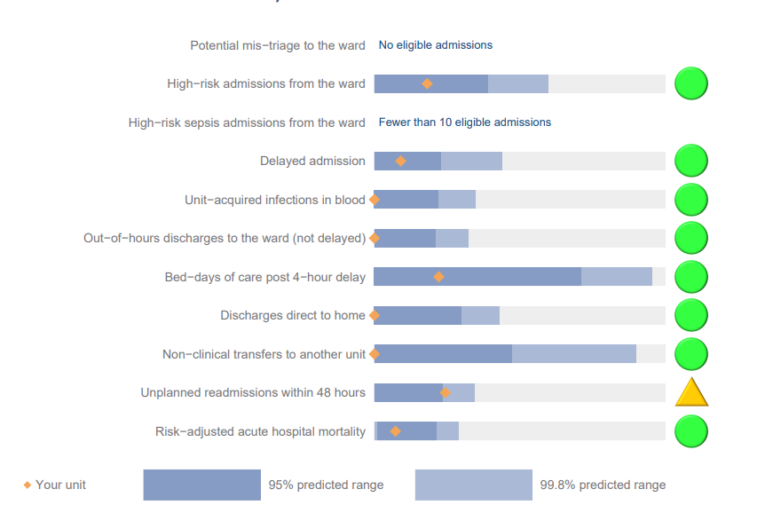
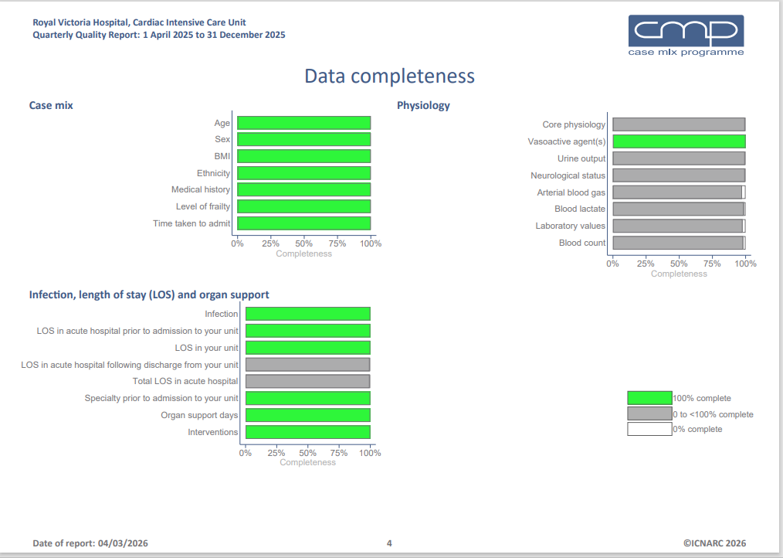


Quarterly Quality Report
Royal Victoria Hospital, Cardiac Intensive Care Unit
1st October to 31 December 2025 (N=222)
Quality Indictors
Data Completeness
High Rates of Completed Submitted Data
Majority of Quality Indicators within the 95% predicted range

Slide 2
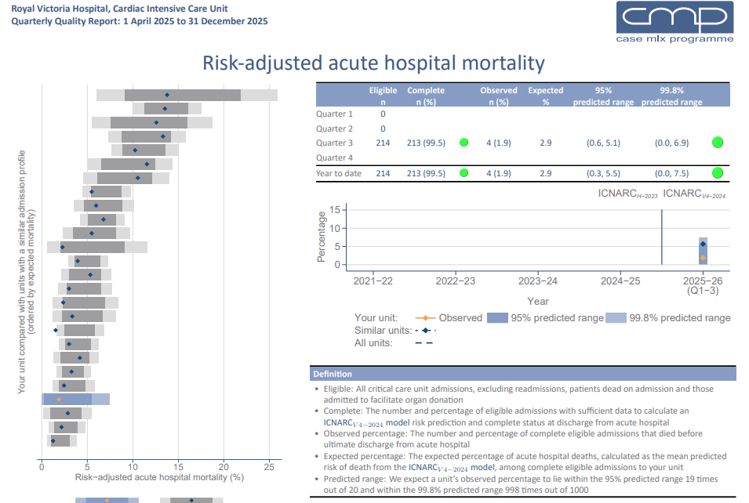
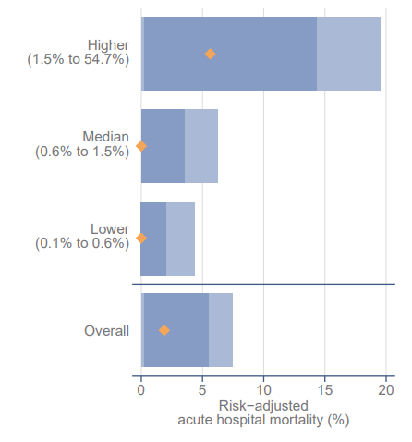
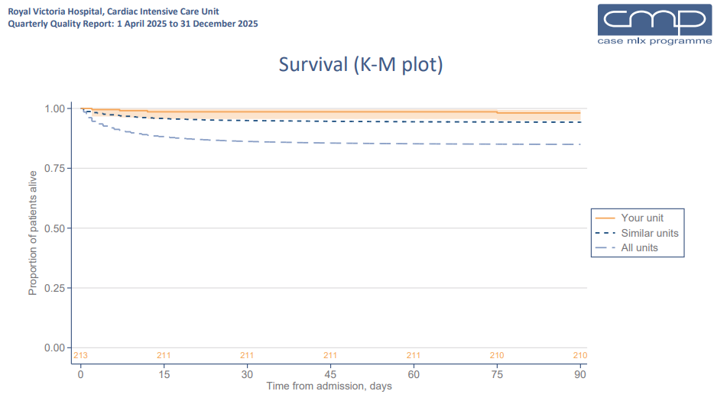
Risk Adjusted Hospital Mortality
Risk Adjusted Hospital Mortality
Overall Mortality is Low, less than predicted and comparable to other units
Risk adjusted mortality rates are favourable

Slide 3
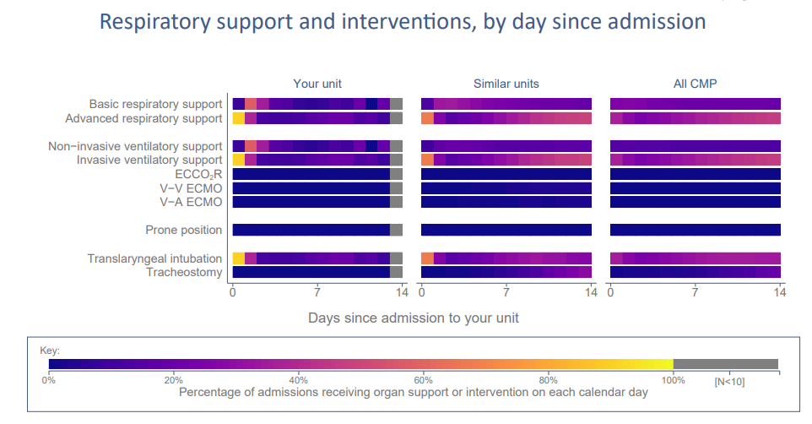
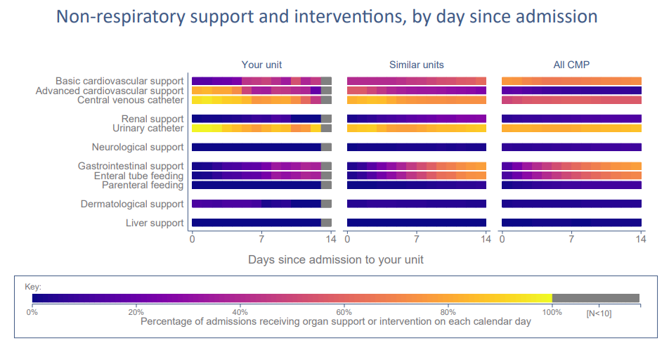
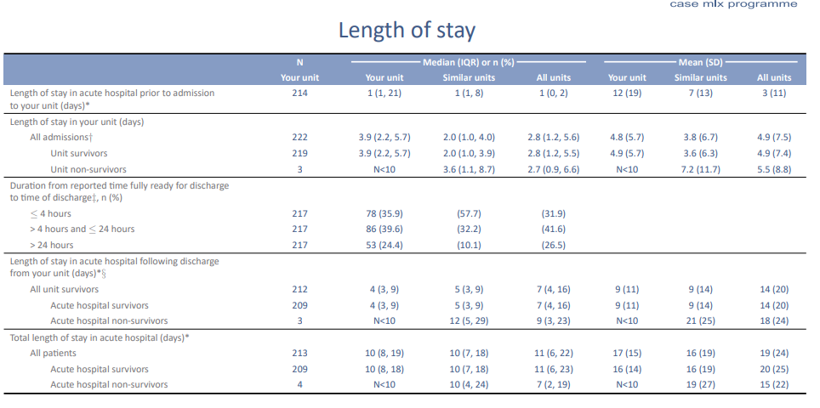
Critical Care Requirements
Higher Requirement for Level 3 critical care compared to other units, maybe related to higher pre operative disease severity
Length Of Stay
Higher Critical Care requirements associated with longer ICU LOS but not hospital; delayed discharges equate to 97 critical care days

