Slide 1
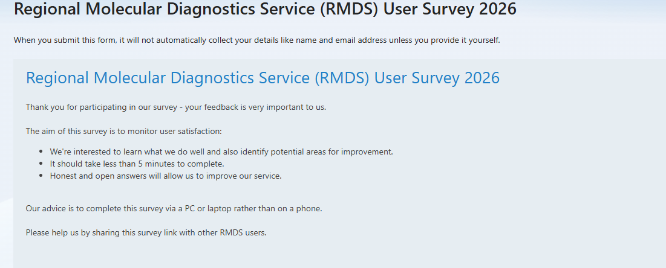

Slide 2
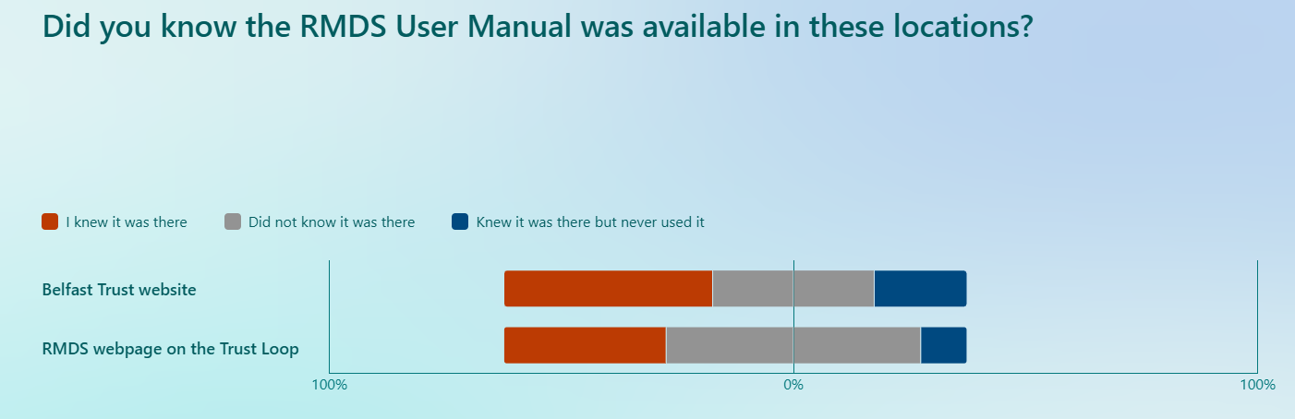
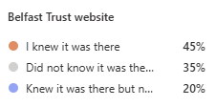
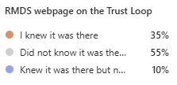
Compared to 2025:
Belfast trust website visibility increased from 24.3% to 65%
Loop visibility increased from 18.9% to 45%

Slide 3
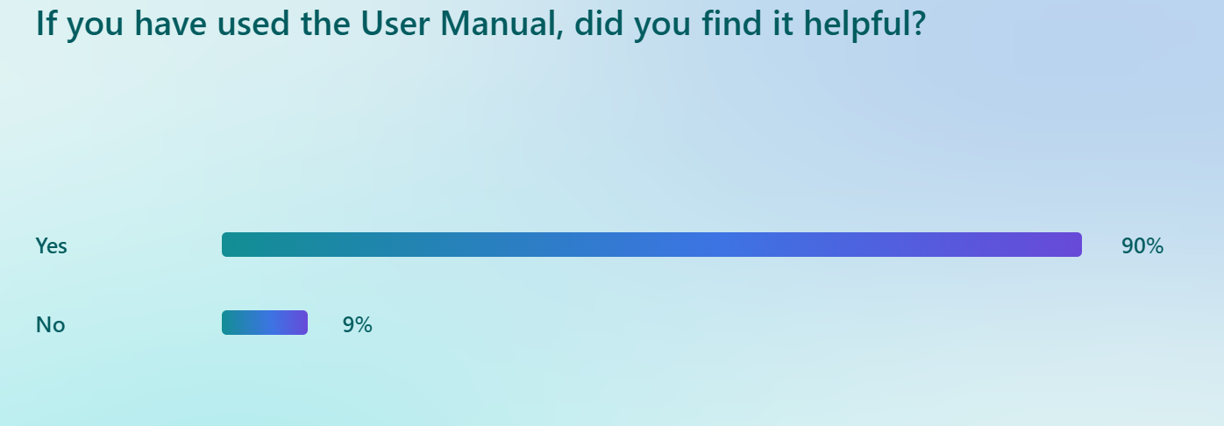
Compared to 2025:
Users reporting User Manual as helpful resource increased from 57% to 90%

Slide 4
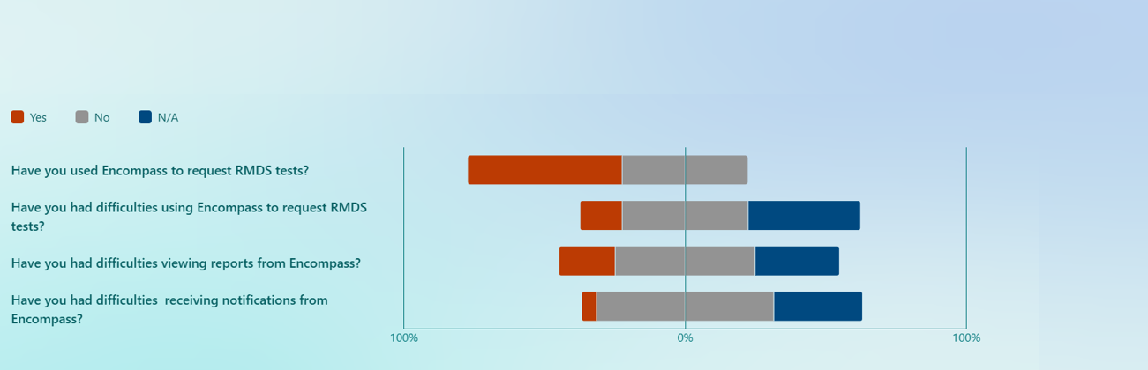
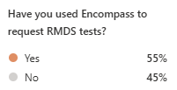
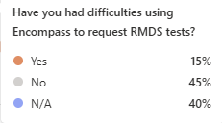
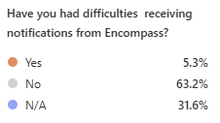
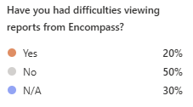
Compared to 2025:
Encompass use increased from 29.7% to 55%
Encompass Difficulties decreased from 24.3% to 15%

Slide 5
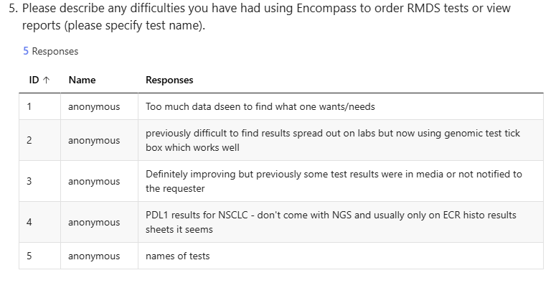

Slide 6
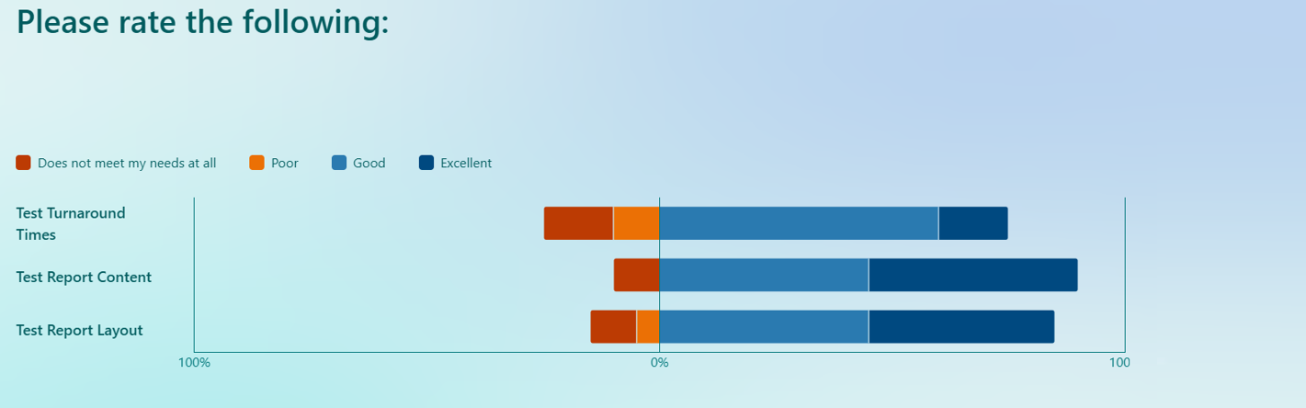
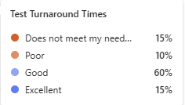
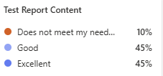
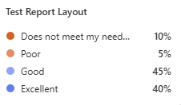
No major changes compared to 2025

Slide 7
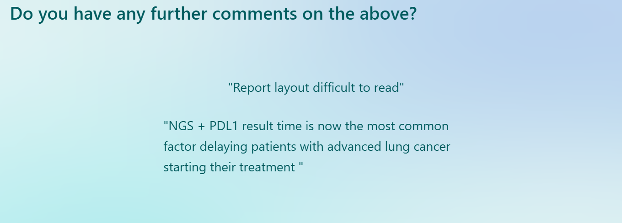

Slide 8
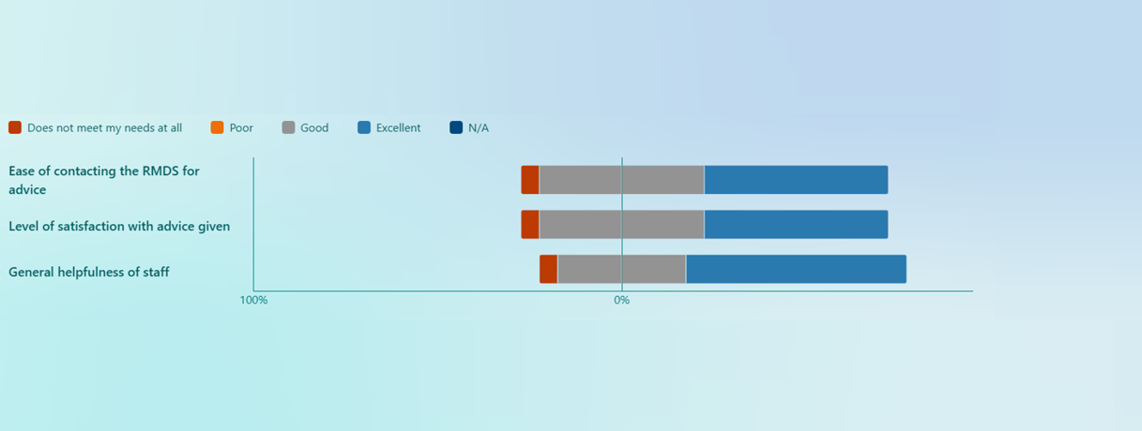
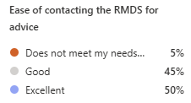
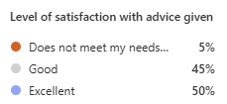
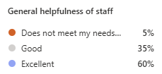
No major changes compared to 2025

Slide 9
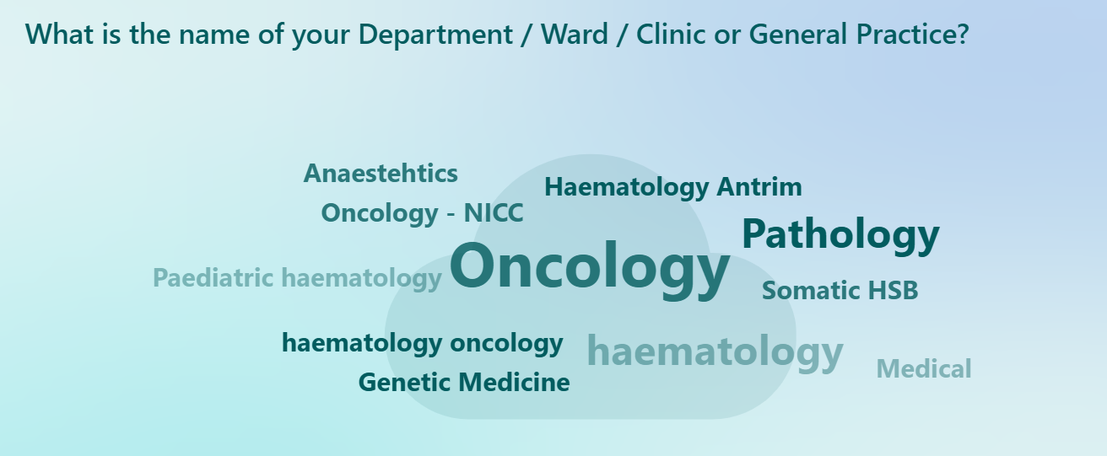

Slide 10
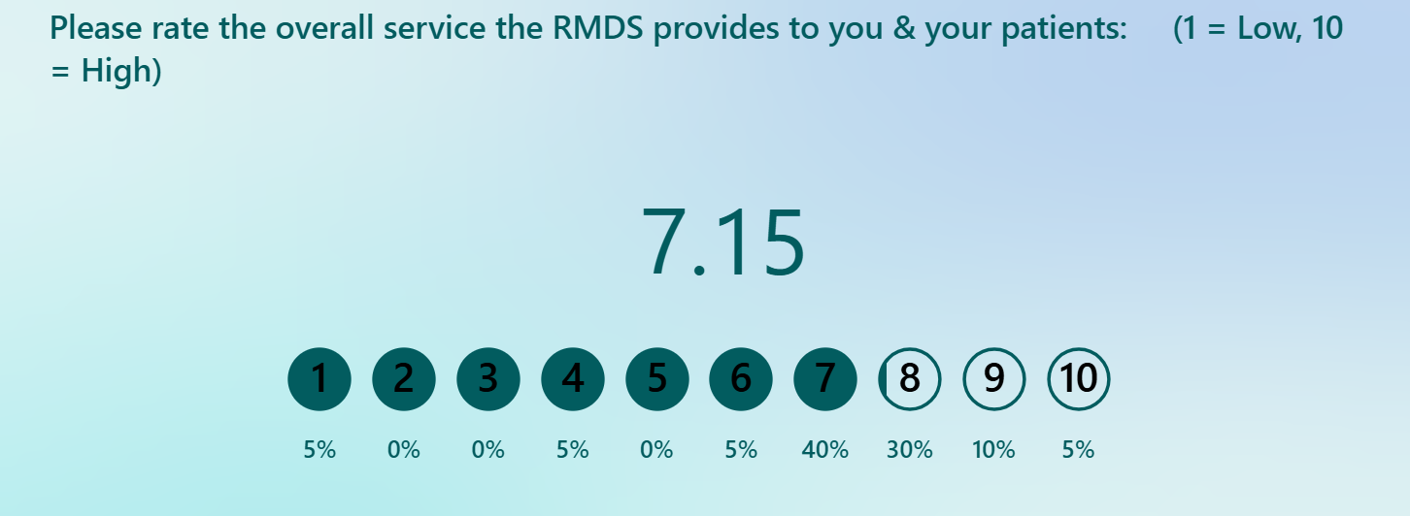
Overall score 7.15 slightly down from 7.61 last year

Slide 11
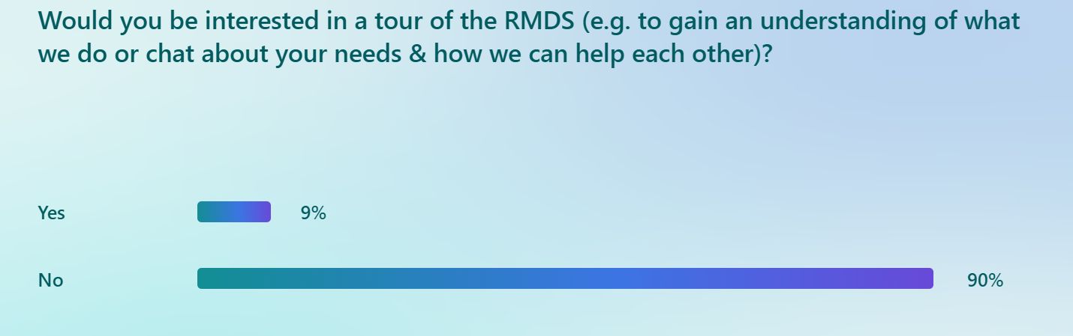
One user interested in a tour
Contacted by Quality Officer

Slide 12
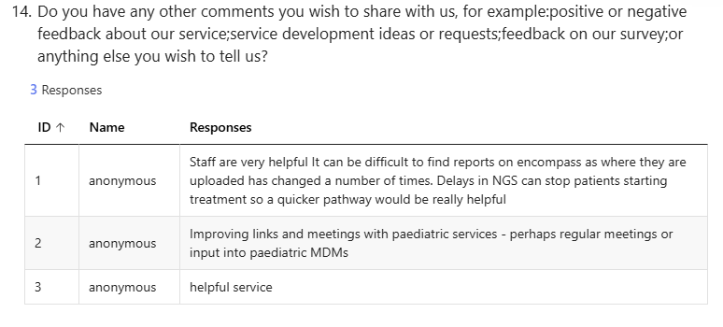

Slide 13

Key Takeaways
Overall score 7.15 slightly down from 7.61 last year
50% less responses compared to last survey – user fatigue?
  Is there a better way to launch survey or receive feedback?
Some Encompass issues noted but generally improving
RMDS user manual visibility and helpfulness has increased
NGS outside TAT highlighted as potentially delaying cancer treatment

