Slide 1

Trust Board Report
Systems Oversight Measures Report
Trust Board - Thursday 27th August 2026
Alastair Campbell
Director of Performance, Planning & Informatics

Slide 2

Contents
Section 1 – Overview & Headlines
Section 2 - Performance
Key SOMs Indicators
Unscheduled Care – Patients not waiting in ED, 12 Hr delays, Delayed discharges and Hip Fractures
Scheduled Care – DNA rates, theatres
Community Care – unmet need, direct payments, unallocated cases
Section 3 - Efficiency & Productivity
Key SOMs Indicators
Scheduled Care – average LoS
Section 4 – Access Improvements
Key SOMs Indicators
Elective Care – outpatient, diagnostic, Inpatient/Daycase, AHP waits
Cancer Services – 14, 31 & 62 day targets (14 day is a regional position)
Unscheduled Care – ED 4hr performance
Mental Health Services – 9 & 13 week waits
Cancer monthly activity
Waiting list summaries, Backlog clearance & Validation
Section 5 - Experience
Patient Satisfaction – Patient Experience Surveys, Friends and Family and Complaints
APPENDIX
System Oversight Measures Summary table – June 2026
Activity
Escalations
SOMs to be implemented

Slide 3
Section 1 – Overview
This Trust Board Report assesses the Trust position for the month of June 2026 and year-to-date performance in relation to a number of key metrics included within the new System Oversight measures (SOMs).
The new System Oversight Measures have been devised around four key domains.
Performance
Efficiency and Productivity
Access improvement/Ministerial Targets
Safety and Quality
All performance metrics are presented in run chart format with the expected target shown in red.
As there are no agreed baselines for levels of activity to be delivered within the SOMs framework, an activity summary is now available showing a comparison of the current month to the equivalent month in the previous year to enable us to provide a robust comparison of encompass activity

Slide 4

Section 1 – Overview – System Oversight Measures – Summary of Metrics reported
Indicator | Metric | Status
Performance
Unscheduled Care | Patients who leave ED without treatment | reported
 | ED 12 hour performance | reported
 | Weekend Discharges - Simple | not reported – low confidence
 | Weekend Discharges – Complex | reported
 | Readmission Rates – 0-7 days & 8-30 days | not reported – low confidence
 | Fractures – Neck of Femur and Other Fractures | reported
Scheduled Care | Outpatient DNA rates | reported
 | PIFU | reported
 | Theatre DNA rates | reported
 | Theatre Utilisation Run Times | reported
 | Theatre Utilisation Operating Times | reported
Community Care | Unmet Need | reported
 | Direct Payments | reported
 | Unallocated Cases | reported
Indicator | Metric | Status
Efficiency & Productivity | Elective Average Length of Stay (5 specialties) | Reported
 | Admission on day of surgery (5 specialties) | not reported – low confidence
Access Improvement/Ministerial Access Targets
Elective Care | Diagnostic Waits | reported
 | New Consultant Outpatient Waits | reported
 | Inpatient/Daycase Waits | reported
 | AHP Waits | reported
Cancer Services | 14, 31 & 62 Day Waits | reported
Unscheduled Care | ED Attendances Waiting < 4 hours | reported
Mental Health Services | Child & Adolescent Mental Health Waits | reported
 | Adult Mental Health Waits | not reported – low confidence
 | Psychological Therapies | not reported – low confidence
 | Dementia | not reported – low confidence
Safety & Quality | Falls Prevention | not reported – low confidence
 | Palliative Care | not reported – low confidence
 | Antimicrobial Consumption | undergoing validation
 | Healthcare Acquired Infections (HCAI) | not reported – low confidence

Slide 5
Section 1 – Headlines
Reporting period – June 2026 in-month performance and year-to-date
Ongoing confidence issues in reporting in a number of areas as we try to understand how the new data differs from reporting pre-encompass. Validation is ongoing also to ensure all relevant data is captured within reports
31 and 62 day cancer data is reported, but subject to ongoing validation
ED did not waits remain above targets for all sites, but 12hour breachers were below target in RBHSC
Endoscopy theatres continue to run above target
Domiciliary Care unmet needs for full packages above target
Targets not met in relation to all waiting lists. Waiting lists are subject to ongoing validation.
Patient experience report for June – 99% overall satisfaction

Slide 6
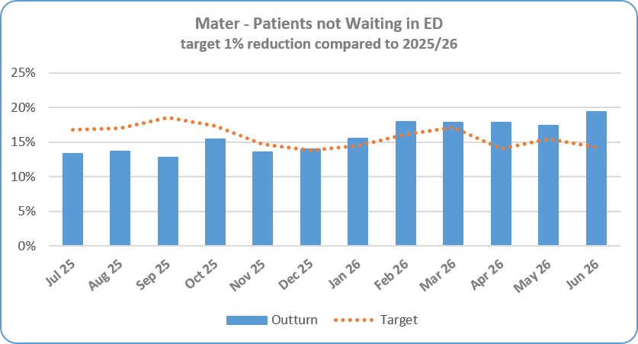

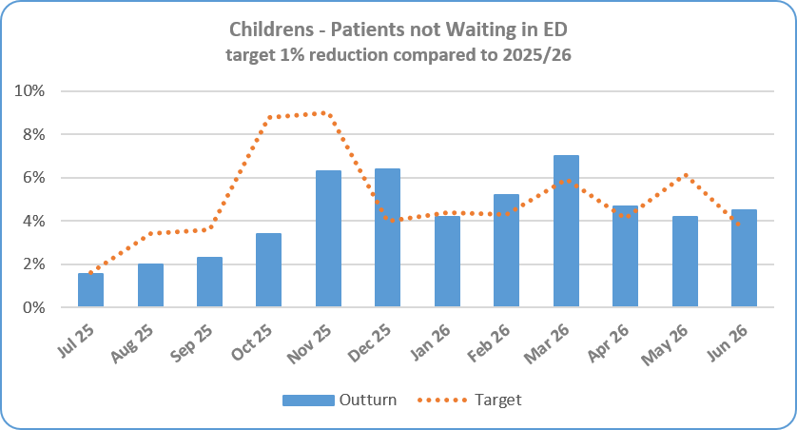

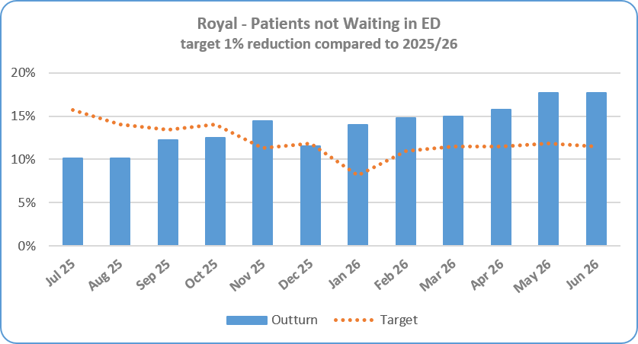

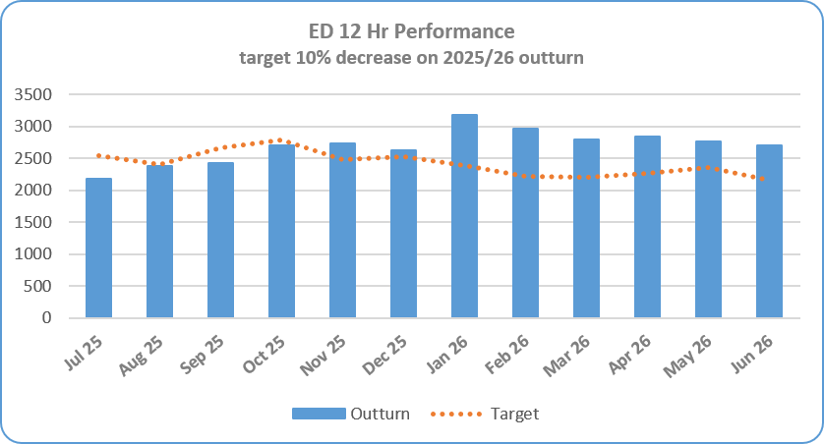
Section 2 – Key SOMs Indicators - Performance
Service Area | Metric | June 26 Target | June 26 In-month Performance | YTD Performance | Rag Status June 26 | Rag Status YTD | Chart
Performance - Unscheduled Care | Patients Not Waiting in ED – Mater 1% reduction compared to 2025/26 | 14.2% | 19.3% - 5.09% above target 713 patients out of 3,690 attendances did not wait | 17.6% 1,981 patients out of 10,895 attendances did not wait
 | Patients Not Waiting in ED - RBHSC 1% reduction compared to 2025/26 | 3.6% | 4.49% - 0.9% below target 160 patients out of 3,561 attendances did not wait | 4.45% 510 patients out of 11,454 attendances did not wait
 | Patients Not Waiting in ED - RVH 1% reduction compared to 2025/26 | 11.5% | 17.66% - 6.1% above target 1,235 patients out of 9,995 attendances did not wait | 16.8% 3,597 patients out of 21,085 attendances did not wait
 | ED – 12 Hour Target * Reduce the number of patients waiting > 12 hours in ED during 25/26 by 10% | 2,164 | 2,707 patients waited > 12 hours during May out of 14,246 attendances. 415 patients over expected target | 8,332 patients waited > 12 hours out of 43,434 attendances

Slide 7
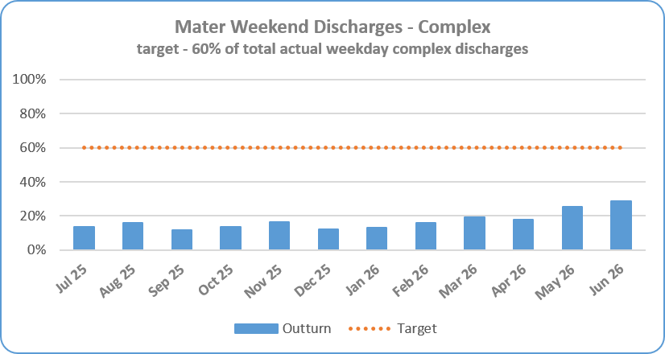

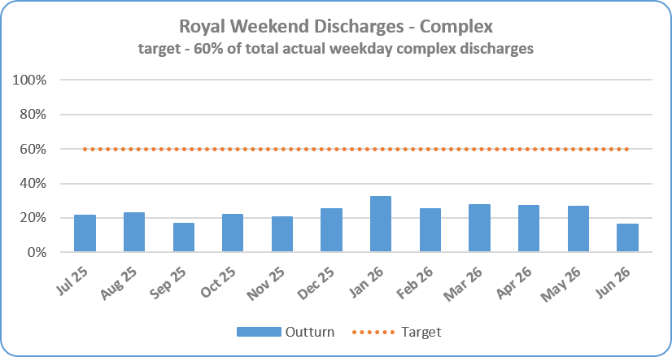
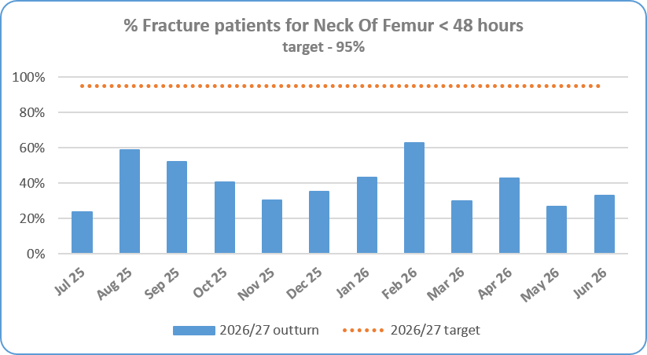
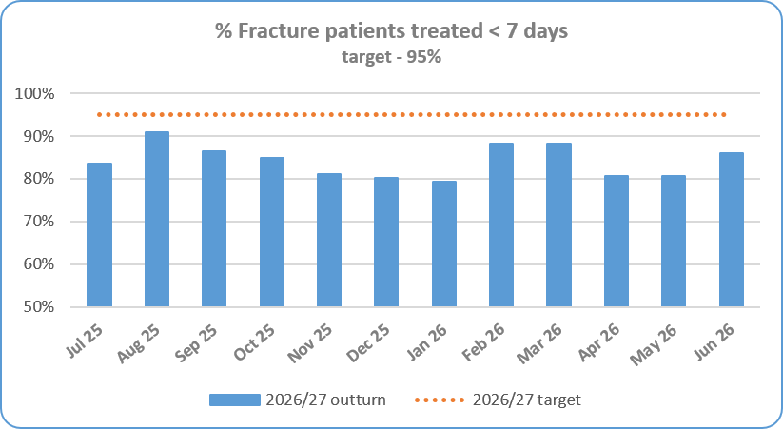
Section 2 – Key SOMs Indicators - Performance
Service Area | Metric | June 26 Target | June 26 In-month Performance | YTD Performance | Rag Status June 26 | Rag Status YTD | Chart
Performance -Unscheduled Care | Complex Delayed Discharges – Mater Target - The number of complex discharges on any Saturday and Sunday should be at least 60% of the average daily number of complex discharges from Mon-Fri in that week. | 60% | 29.86% | 24.44%
 | Complex Delayed Discharges – RVH Target - The number of complex discharges on any Saturday and Sunday should be at least 60% of the average daily number of complex discharges from Mon-Fri in that week. | 60% | 16.33% | 23.33%
 | Hip Fractures Target - 95% of patients where clinically appropriate, wait no longer than 48 hours for inpatient treatment | 95% | 32.94% 28 out of 85 seen <48hrs | 35.38% 75 out of 212 seen <48 hrs
 | Other Fractures Target - 95% of other fractures, where clinically appropriate, wait no longer than 7 days for inpatient treatment for fractures | 95% | 86.01% 123 out of 143 treated within 7 days | 85.04% 302 out of 365 treated within 7 days

Slide 8
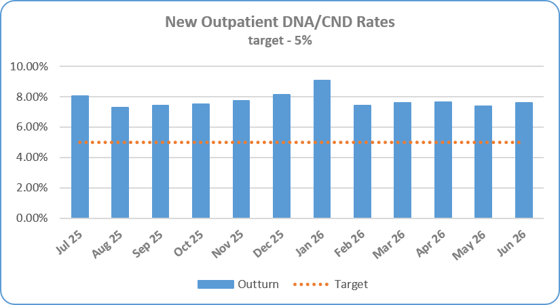
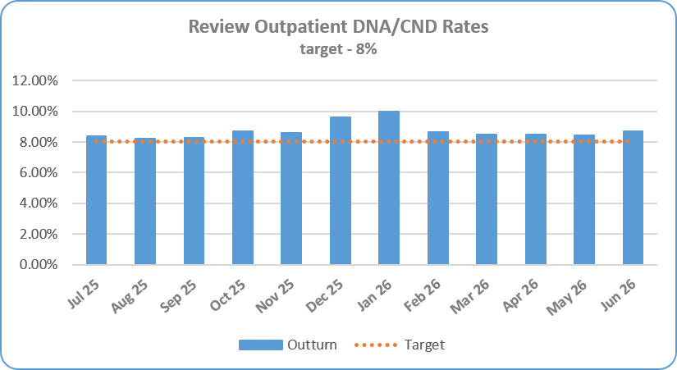

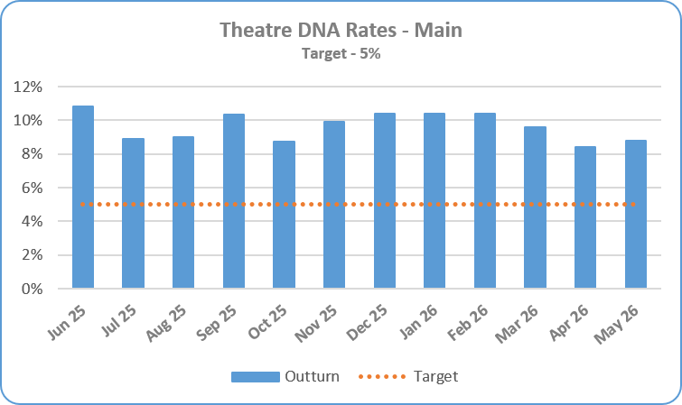
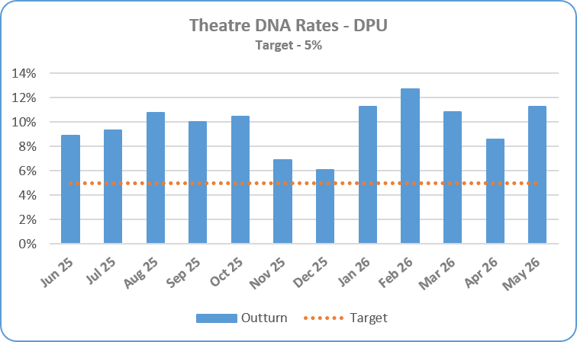
Section 2 – Key SOMs Indicators - Performance
Service Area | Metric | June 26 Target | June 26 In-month Performance | YTD Performance | Rag Status Jun 26 | Rag Status YTD | Chart
Performance -Scheduled Care | DNA rates for New consultant outpatient appointments Target – maximum 5% | 5% | 7.60% 1,0238 DNA’s out of 16,285 new appointments | 7.54% 3,500 DNA’s out of 46,397 new appointments
 | DNA rates for Review consultant outpatient appointments Target – maximum 8% | 8% | 8.68% 3,115 DNA’s out of 35,869 review appointments | 8.53% 8,535 DNA’s out of 99,993 review appointments
 | Theatre DNA Rates– Main Theatres Target – maximum 5% | 5% Monitored a month in arrears | 11.26% (May 26) | 8.61%
 | Theatre DNA Rates – DPU Target – maximum 5% | 5% Monitored a month in arrears | 11.26% (May 26) | 9.92%

Slide 9
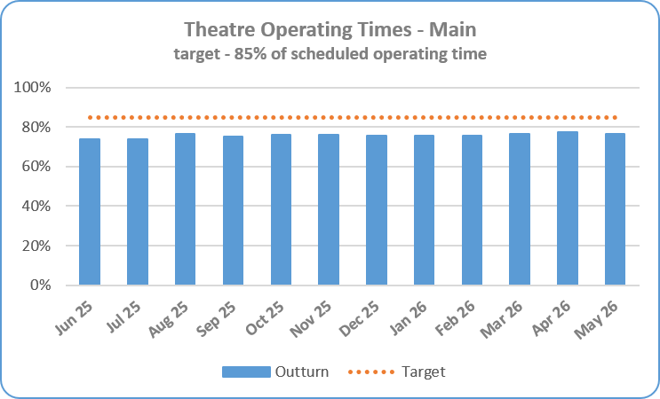

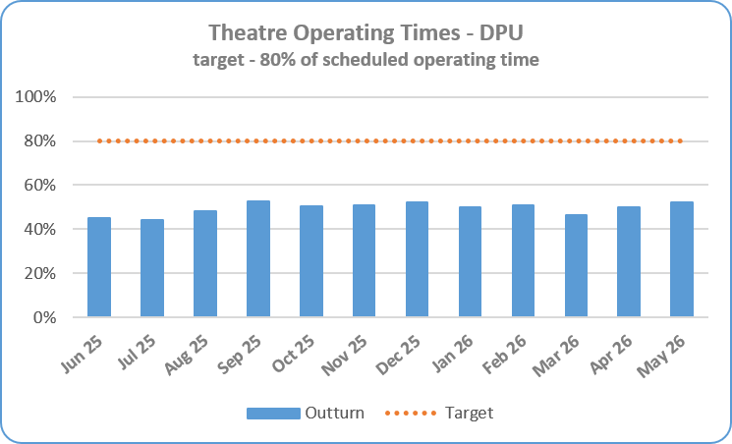

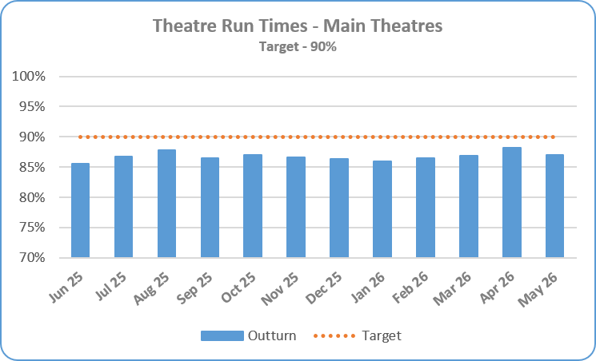


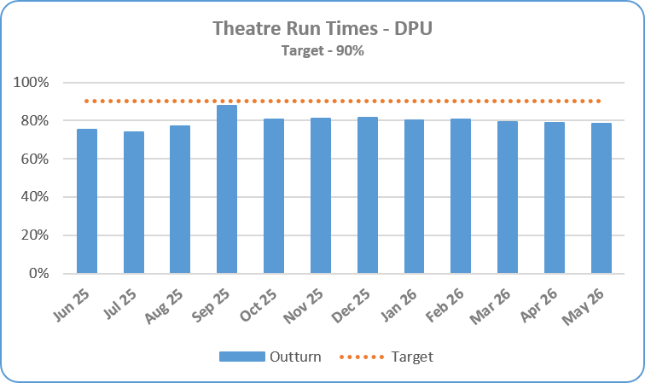


Section 2 – Key SOMs Indicators - Performance
Service Area | Metric | June 26 Target | June 26 In-month Performance | YTD Performance | Rag Status Jun 26 | Rag Status YTD | Chart
Performance -Scheduled Care | Theatre Utilisation - Operating Times – Main Theatres Target – maximum operating rate of 85% | 85% Monitored a month in arrears | 76.51% (May 26) | 77.04%
 | Theatre Utilisation - Operating Times – DPU Target – maximum operating rate of 80% | 80% Monitored a month in arrears | 52.18% (May 26) | 51.08%
 | Theatre Utilisation - Run Times – Main Theatres Target – minimum run time rate of 90% | 90% Monitored a month in arrears | 87.03% (May 26) | 87.60%
 | Theatre Utilisation - Run Times – DPU Target – minimum run time rate of 90% | 90% Monitored a month in arrears | 78.53% (May 26) | 78.70%

Slide 10
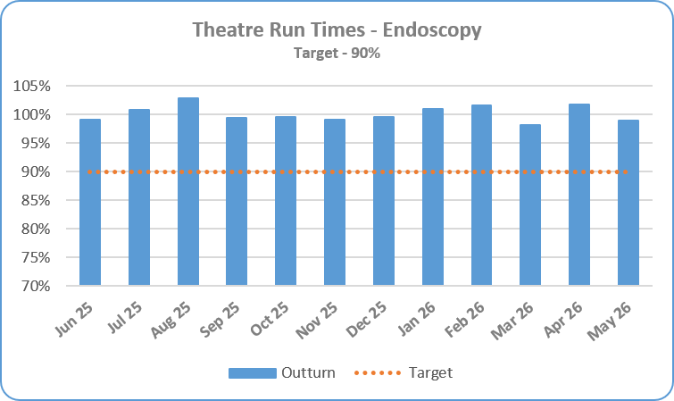


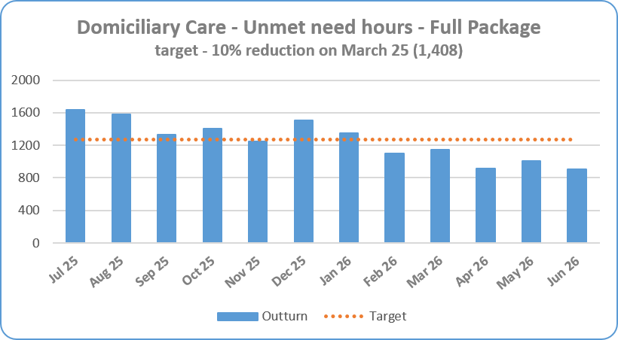
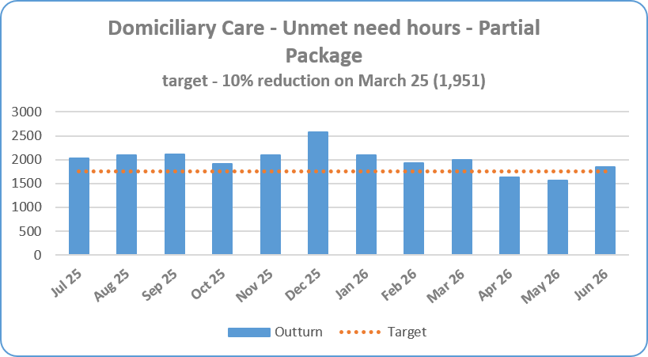

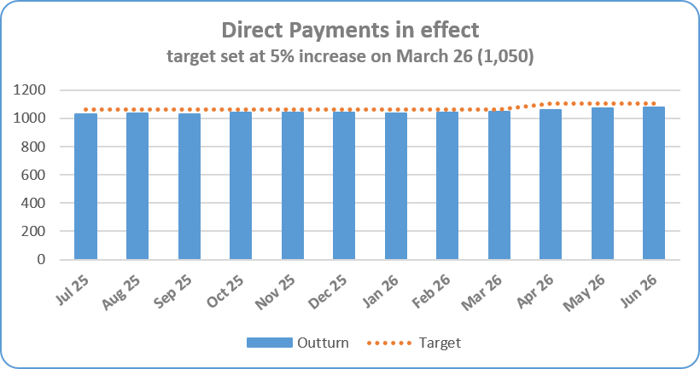

Section 2 – Key SOMs Indicators - Performance
Service Area | Metric | June 26 Target | June 26 In-month Performance | YTD Performance | Rag Status Jun 26 | Rag Status YTD | Chart
Performance – Scheduled Care | Theatre Utilisation - Run Times – Endoscopy Target – minimum run time rate of 90% | 90% Monitored a month in arrears | 98.93% (May 26) | 100.33%
Community Care | Domiciliary Care – Unmet Need – Full Package Target- 10% reduction in unmet need hours by March 2026 compared to position at 31 March 25 (1408 hrs) | 1,267 hrs | 905 hrs -35.72% under target – 362 hours | 905 hrs
 | Domiciliary Care – Unmet Need – Partial Package Target - 10% reduction in unmet need hours by March 2026 compared to position at 31 March 25 (1951 hrs) | 1,756 hrs | 1,844 hrs -5.48% under target- 88 hours | 1,558 hrs
 | Direct Payments Target - 5% increase in Service User Direct Payments in effect by March 2026 compared to position at 31 March 2026 (1050 service users) | 1,103 | 1,080 2.86% increase on March 26 position | 1,080

Slide 11
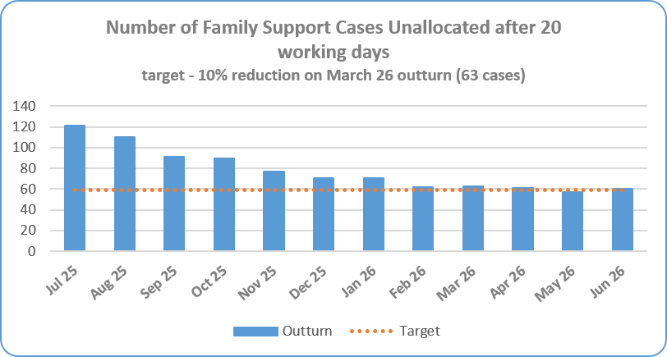
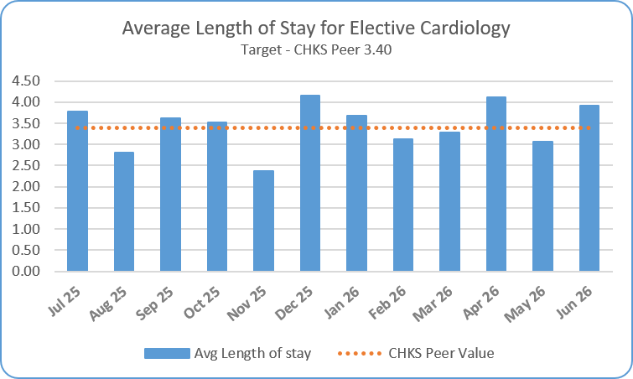

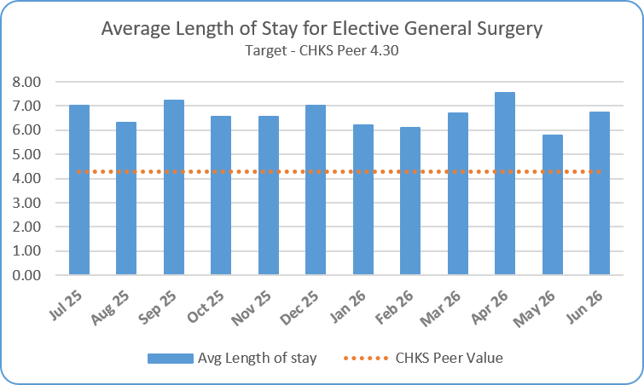
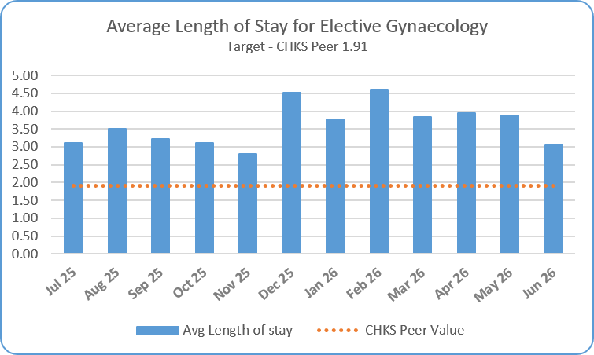
Section 2/3 – Key SOMs Indicators - Performance and Efficiency & Productivity
Service Area | Metric | June 26 Target | June 26 In-month Performance | YTD Performance | Rag Status Jun 26 | Rag Status YTD | Chart
Performance – Community Care | Family Support – Unallocated Cases Target - reduce by 10% by March 2027 compared to position at end March 2026 – 63 cases | 59 cases | 60 cases 9.09% decrease on March 26 position | 60 cases
Efficiency & Productivity - Scheduled Care | Average LoS for Elective Patients Cardiology (includes Paediatrics) Target - Reduce LoS against CHKS peer group level | 3.40 days | 3.91 days | 3.70 days
 | Average LoS for Elective Patients General Surgery (includes Breast & Vascular) Target - Reduce LoS against CHKS peer group level | 4.30 days | 6.75 days | 6.69 days
 | Average LoS for Elective Patients Gynaecology (includes oncology) Target - Reduce LoS against CHKS peer group level | 1.91 days | 3.06 days | 3.63 days

Slide 12
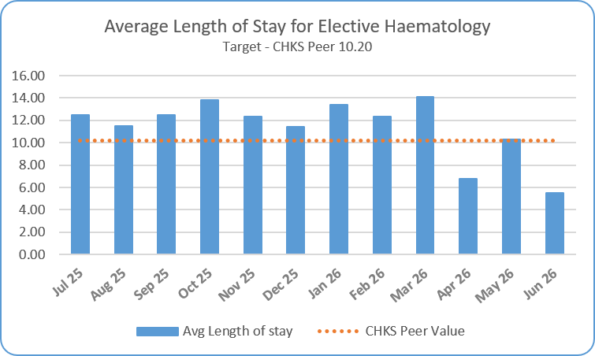
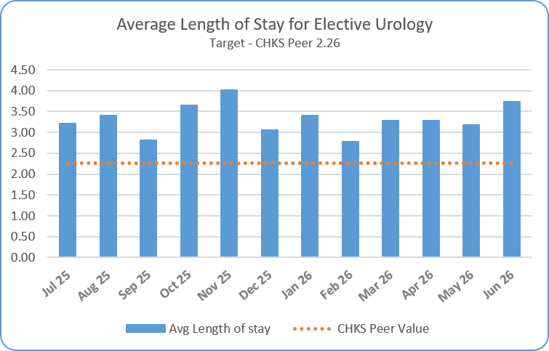
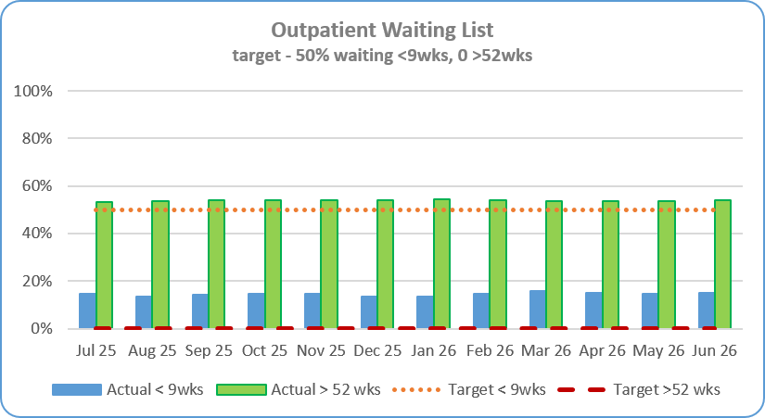
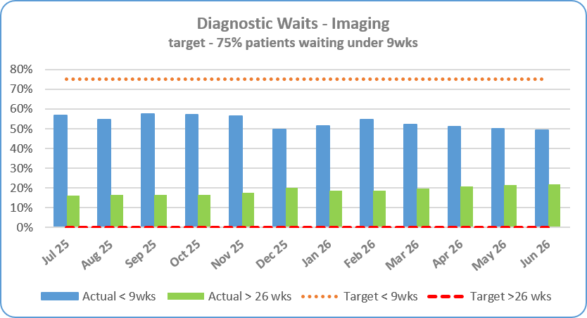
Section 3/4 – Key SOMs Indicators - Efficiency & Productivity and Access Improvement
Service Area | Metric | June 26 Target | June 26 In-month Performance | YTD Performance | Rag Status Jun 26 | Rag Status YTD | Chart
Efficiency & Productivity Scheduled Care | Average LoS for Elective Patients Haematology (includes paediatrics) Target - Reduce LoS against CHKS peer group level | 10.20 days | 5.48 days | 7.52 days
 | Average LoS for Elective Patients Urology Target - Reduce LoS against CHKS peer group level | 2.26 days | 3.74 days | 3.40 days
Access Improvement/ Ministerial Targets Elective Care | New Outpatient Waiting List Target – 50% patients waiting < 9 wks 0 patients waiting over 52 wks | 50% < 9 wks 0 over 52 wks | 15.05% patients under 9 wks (24,699 out of 164,125) 88,959 patients waiting over 52 weeks – 54.20% | 15.05% 54.20%
 | Diagnostic Waiting Lists – Imaging Target – 75% patients waiting < 9 wks 0 patients waiting over 26 wks | 75% < 9 wks 0 over 26 wks | 49.32% patients under 9 wks (13,841 out of 28,063) 6,133 out of 28,063 patients waiting over 26 wks – 21.85% | 49.32% 21.85%

Slide 13
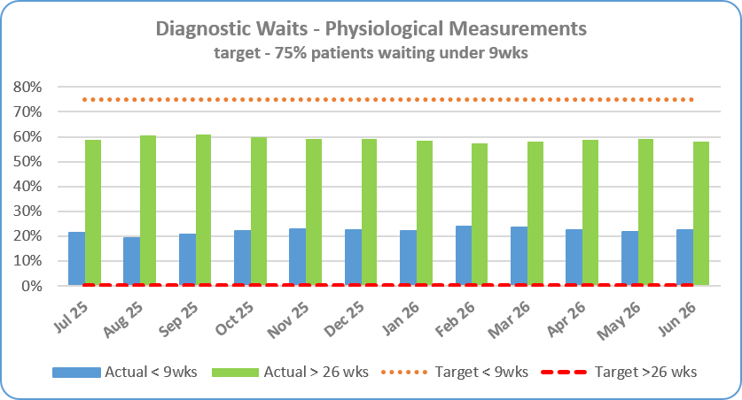
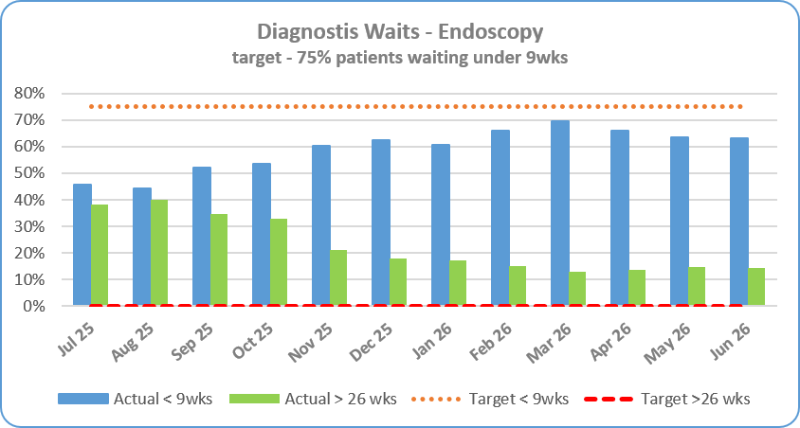
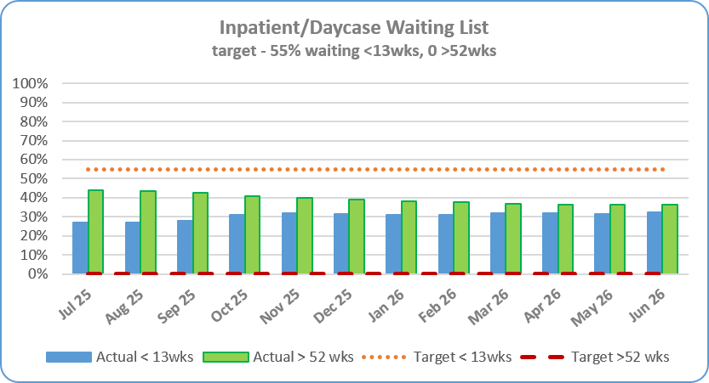
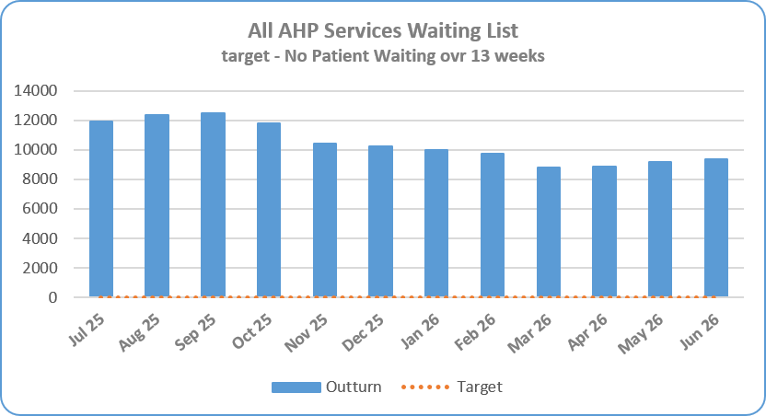
Section 3/4 – Key SOMs Indicators - Efficiency & Productivity and Access Improvement
Service Area | Metric | June 26 Target | June 26 In-month Performance | YTD Performance | Rag Status Jun 26 | Rag Status YTD | Chart
Access Improvement/ Ministerial Targets Elective Care | Diagnostic Waiting Lists – Physiological Measurements Target – 75% patients waiting < 9 wks 0 patients waiting over 26 wks | 75% < 9 wks 0 over 26 wks | 22.41% patients under 9 wks (6,279 out of 28,015) 16,291 out of 28,015 patients waiting over 26 wks – 58.15% | 22.41% 58.15%
 | Diagnostic Waiting Lists – Endoscopy Target – 75% patients waiting < 9 wks 0 patients waiting over 26 wks | 75% < 9 wks 0 over 26 wks | 63.02% patients under 9 wks (1,280 out of 2,031) 293 out of 2,031 patients waiting over 26 wks – 14.43% | 63.02% 14.43%
 | Inpatient & Daycase waiting lists Target – 55% patients waiting < 13 wks 0 patients waiting over 52 wks | 55% < 13 wks 0 over 52 wks | 32.52% patients waiting < 13wks (12,060 out of 37,086) 13,535 patients waiting over 52 wks | 32.52% 36.50%
 | AHP Waiting Lists – All Services Target - No patients waiting over 13 wks | No patients waiting over 13 wks | 9,342 waiting over 13 wks out of a total of 22,089 (42.29%) | 42.29%

Slide 14
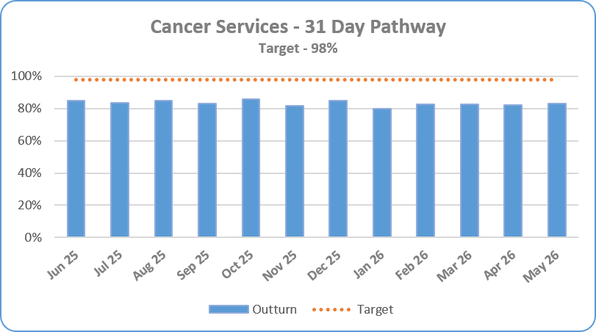
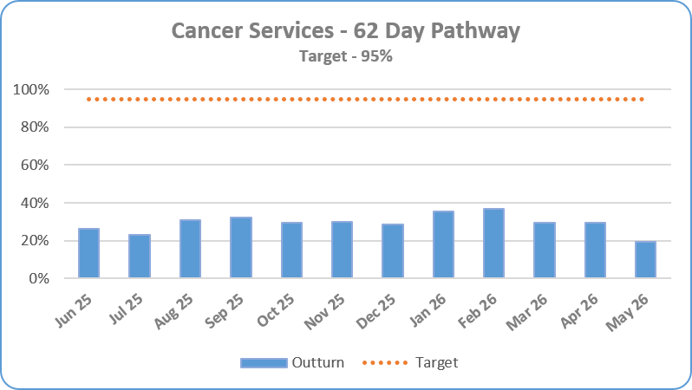

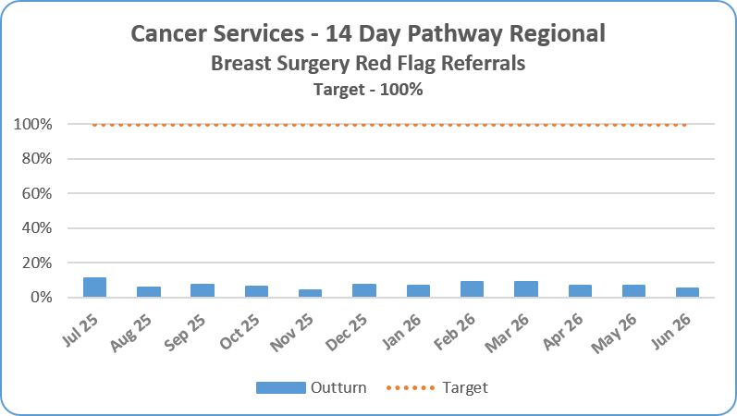
Section 4 – Key SOMs Indicators - Access Improvement
Service Area | Metric | June 26 Target | June In-month Performance | YTD Performance | Rag Status Jun 26 | Rag Status YTD | Chart
Cancer Services | 31 day Performance Target - 98% of cancer diagnosis patients to receive their first definitive treatment <31 days of a DTT | 98% Monitored a month in arrears Figures are provisional as pathways are still being closed down and validation ongoing. | 83.12% (May 26) 320 out of 385 patients were seen <31 days – May | 83.12%
 | 62 day Performance Target - 95% of suspect cancer patients red flag referred to be begin definitive treatment <62 days of referral | 95% Monitored a month in arrears Figures are provisional as pathways are still being closed down and validation ongoing. | 19.42% (May 26) 27 out of 139 patients were seen <62 days | 19.42%
 | 14 Day Performance – Regional Position so not reported in Belfast Trust SOMs Target – 100% of suspect breast cancer referrals to be seen within 14 days | 100% | 5.18% 62 out of 1,198 patients were seen <14 days in June | 5.18%

Slide 15
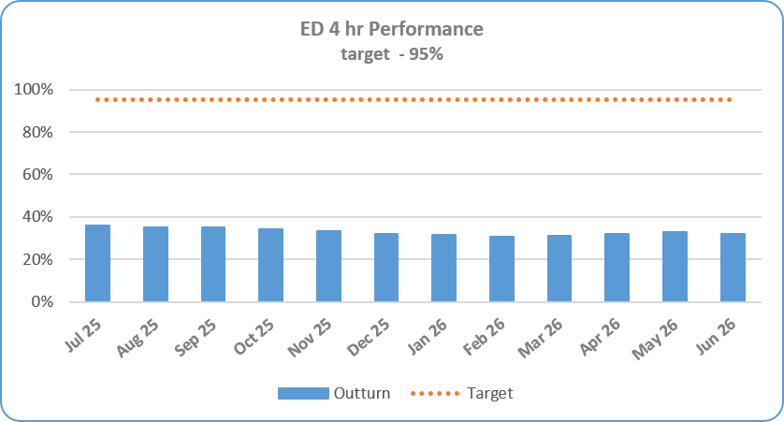
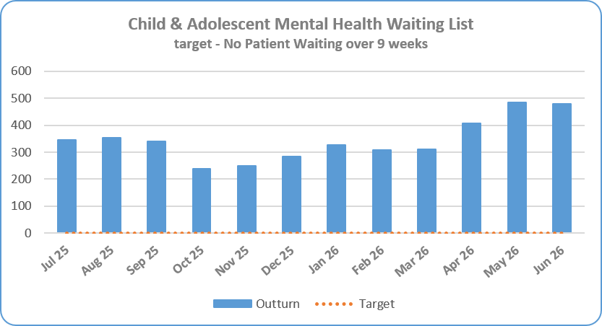
Section 4 – Key SOMs Indicators - Access Improvement
Service Area | Metric | June 26 Target | June 26 In-month Performance | YTD Performance | Rag Status Jun 26 | Rag Status YTD | Chart
Access Improvement/ Ministerial Targets Unscheduled Care Care | ED <4 Hour Performance Target – 95 % of patients waiting <4 hours from arrival to discharge/admission | 95% | 31.93% 4,549 out of 14,246 attendances | 32.29% 14,026 out of 43,434 attendances
Mental Health Services | Child & Adolescent Mental Health Services Waiting List Target – No patients waiting over 9 weeks | No patients waiting over 9 wks | 478 52.13% of total waiting (917) | 478

Slide 16
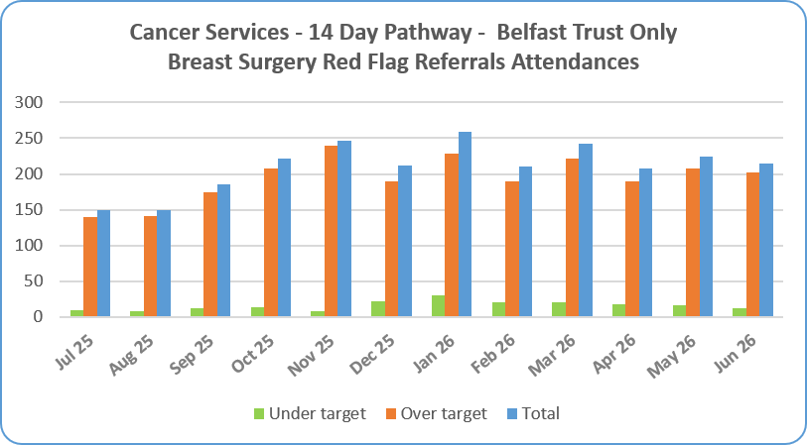
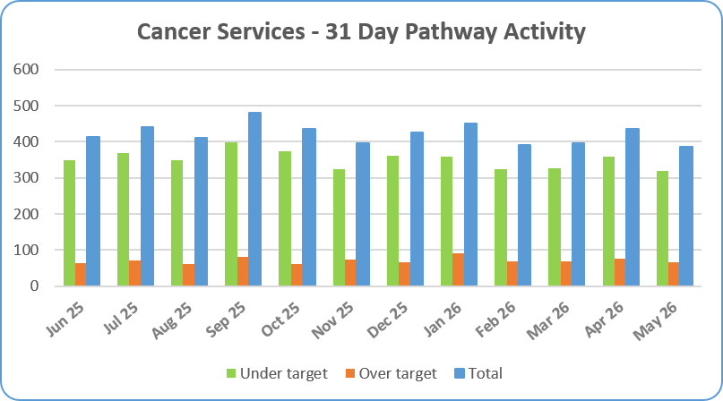
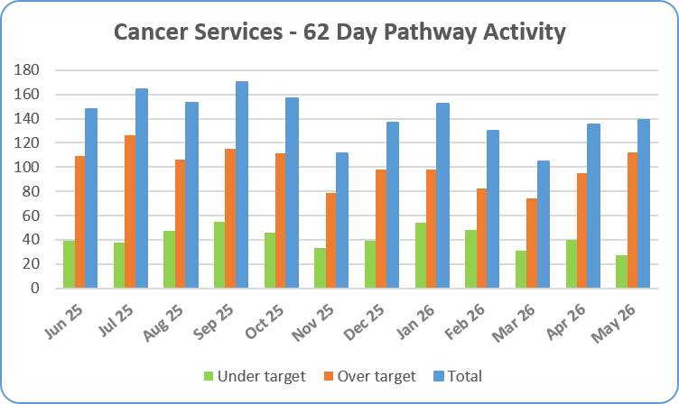
Cancer Monthly Activity
31 & 62 day activity reported a month in arrears

Slide 17
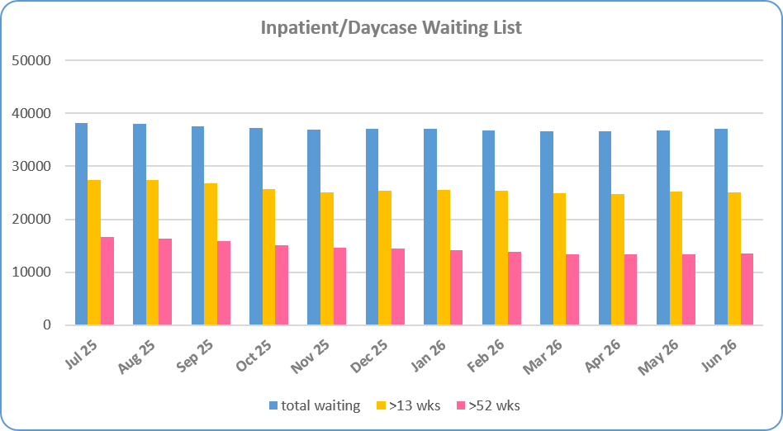
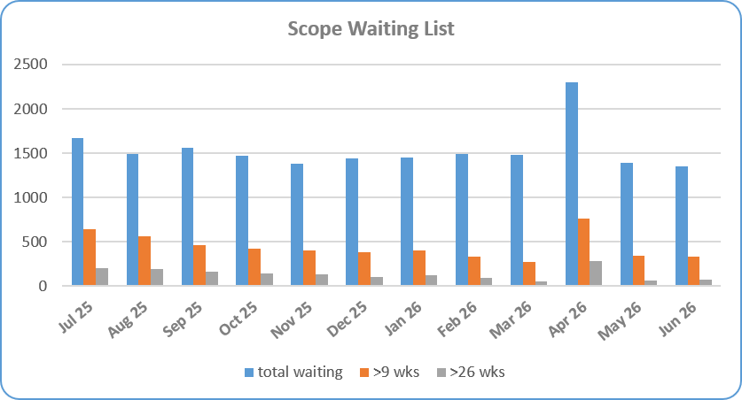
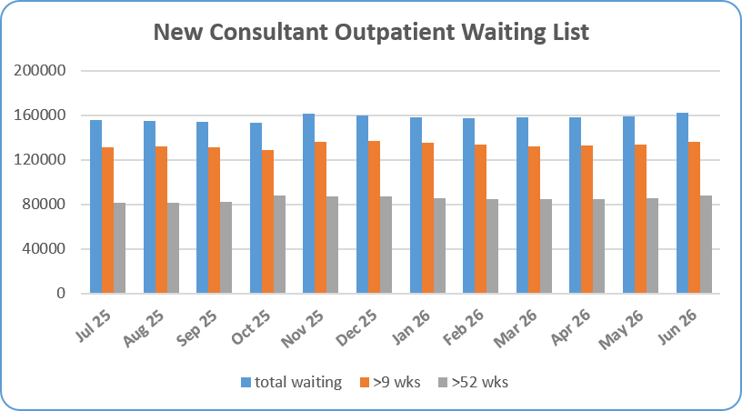
Waiting List Summaries

Slide 18
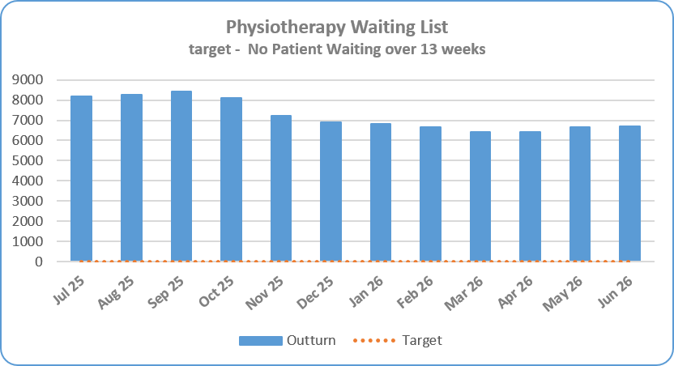
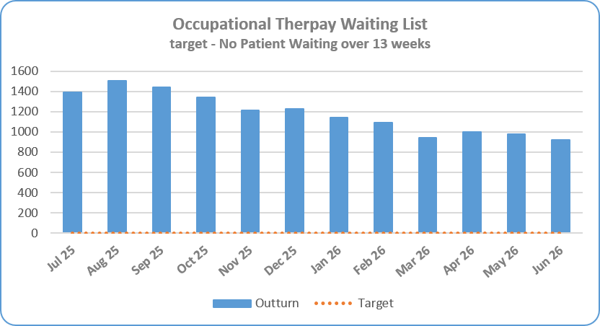
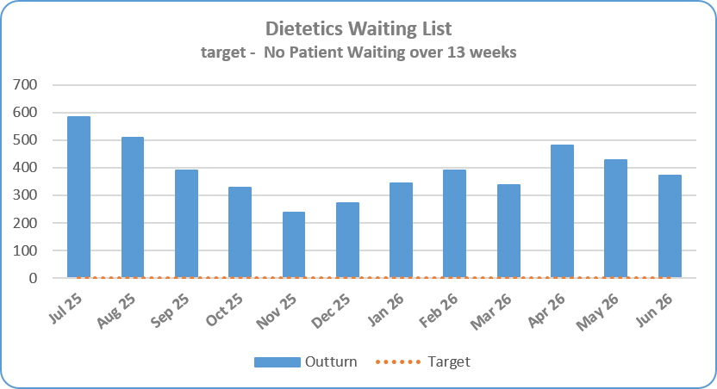
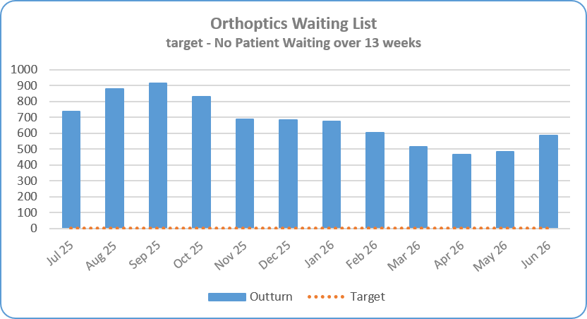
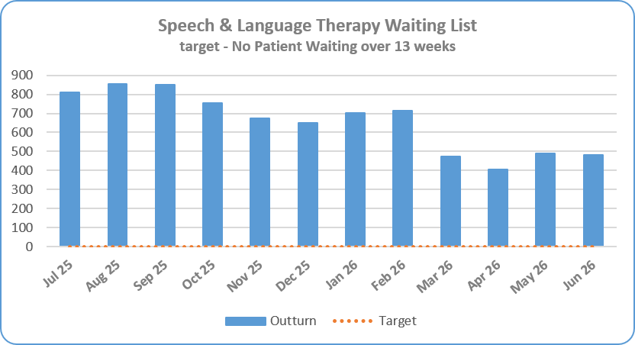
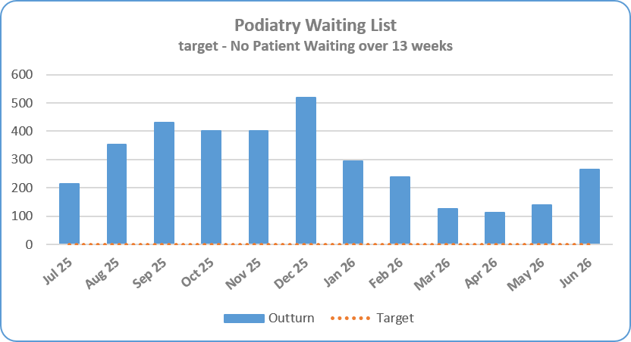
AHP Waiting List Summaries by Profession

Slide 19
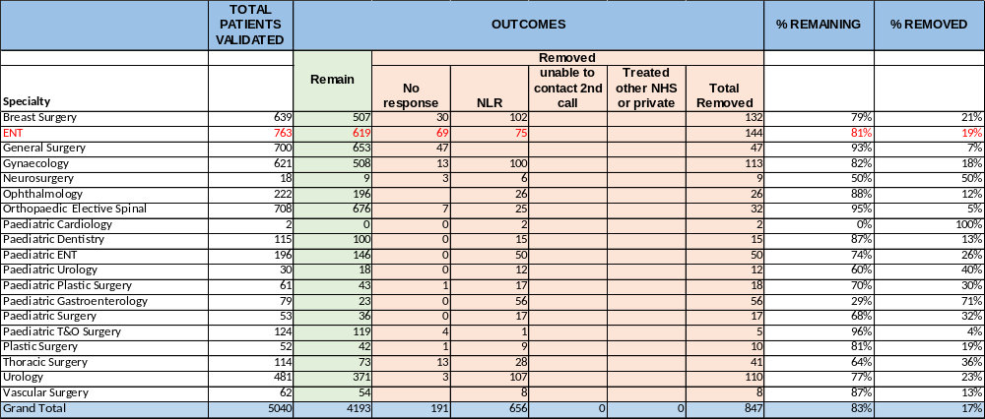

Waiting List Validation – Inpatients & Scope as at 29th June 2026

Slide 20

Waiting List Validation – Outpatient as at 29th June 2026

Slide 21

Waiting List Validation – Outpatient as at 29th June 2026 cont’d

Slide 22


Section 3 – Patient Satisfaction - Real-Time Feedback: Patient Experience Charts - Month of June 2026 = 726 surveys
1st June 2026-30th June 2026, 726 surveys were completed with adult inpatients and an additional 177 surveys were completed across remaining Real Time Patient Experience engagement tools.
In June 2026, of 726 adult inpatients, 99% were extremely likely to recommend the ward they were in to their friends or family and overall satisfaction is 99%.
The highest scoring Domains in June 2026 were: (10.00) for Nurses/Midwives, Kindness & Compassion and Respect & Dignity followed by (9.99) for Doctors, Pain Control and Cleanliness.
Noise at Night remains a challenging Domain, scoring (9.71) in June 2026.
Real Time Patient Experience continues to engage with Services exploring expansion within resources, with a service review ongoing.
7

Slide 23

Section 5 – Patient Satisfaction
Service Area | NOTE: This information is produced quarterly
Datix – Complaints and Compliments | New classification of complaints have been implemented by SPPG – the new categories and subjects are detailed below.

Slide 24


Section 5 – Patient Satisfaction
Service Area | According to this new classification of complaints the data for 2025/26 Quarter 4 as follows:
Datix – Complaints

Slide 25
Appendix

Slide 26

System Oversight Measures Indicators Summary Tables

Slide 27


Activity Summary Tables
Outpatient Attendances
Elective Admissions & Daycases

Slide 28


Activity Summary Tables
AHP Contacts
Imaging Activity

Slide 29


Slide 30
New SOMs Indicators still to be implemented and reported
Performance:
Review OP Appointments
Efficiency & Productivity:
Daycase Rates
Safety & Quality:
SSKIN Bundle
MUST

