Slide 1

Belfast Trust 2026/27 Savings Plan
Trust Board Presentation
27 August 2026
Notes:
Title Slide

Slide 2

Strategic Context
The Department of Health’s Reset Plan is aimed at stabilising services, reforming care and improving outcomes through prevention, neighbourhood-based care and care closer to home
Delivering system wide efficiencies to address the current HSC deficit and to ensure longer term financial sustainability is a key theme within the Reset Plan. Prevention and early intervention is at the core of creating a sustainable financial model for HSCNI
In the absence of an agreed Executive budget, the HSC faces a projected £800 million funding gap in 2026/27
Trusts have a statutory obligation to breakeven each year
In March 2026, Trusts submitted draft plans to achieve a 6% savings target as reflected in their opening budget allocations.
On 24 June 2026, the Department of Health outlined a revised savings target of 4%, in addition to meeting any underlying funding gaps, in order to avoid measures that might cause harm.

Slide 3
Current Savings Plans Overview
Significant recurrent savings were delivered by Belfast Trust in 2024/25 and 2025/26 (3.8%) in the context of no growth funding
Breakeven in recent years has relied on significant non-recurrent ‘windfalls’ and underspends; as a result, the Trust has an underlying deficit of £29m (1.4%) after deficit funding
The total savings requirement Belfast Trust, to include its opening deficit, is therefore 5.4% (£111m)
ln March 2027, Trust Board approved phase 1 low impact savings of £67.9m (3.3% of RRL)
These savings are on track to deliver in 2026/27 with key areas being reductions in temporary workforce premiums, ongoing workforce control and pharmacy

Slide 4
Phase 1 Savings Plans in Progress
 | £'000
Reductions in agency and backfill | 15,570
Workforce controls including overtime, restructuring, skill mix & absence management | 8,208
Admin efficiencies iro encompass | 1,050
Procurement and contract management savings | 6,015
Pharmacy savings | 7,000
Digital/AI including reduction in postage/stationery costs | 1,500
Income generation (incl. rise in canteen & carpark prices and private patient income) | 1,380
Energy savings | 3,000
SFMRG labs optimisation savings | 2,285
Corporate savings including non-recurrent slippage/rebates | 15,500
Care home/care management savings including Liaison Care work and in-house care review efficiencies | 4,750
Children's services- fostering cost reductions | 1,600
Total phase 1 savings currently on track for delivery | 67,858

Slide 5
Additional Savings to Address Shortfall
In July 2026, the Trust submitted a range of phase 2 savings measures aimed at closing the £43.5m savings gap for consideration, a number of which would have adverse service user implications
On 14 August 2026, SPPG advised that the Minister had signed off £18.1m of savings; an additional £2m was RAG rated green but required further information
This £20.1m of savings would bring in-year savings to 4.3%, with a 1.1% shortfall against the combined DoH target of 5.4% for 2026/27
Belfast’s higher relative savings shortfall is wholly attributable to the Trust’s opening deficit

Slide 6
Summary Savings Position for 2026/27
 | £'m | % of RRL
Trust underlying deficit (excluding 2026/27 inescapable pressures) | 29.0 | 1.4%
4% savings target | 82.3 | 4.0%
Total savings requirement to meet deficit and 4% target | 111.3 | 5.4%
Approved Phase 1 plans currently being progressed | 67.9 | 3.3%
Phase 2 plans rated green by SPPG | 20.1 | 1.0%
Total Proposed Savings in 2026/27 | 88.0 | 4.3%
Total Shortfall against 4% target and opening deficit | 23.3 | 1.1%
Total Planned Savings between 2024/25 and 2026/27 | 166.6 | 8.10%

Slide 7
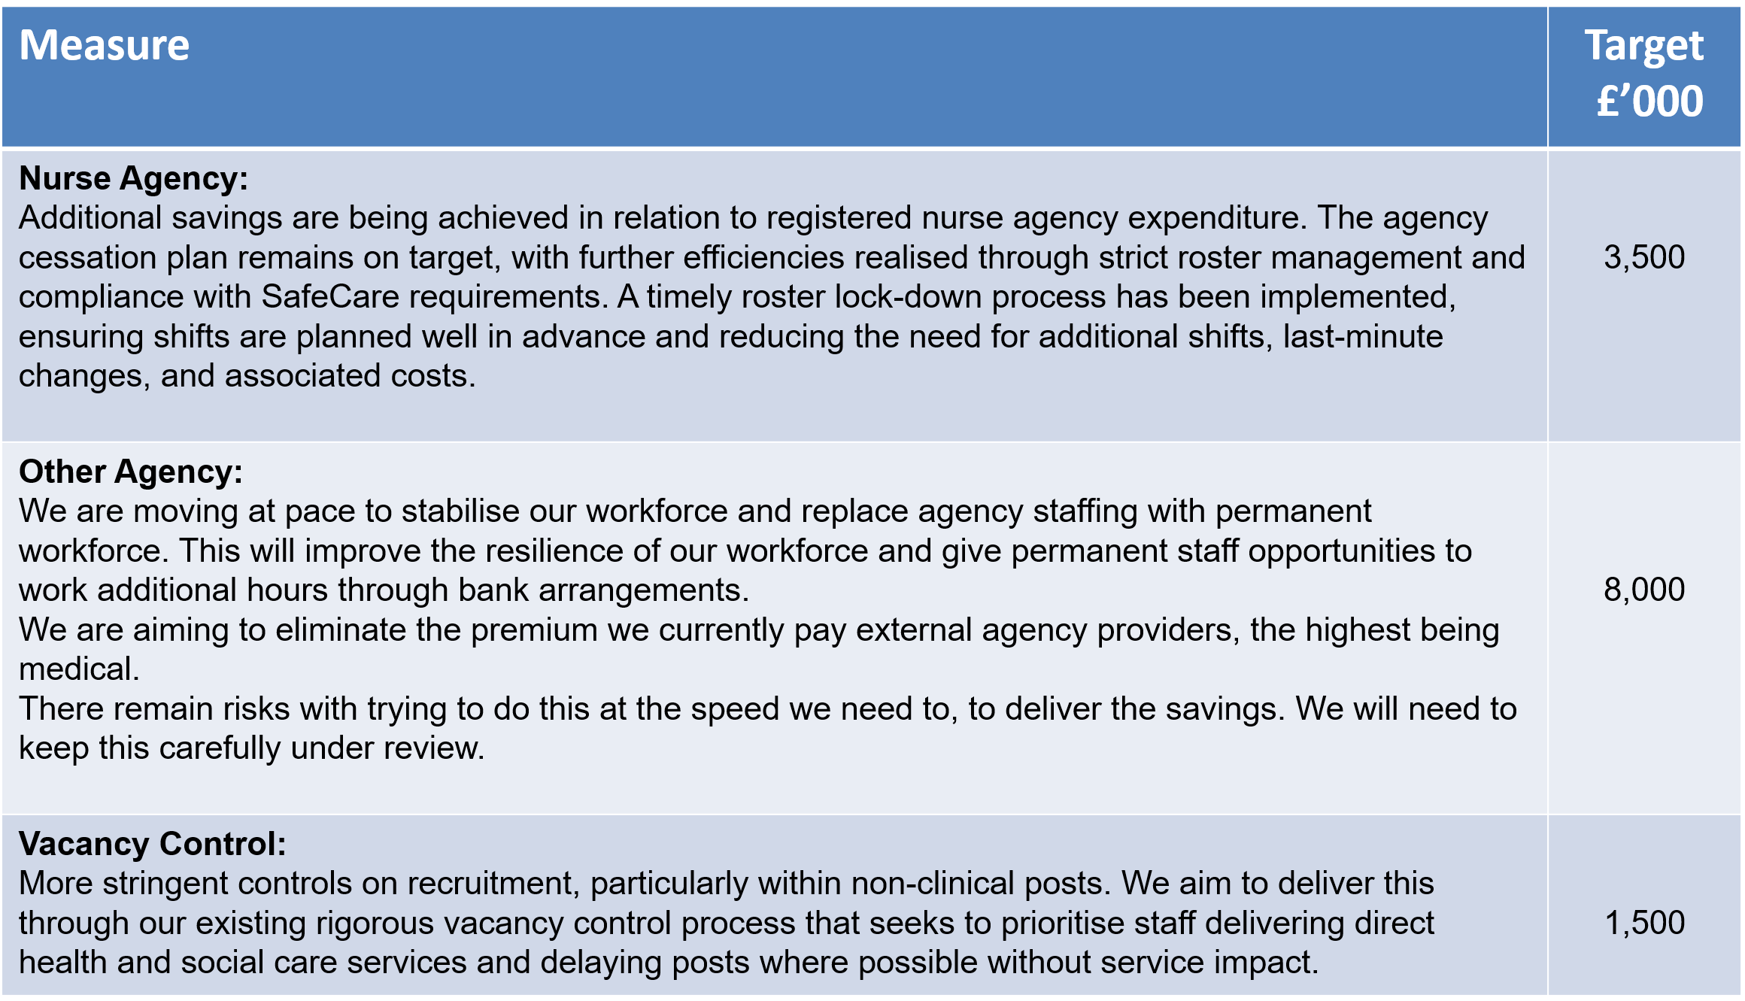
Phase 2 Savings Proposals

Slide 8
Phase 2 Savings Proposals
Measure | Target £’000
Request for procurement savings supported by PALS We are working with our central procurement teams to identify where we may be able to drive out some cash reductions through standardising what we buy. | 750
Diagnostics reform We are working as part of the region to look at whether we are using our diagnostic services as efficiently as we can. This is clinically led to ensure consistency and patient safety in any decisions. | 250
Cease Phone First This relates to removal of the phone element of this service and the additional clinical staff in RVH ED to triage these patients. | 470

Slide 9
Phase 2 Savings Proposals
Measure | Target £’000
Further reduction in enhanced patient care observations The Trust would expediate the work around the risk assessment process being implemented in the acute hospital wards. SafeCare is being successfully implemented and the Trust was recently ranked second in the UK in terms of compliance. Reductions with the acute sites has a consequential impact within the community. | 1,500
Further targeted review of high cost placements There are a growing number of very high cost placements within our Trust. Individuals in receipt of this expensive care (where they may have one or more individuals with them for long periods of the day and night) need to have their care needs regularly assessed to ensure they still require this very intensive level of care. We are focusing on ensuring these individuals receive that review, and if appropriate, have the level of care reduced. | 1,500
Reduce cleaning in administrative areas The Trust will look at cleaning duties within admin areas with a view to limit certain tasks or reduce the frequency of cleaning. | 250

Slide 10
Phase 2 Savings Proposals
Measure | Target £’000
Reduction in planned estates expenditure Planned estates expenditure to be reduced through the reprioritisation of non-essential maintenance, the deferral of lower-risk backlog maintenance, tighter control of discretionary works and the review of estate utilisation. Careful management is required to ensure that any reductions do not adversely impact statutory compliance, patient safety or operational service delivery. | 2,000
Transport savings through SPPG led workstream This will be led by SPPG with a focus on non-emergency transport. Savings could be achieved through tighter eligibility management, increased utilisation of shared and community transport options, improved route planning and better alignment of transport scheduling | 400
TOTAL | 20,120

Slide 11
Phase 2 Savings – Success Factors & Principles
Six principles, organised around three commitments
SAFETY & MANDATE
ALIGNMENT & ACCOUNTABILITY
OWNERSHIP & TRUST
01
Patient safety first
03
Clear accountability
05
Leaders own delivery
Agree risk appetite, strengthen clinical oversight, and use clear escalation and exception processes.
Align regionally while keeping central ownership for delivery and decisions.
Clinical and operational leaders own workforce decisions and robust contingency plans.
02
04
06
Mandate to act
One regional approach
Communicate openly
Secure assurance and political support for decisions needed to deliver savings.
Coordinate timing and approach, backed by rapid DoH and regional communications.
Be transparent with staff, unions, patients and the public on impacts and mitigations.
Safe delivery depends on all three commitments working together.

Slide 12
Key Risks & Issues
The deliverability of the full quantum of Phase 2 savings measures presents extreme risk given the limited timescales for effective planning, engagement and change management and the level of reliance on external factors
Belfast Trust placed at Level 3 on the SIF in August 2026 and asked to consider external support to identify further savings to close the 1.1% savings shortfall
Further discussion is needed with SPPG re 2026/27 growth and other inescapable pressures for which there is currently a £20m (1%) funding shortfall
Clarity is also sought on the residual Trust income gap of £40m (difference between the 4% target and 6% reduction in the Trust’s income)

Slide 13
Engagement, Equality & Consultation
The Trust’s cost savings and efficiency proposals are predominantly within the scope of management control and good financial governance and include the need to make choices on flexible and discretionary spend combined with non-front-line or lower impact services.
Each of the savings measures has been risk assessed and will be monitored on a regular basis to ensure that the impact is not more adverse or differential than anticipated.
In accordance with our statutory equality duties, equality screenings have been undertaken to assess potential impact on patients, service users and staff with mitigations detailed to lessen any such impact.

Slide 14
Long Term Financial Sustainability Focus
Alongside 2026/27 savings plans, the Trust will continue to develop a three year improvement and financial plan as part of the DoH Reset Plan and financial recovery plan
In line with the Reset Plan, the long term focus will be on developing Trust level programmes on:
  Outpatient reform
  The shift to Neighbourhood
  Sensible care
  Digital transformation
  Improved productivity
System reform and transformation is key to long term financial sustainability - the Trust will fully engage with other Trusts and DoH/SPPG in identifying opportunities for cross-Trust/system improvement and efficiency and implementing change at pace

Slide 15
Next Steps and Trust Board Requirement
Local TU colleagues briefed broadly on plans ahead of 27 August Trust Board
The Trust’s well established DVP programme will monitor progress on phase 2 savings with an initial focus on agreeing local and regional enablers, mitigations and planning/escalation processes
Trust Board members are asked to confirm that the Board has given careful consideration to all possible options to achieve savings whilst mitigating the impact on service users
Having given due consideration to the proposals, and to the Trust’s competing legal requirements, Trust Board is asked to approve the immediate implementation of all phase 2 proposals tabled

